Slide 1
Interference Fit Fastener – Working Group
Working Group on
Engineered Residual Stress Implementation
Robert Pilarczyk
rtpilarczyk@hill-engineering.com

Slide 2
Agenda
Terminology
Implementation Plan
  Phase I: Baseline Stress Analysis
  Phase II: Stress Intensity Factor Comparisons
  Phase III: Crack Growth Analyses
Phase I
  Objectives/Approach
  Inputs
  Results
  Testing

Slide 3
Terminology
Term | Description
Applied Interference | Interference (percentage) based on initial hole and fastener diameters
Retained Interference | Interference (percentage) based on final hole and fastener diameters subsequent to any plasticity induced by fastener installation or subsequent loading
Fastener Gap Point | Xxx
Interference Stress | Stress in specimen due to interference with fastener/pin only
Total Stress | Stress in specimen due to interference with fastener/pin and applied remote loading

Slide 4
Implementation Plan
  Phase I: Baseline Stress Analysis Verification
  Start with a 3D FE model that represents the IFF test specimen from RR. Identify the reference stress analysis that anyone would agree with.
    Use different tools, Ansys, Nastran, StressCheck etc
  Use a IFF reduced order model (plate like) and compare the stress analysis against the specimen level results
  Verification against known published solutions and new test data (tollgate)
Phase II: Stress Intensity Factor Comparisons
  Add a corner crack to the IFF 3D model and perform the same comparison: specimen vs. reduced order model, different tools
  Add an edge crack to the IFF 3D model and perform the same comparison: specimen vs. reduced order model, different tools
  Complete a verification tollgate
Phase III: Crack Growth Analyses
  Perform crack growth for a IFF corner crack using different tools and compare results
  Perform crack growth for a IFF edge crack using different tools and compare results
  Complete a verification tollgate
  At this point continue with validation (comparison with RR test data)

Slide 5
Phase I: Baseline Stress Analysis
Objectives
  The accuracy of SIFs and crack growth predictions for IFF conditions is highly dependent on the accuracy of the stress analysis
  The primary objective of Phase I is to establish a set of reference stress analyses agreed upon by the working group
  These analyses will establish the baseline stress state and can be utilized for follow-on phases
  Additionally, the analyses can by utilized to characterize:
    The onset of plastic deformation and the bounds of elastic vs. elastic/plastic regimes
    The relationship between far field loading and local strain cycles
    The variability as a function of key factors (e.g. interference level, modeling assumptions, remote loading)
  Verification against known published solutions and new test data (tollgate)

Slide 6
Phase I: Baseline Stress Analysis
Approach
  Leverage ERSI SIF Round Robin case #3 as an initial analysis condition
  Investigate varying levels of interference
  Utilize multiple software suites and compare results
  Complete comparisons to:
    Published solutions (e.g. NASA paper)
    Newly developed test data

Slide 7
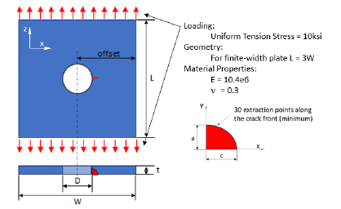
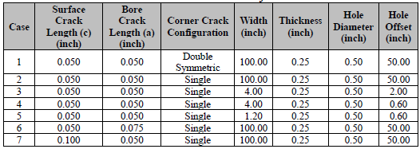
Phase I: Baseline Stress Analysis
Analysis Inputs
  Geometry
    Rectangular plate, width W, length L, and thickness t, diameter D
    Centered hole
  Material properties:
    Plate
      E = 10,400 ksi
      ν = 0.3
      Also need stress-strain curve to build input for elastic-plastic analysis
    Fastener/Plug
      E = 30,000 ksi
      ν = 0.27
No Cracks for Phase I

Slide 8
Phase I: Baseline Stress Analysis
Analysis Inputs, cont.
  Loading conditions
    Uniform tension stress of -10, 0, 10, and 25 ksi
    Sequence/s
      E.g., fastener install, load point 1, unload, load point 2, unload, remove fastener
  Interference configurations
    Open hole
    Neat fit
    0.3, 0.5, 0.7% interference
Analysis Results
  Need to define the required data to be submitted by participants
    What are we trying to capture/compare?
      E.g., hoop and radial stress and strain near the hole (line plots, contour plot)
    What comparisons will be completed for the different submissions, literature sources, and new test data?

Slide 9
Phase I: Baseline Stress Analysis
Verification Tests
  Design conditions
    What fasteners (steel HiLoks?)
    Collars/nuts and fastener torque/pre-load
      I would say no for now and just install the fastener and use the open face for DIC and/or strain gauges
  What data do we want to capture?
    3D geometric measurements of fastener and hole
      Calculate applied interference along bore
    Surface strains (DIC, strain gauges)
      After fastener install
      At each load condition
      At each unload
      After fastener removal
    Transition point for fastener gapping
    3D geometric measurements after loading and fastener removal
      Calculate retained interference along bore and characterize any plasticity

