Slide 1
Interference Fit Fastener – Working Group
Working Group on
Engineered Residual Stress Implementation
Robert Pilarczyk
rtpilarczyk@hill-engineering.com

Slide 2
Agenda
Terminology
Implementation Plan
  Phase I: Baseline Stress Analysis
  Phase II: Stress Intensity Factor Comparisons
  Phase III: Crack Growth Analyses
Phase I
  Objectives/Approach
  Inputs
  Results
  Testing

Slide 3
Terminology
Term | Description
Applied Interference | Interference (percentage) based on initial hole and fastener diameters
Retained Interference | Interference (percentage) based on final hole and fastener diameters subsequent to any plasticity induced by fastener installation or subsequent loading
Fastener Gap Point | Xxx
Interference Stress | Stress in specimen due to interference with fastener/pin only
Total Stress | Stress in specimen due to interference with fastener/pin and applied remote loading

Slide 4
Implementation Plan
  Phase I: Baseline Stress Analysis Verification
  Start with a 3D FE model that represents the IFF test specimen from RR. Identify the reference stress analysis that anyone would agree with.
    Use different tools, Ansys, Nastran, StressCheck etc
  Use a IFF reduced order model (plate like) and compare the stress analysis against the specimen level results
  Verification against known published solutions and new test data (tollgate)
Phase II: Stress Intensity Factor Comparisons
  Add a corner crack to the IFF 3D model and perform the same comparison: specimen vs. reduced order model, different tools
  Add an edge crack to the IFF 3D model and perform the same comparison: specimen vs. reduced order model, different tools
  Complete a verification tollgate
Phase III: Crack Growth Analyses
  Perform crack growth for a IFF corner crack using different tools and compare results
  Perform crack growth for a IFF edge crack using different tools and compare results
  Complete a verification tollgate
  At this point continue with validation (comparison with RR test data)

Slide 5
Phase I: Baseline Stress Analysis
Objectives
  The accuracy of SIFs and crack growth predictions for IFF conditions is highly dependent on the accuracy of the stress analysis
  The primary objective of Phase I is to establish a set of reference stress analyses agreed upon by the working group
  These analyses will establish the baseline stress state and can be utilized for follow-on phases
  Additionally, the analyses can by utilized to characterize:
    The onset of plastic deformation and the bounds of elastic vs. elastic/plastic regimes
    The relationship between far field loading and local strain cycles
    The variability as a function of key factors (e.g. interference level, modeling assumptions, remote loading)
  Verification against known published solutions and new test data (tollgate)

Slide 6
Phase I: Baseline Stress Analysis
Approach
  Leverage ERSI SIF Round Robin case #3 as an initial analysis condition
  Investigate varying levels of interference
  Utilize multiple software suites and compare results
  Complete comparisons to (if applicable):
    Published solutions (e.g. NASA paper)
    Newly developed test data

Slide 7
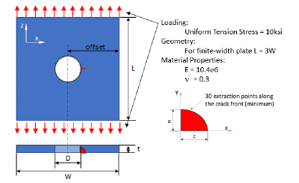
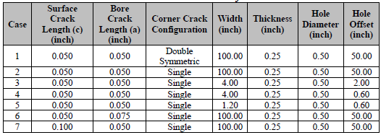
Phase I: Baseline Stress Analysis
Analysis Inputs
  Geometry
    Rectangular plate with centered hole
    Width W = 4.00”
    Length L = 3W = 12.00”
    Thickness t = 0.25”
    Diameter D = 0.25”
  Material properties
    Plate
      Aluminum 7075-T651 plate
      E = 10,400 ksi
      ν = 0.3
      Also need stress-strain curve as input for elastic-plastic analysis
    Fastener/Plug (Hi-Lok (HL18BP-8-4)?)
      xxx material
      E = 30,000 ksi
      ν = 0.27
No Cracks for Phase I

Slide 8
Phase I: Baseline Stress Analysis
Analysis Inputs, cont.
  Interference configurations
    Open hole
    Neat fit
    0.2, 0.4, 0.6% interference
  Loading conditions
    Uniform tension stress of -10, 0, 10, and 25 ksi
    Sequences to model
      Install fastener, remove fastener
        Interference conditions only (3 cases total)
      Install fastener, load to -10 ksi, unload, remove fastener
        Neat fit and interference conditions (4 cases total)
      Install fastener, load to 10 ksi, unload, remove fastener
        Neat fit and interference conditions (4 cases total)
      Install fastener, load to 25 ksi, unload, remove fastener
        Neat fit and interference conditions (4 cases total)
      15 cases total
      Do we need to look at the “removed fastener” state (i.e., residual stress)?
W
yz plane
y
L
xz plane
x
t
Do we need to down select to fewer cases?

Slide 9
Phase I: Baseline Stress Analysis
Analysis Results
  Need to define the required data to be submitted by participants
    What are we trying to capture/compare?
      Hoop stress at crack plane drives crack growth
      E.g., hoop and radial stress and strain near the hole (line plots, contour plot)
    What comparisons will be completed for the different submissions, literature sources, and new test data?
    Some ideas for required output data
      Hoop stress at xz plane (+x side) for each step in analysis
        Text file with (x,z,hoop stress) data
      Radial stress at xz plane (+x side) for each step in analysis
        Text file with (x,z,radial stress) data
      Hoop stress at yz plane (+x side) for each step in analysis
        Text file with (y,z,hoop stress) data
      Radial stress at yz plane (+x side) for each step in analysis
        Text file with (y,z,radial stress) data
      Hoop and radial strain at specified strain gage locations on the plate surface (next slide)
      Others?
W
yz plane
y
L
xz plane
x
t

Slide 10
Phase I: Baseline Stress Analysis
Verification Tests
  Design conditions
    Steel rod/plug
  What data do we want to capture?
    3D geometric measurements of fastener and hole
      Calculate applied interference along bore
    Surface strains (DIC, strain gages)
      After fastener install
      At each applied load
      After each unload
      After fastener removal
      Strain gages to capture hoop and radial strain at planes indicated
        Need to specify distances from hole
    Transition point for fastener gapping
    3D geometric measurements after loading and fastener removal
      Calculate retained interference along bore and characterize any plasticity
W
y
L
x
Strain gage
t

