Slide 1
Interference Fit Fastener – Working Group
Working Group on
Engineered Residual Stress Implementation
Robert Pilarczyk
rtpilarczyk@hill-engineering.com

Slide 2
Submission summary

Slide 3
0.3% interference
Step 1 – pin install
Step 2 – remove pin

Slide 4
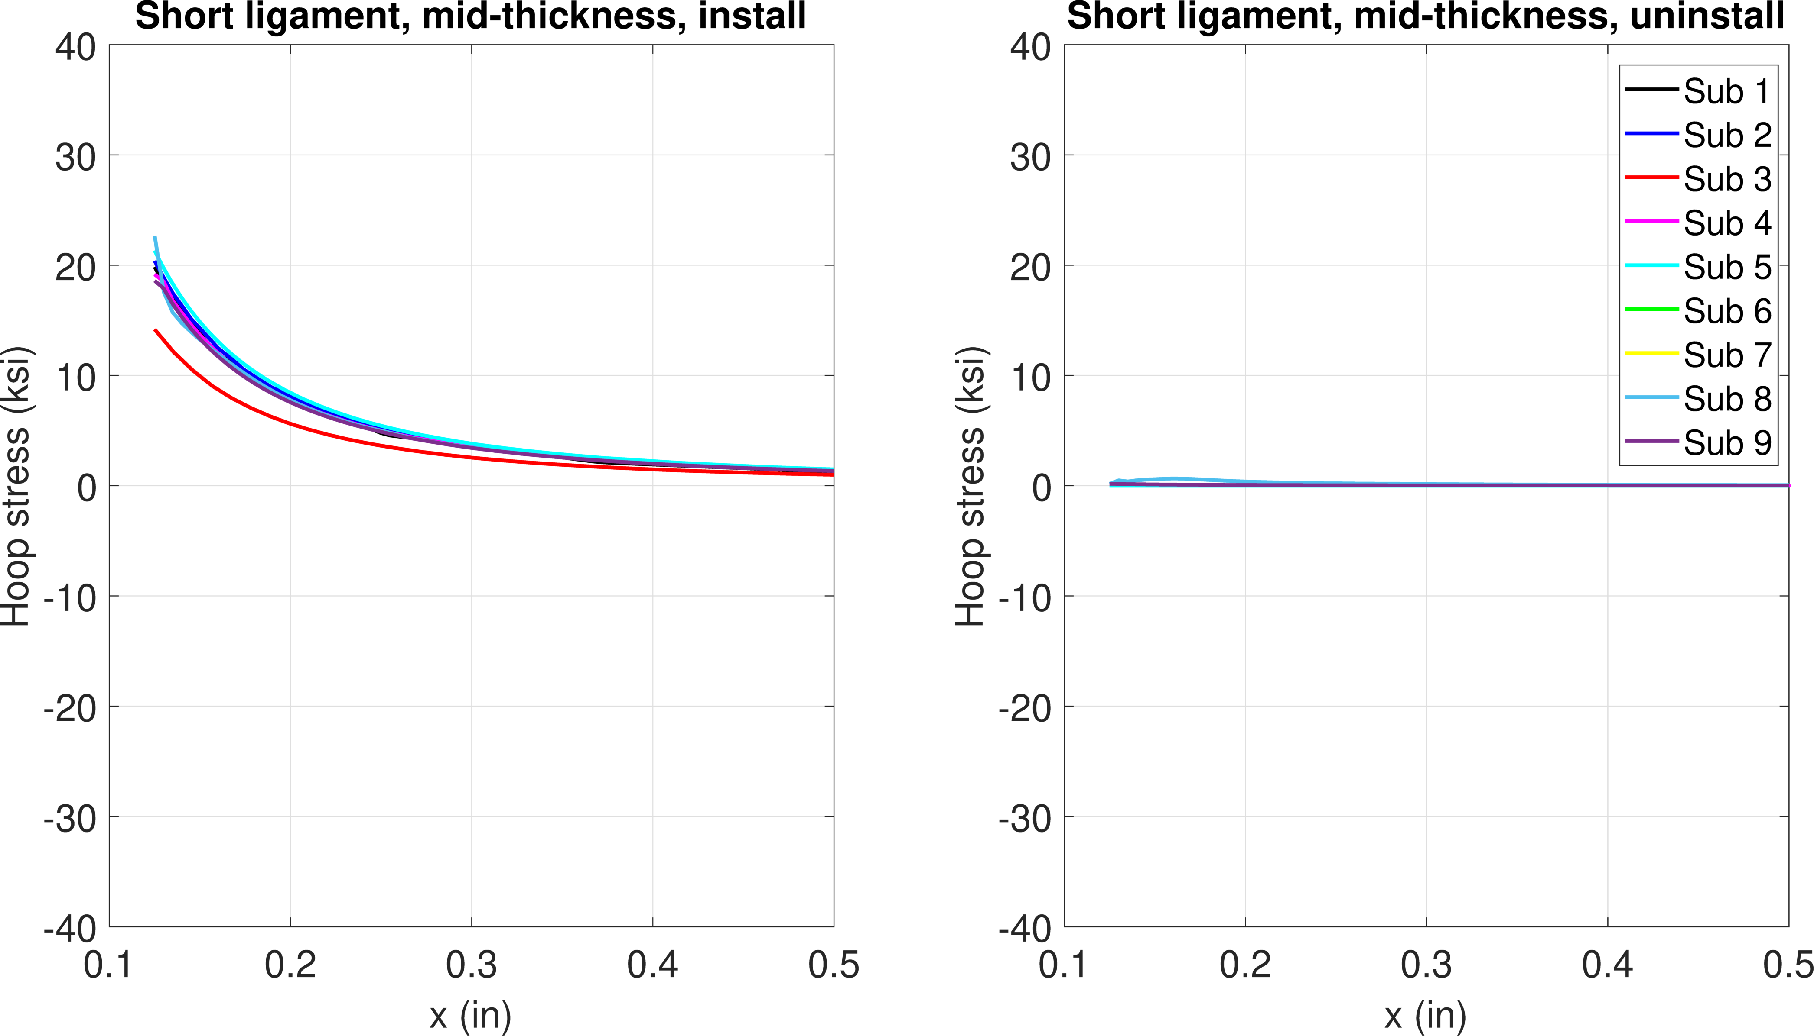
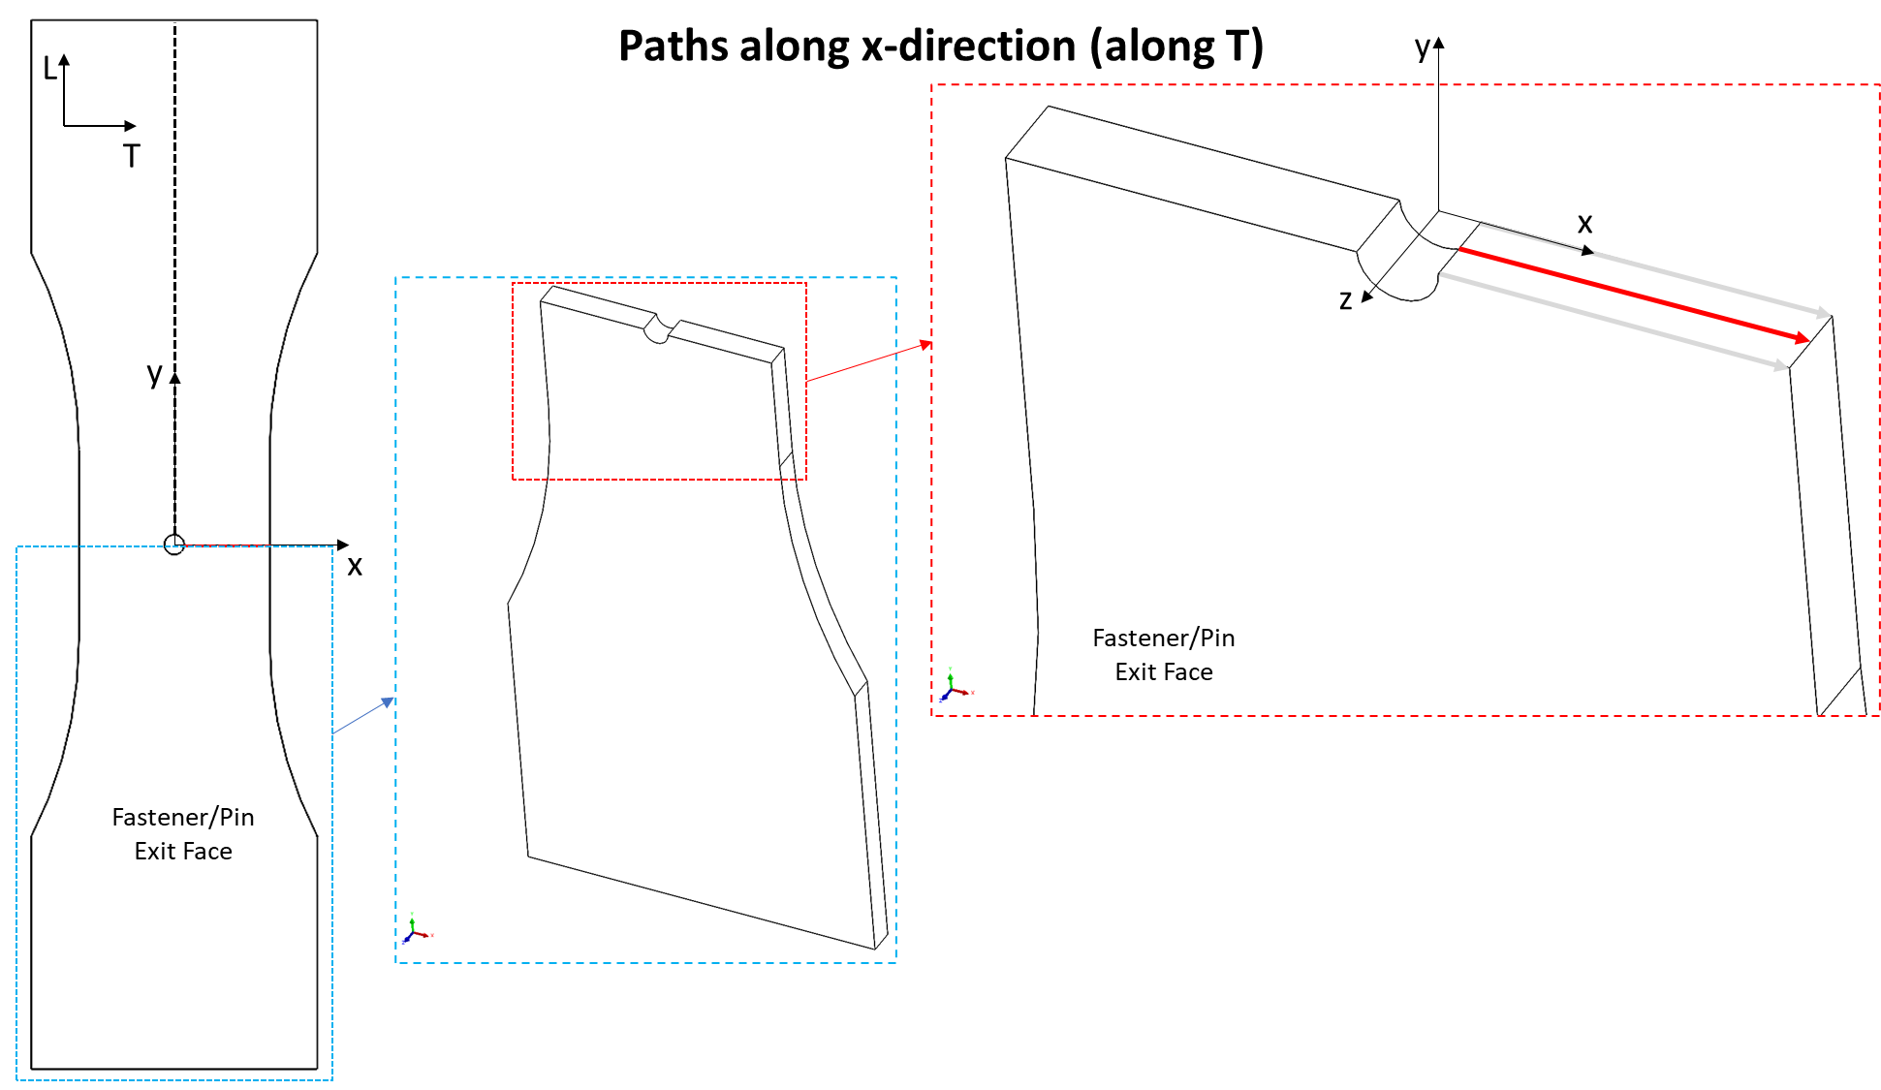
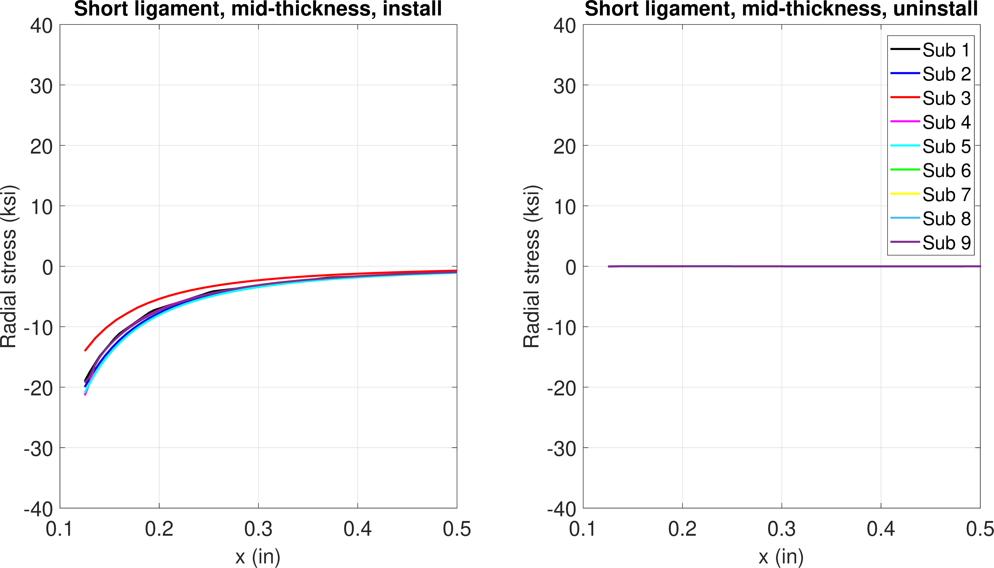
FE model results – 0.3% interference
Elastic
Hoop stress
No residual stress
Mid-thickness
Install
Remove
Install
Remove
Radial stress

Slide 5
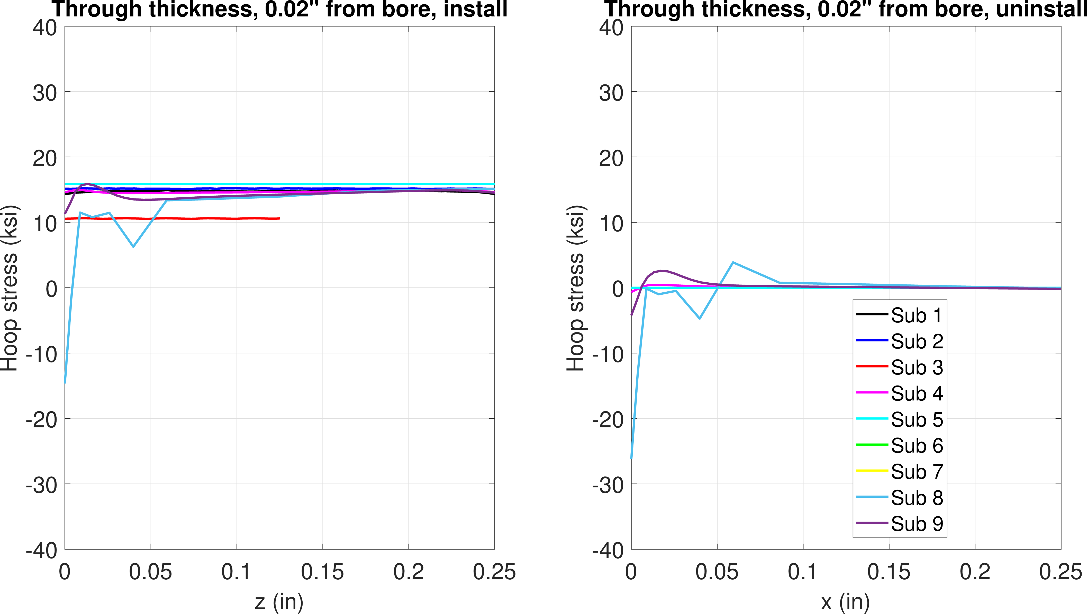
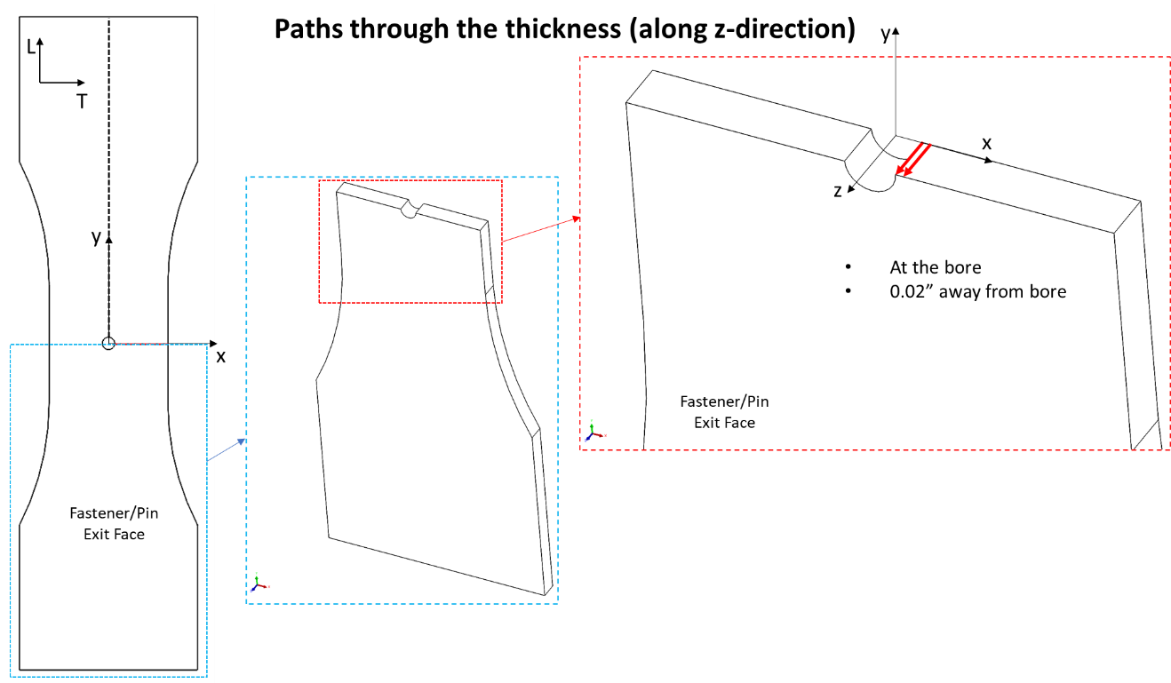
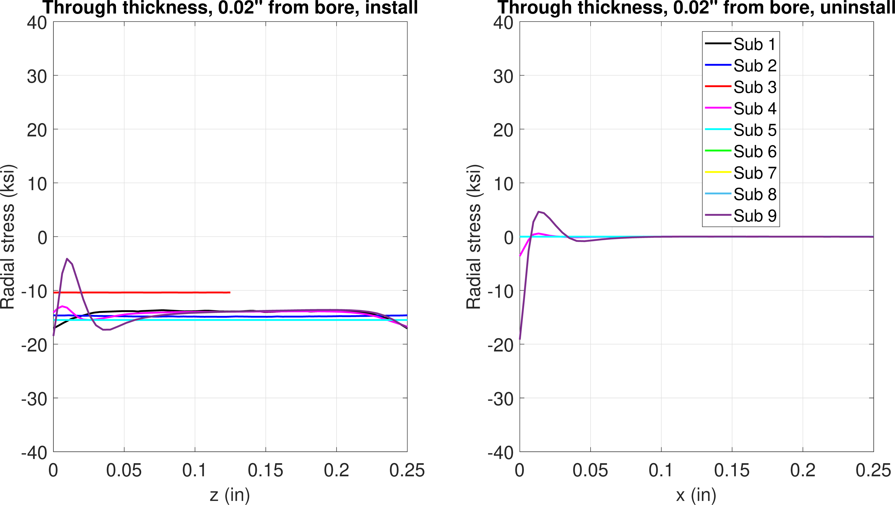
FE model results – 0.3% interference
Install
Remove
Some plasticity and RS near pin entry
Hoop stress
0.02” from bore
Install
Remove
Radial stress

Slide 6
0.6% interference
Step 1 – pin install
Step 2 – remove pin

Slide 7
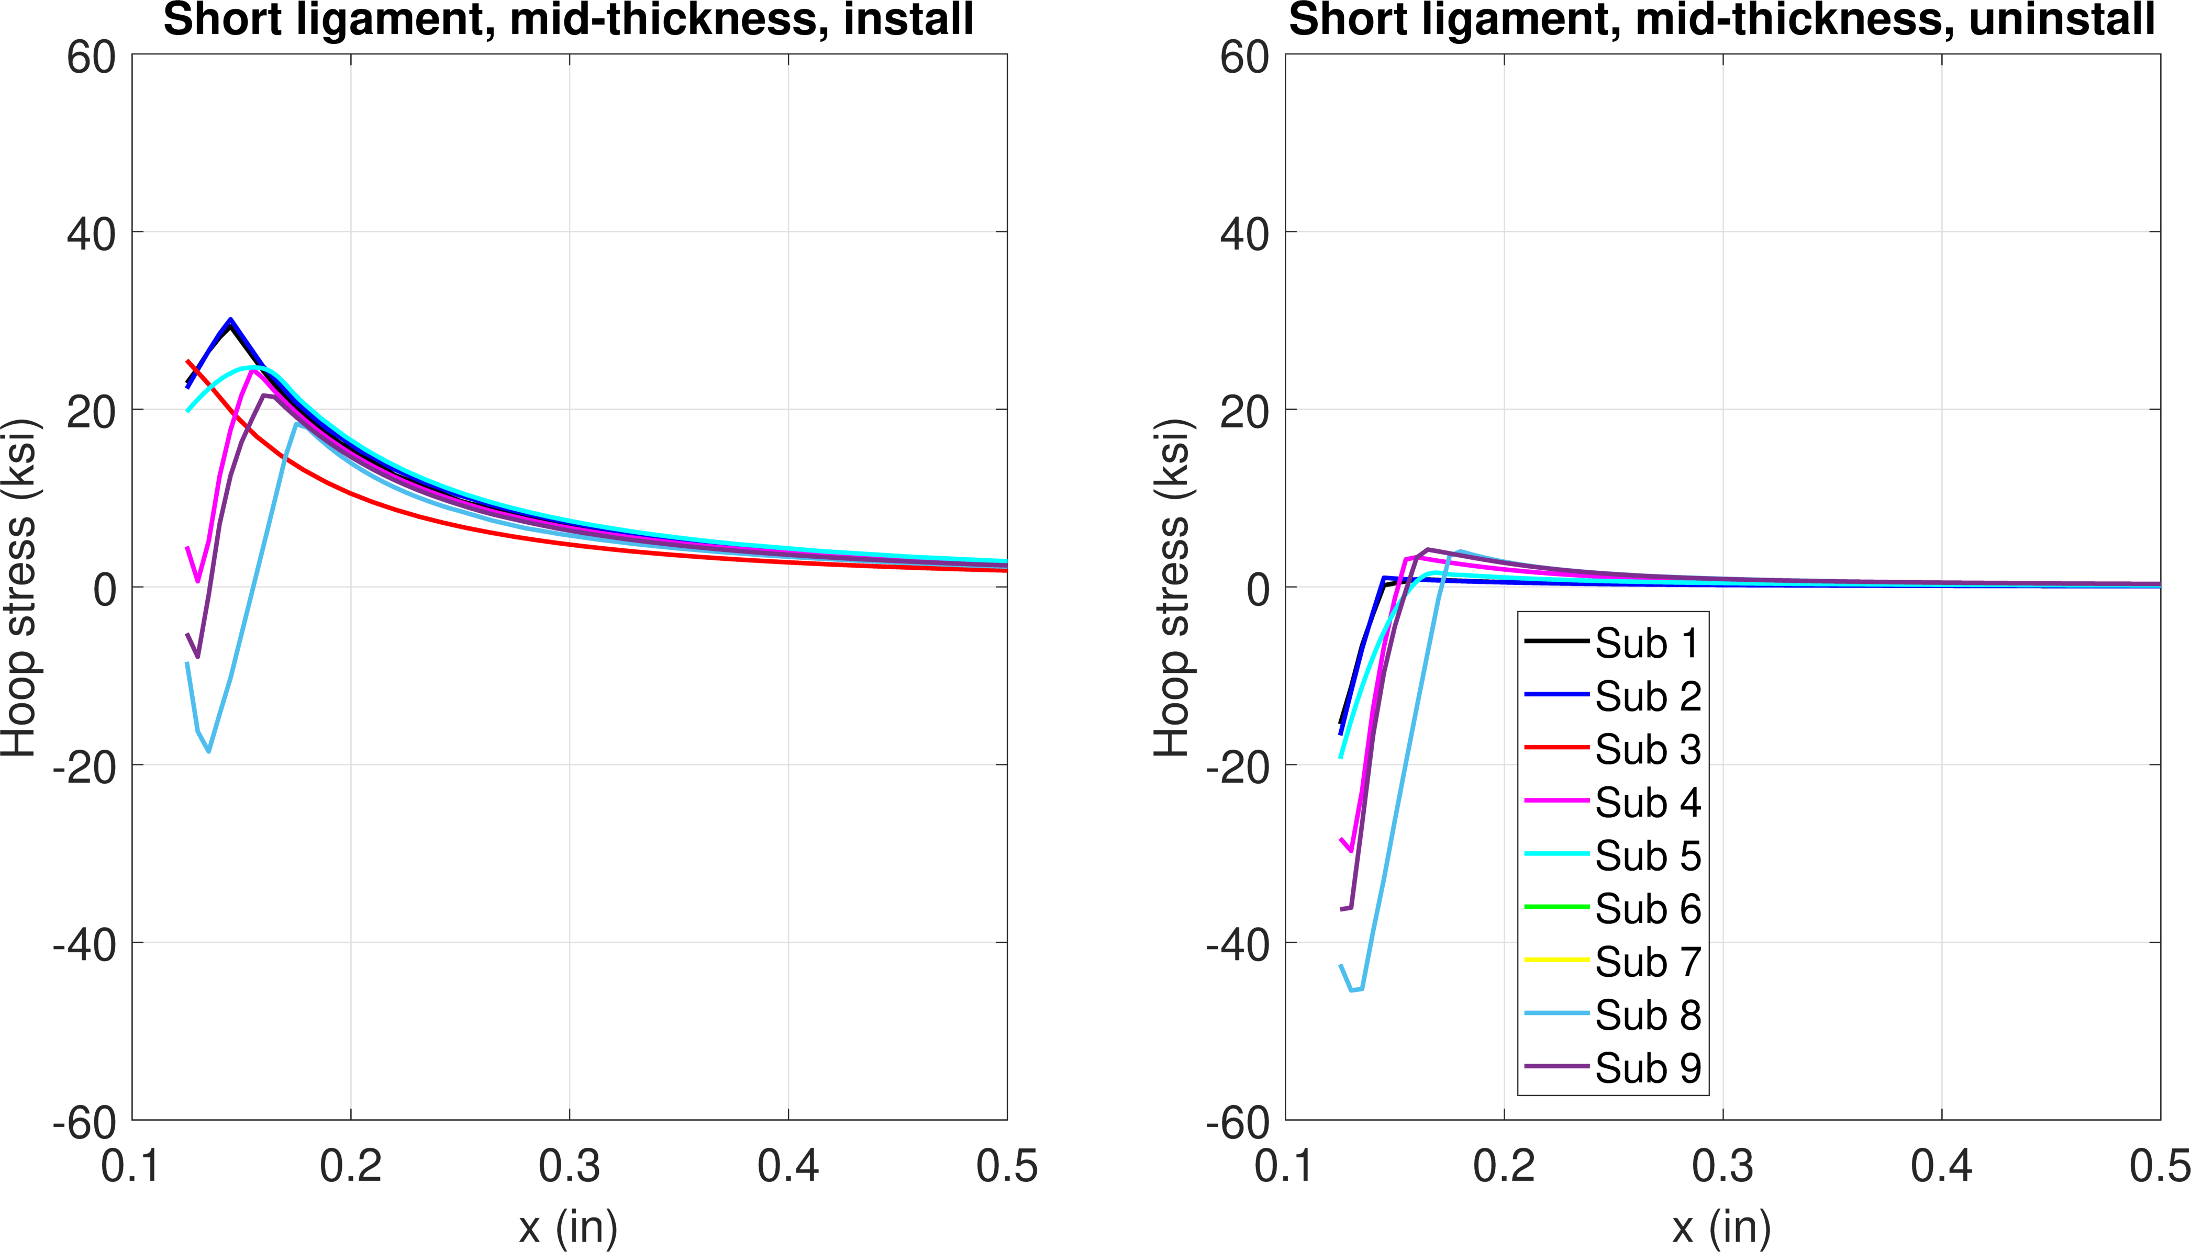
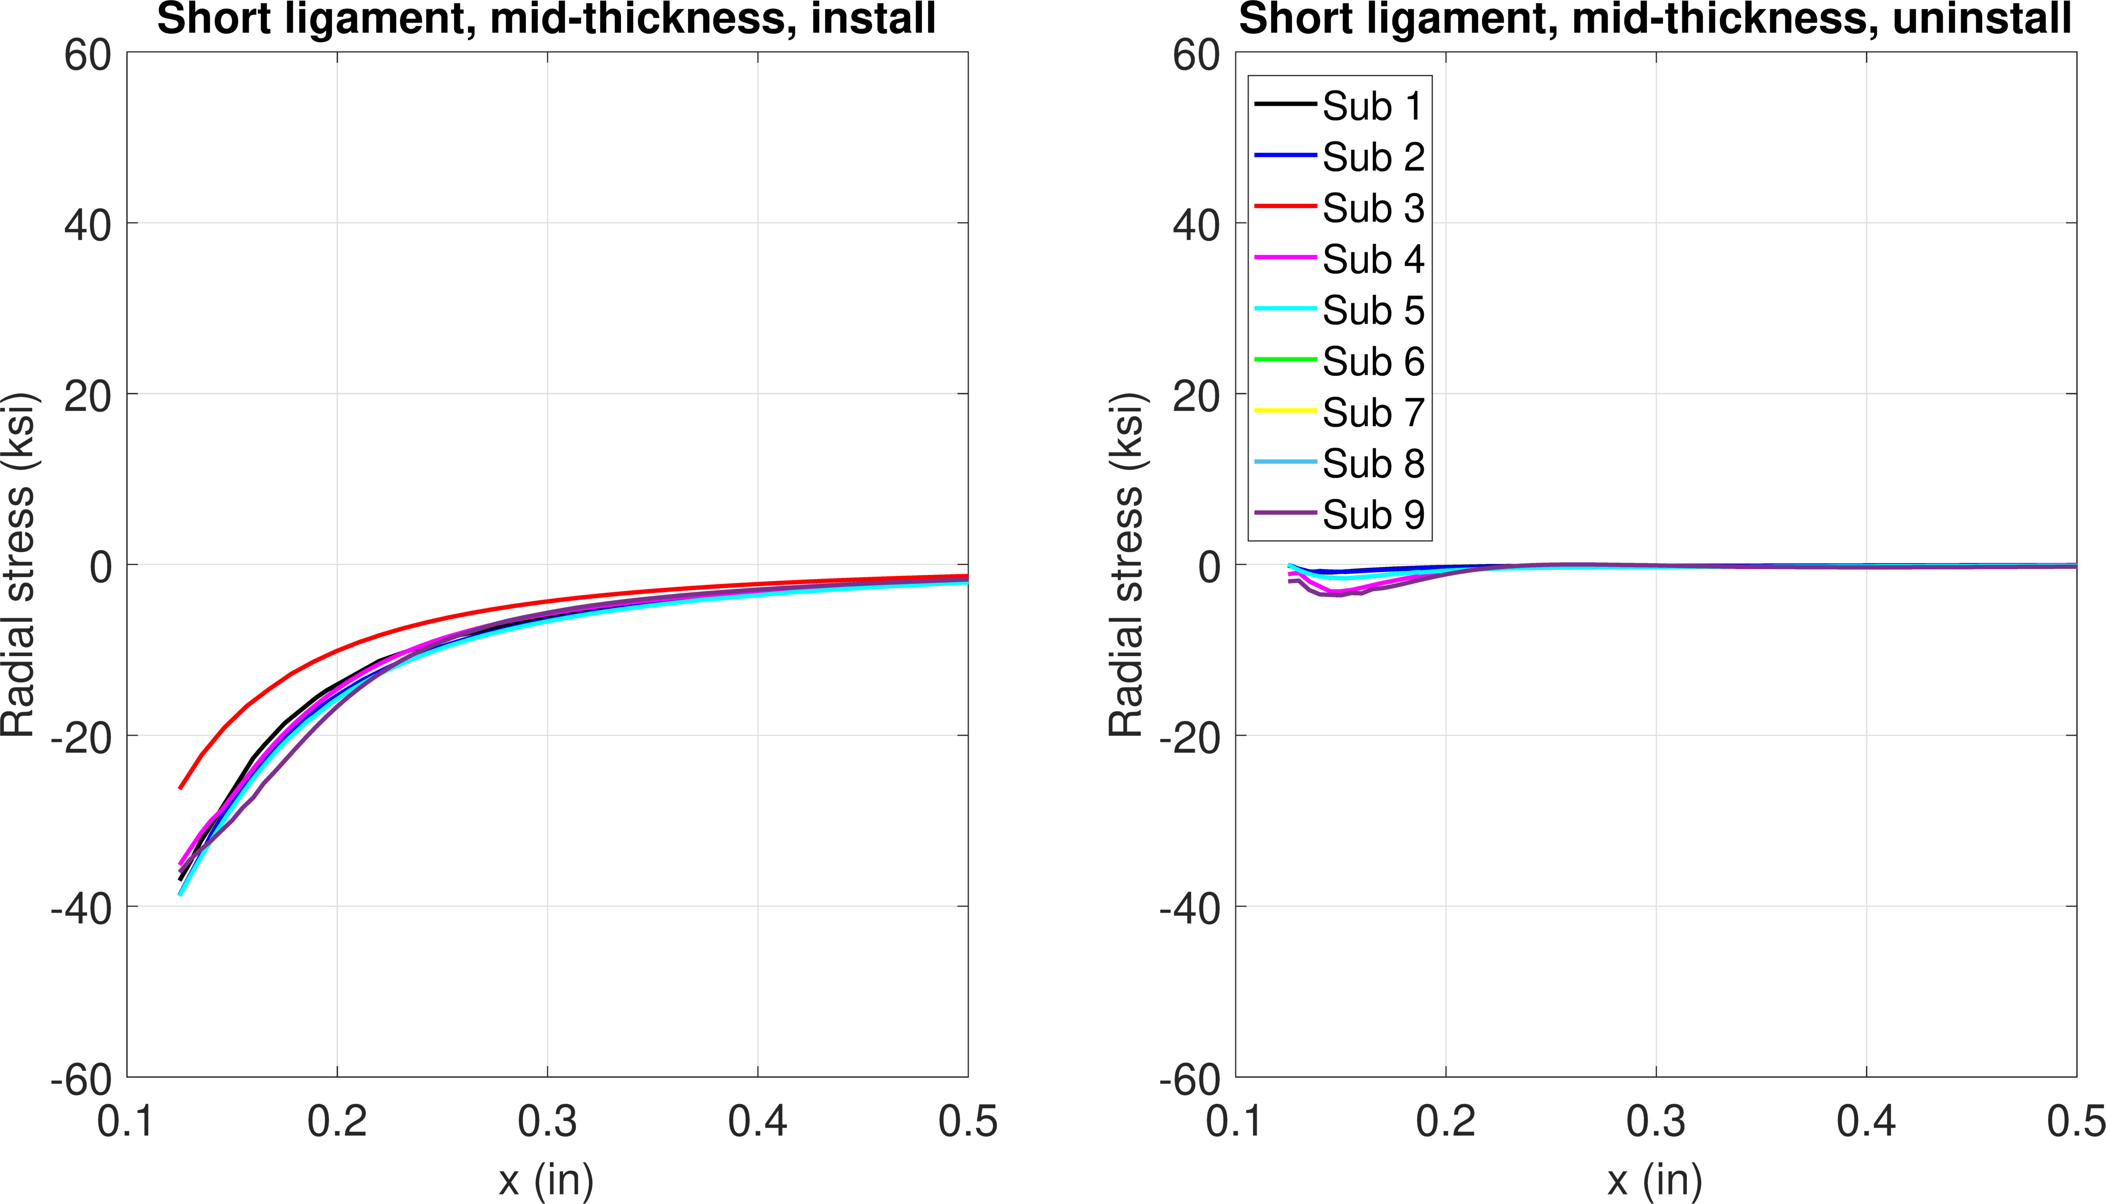
FE model results – 0.6% interference
Install
Remove
Plasticity
Compressive residual stress
Hoop stress
Mid-thickness
Install
Remove
Radial stress

Slide 8
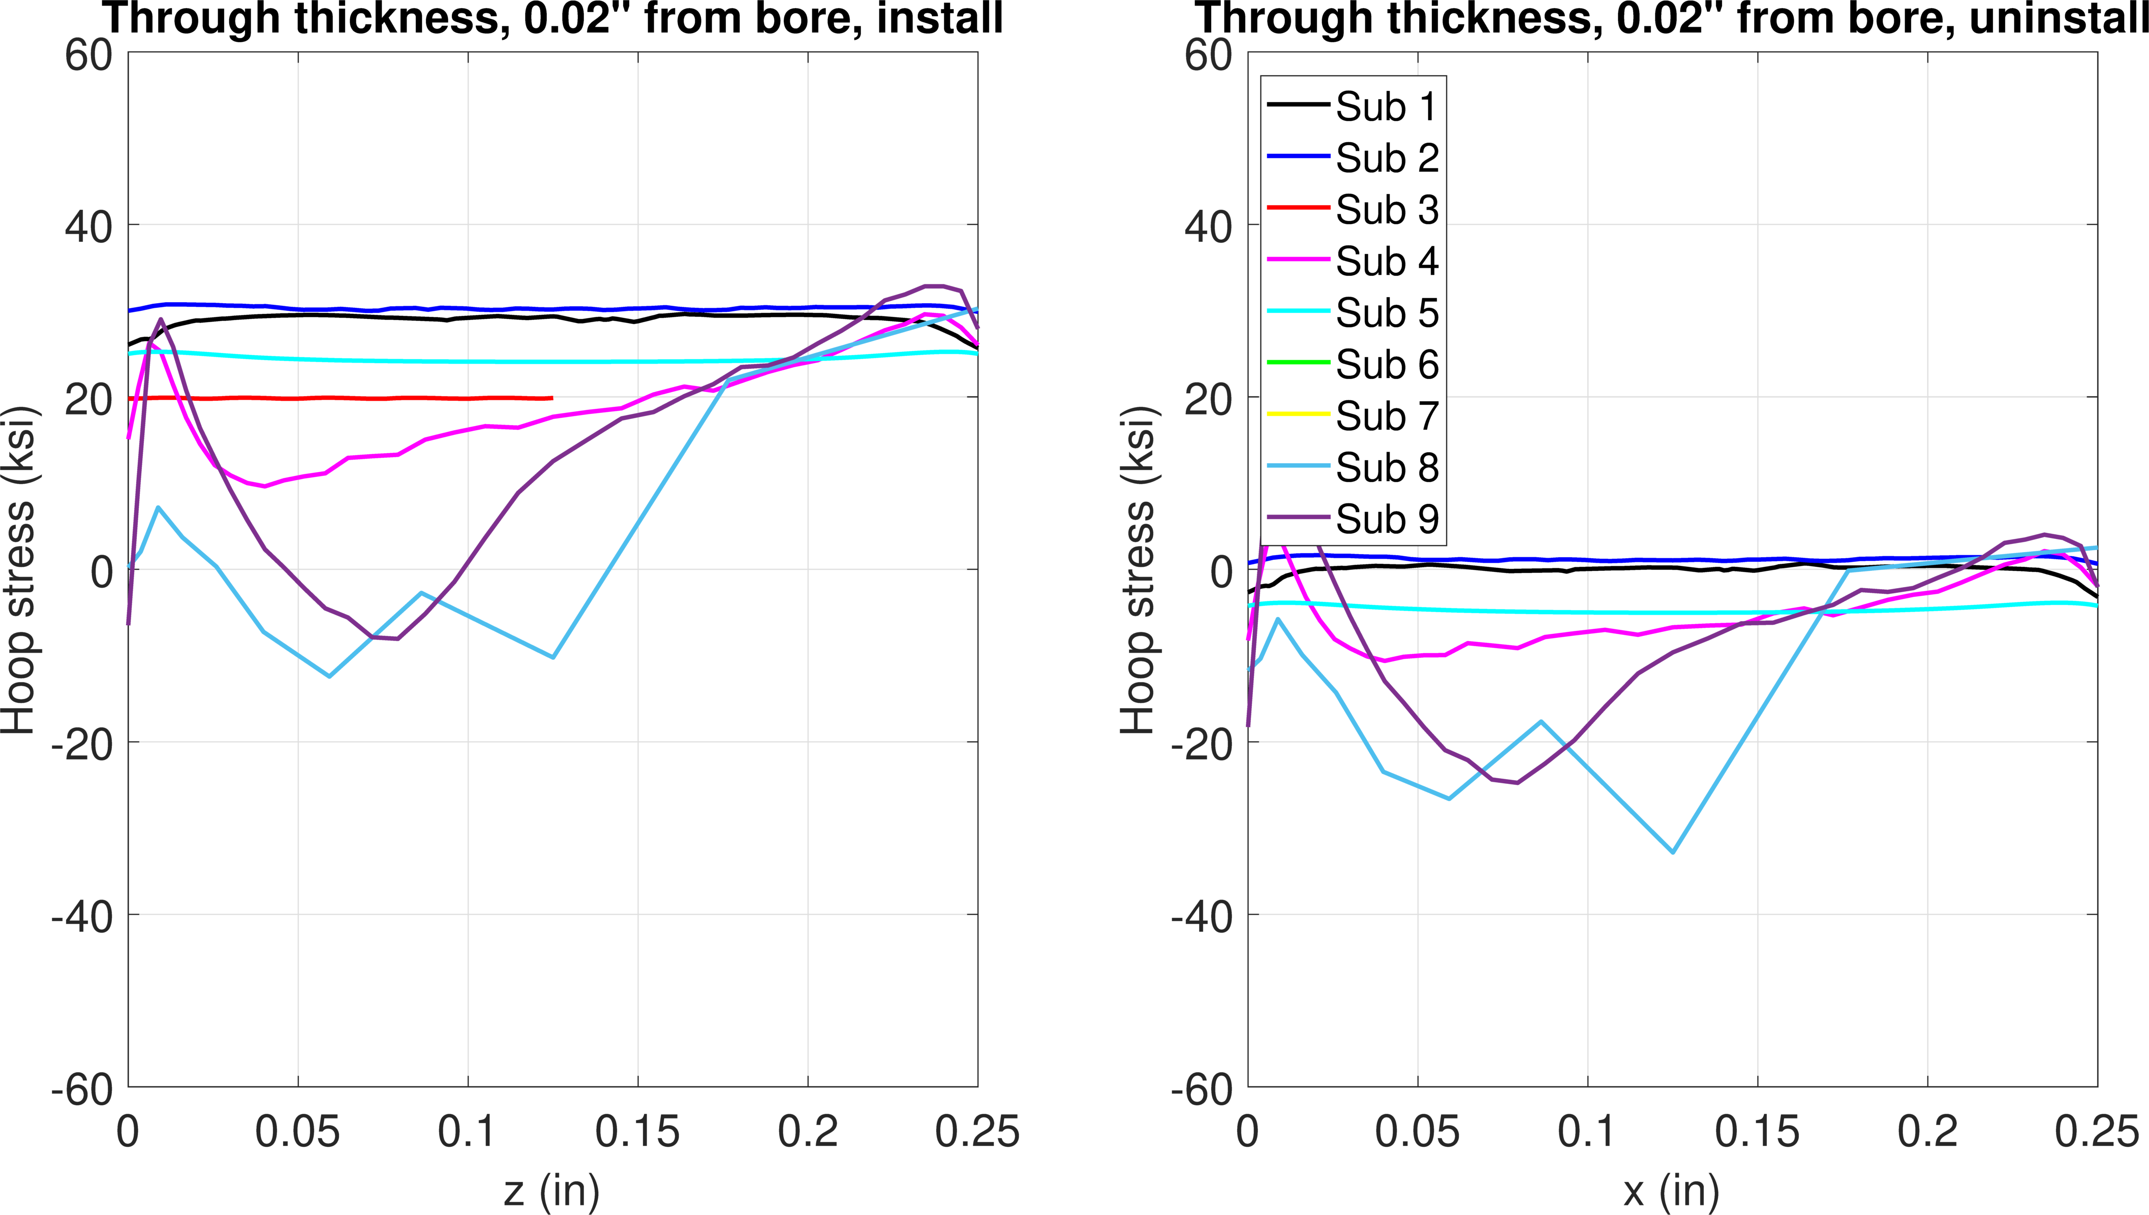
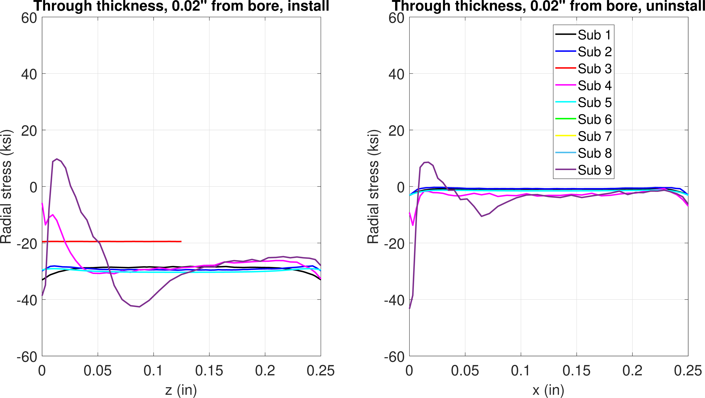
FE model results – 0.6% interference
Hoop stress
0.02” from bore
Install
Remove
Install
Remove
Radial stress

Slide 9
1.2% interference
Step 1 – pin install
Step 2 – remove pin

Slide 10
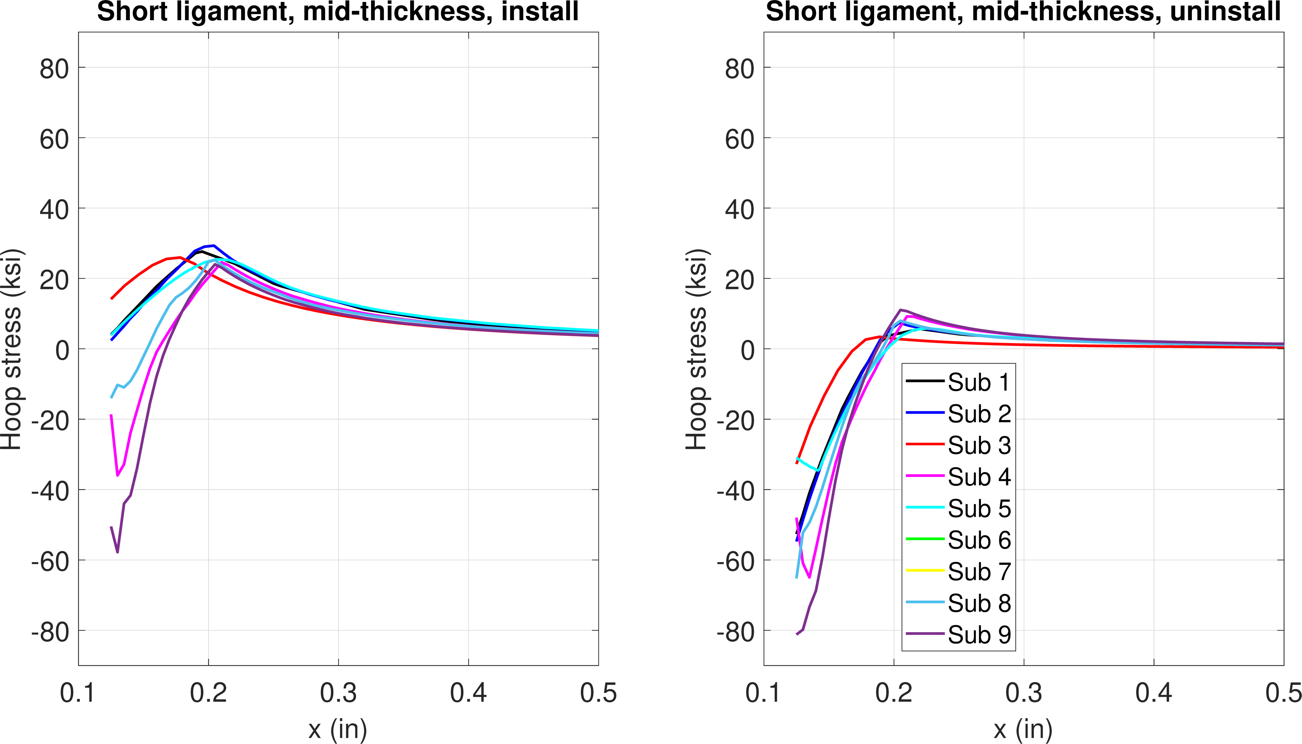
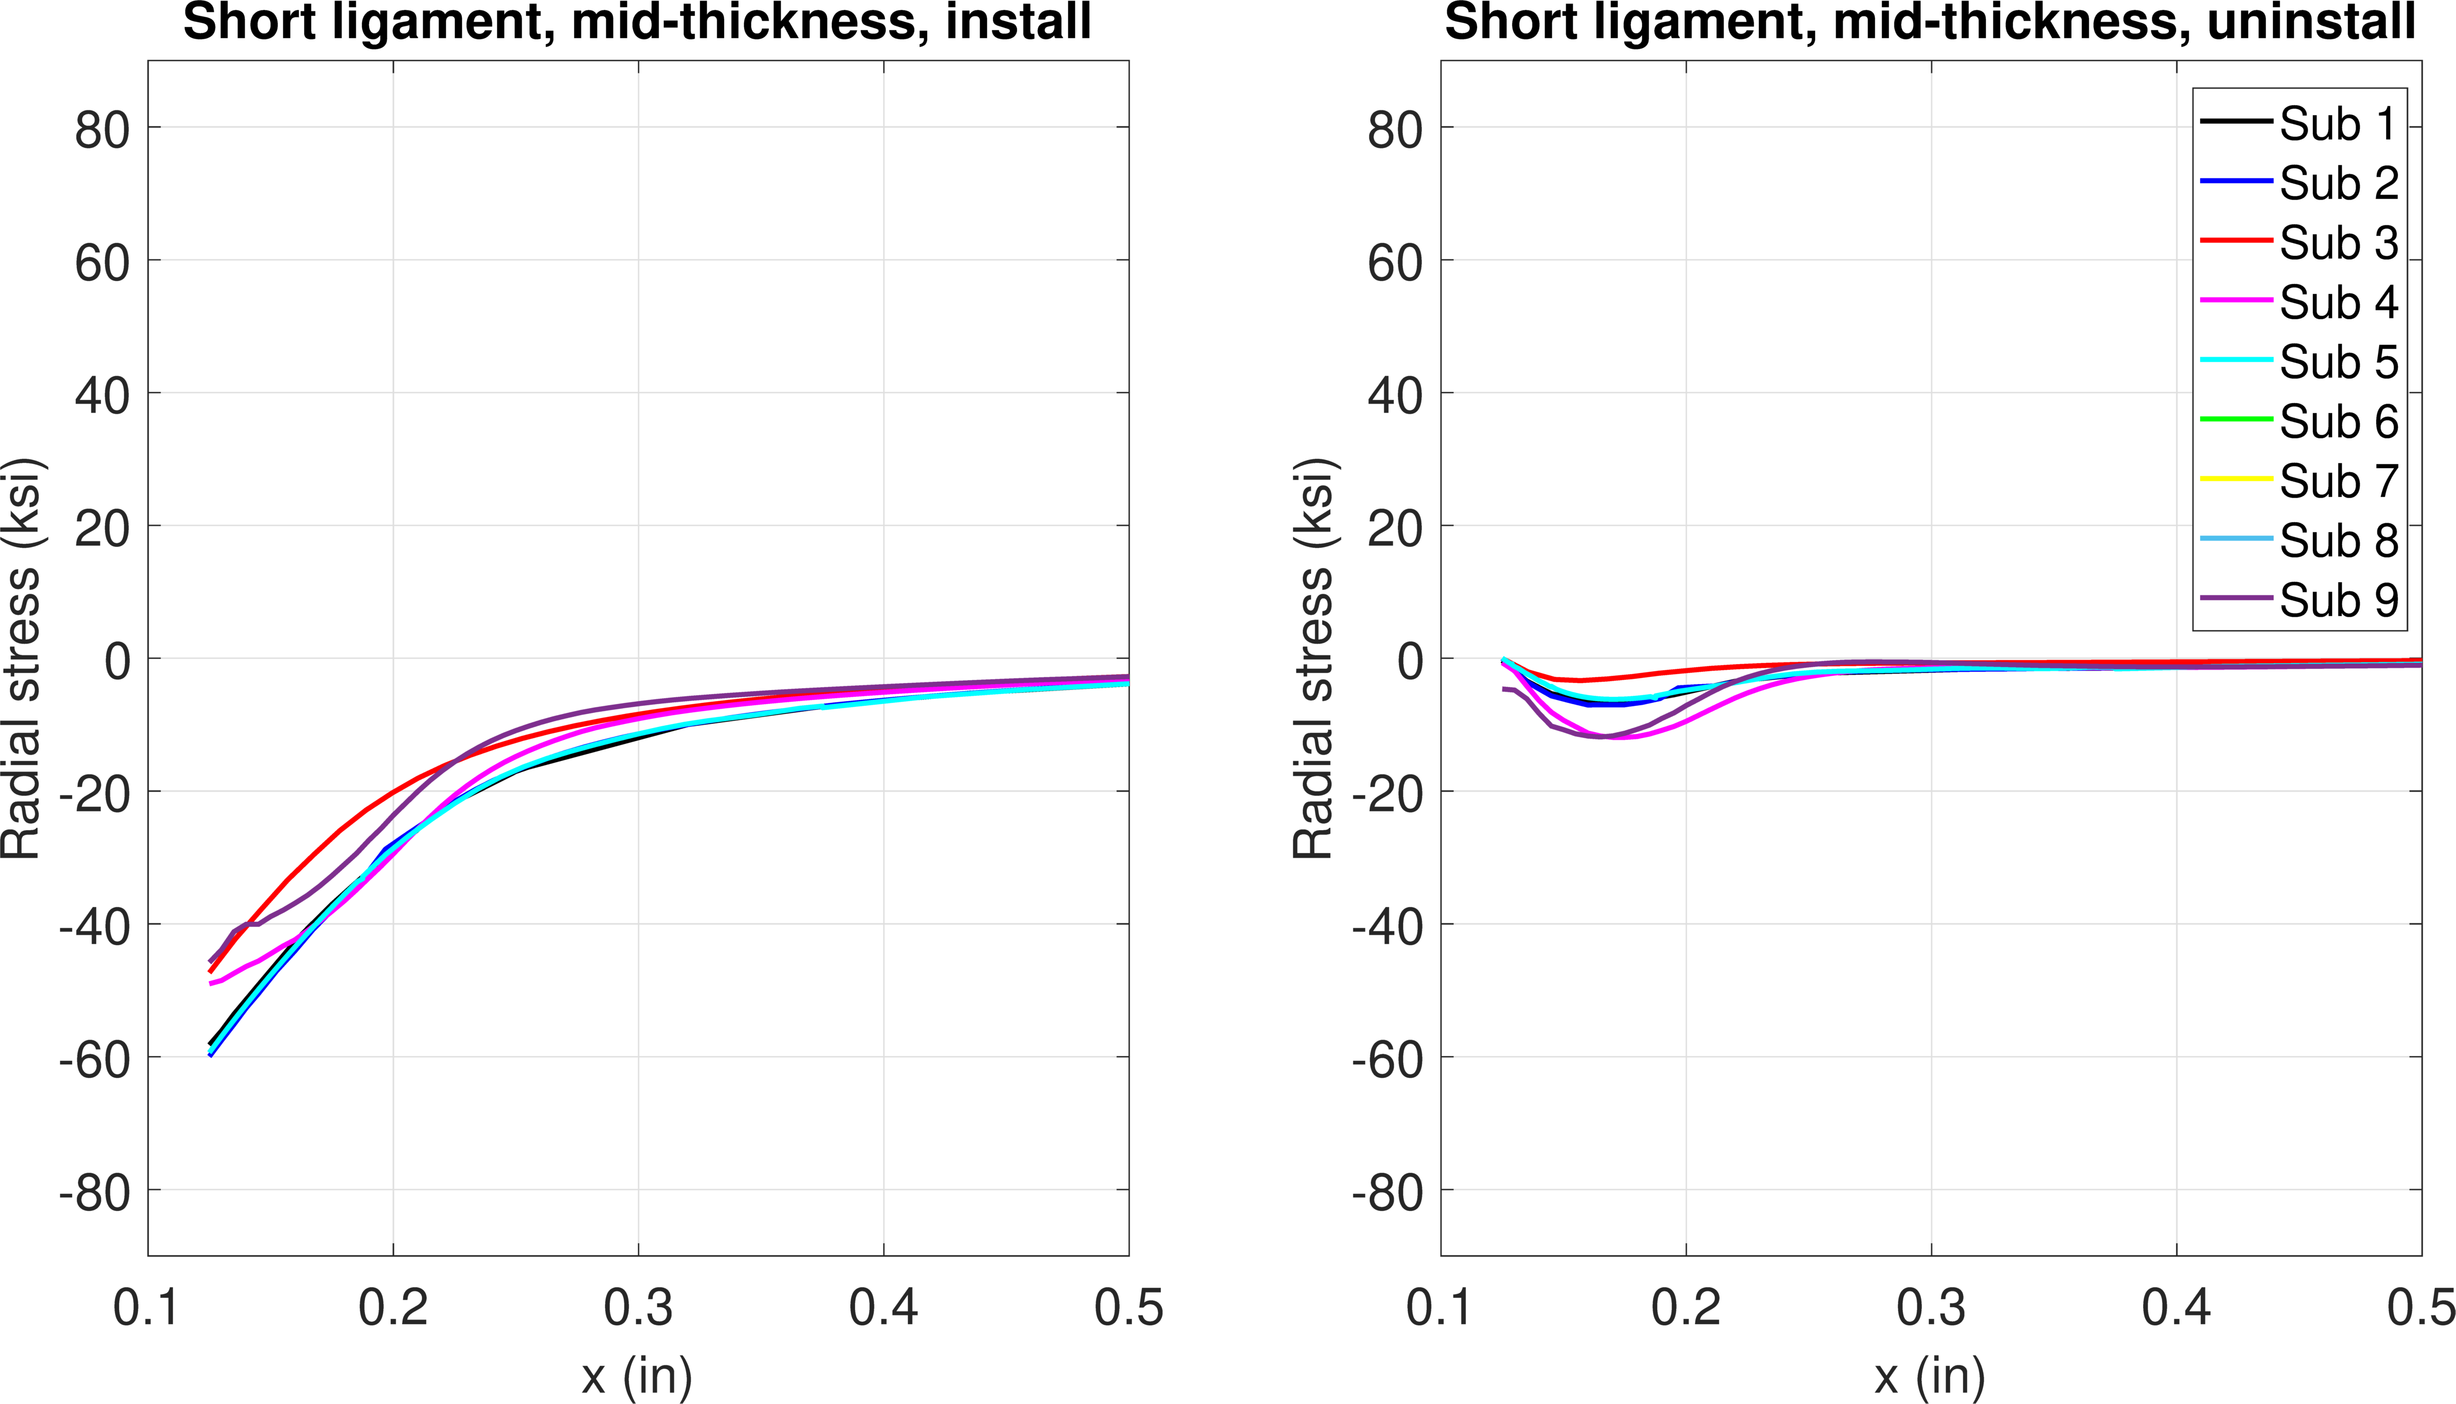
FE model results – 1.2% interference
Install
Remove
Plasticity
Compressive residual stress
Hoop stress
Mid-thickness
Install
Remove
Radial stress

Slide 11
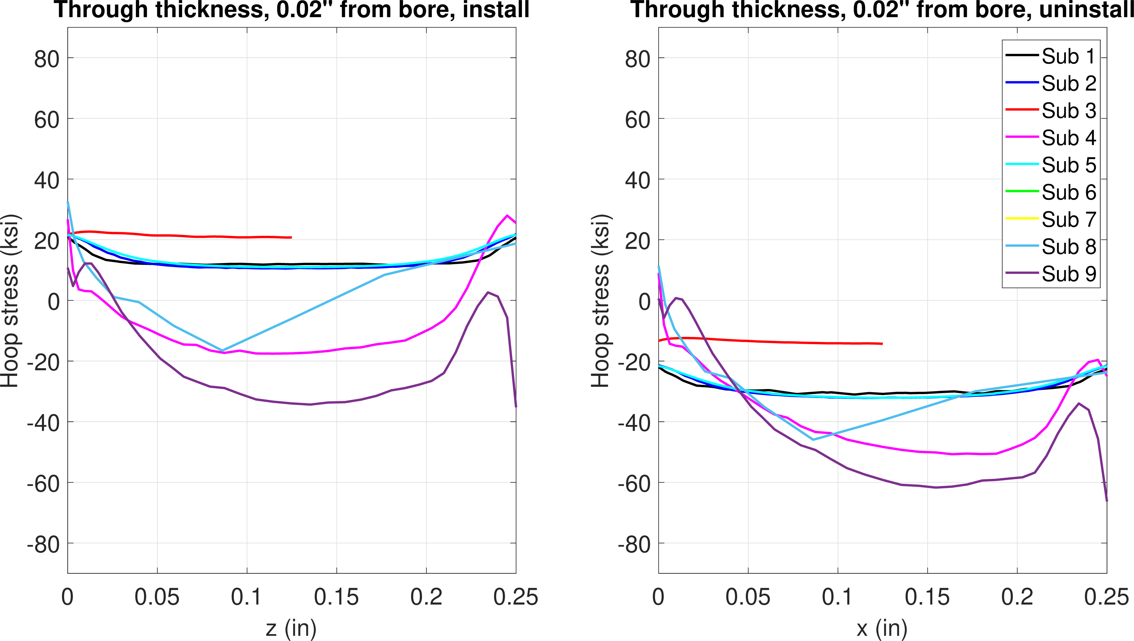
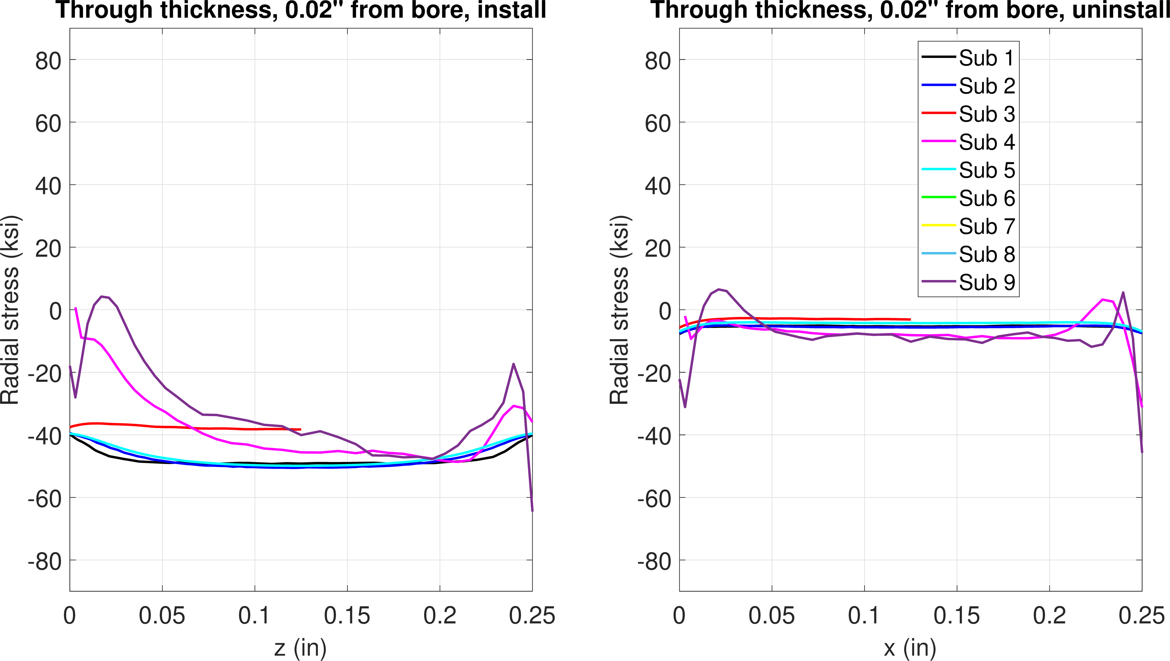
FE model results – 1.2% interference
Install
Remove
Hoop stress
0.02” from bore
Install
Remove
Radial stress

Slide 12
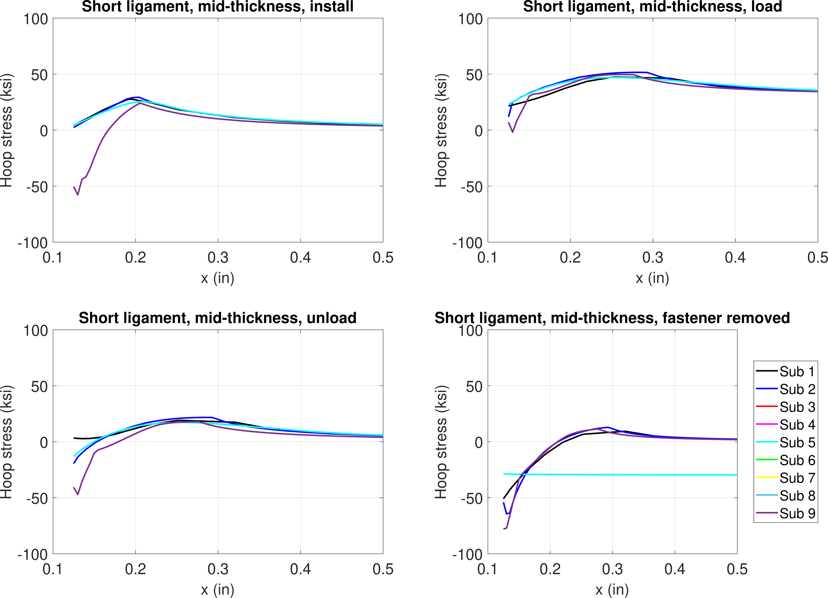
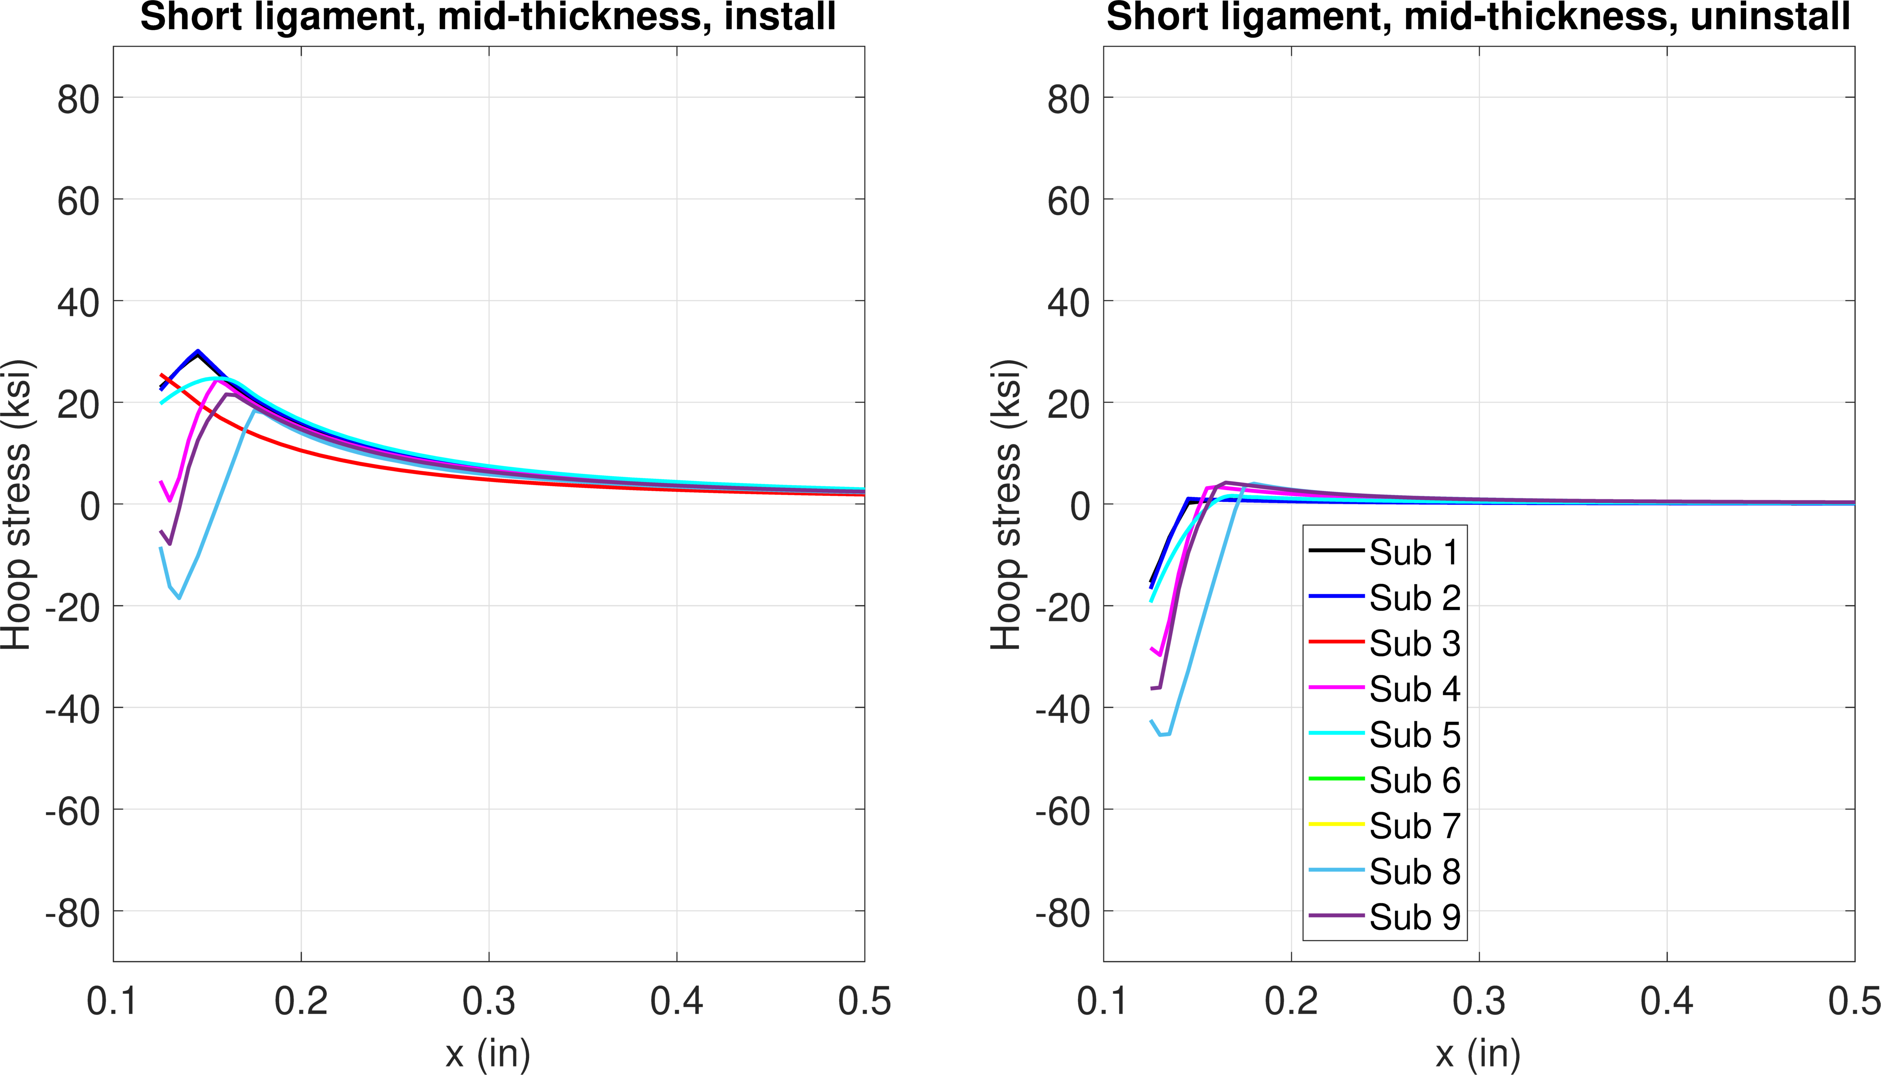
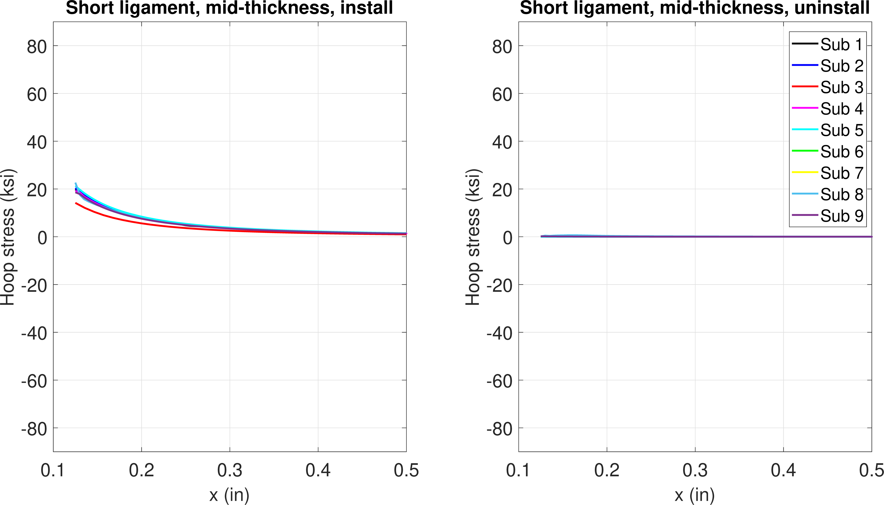
Comparisons
Stress from installation for all conditions below
  At mid-thickness
Models that simulate fastener install
Elastic
Plasticity
More plasticity
0.3% interf.
0.6% interf.
1.2% interf.

Slide 13
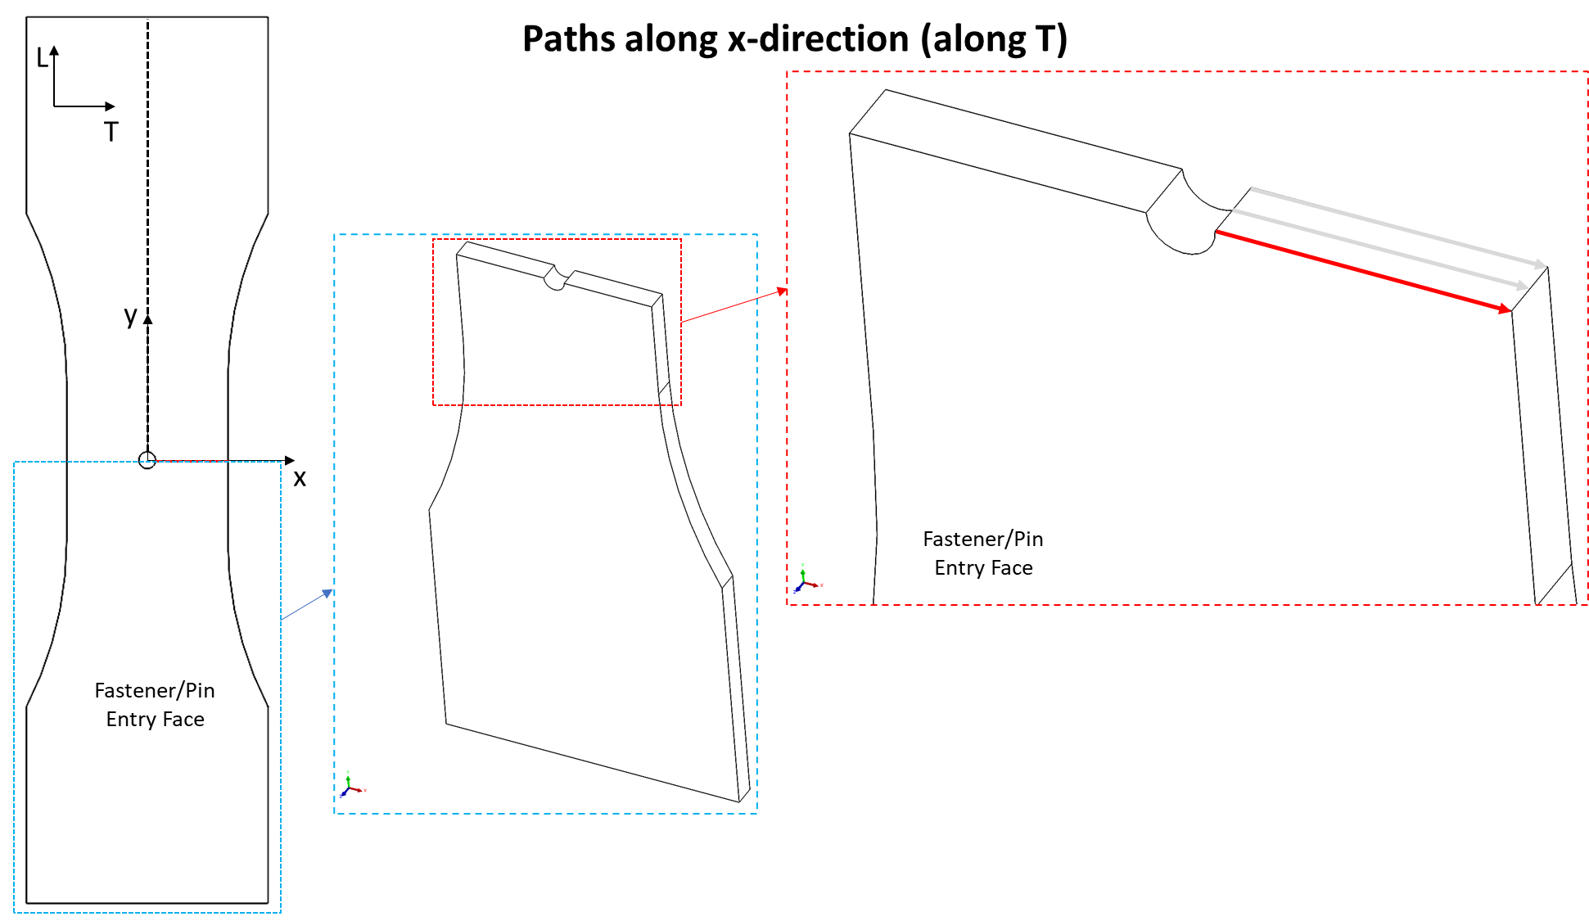
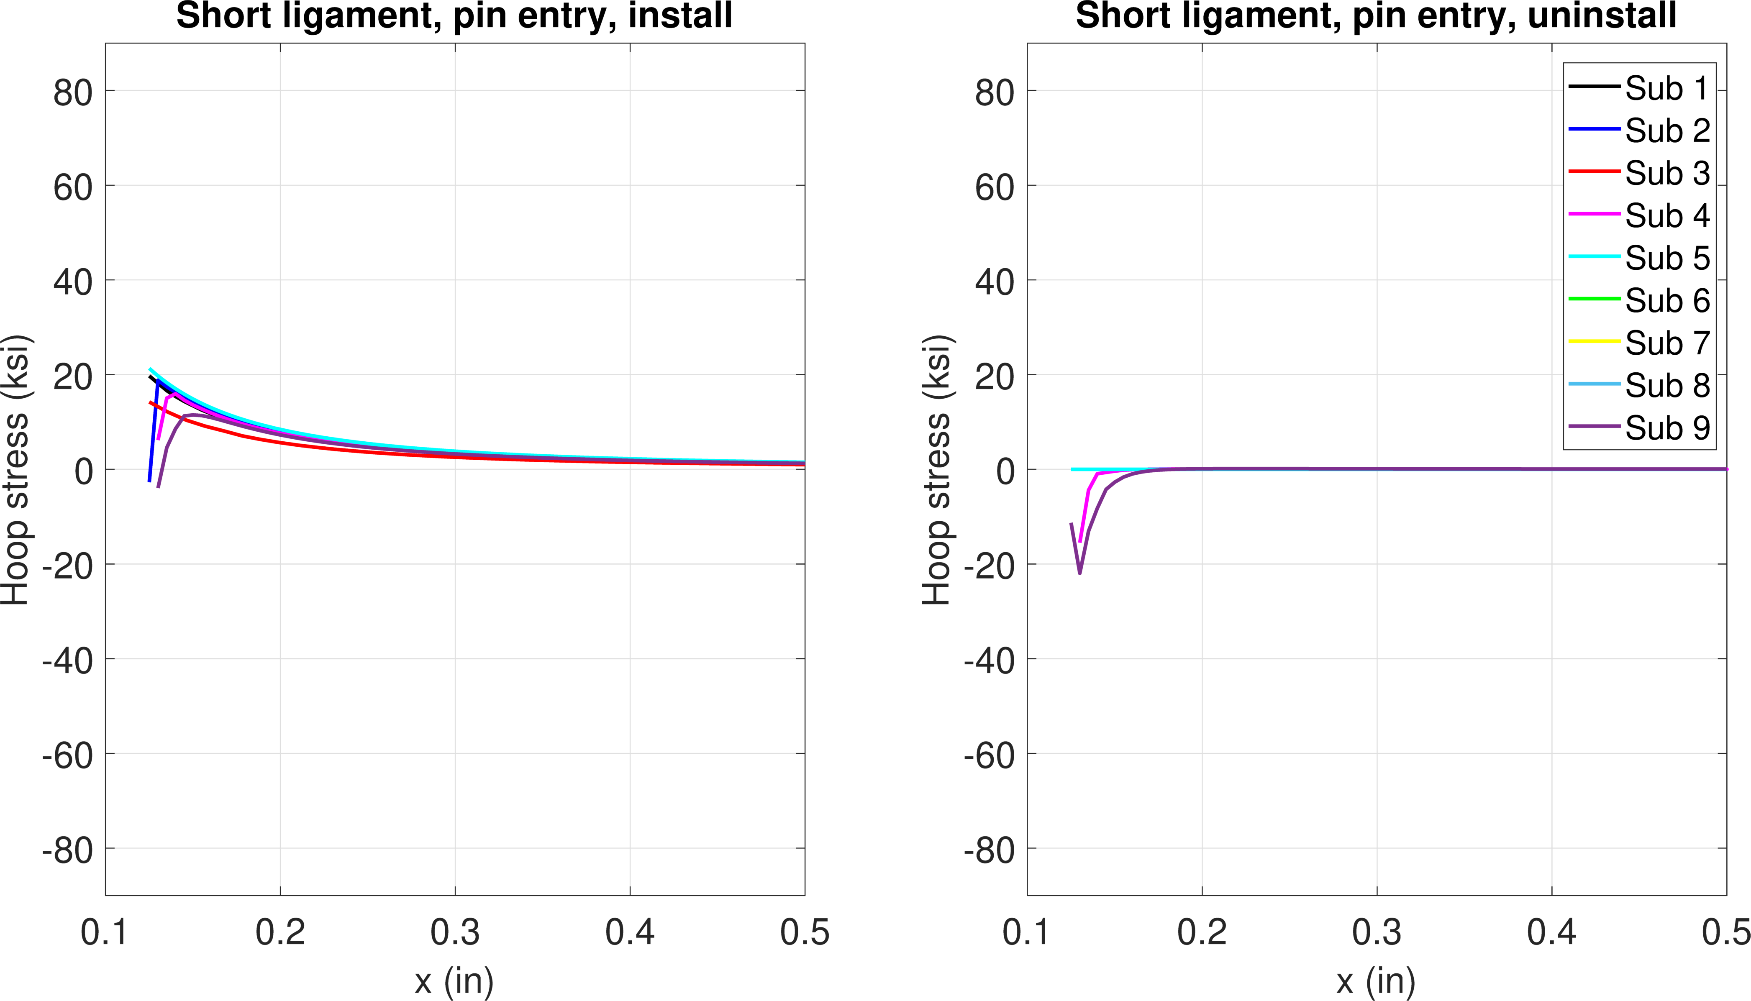
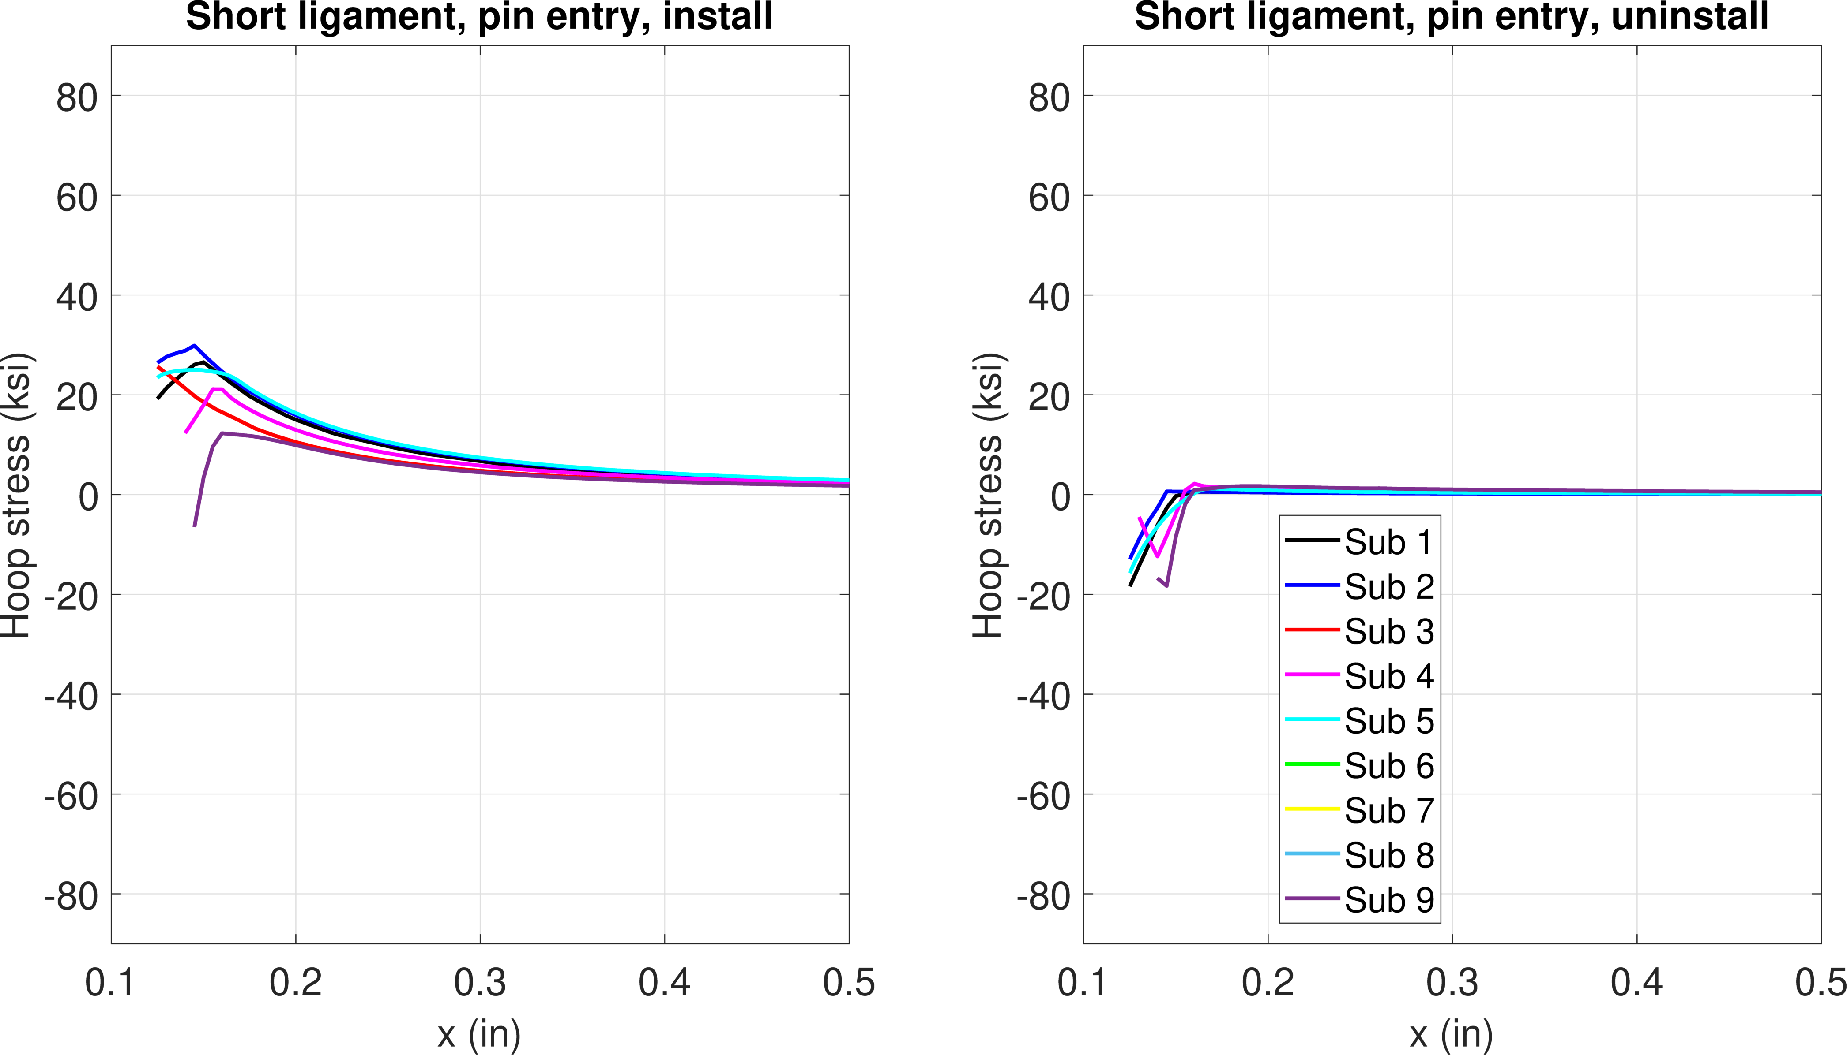
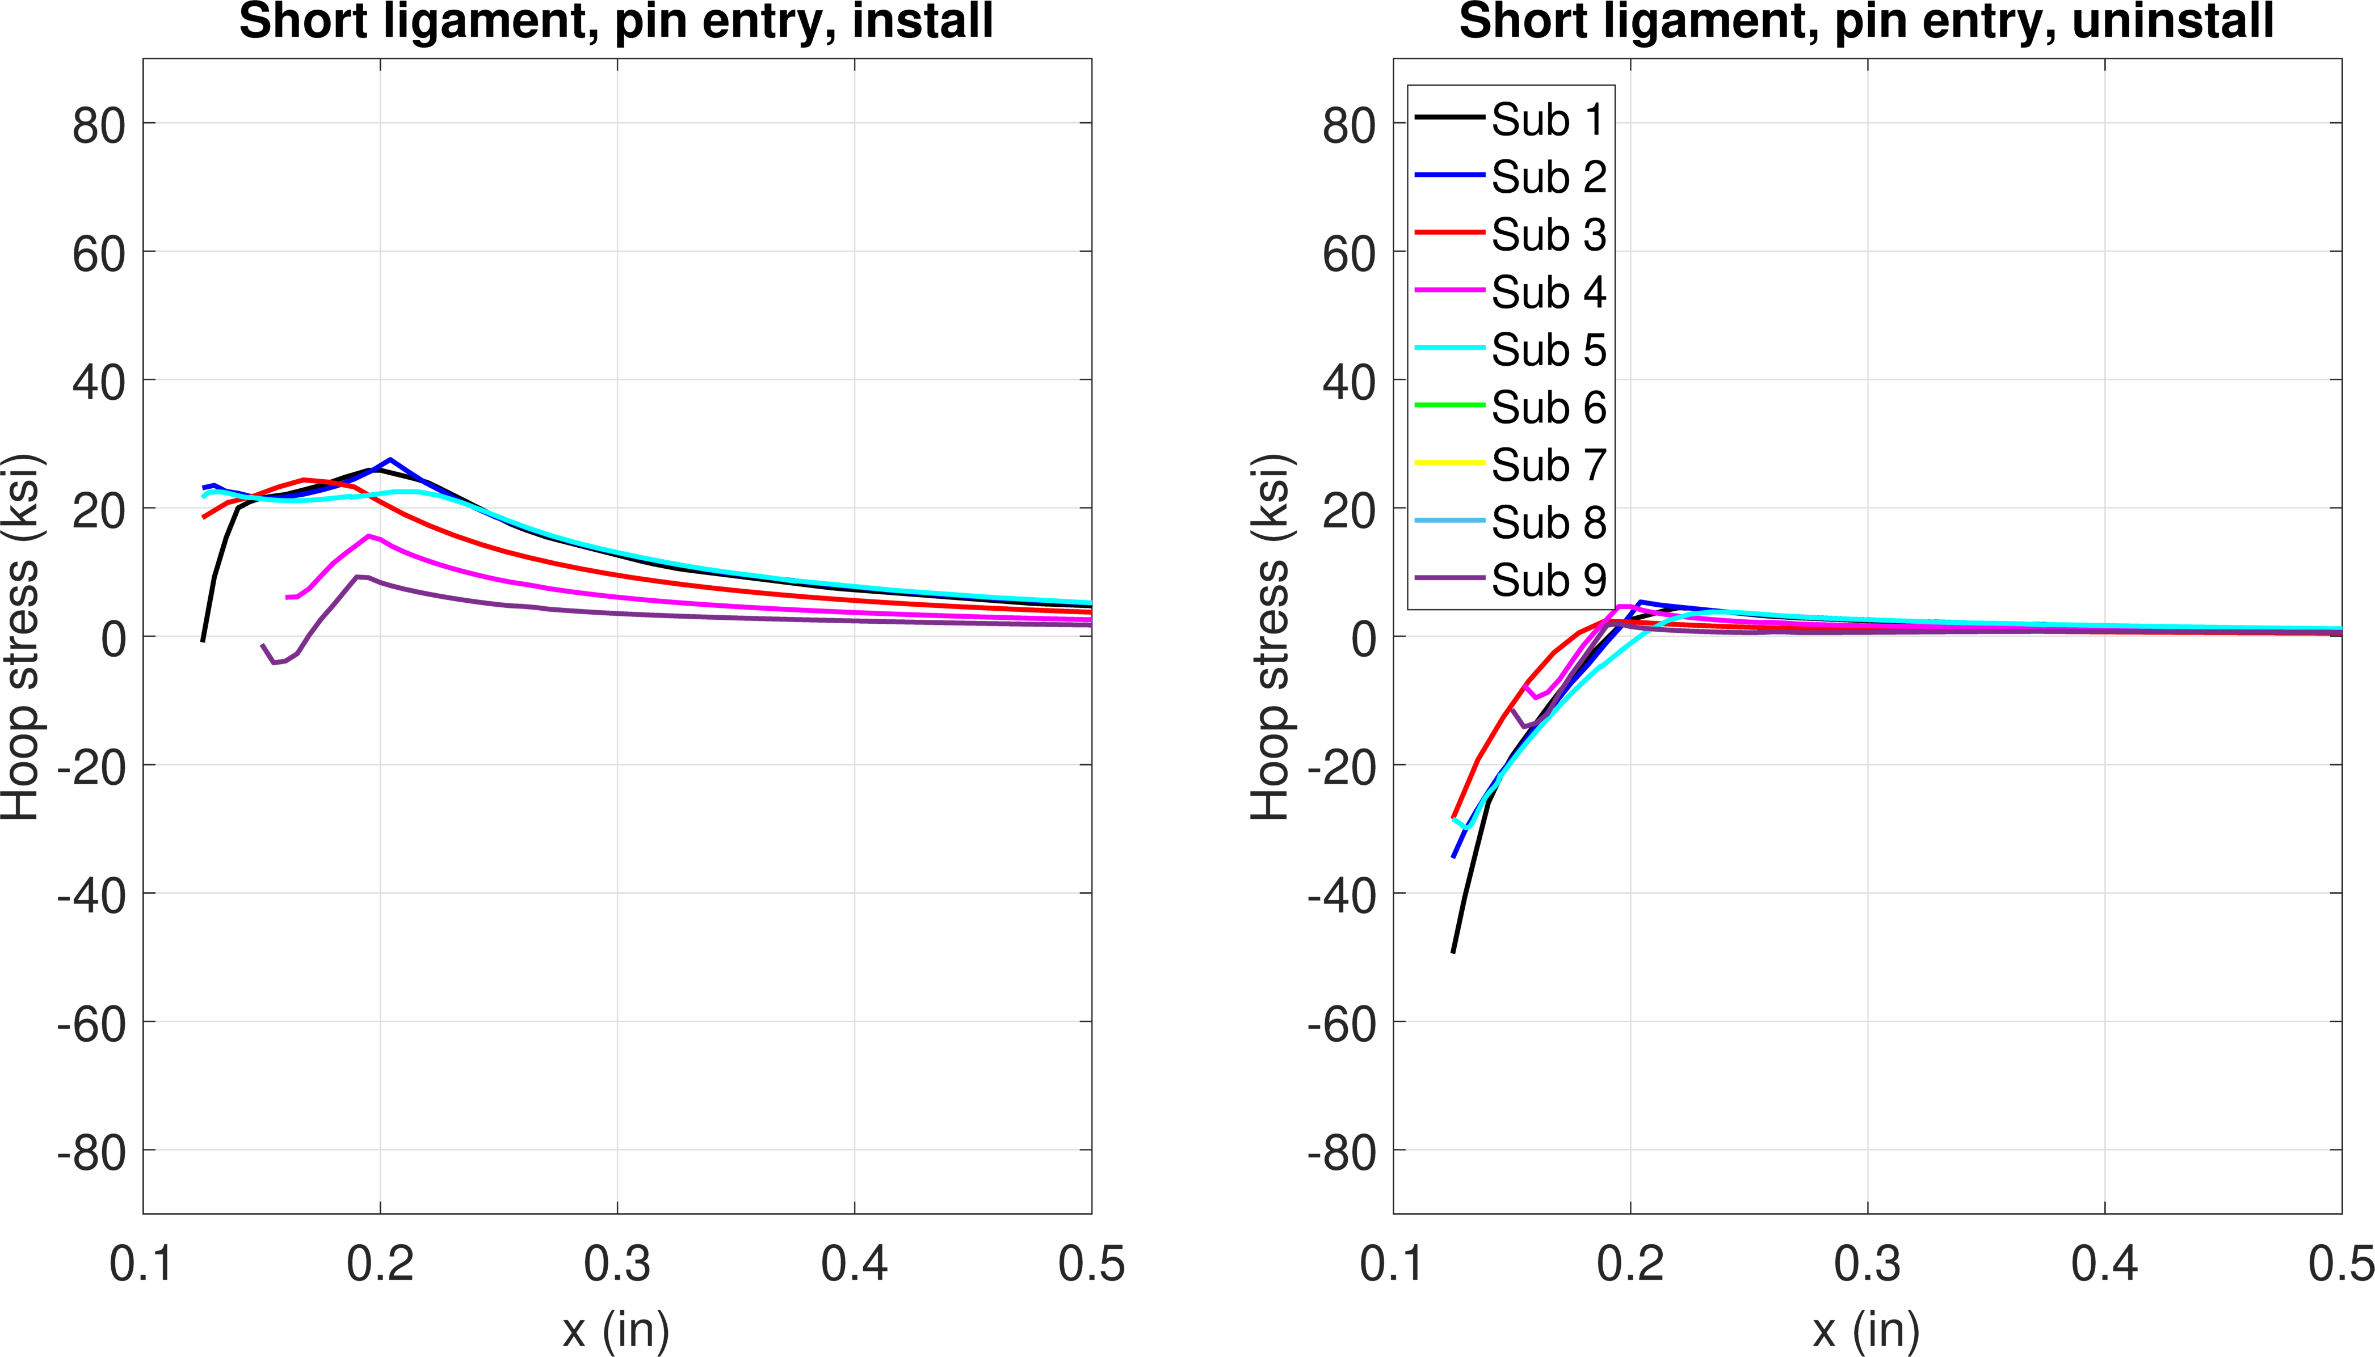
Comparisons
Stress from installation for all conditions below
  At entry surface
3 models show plasticity
2 of them simulate fastener push in
Plasticity
More plasticity
0.3% interf.
0.6% interf.
1.2% interf.

Slide 14
Comparisons
Stress after fastener removal for all conditions below
  At mid-thickness
0.3% interf.
0.6% interf.
1.2% interf.
No RS
Some compressive RS
More compressive RS

Slide 15
Comparisons
Stress after fastener removal for all conditions below
  At entry surface
0.3% interf.
0.6% interf.
1.2% interf.
Compressive RS from 2 models that simulate fastener push in
Some compressive RS
More compressive RS

