Slide 1
Interference Fit Fastener – Working Group
Working Group on
Engineered Residual Stress Implementation
Robert Pilarczyk
rtpilarczyk@hill-engineering.com

Slide 2
Submission summary

Slide 3
Neat fit
Step 1 – pin install
Step 2 – remote loading
Step 3 – unload
Step 4 – remove pin

Slide 4
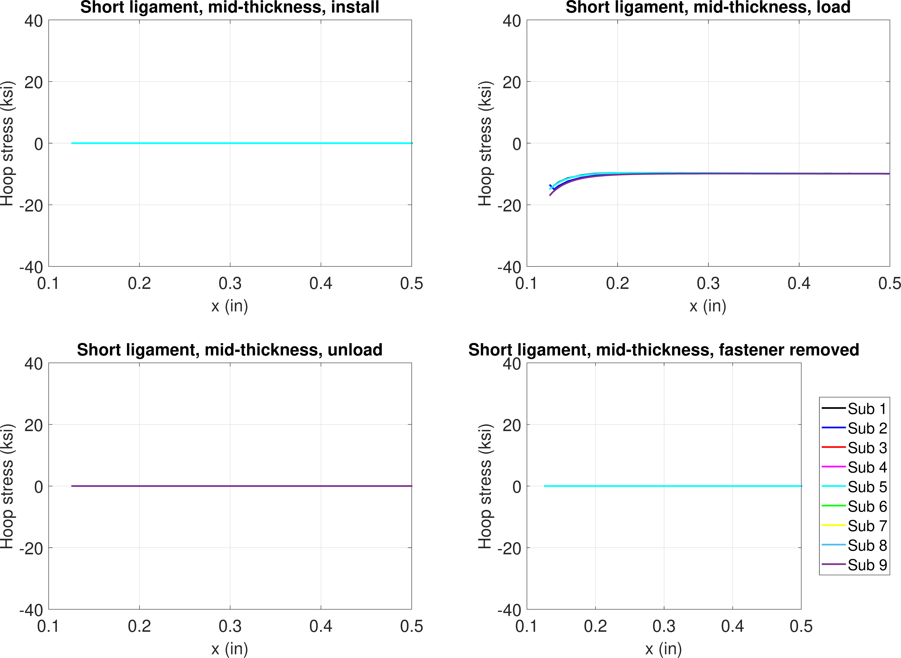
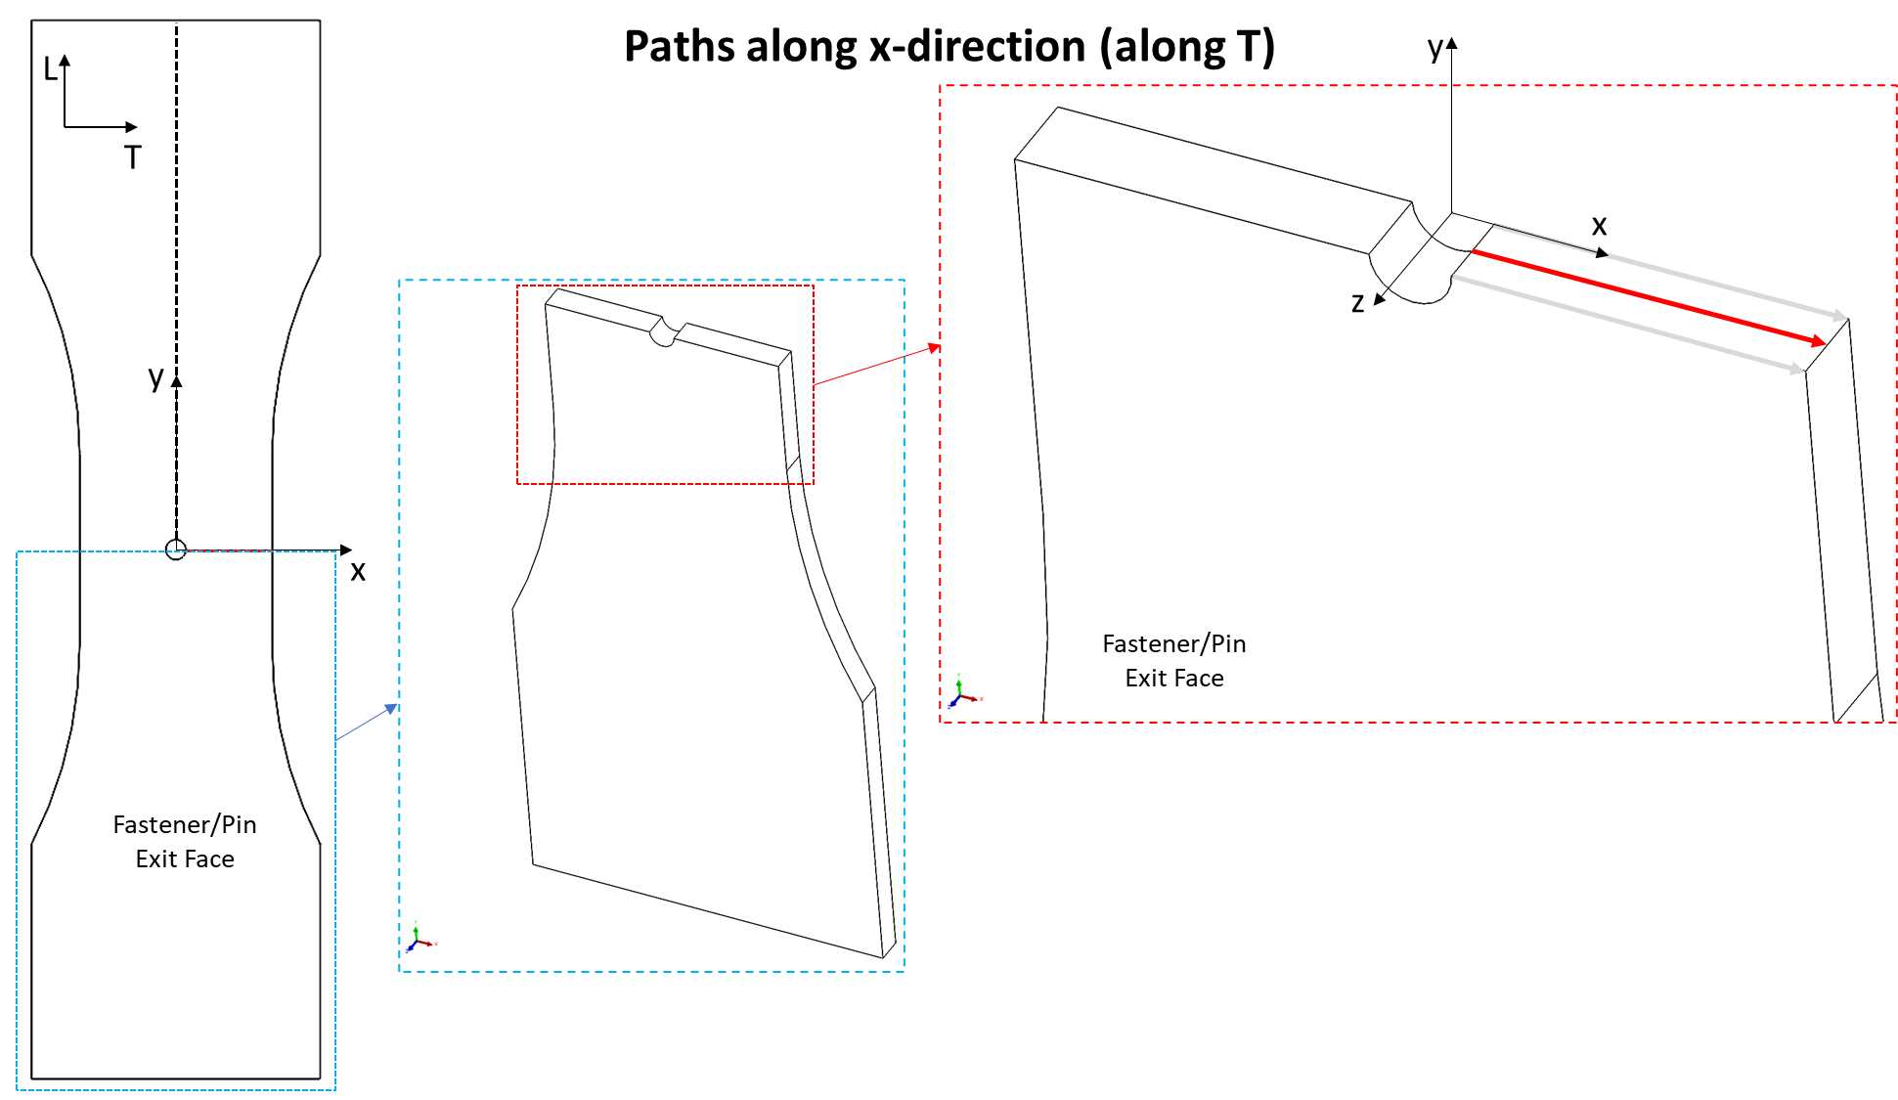
FE model results – neat fit, -10 ksi
Hoop stress, mid-thickness
-10 ksi
Install
Load
Unload
Remove

Slide 5
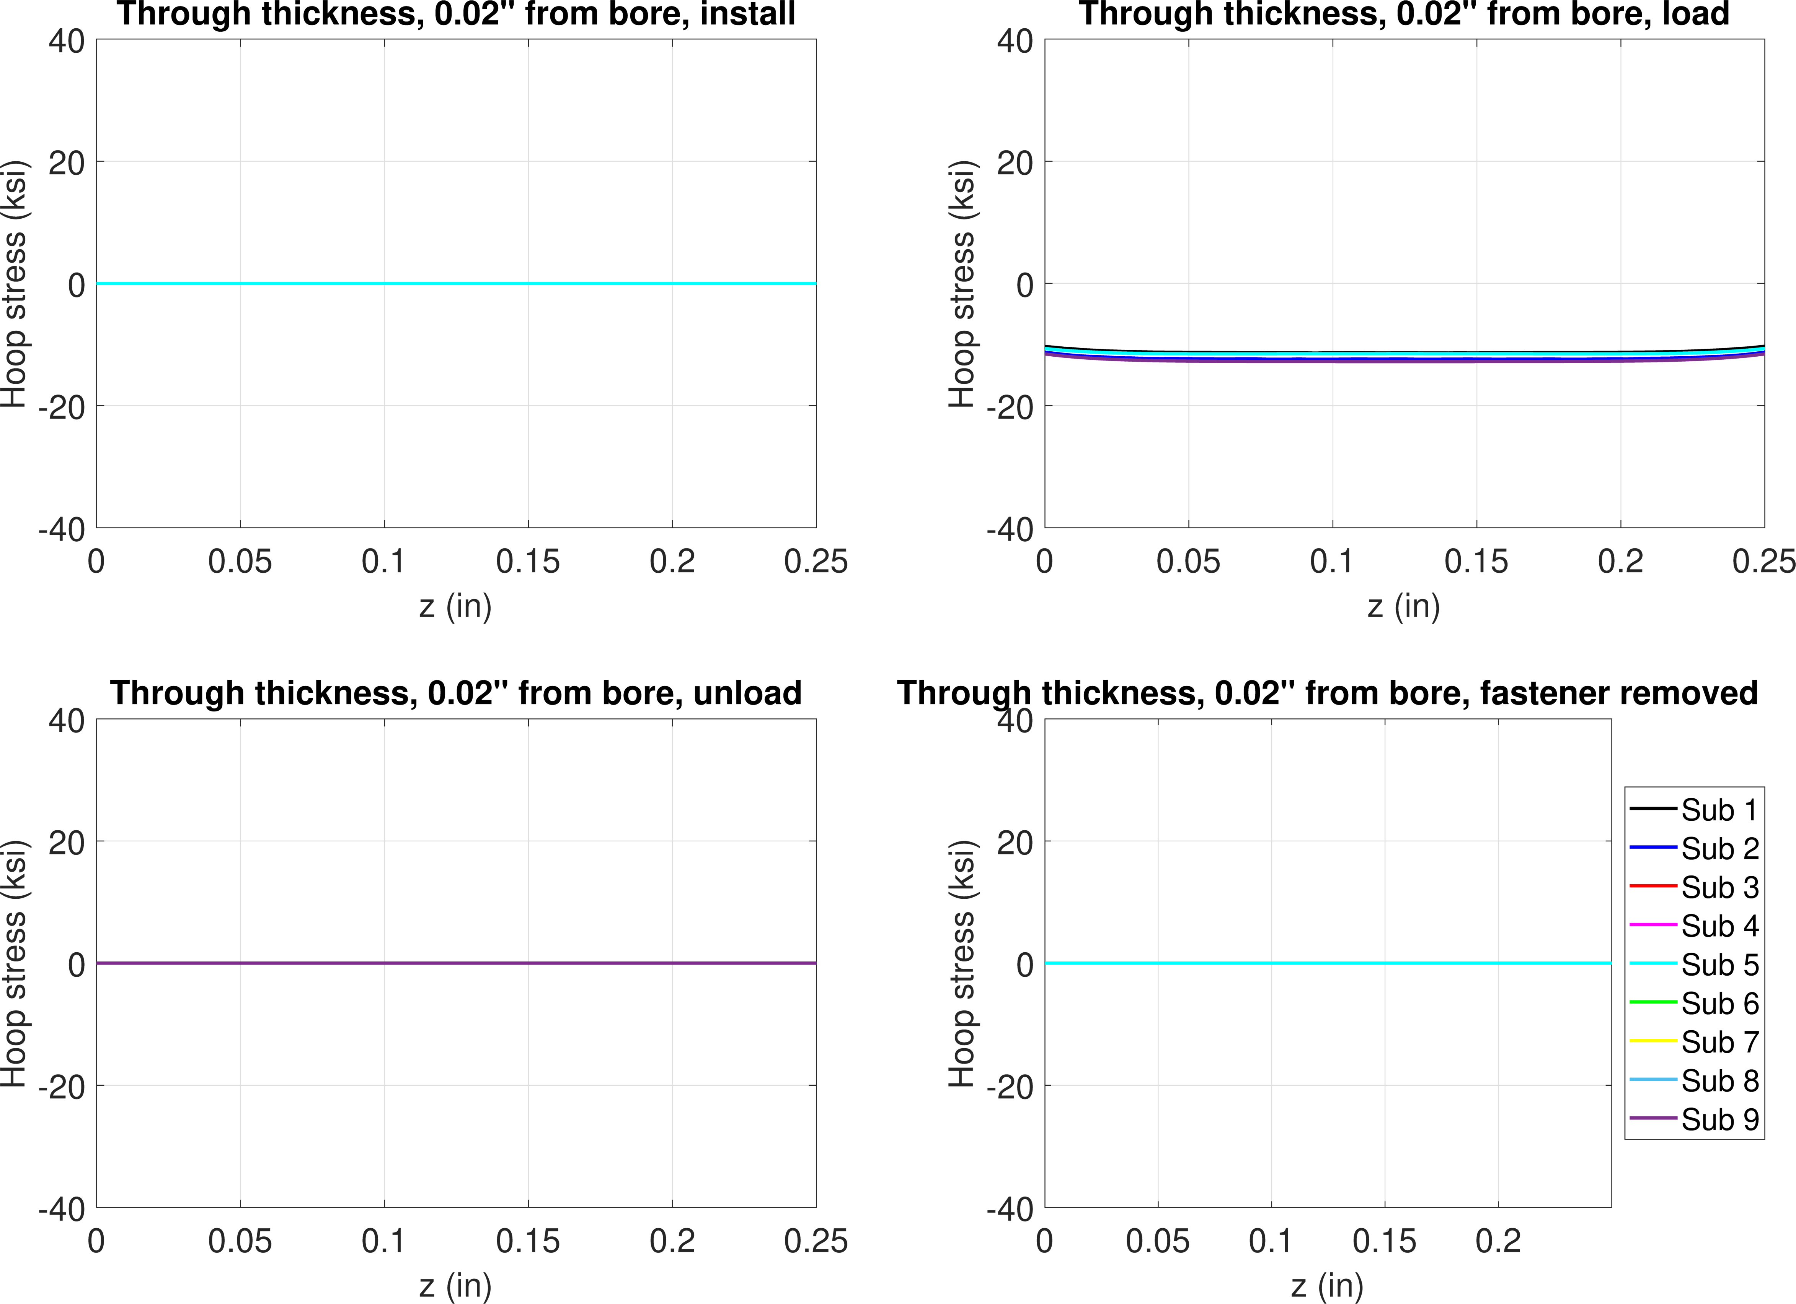
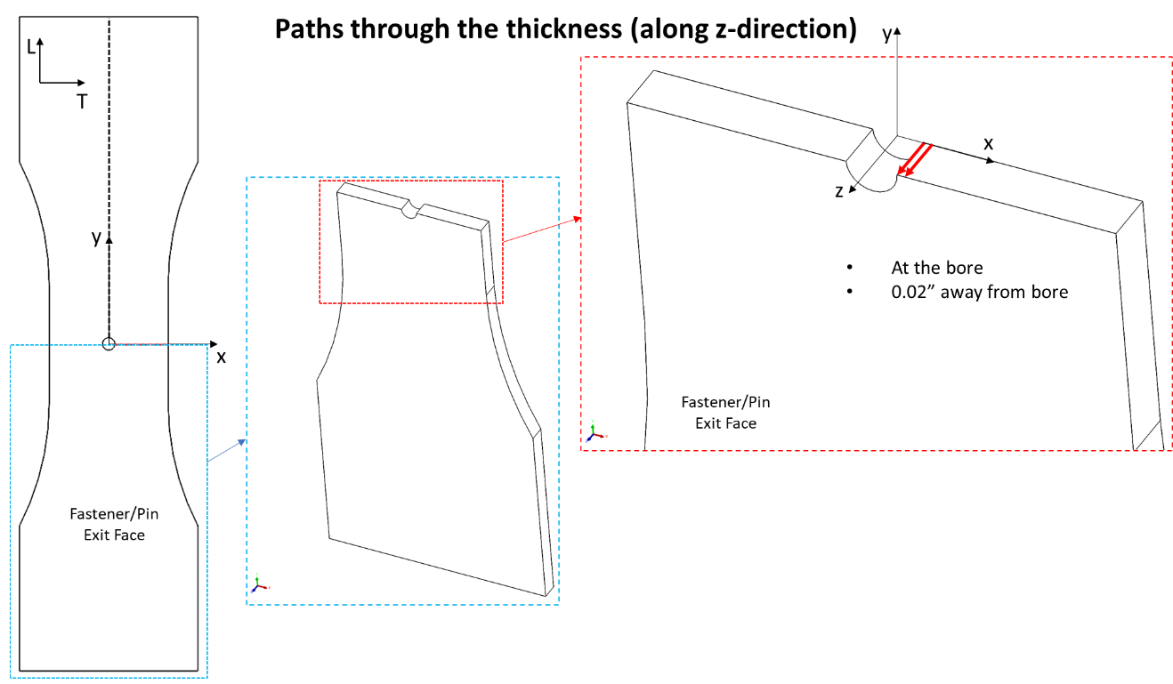
FE model results – neat fit, -10 ksi
Hoop stress, 0.02” from bore
Install
Load
Unload
Remove

Slide 6
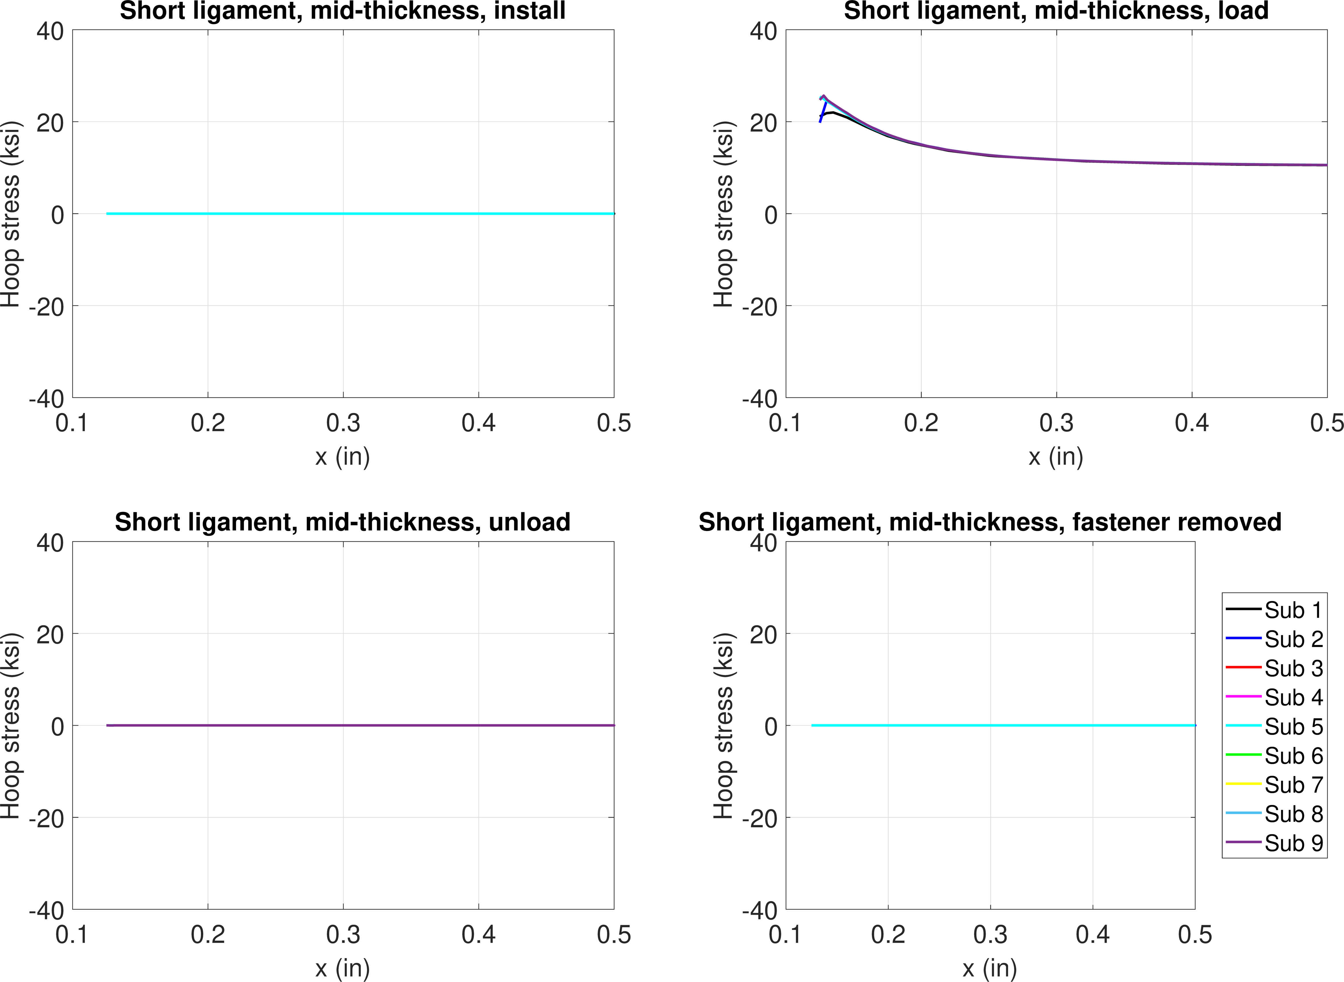
FE model results – neat fit, 10 ksi
Hoop stress, mid-thickness
10 ksi
Install
Load
Unload
Remove

Slide 7
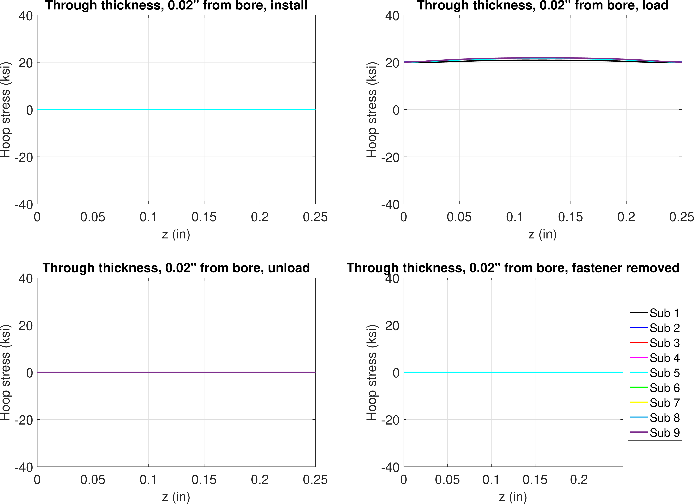
FE model results – neat fit, 10 ksi
Hoop stress, 0.02” from bore
Install
Load
Unload
Remove

Slide 8
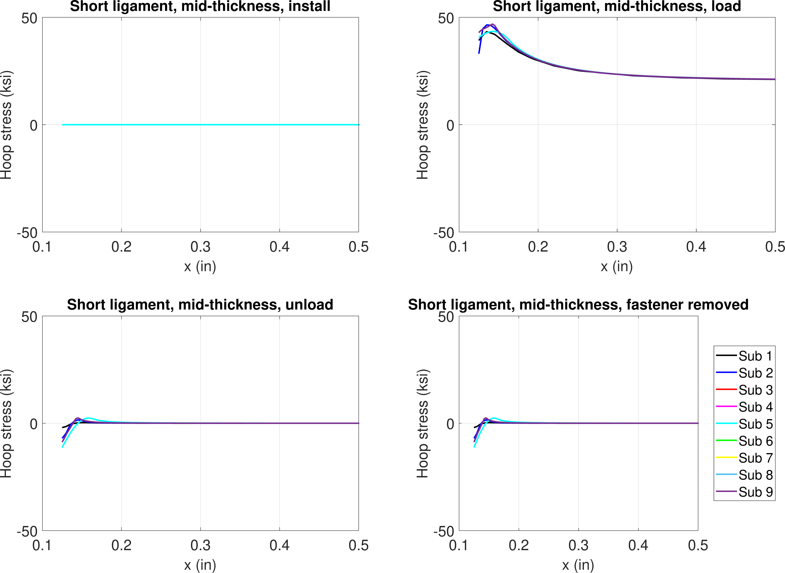
FE model results – neat fit, 20 ksi
Hoop stress, mid-thickness
20 ksi
Plasticity
Install
Load
Unload
Remove

Slide 9
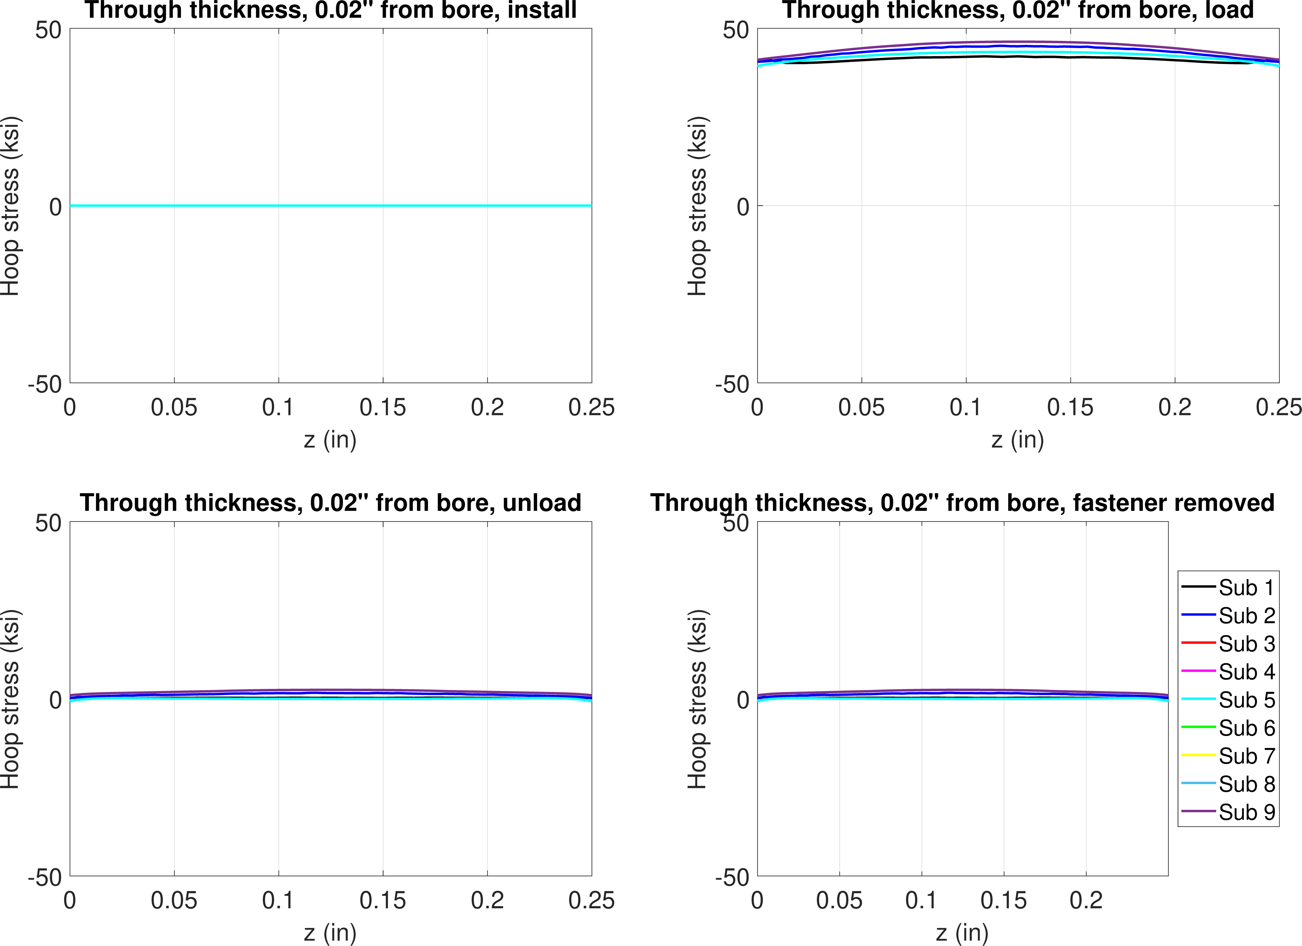
FE model results – neat fit, 20 ksi
Hoop stress, 0.02” from bore
Install
Load
Unload
Remove

Slide 10
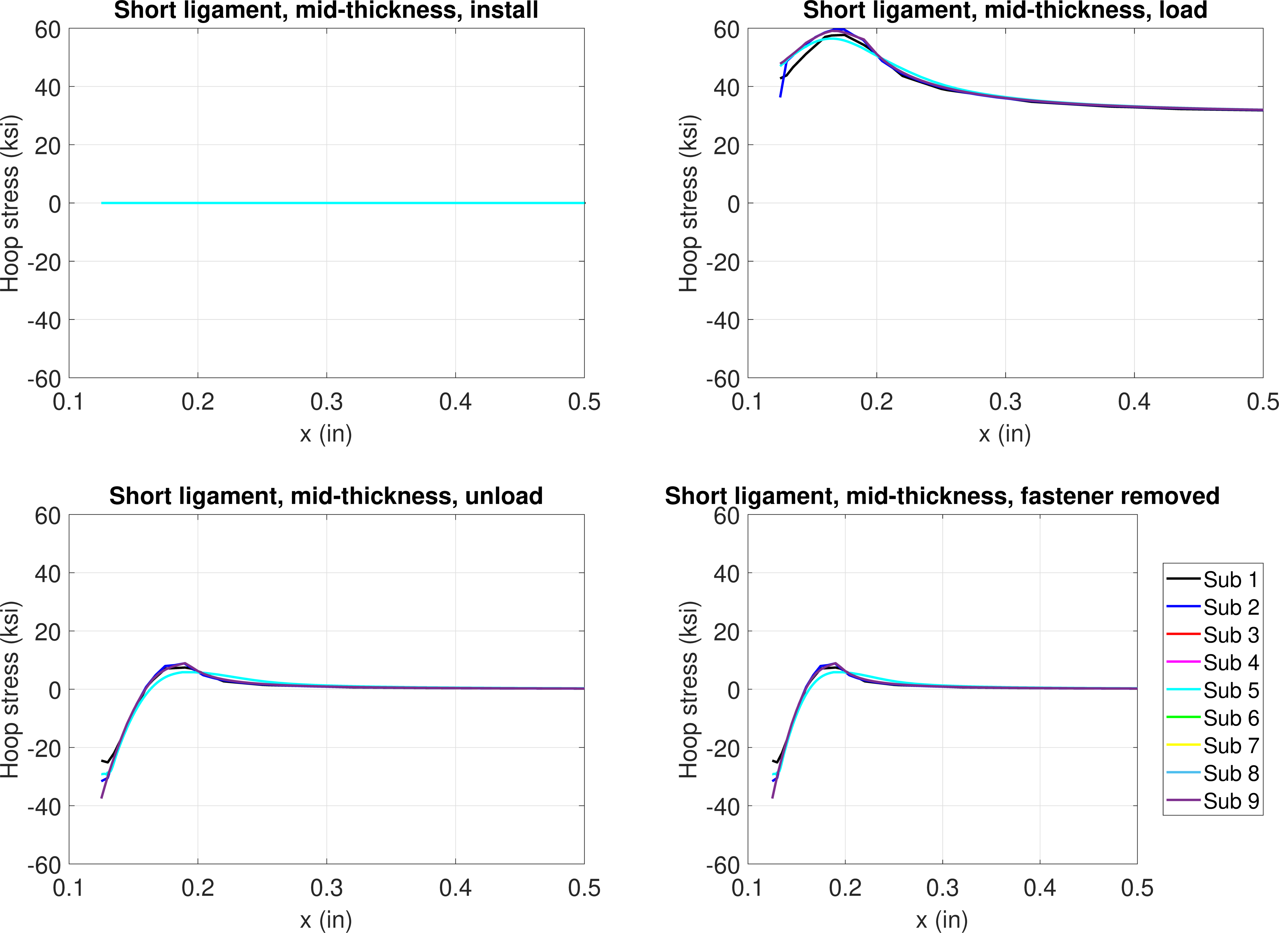
FE model results – neat fit, 30 ksi
Hoop stress, mid-thickness
30 ksi
Install
Load
Unload
Remove

Slide 11
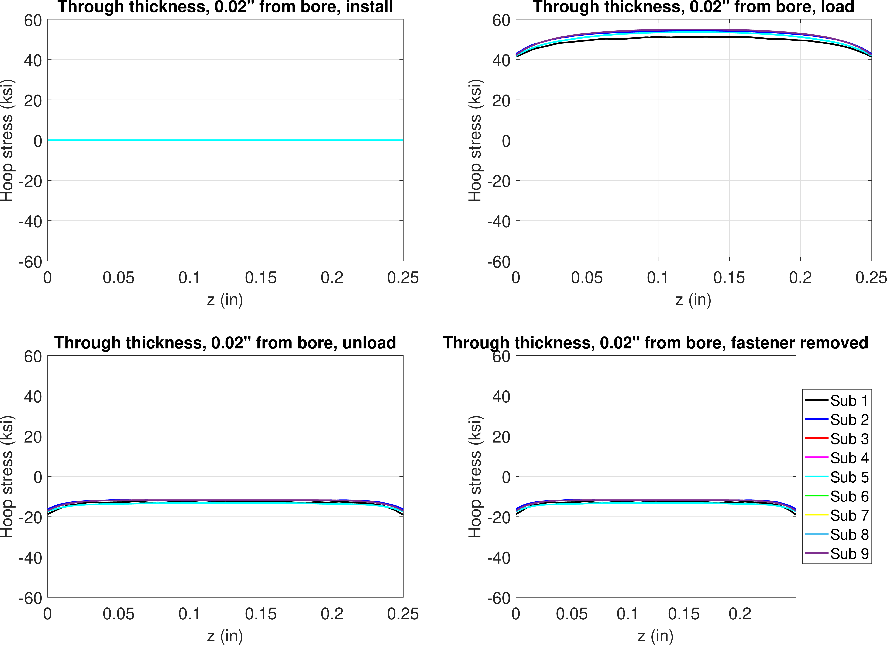
FE model results – neat fit, 30 ksi
Hoop stress, 0.02” from bore
Install
Load
Unload
Remove

Slide 12
0.3% interference
Step 1 – pin install
Step 2 – remote loading
Step 3 – unload
Step 4 – remove pin

Slide 13
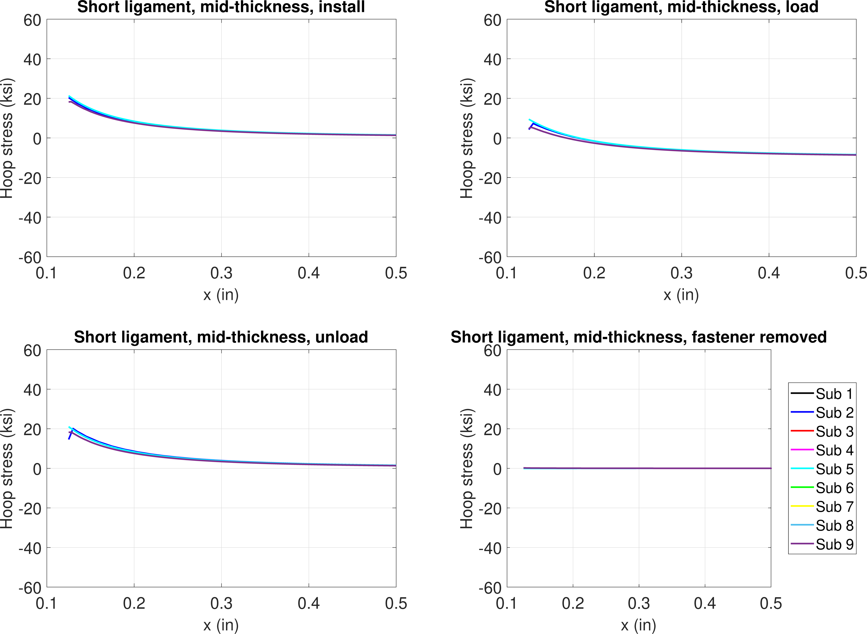
FE model results – 0.3% interference, -10 ksi
Hoop stress, mid-thickness
Elastic
Install
Load
Unload
Remove

Slide 14
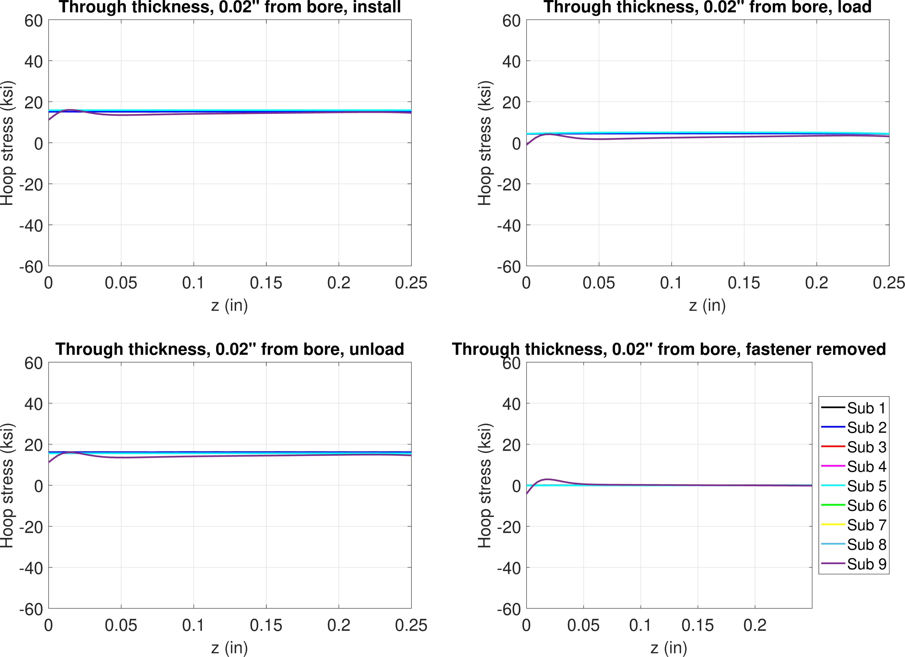
FE model results – 0.3% interference, -10 ksi
Hoop stress, 0.02” from bore
Install
Load
Unload
Remove

Slide 15
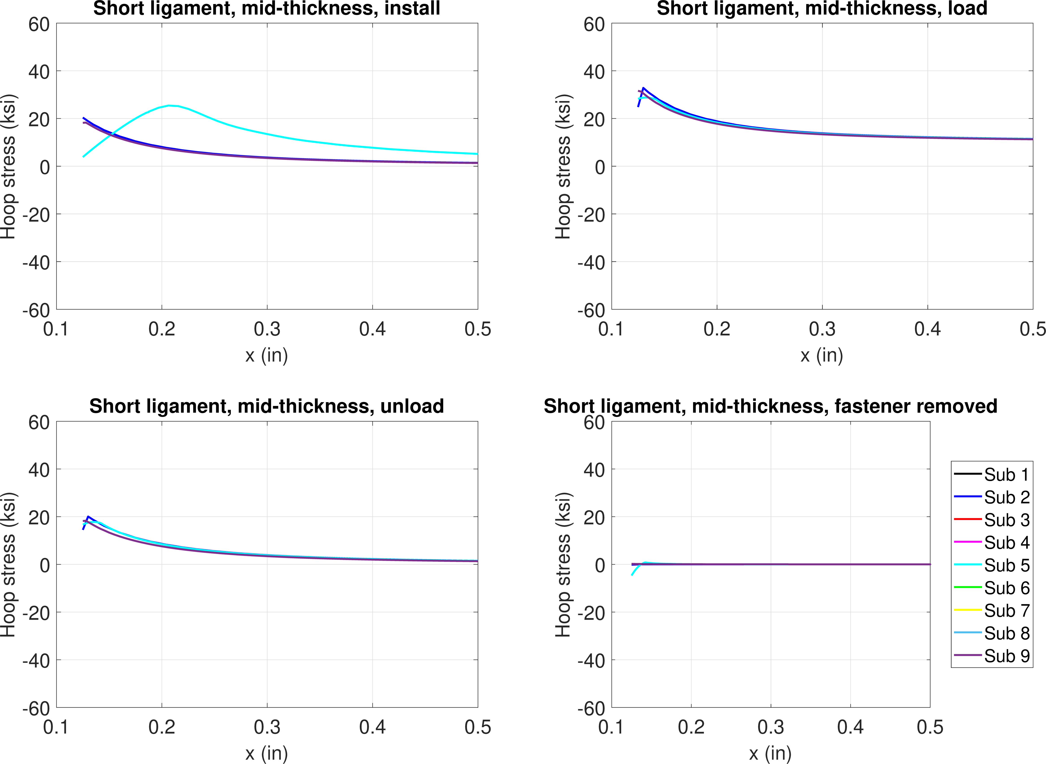
FE model results – 0.3% interference, 10 ksi
Hoop stress, mid-thickness
Install
Load
Unload
Remove

Slide 16
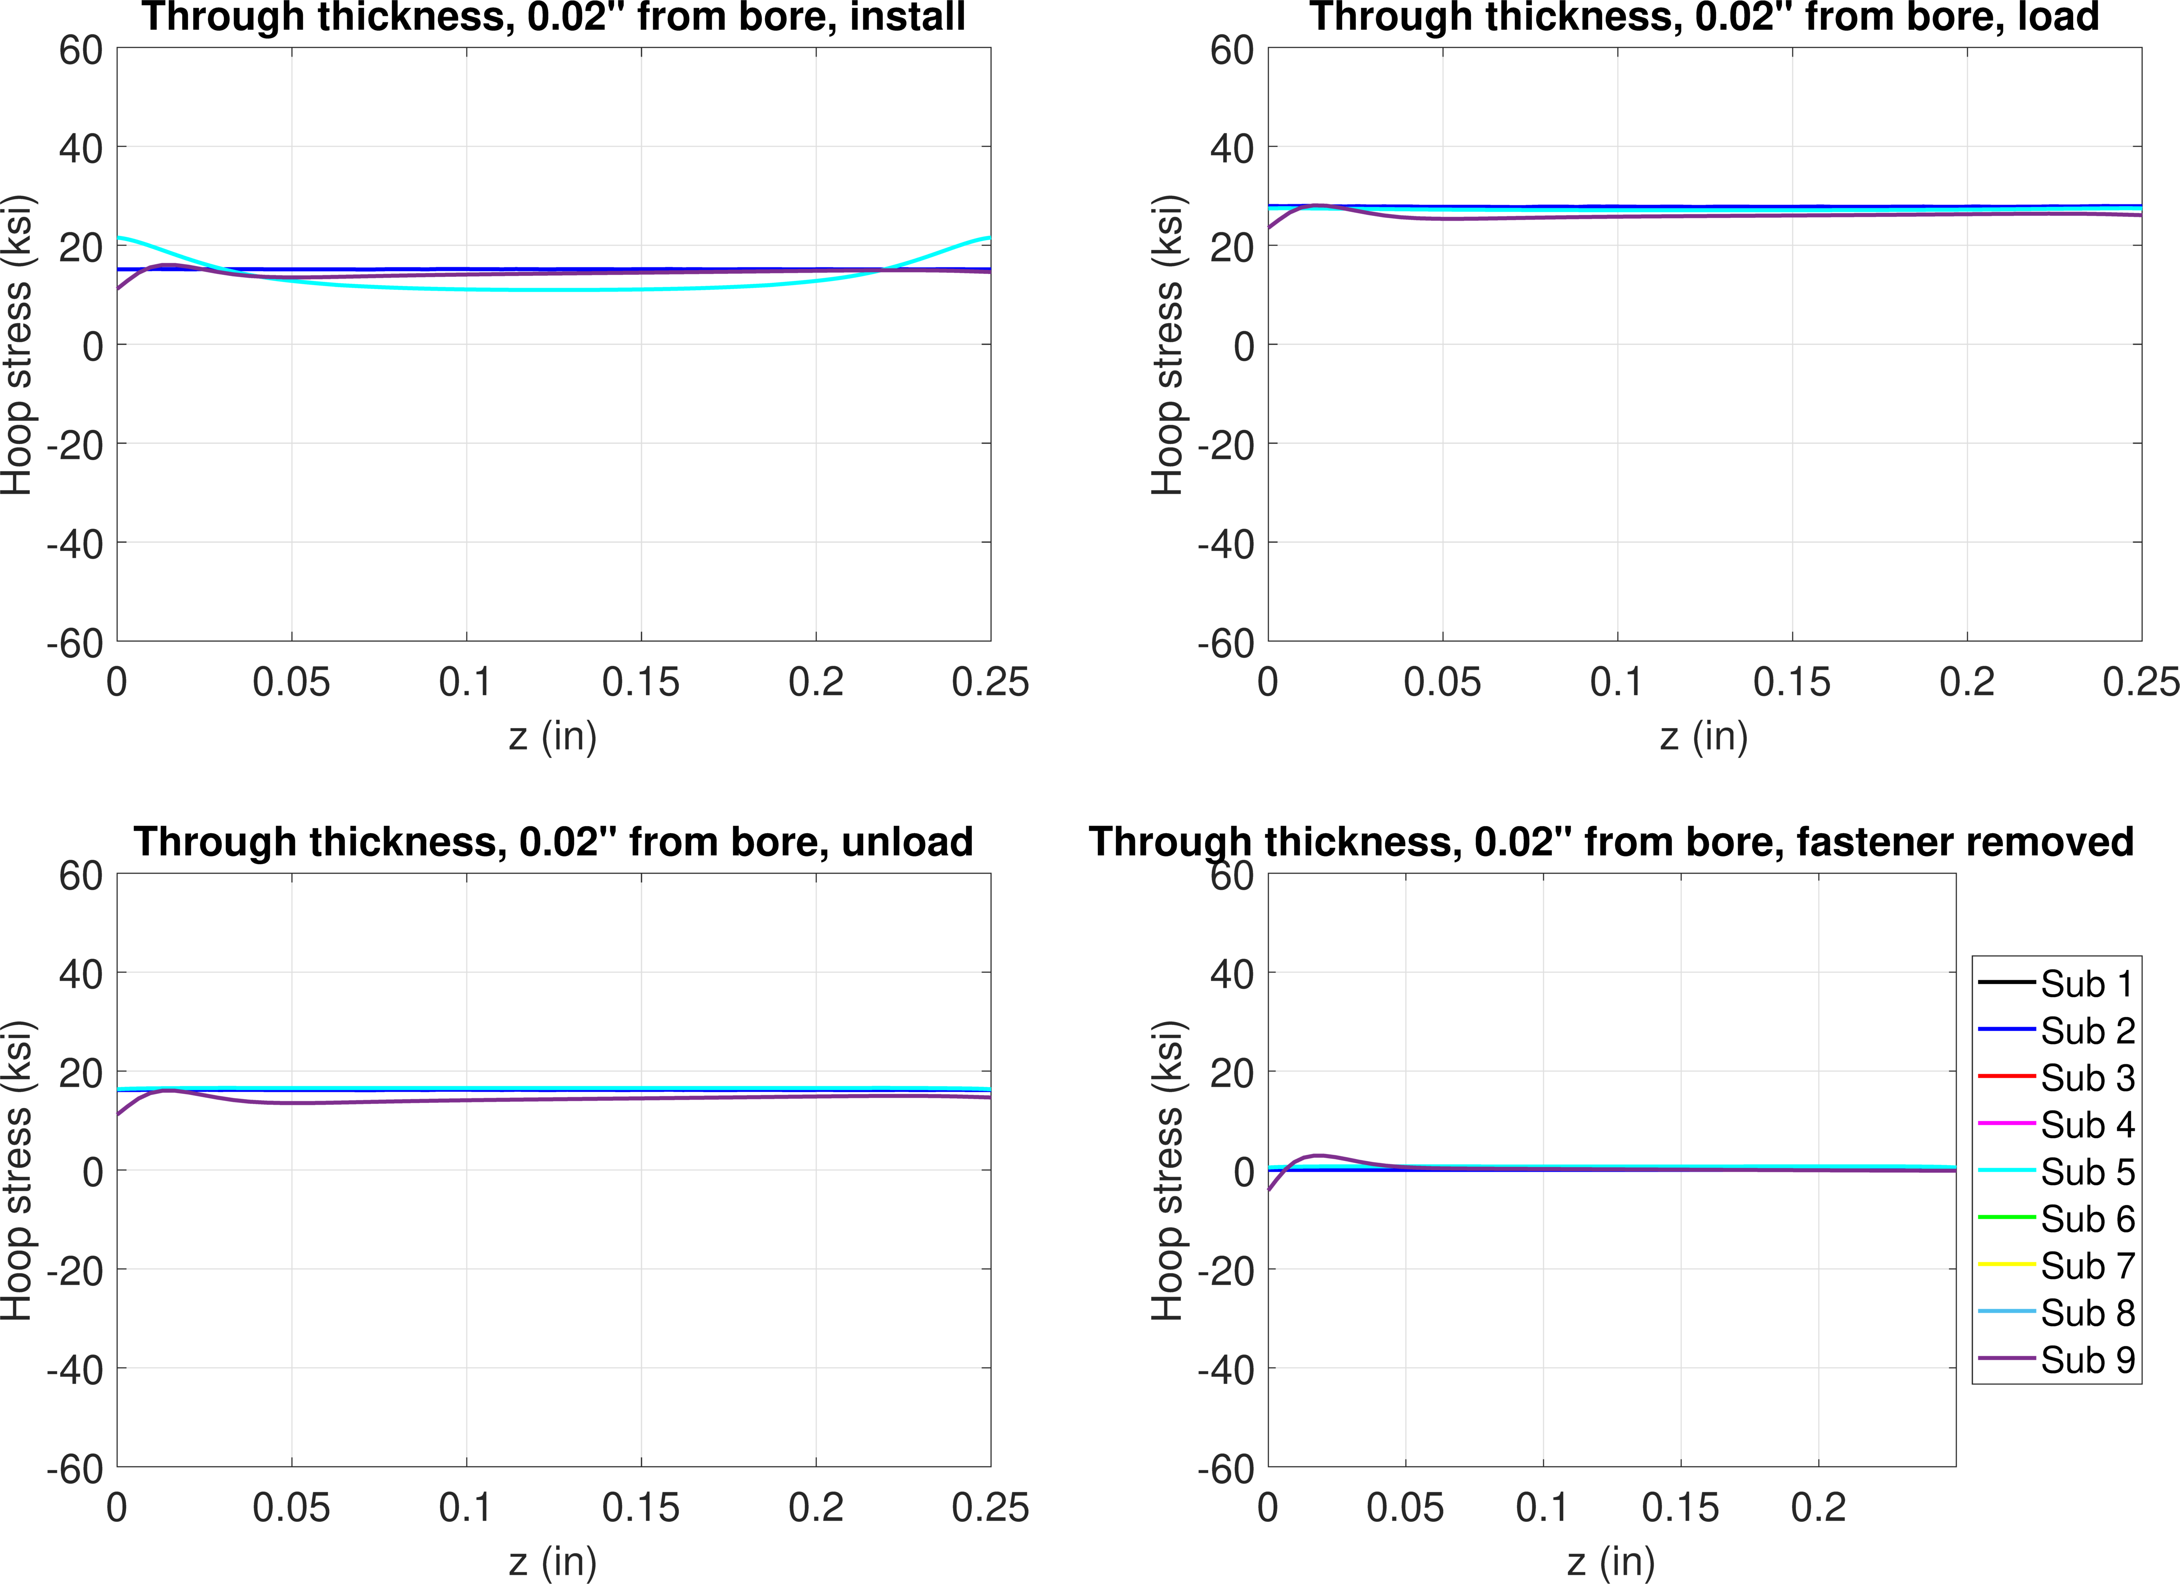
FE model results – 0.3% interference, 10 ksi
Hoop stress, 0.02” from bore
Install
Load
Unload
Remove

Slide 17
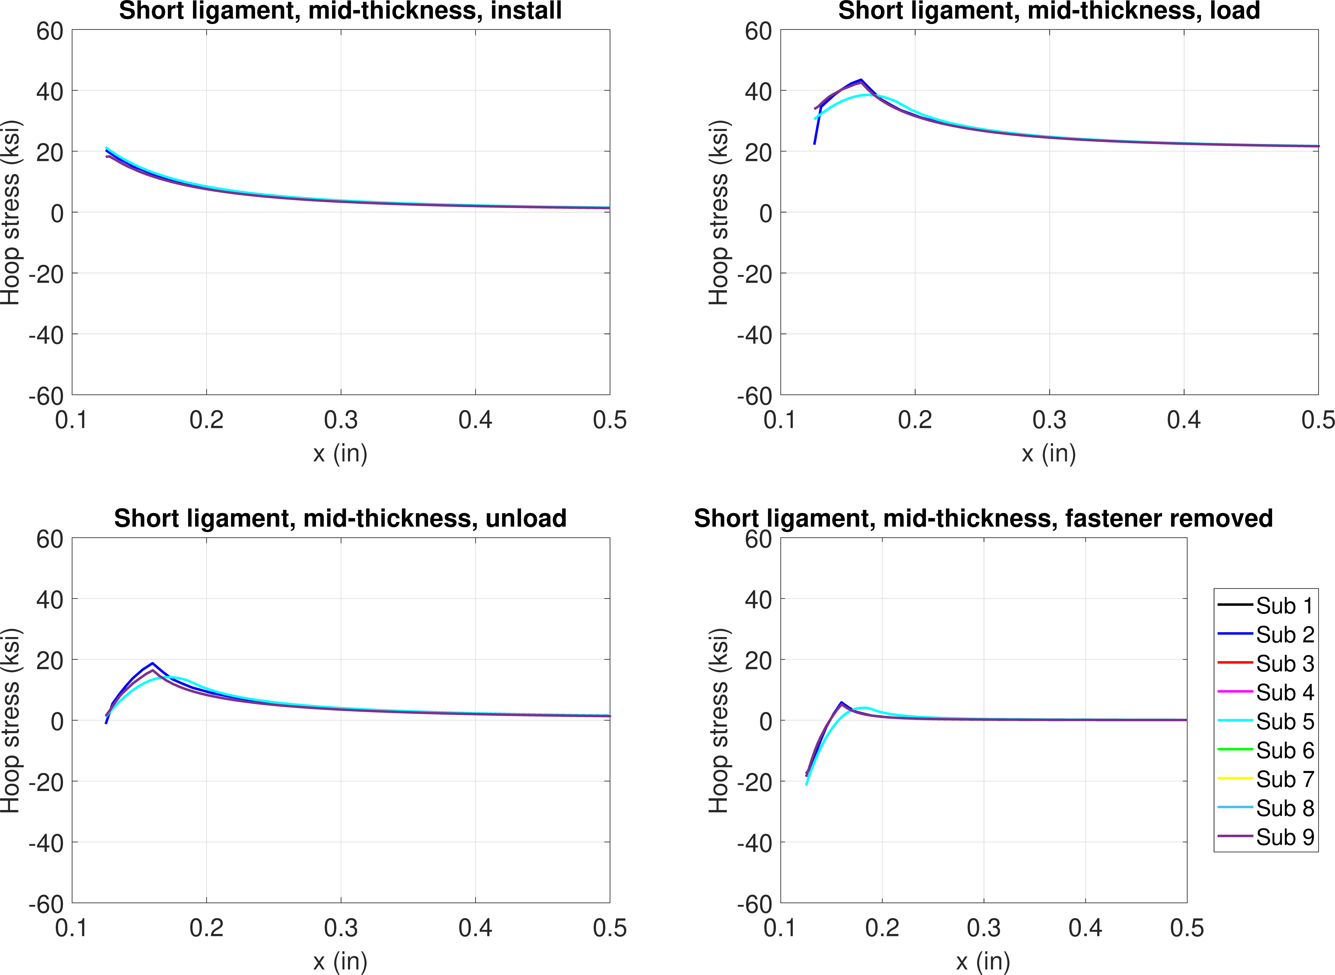
FE model results – 0.3% interference, 20 ksi
Hoop stress, mid-thickness
Install
Load
Unload
Remove

Slide 18
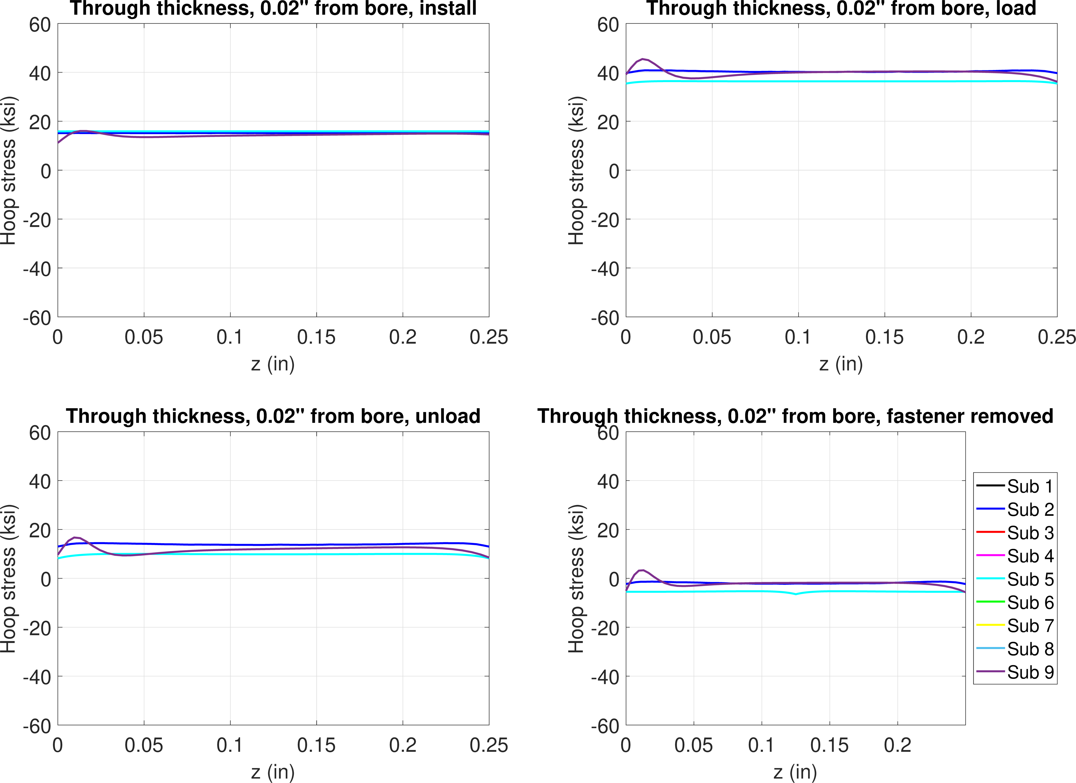
FE model results – 0.3% interference, 20 ksi
Hoop stress, 0.02” from bore
Install
Load
Unload
Remove

Slide 19
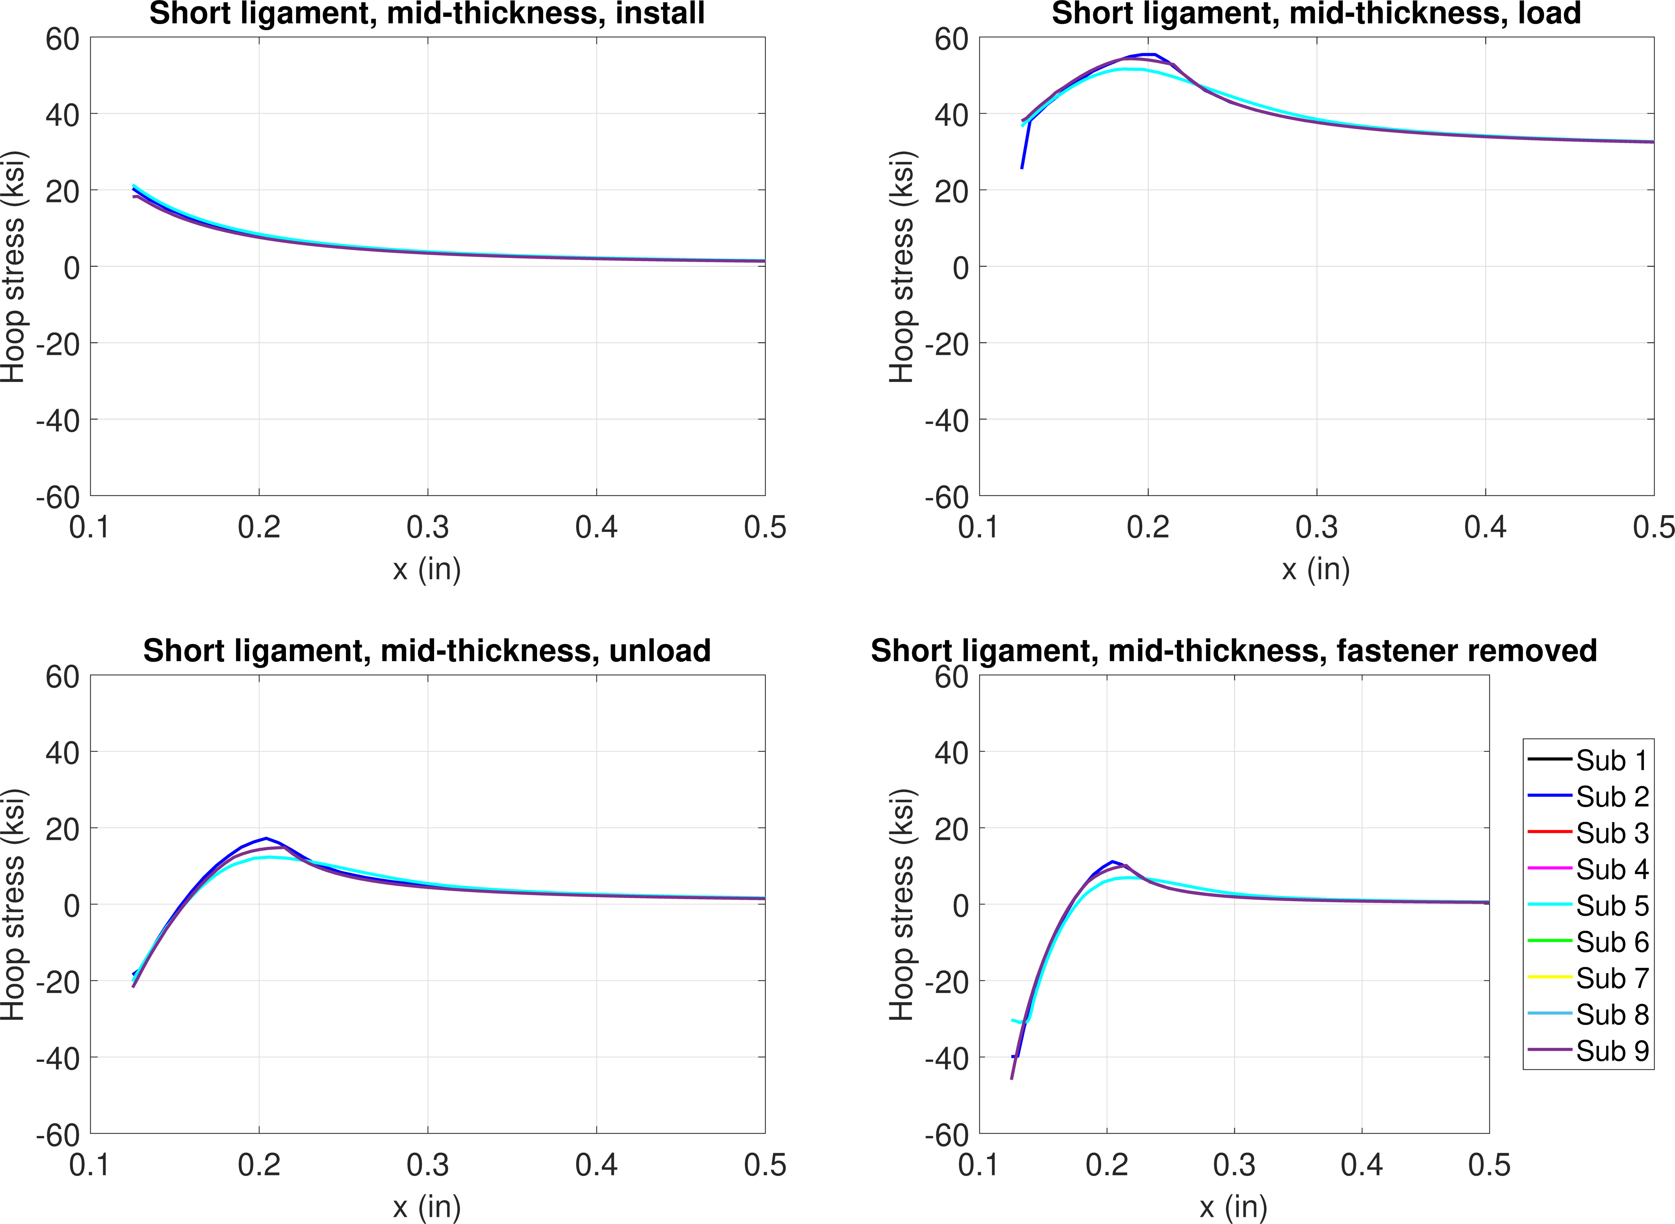
FE model results – 0.3% interference, 30 ksi
Hoop stress, mid-thickness
Install
Load
Unload
Remove

Slide 20
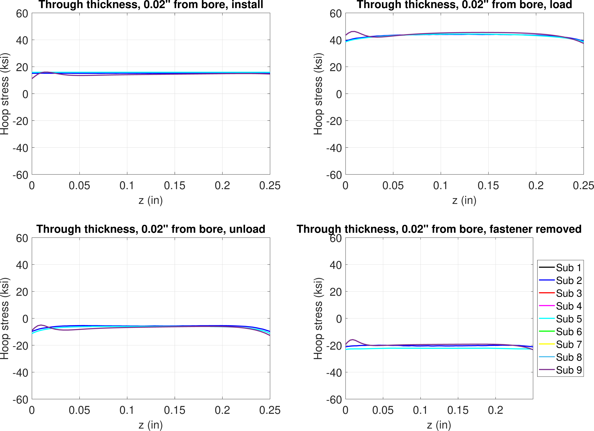
FE model results – 0.3% interference, 30 ksi
Hoop stress, 0.02” from bore
Install
Load
Unload
Remove

Slide 21
0.6% interference
Step 1 – pin install
Step 2 – remote loading
Step 3 – unload
Step 4 – remove pin

Slide 22
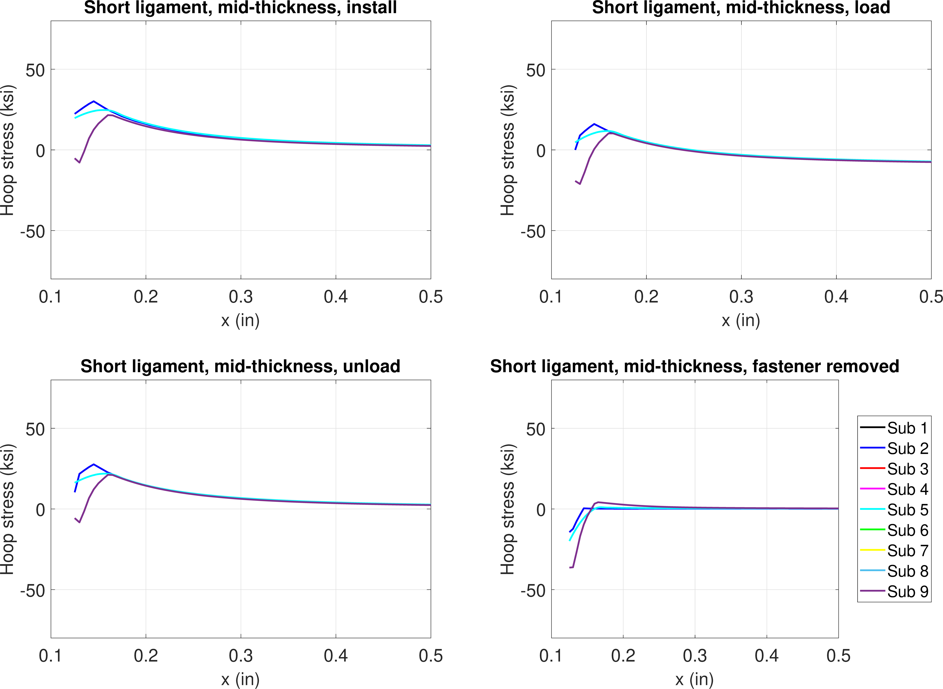
FE model results – 0.6% interference, -10 ksi
Hoop stress, mid-thickness
Plasticity from installation
Install
Load
Unload
Remove

Slide 23
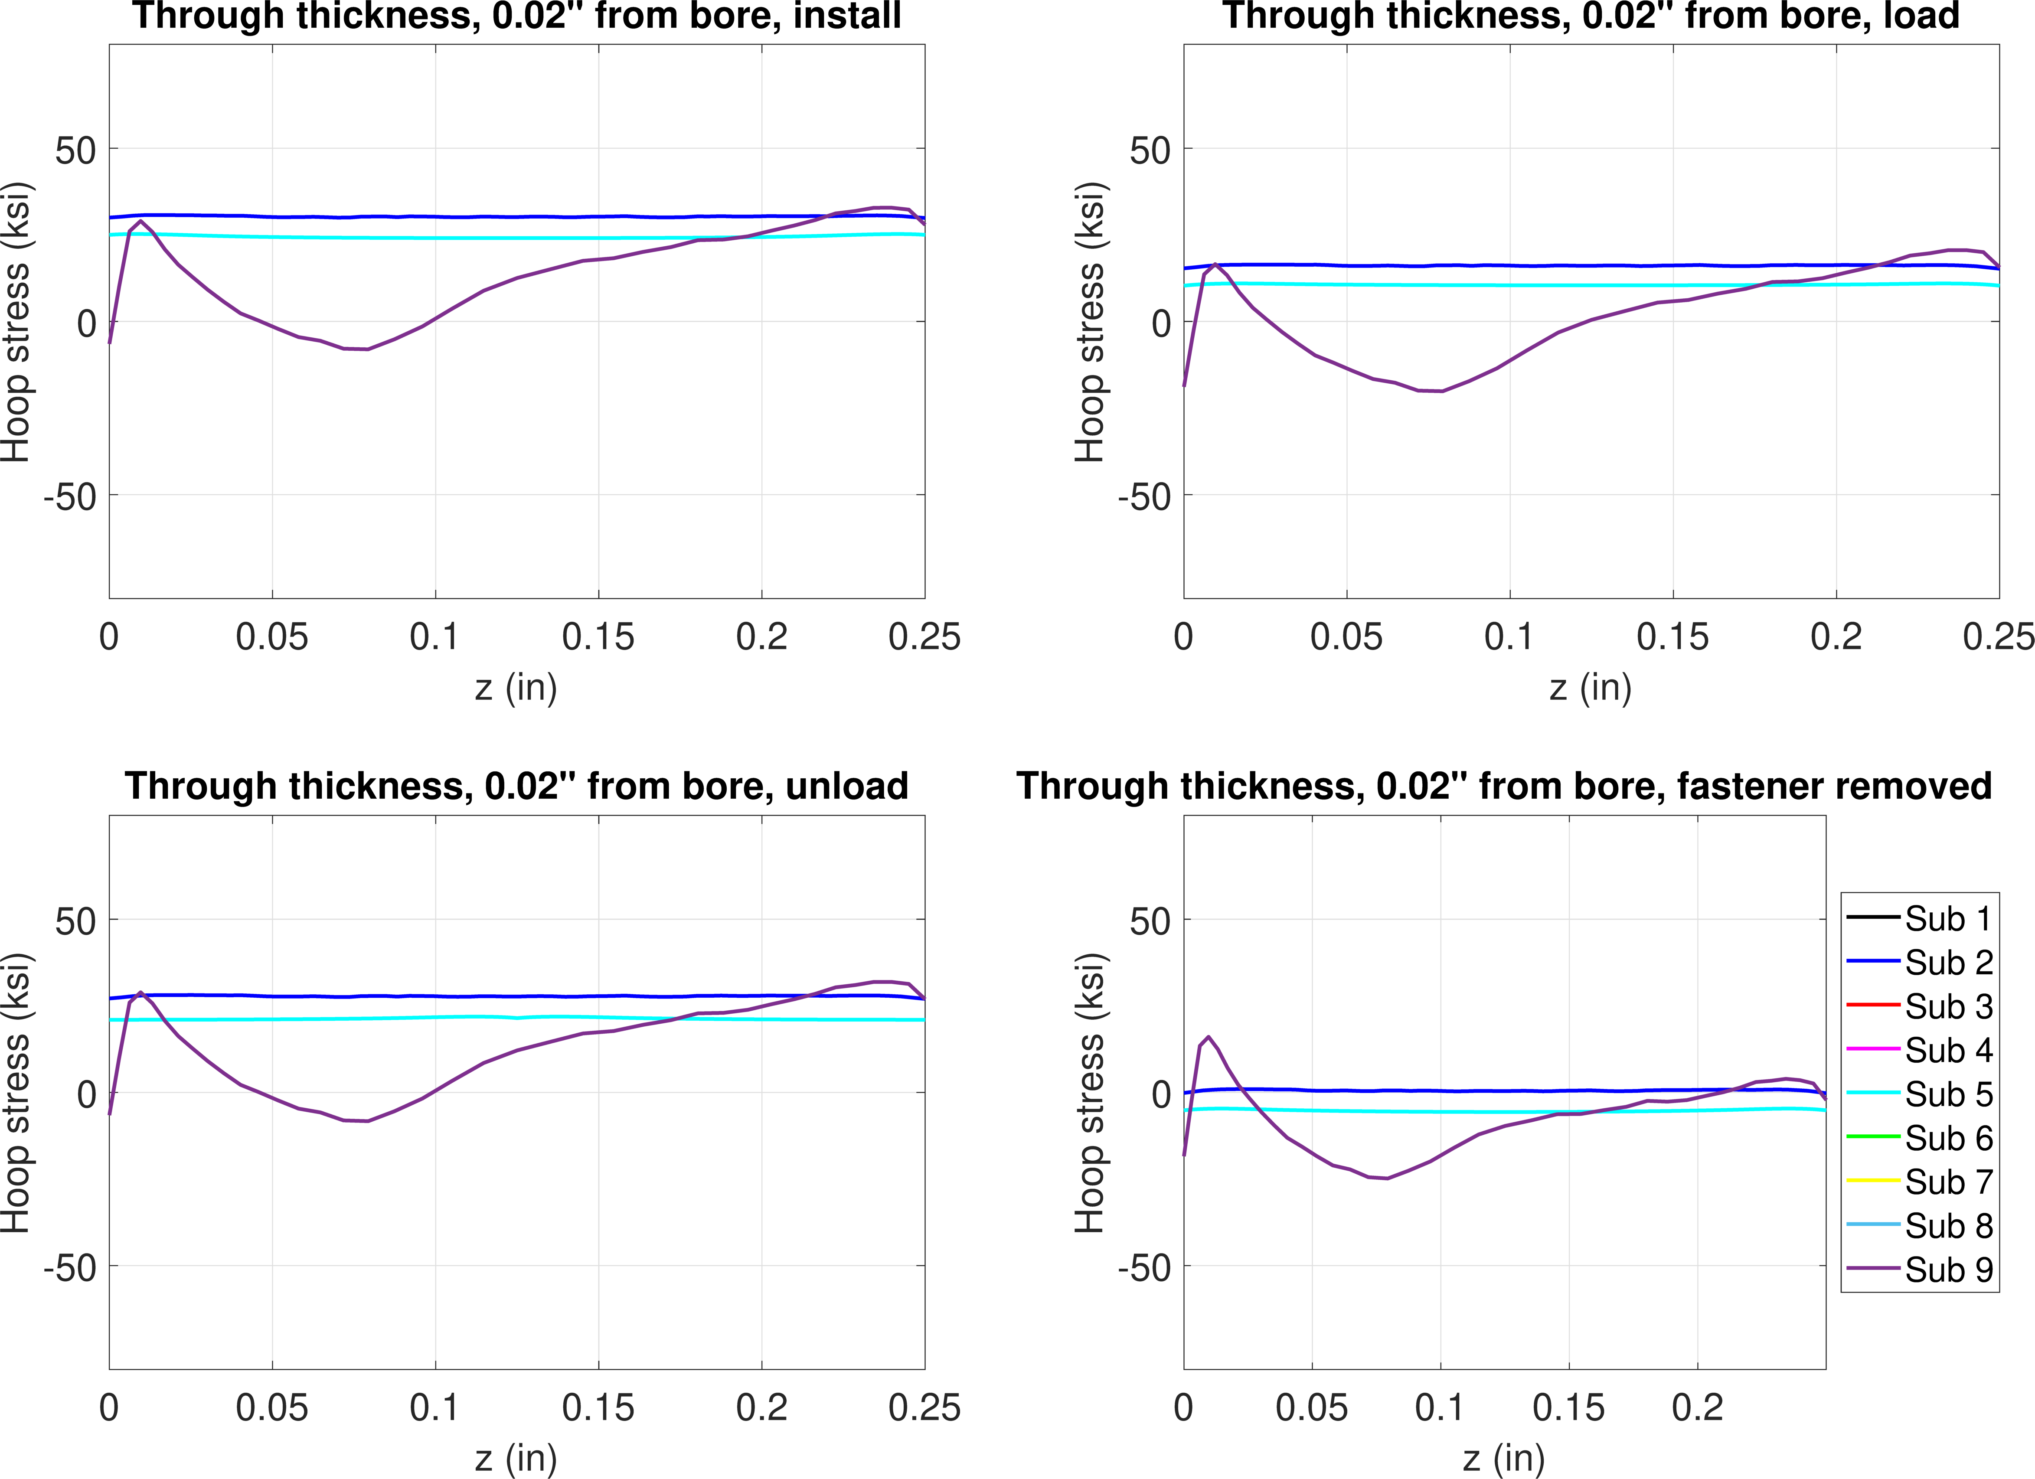
FE model results – 0.6% interference, -10 ksi
Hoop stress, 0.02” from bore
Install
Load
Unload
Remove

Slide 24
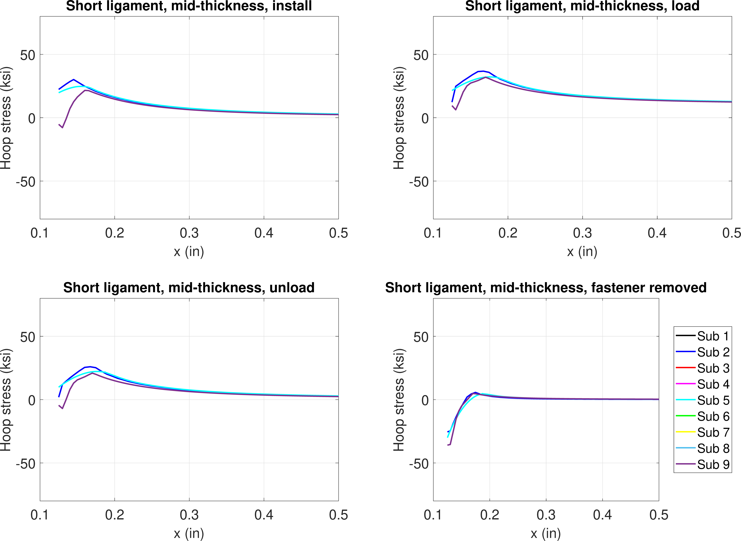
FE model results – 0.6% interference, 10 ksi
Hoop stress, mid-thickness
Install
Load
Unload
Remove

Slide 25
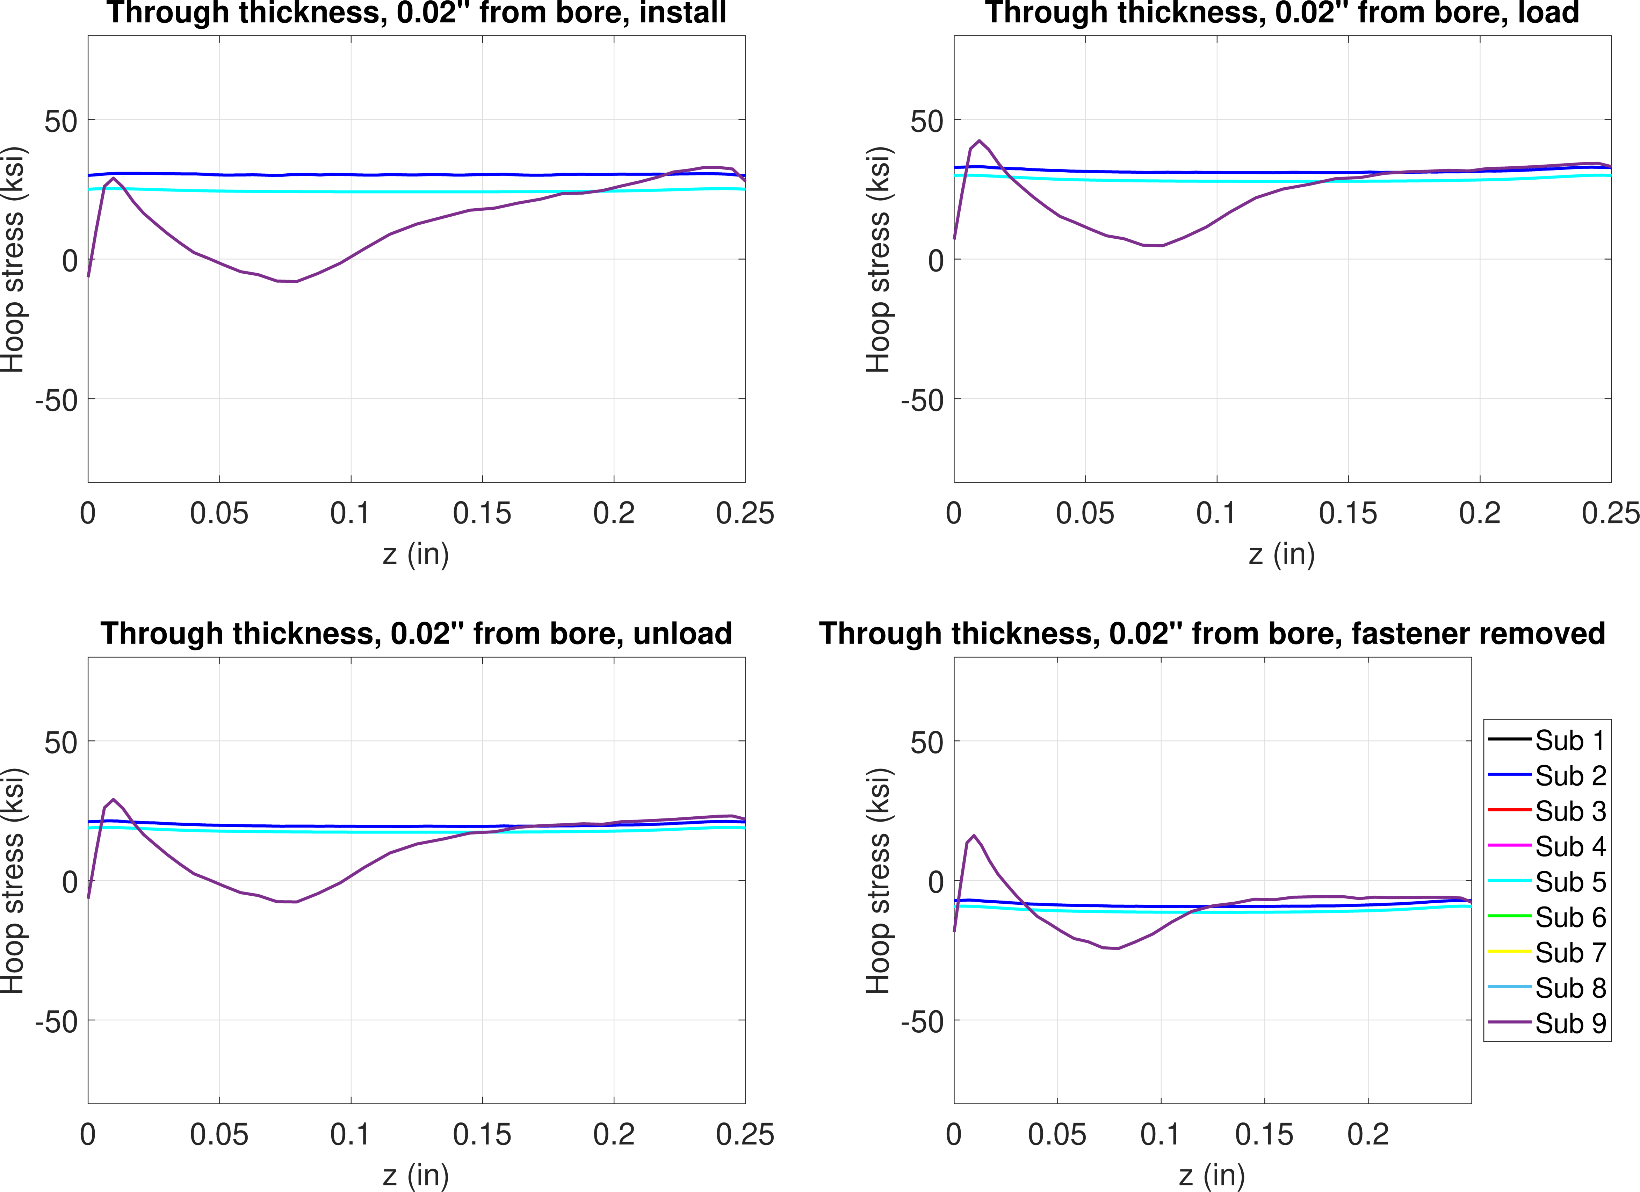
FE model results – 0.6% interference, 10 ksi
Hoop stress, 0.02” from bore
Install
Load
Unload
Remove

Slide 26
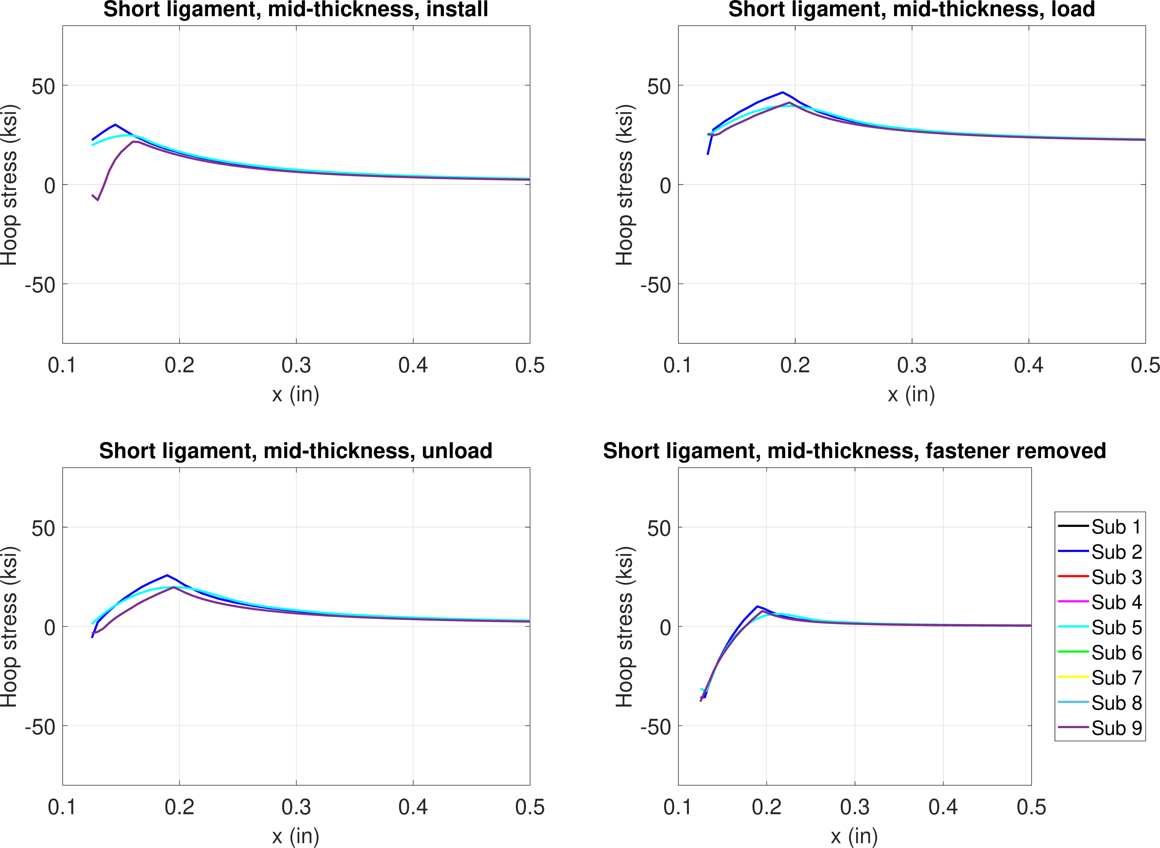
FE model results – 0.6% interference, 20 ksi
Hoop stress, mid-thickness
Install
Load
Unload
Remove

Slide 27
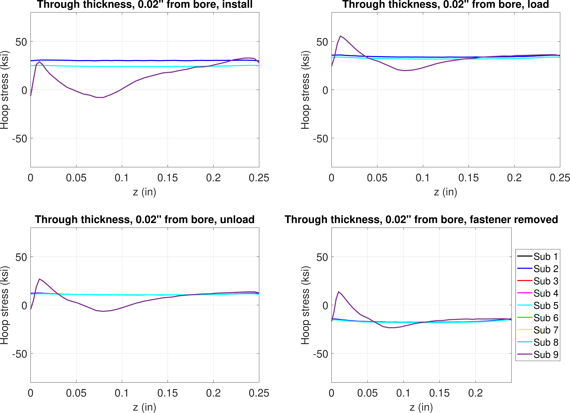
FE model results – 0.6% interference, 20 ksi
Hoop stress, 0.02” from bore
Install
Load
Unload
Remove

Slide 28
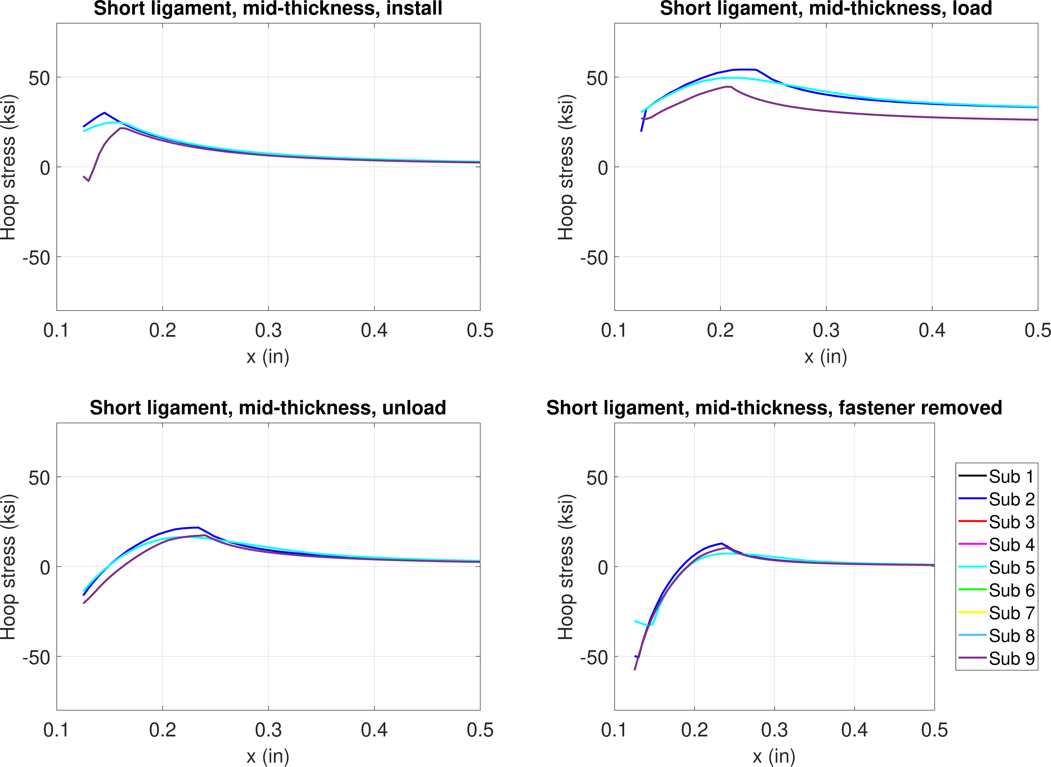
FE model results – 0.6% interference, 30 ksi
Hoop stress, mid-thickness
Install
Load
Unload
Remove

Slide 29
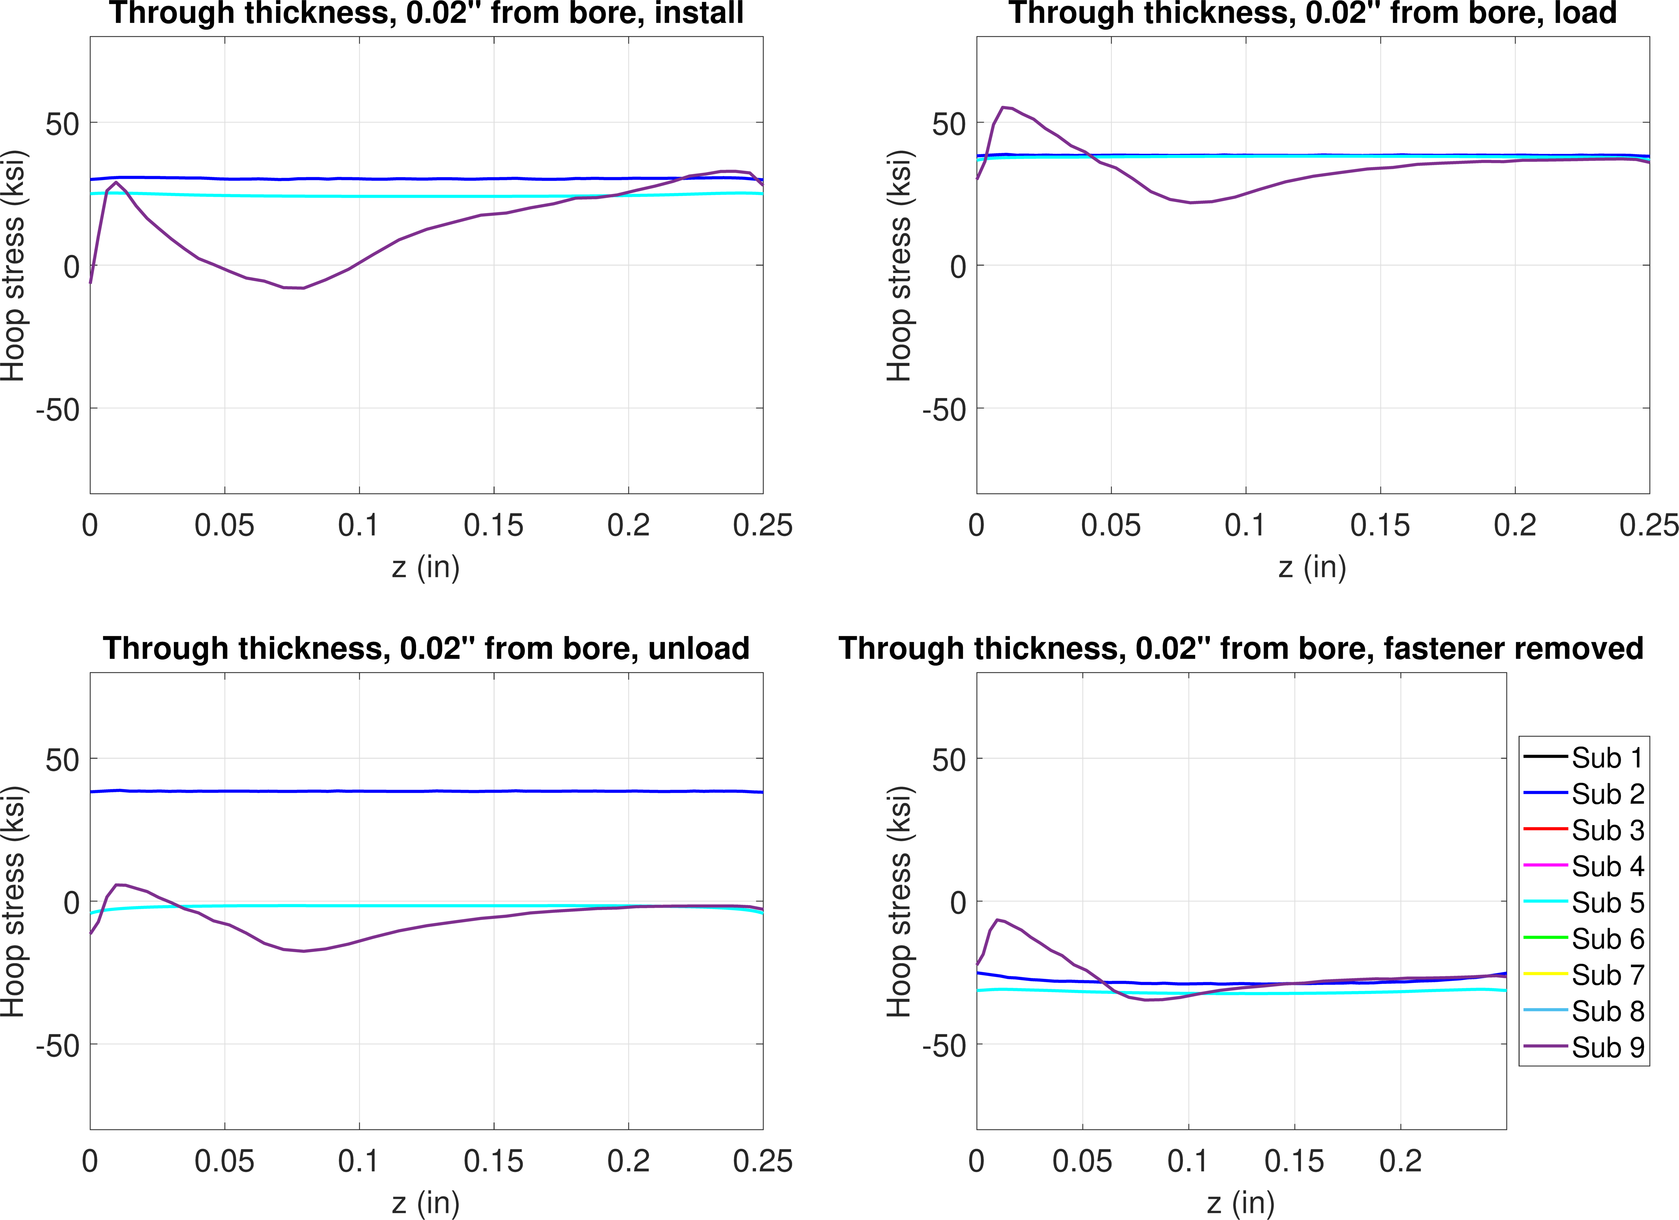
FE model results – 0.6% interference, 30 ksi
Hoop stress, 0.02” from bore
Install
Load
Unload
Remove

Slide 30
1.2% interference
Step 1 – pin install
Step 2 – remote loading
Step 3 – unload
Step 4 – remove pin

Slide 31
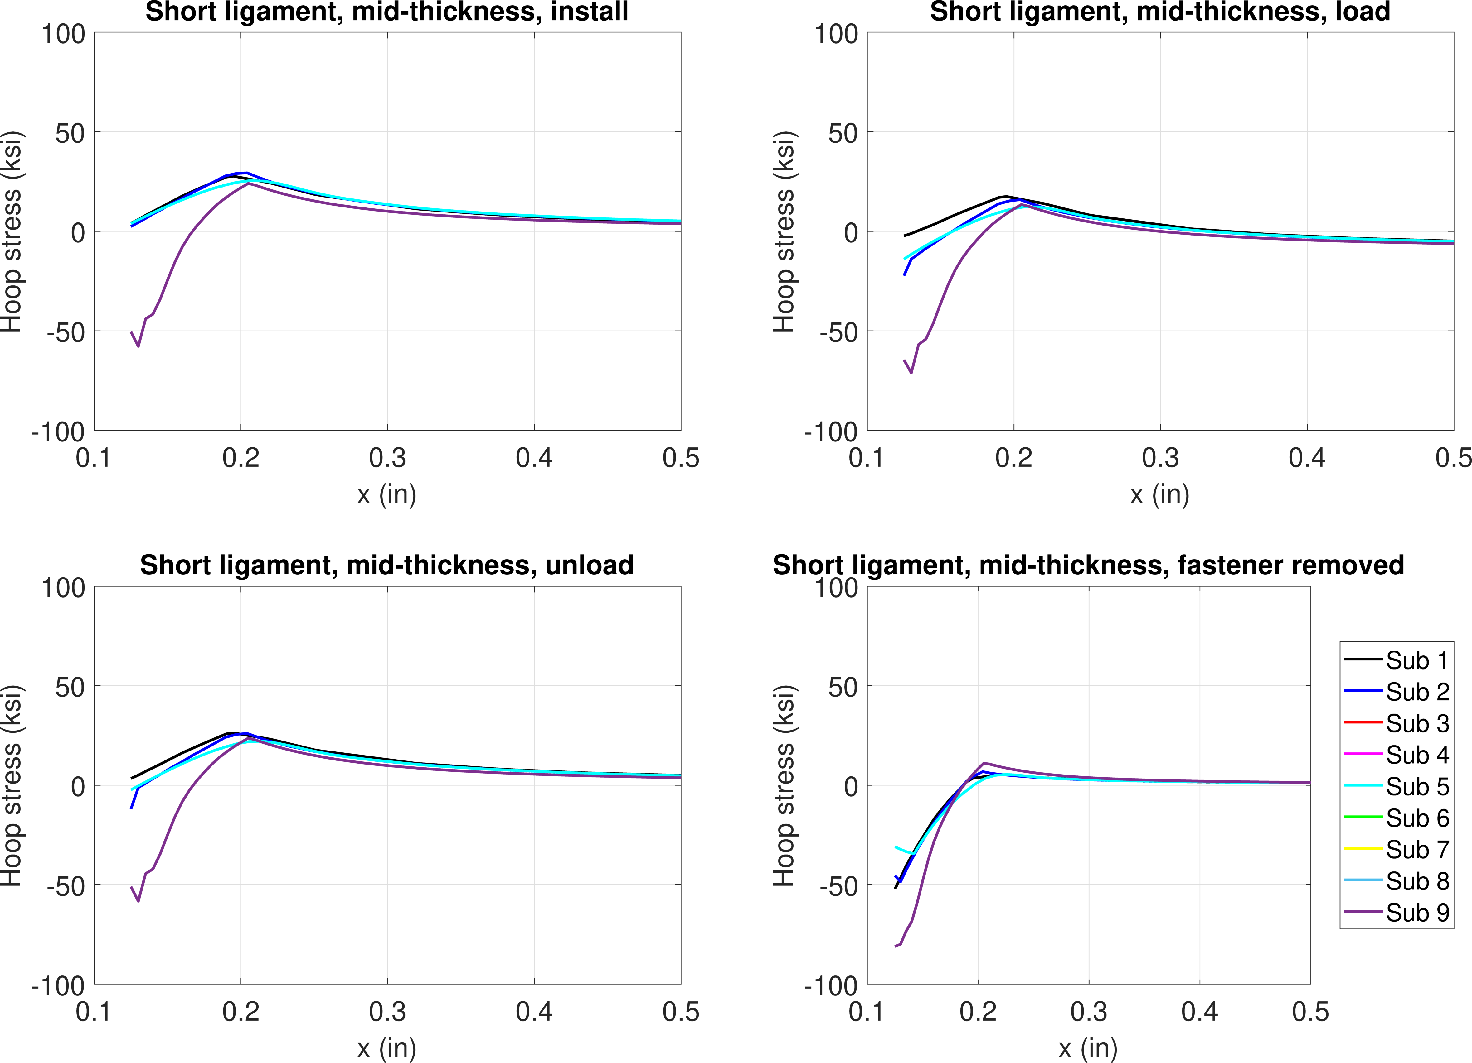
FE model results – 1.2% interference, -10 ksi
Hoop stress, mid-thickness
More plasticity from installation
Install
Load
Unload
Remove

Slide 32
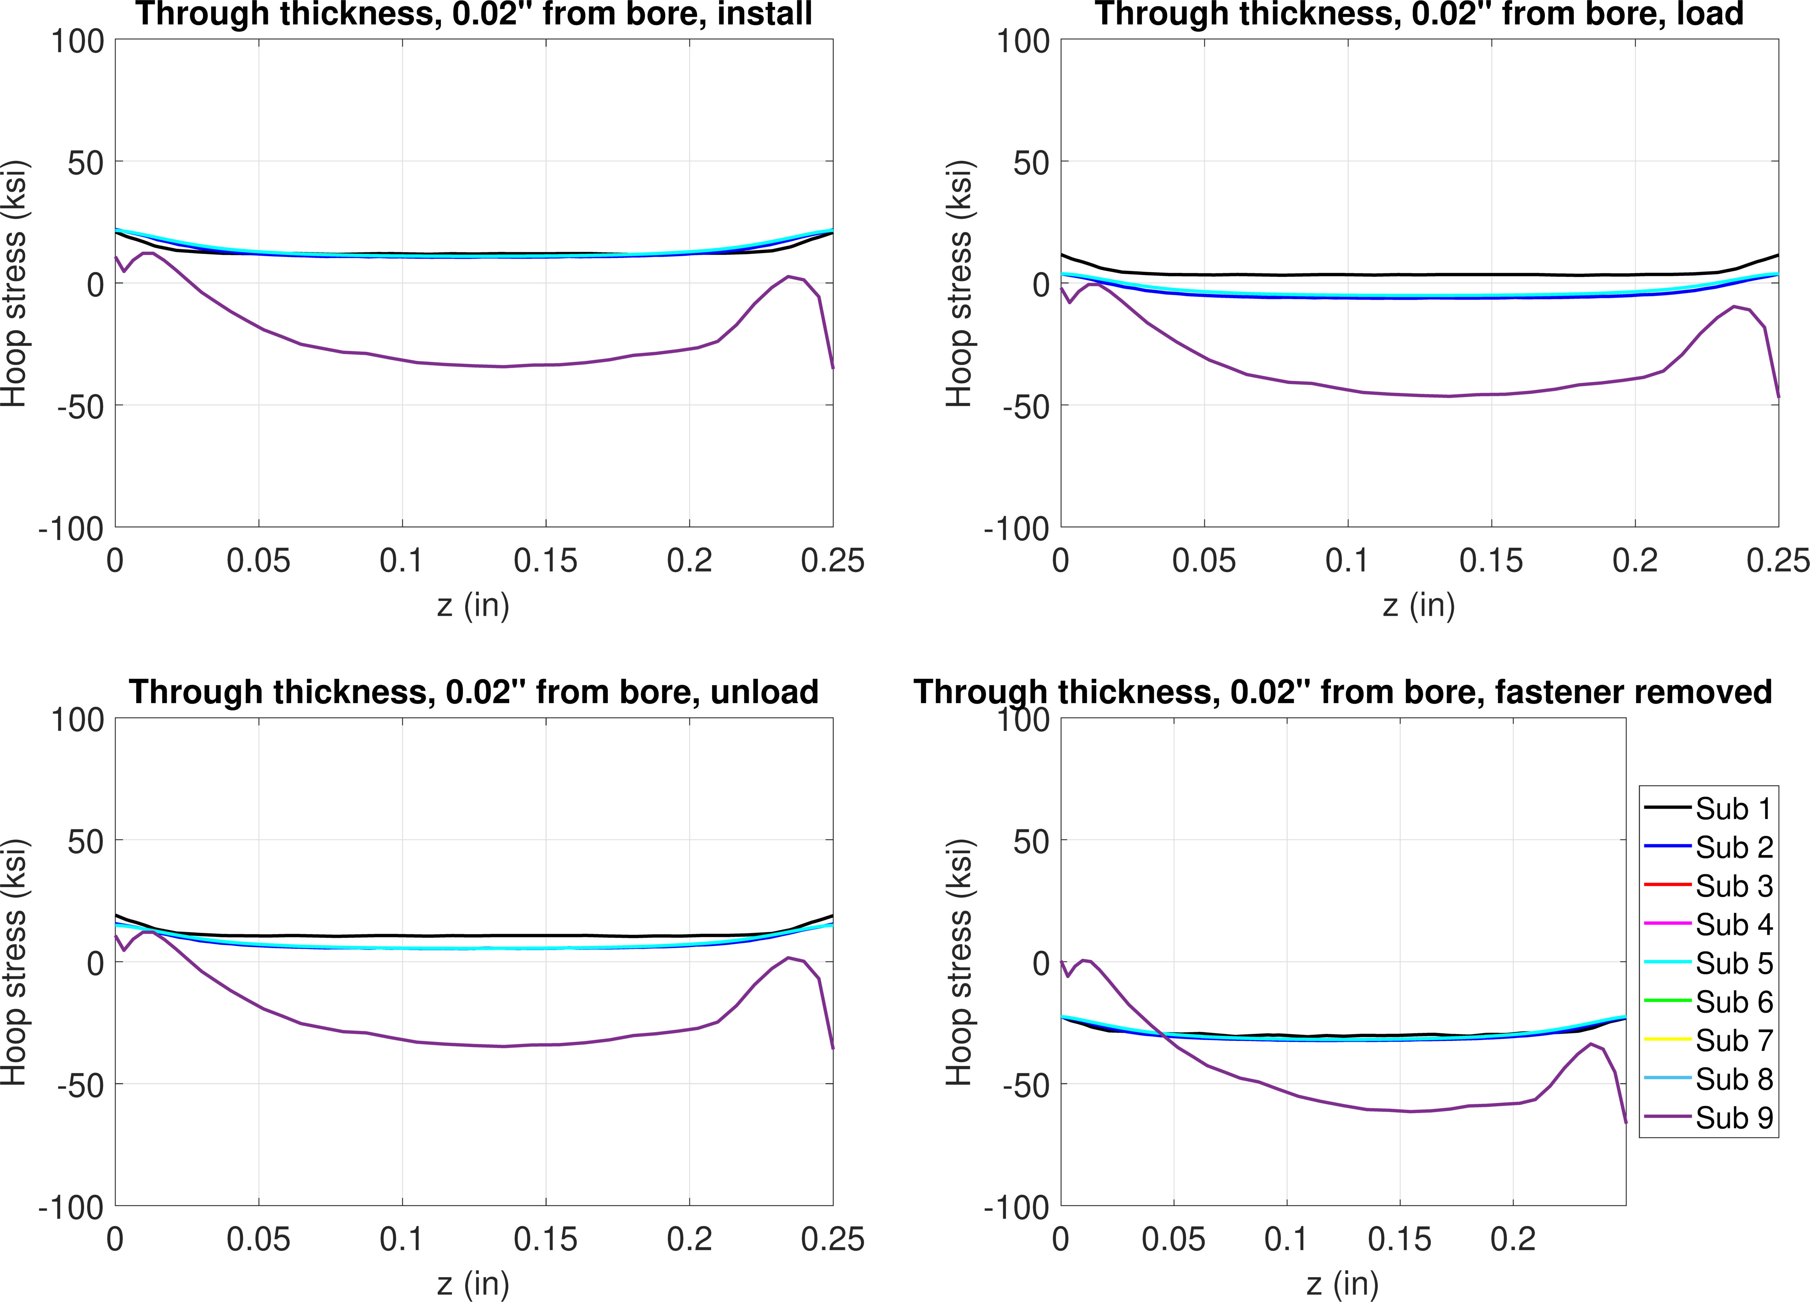
FE model results – 1.2% interference, -10 ksi
Hoop stress, 0.02” from bore
Install
Load
Unload
Remove

Slide 33
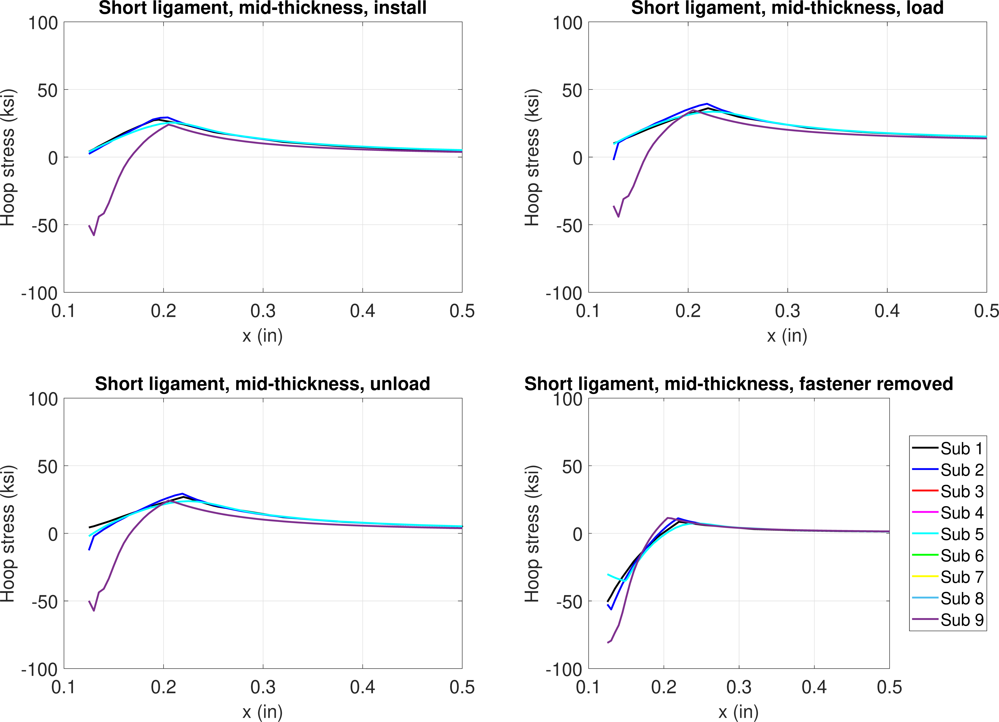
FE model results – 1.2% interference, 10 ksi
Hoop stress, mid-thickness
Install
Load
Unload
Remove

Slide 34
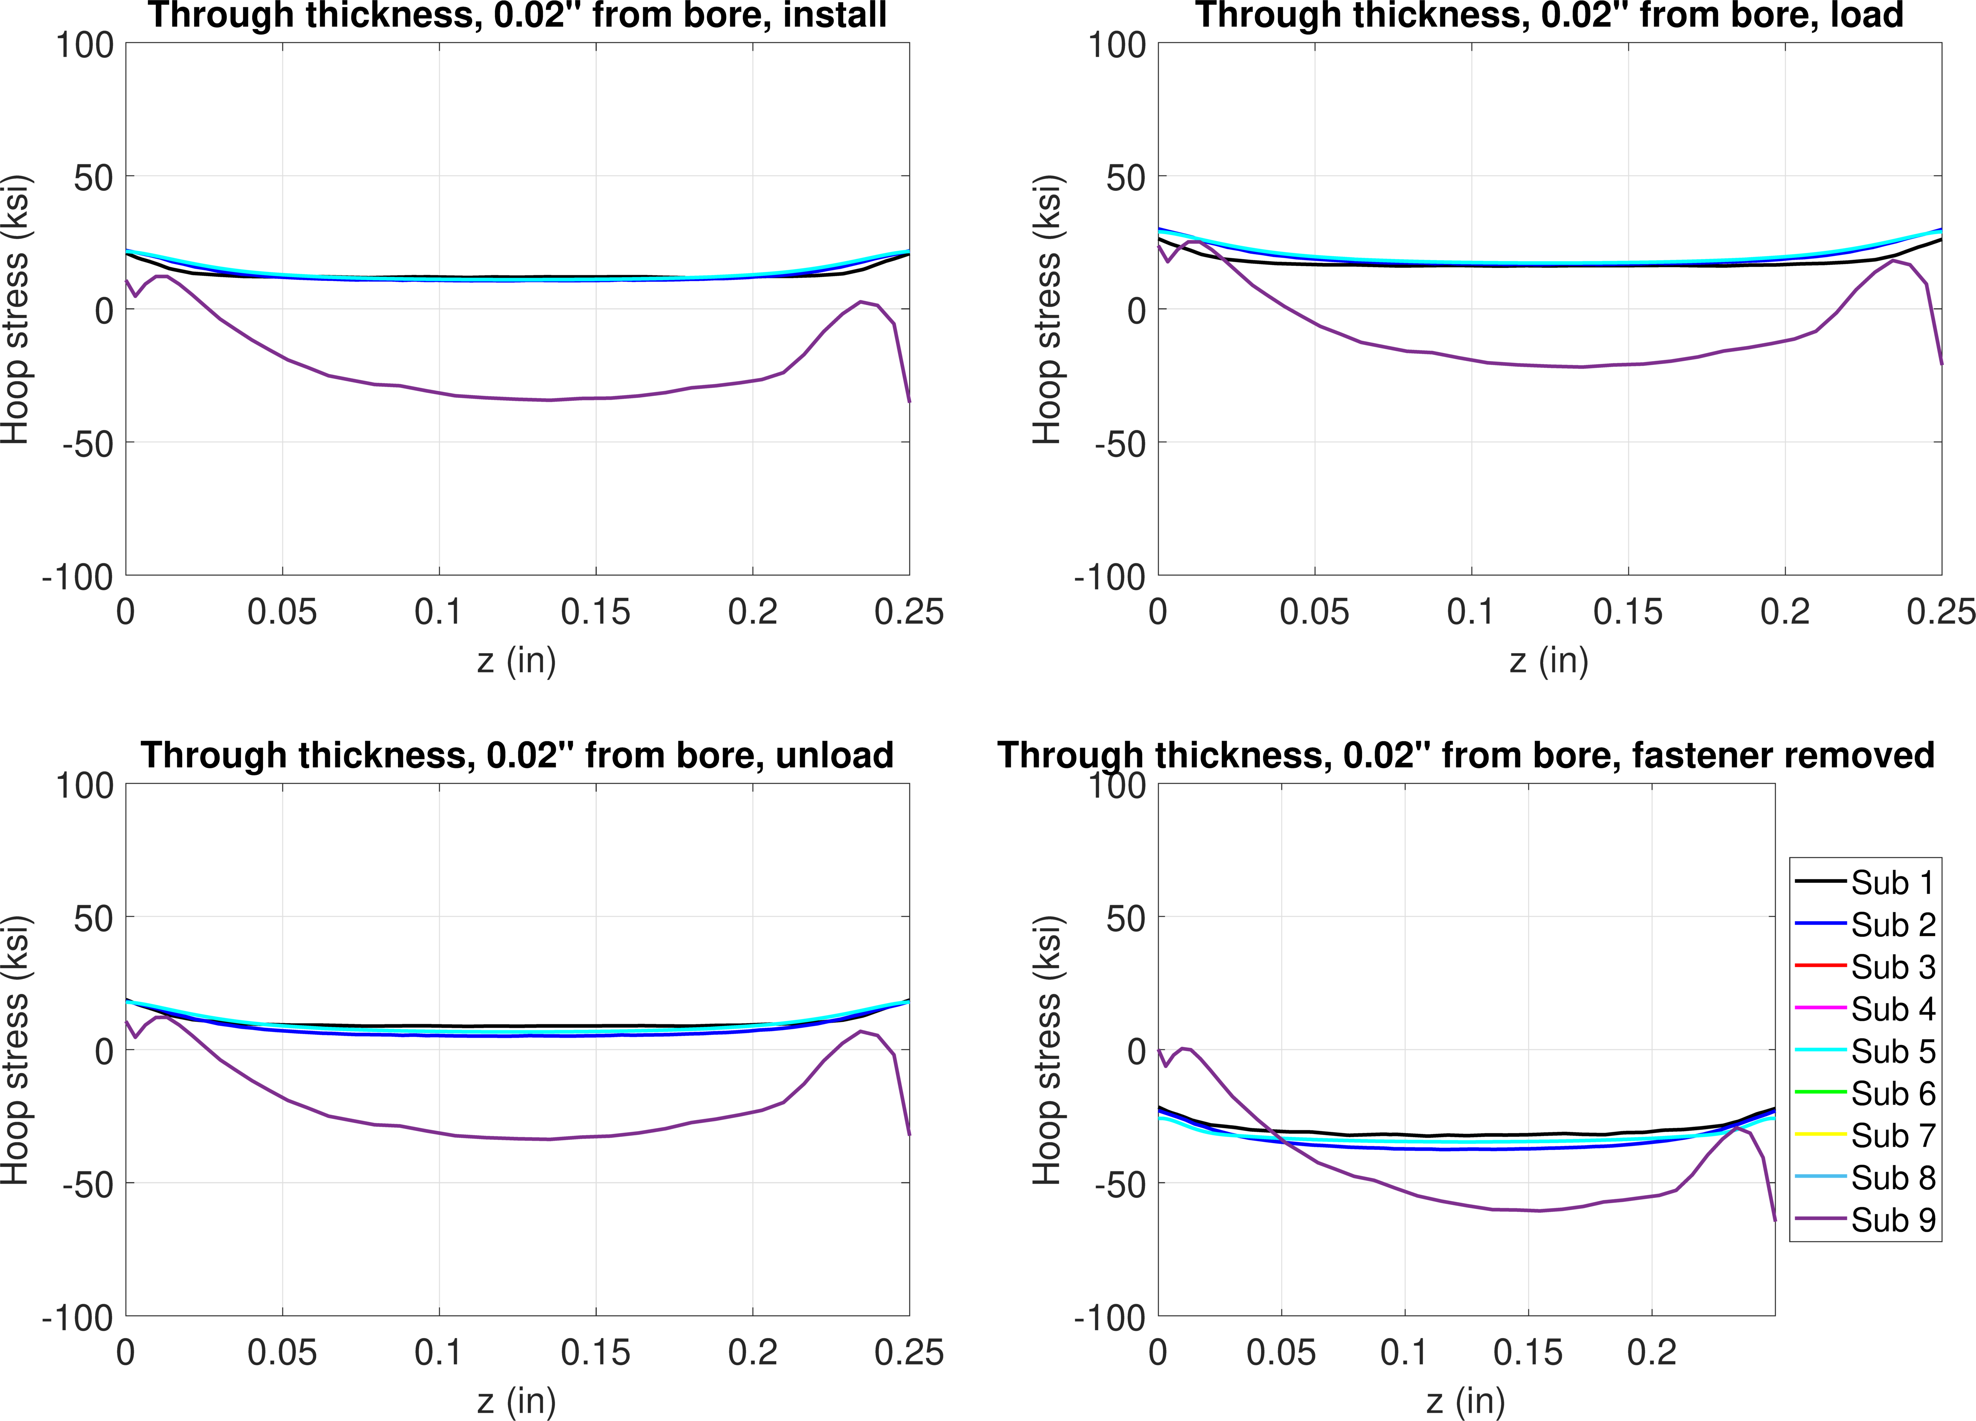
FE model results – 1.2% interference, 10 ksi
Hoop stress, 0.02” from bore
Install
Load
Unload
Remove

Slide 35
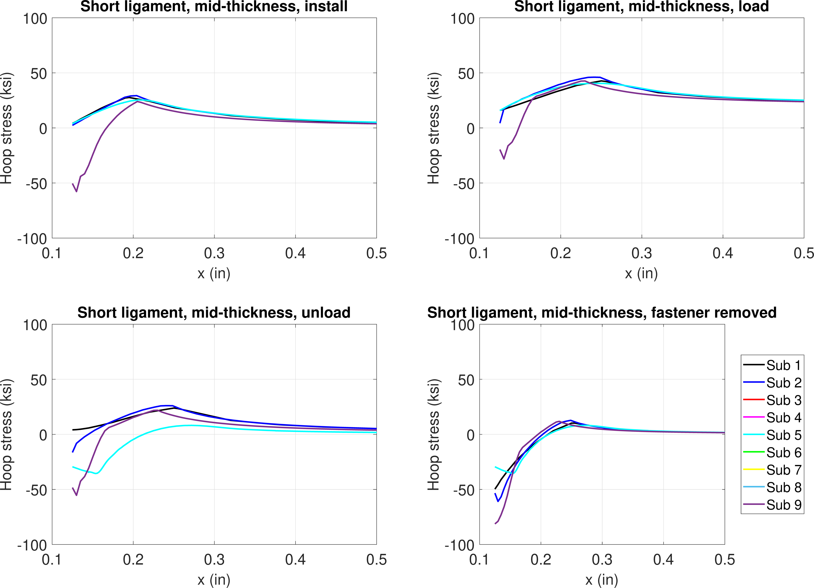
FE model results – 1.2% interference, 20 ksi
Hoop stress, mid-thickness
Install
Load
Unload
Remove

Slide 36
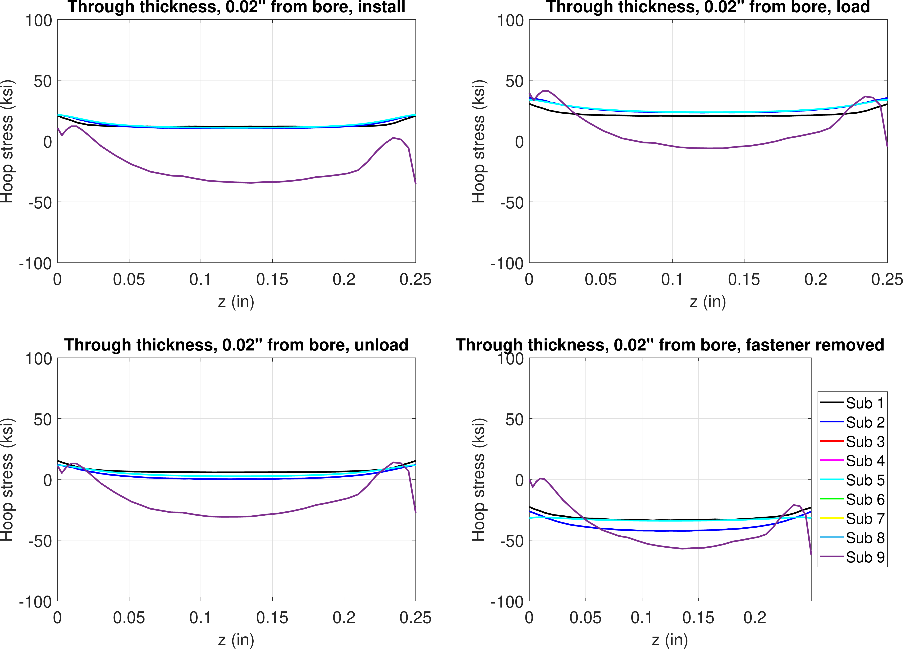
FE model results – 1.2% interference, 20 ksi
Hoop stress, 0.02” from bore
Install
Load
Unload
Remove

Slide 37
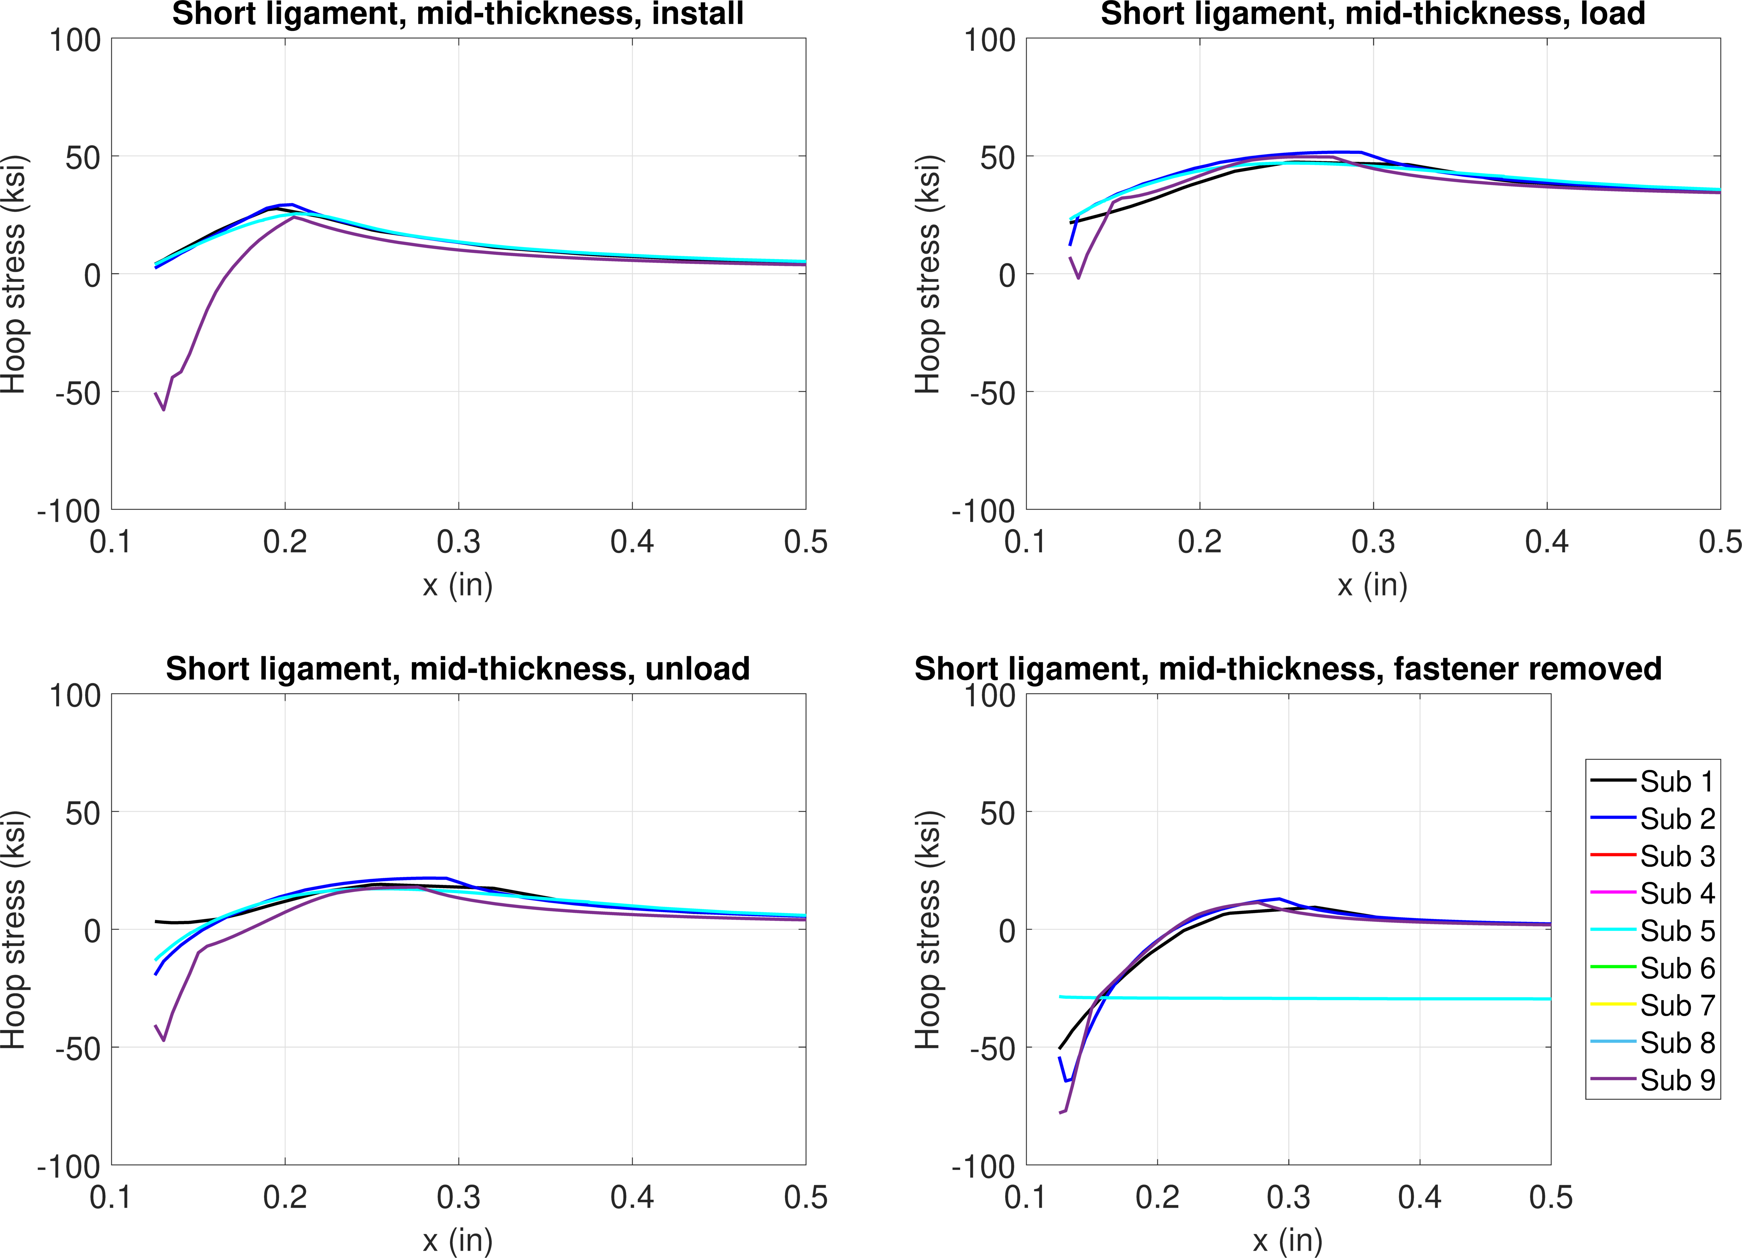
FE model results – 1.2% interference, 30 ksi
Hoop stress, mid-thickness
Install
Load
Unload
Remove

Slide 38
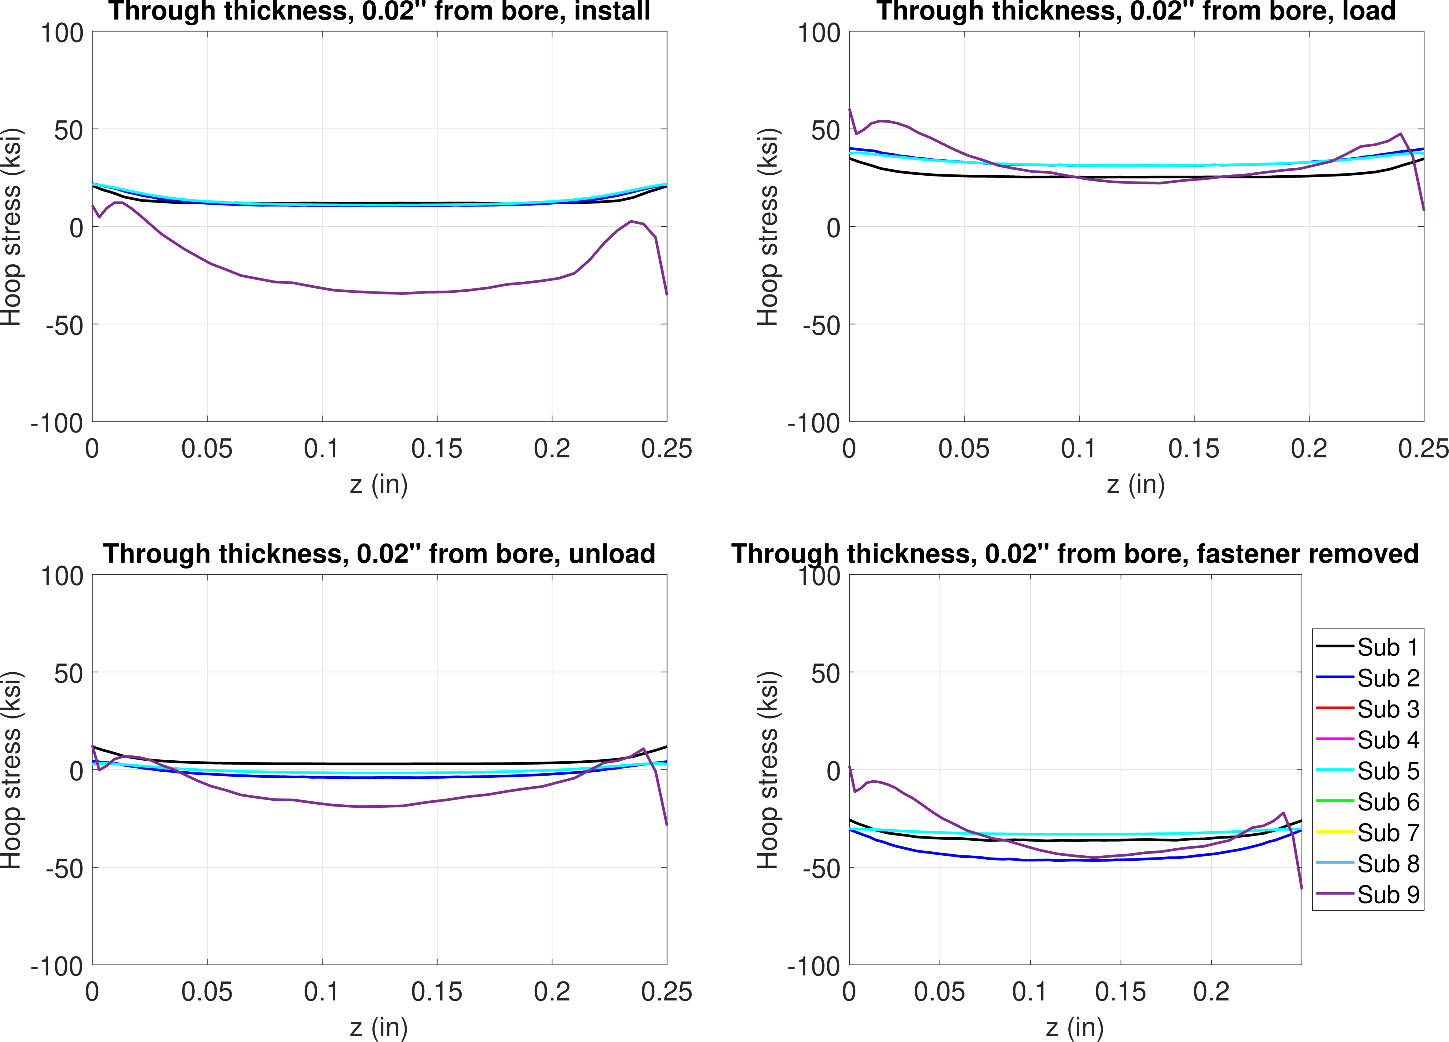
FE model results – 1.2% interference, 30 ksi
Hoop stress, 0.02” from bore
Install
Load
Unload
Remove

Slide 39
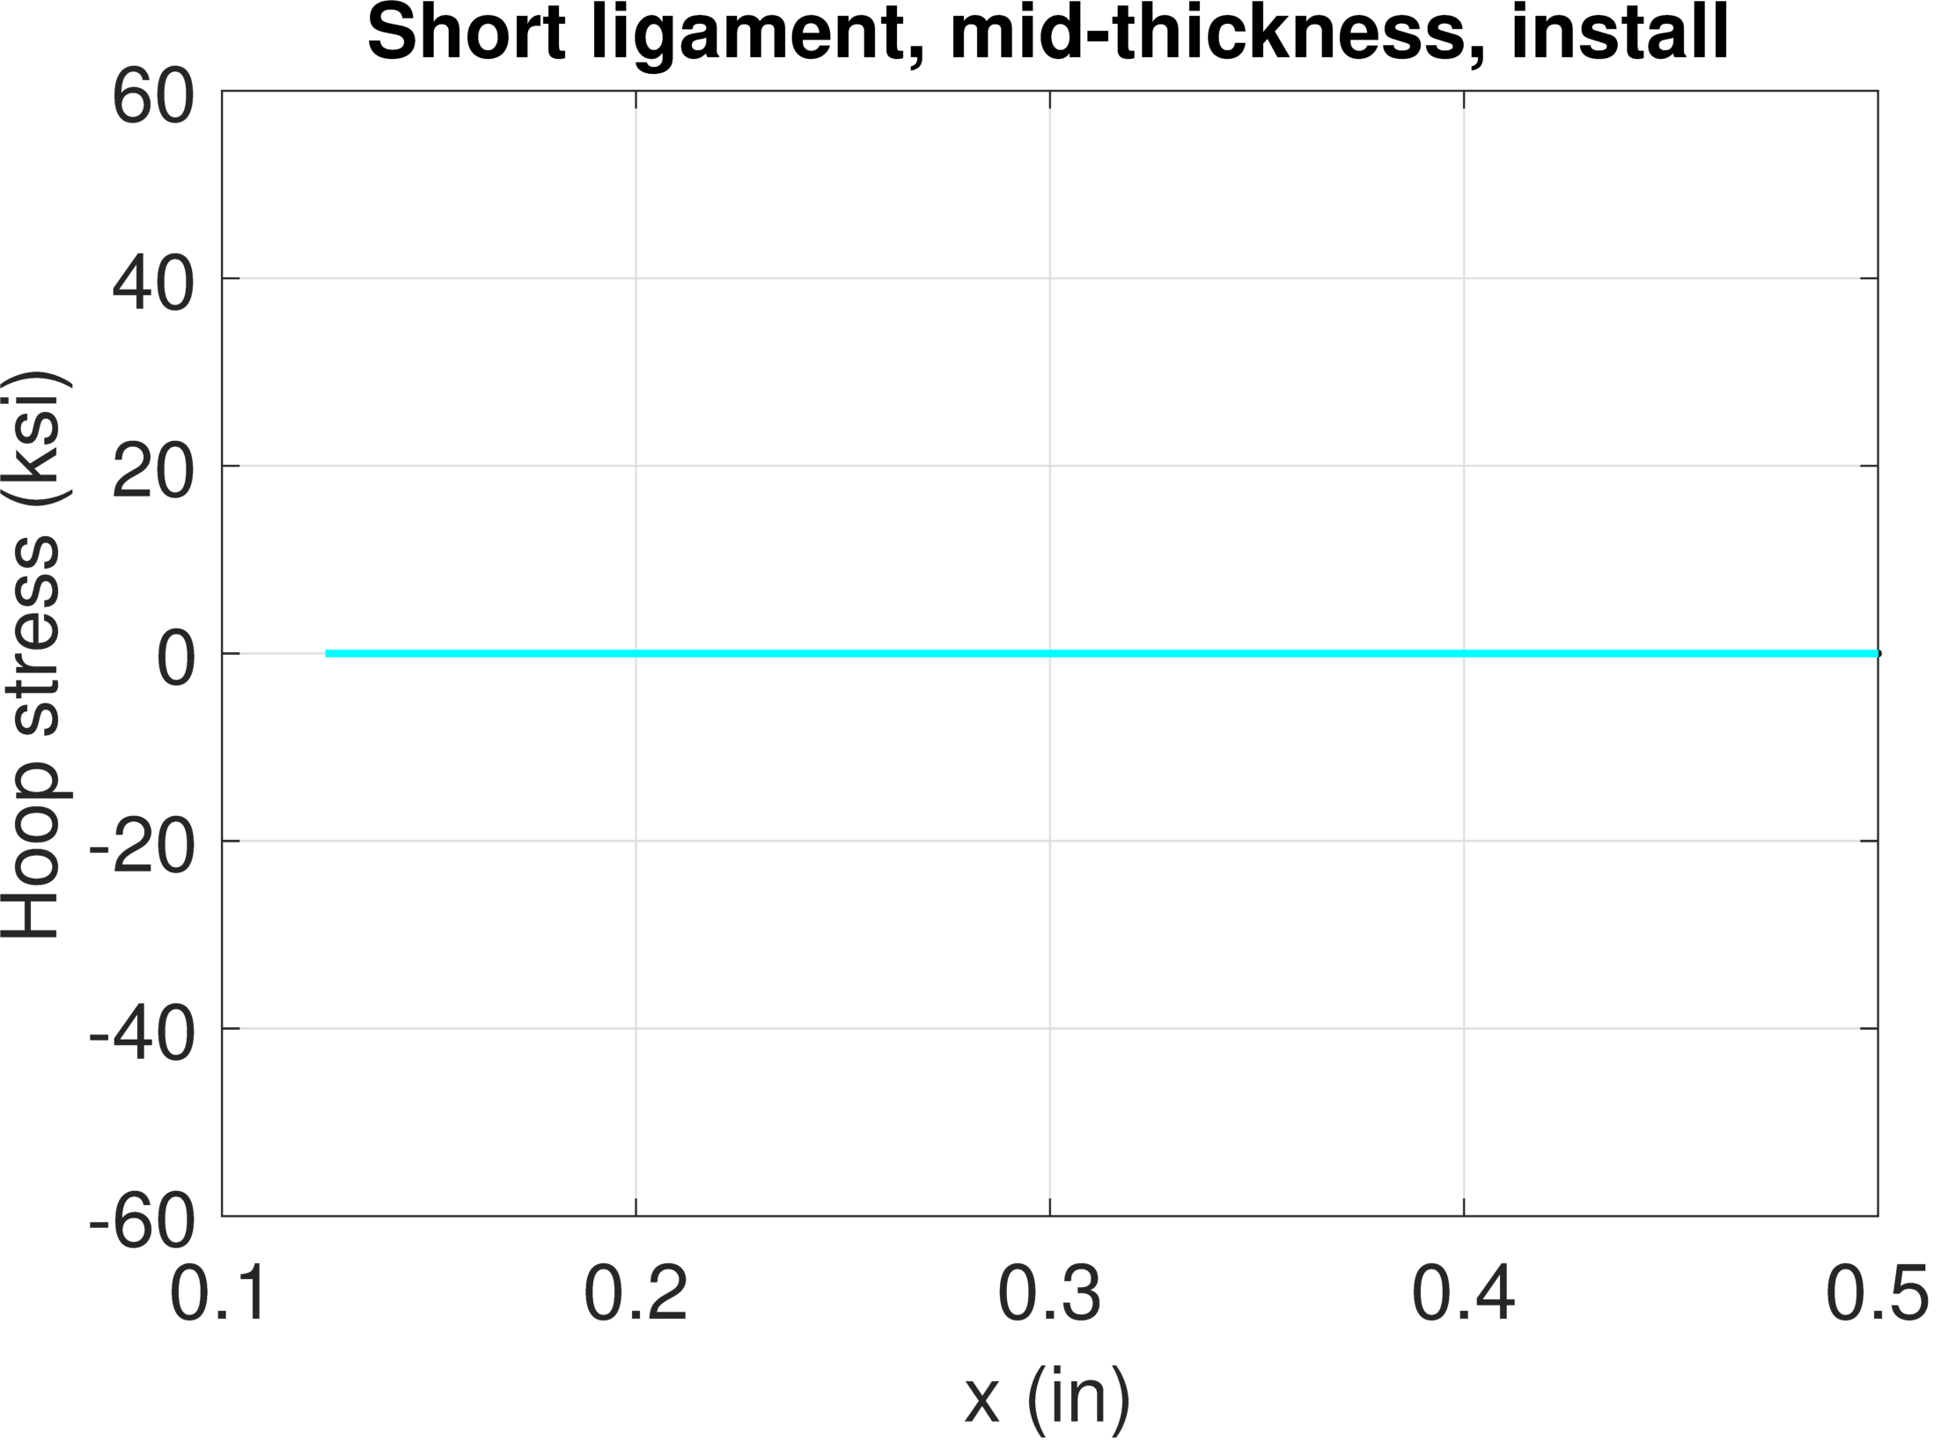
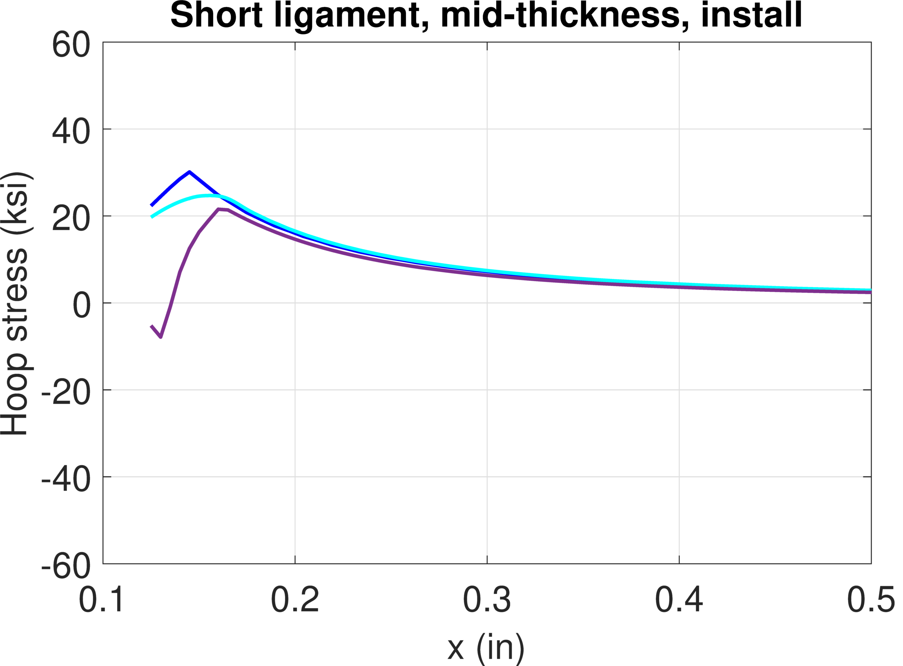
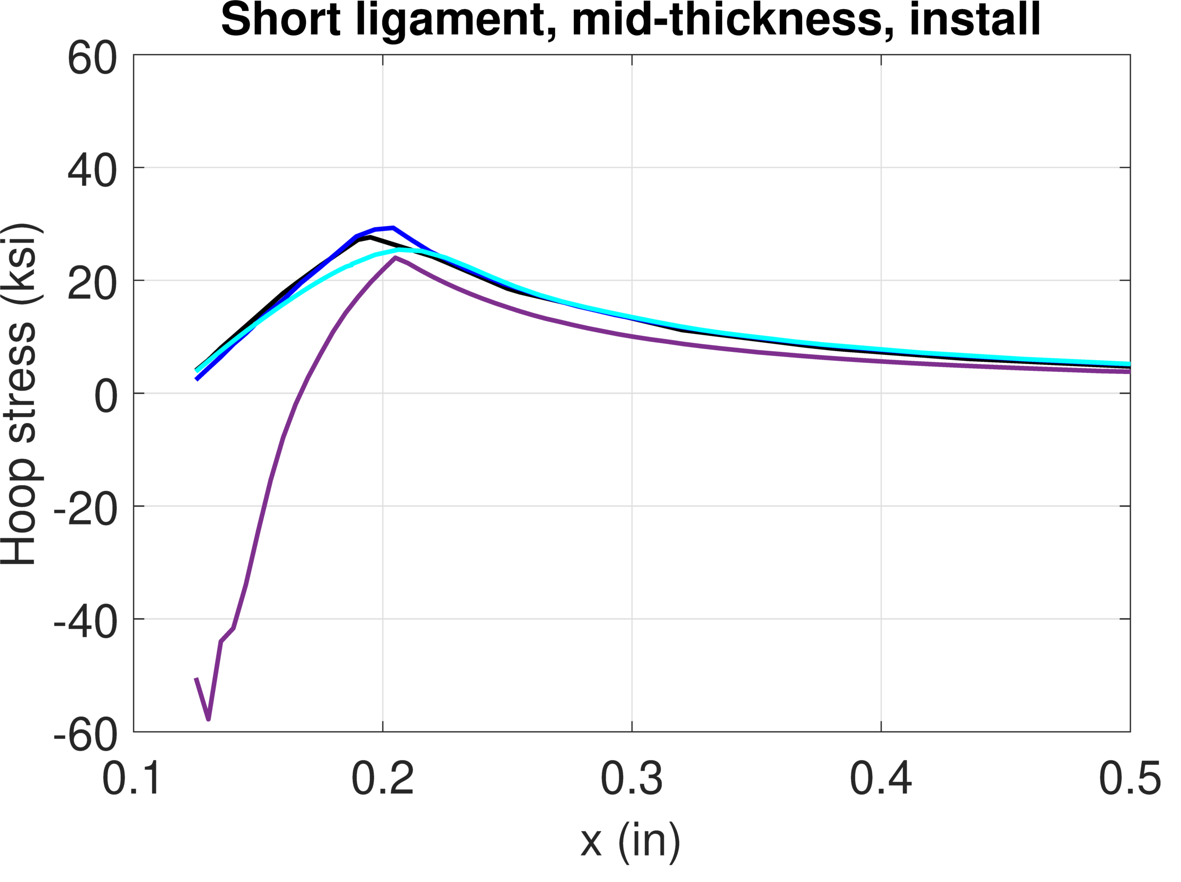
Comparisons
Stress from installation for all conditions below
  At mid-thickness
No stress
Elastic
Plasticity
More plasticity
Neat fit
0.3% interf.
0.6% interf.
1.2% interf.

Slide 40
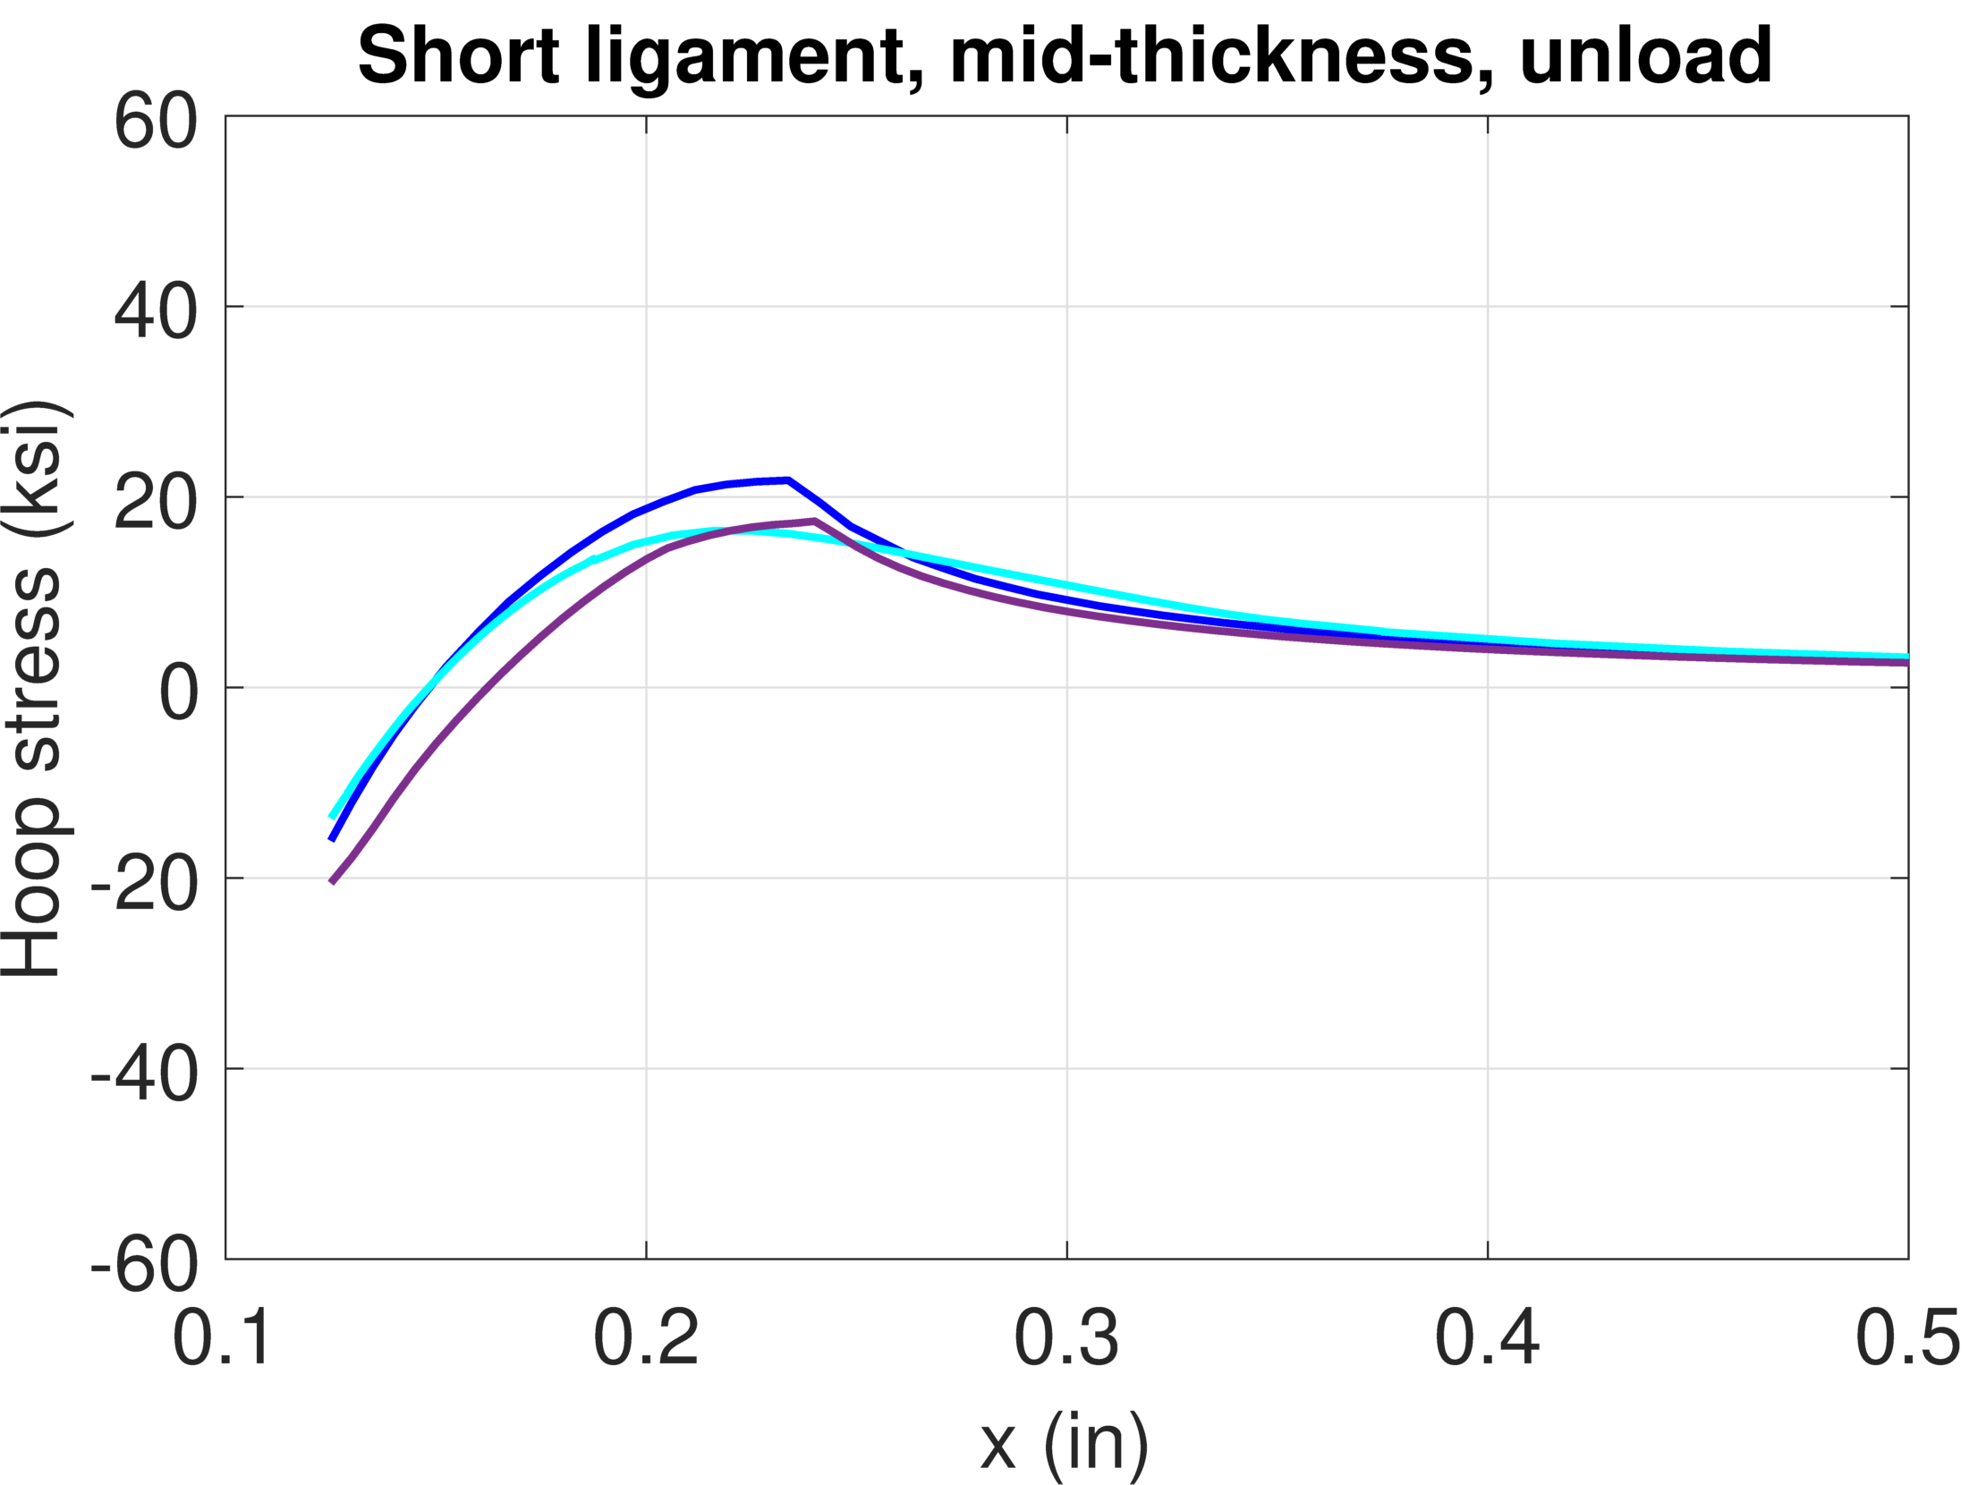
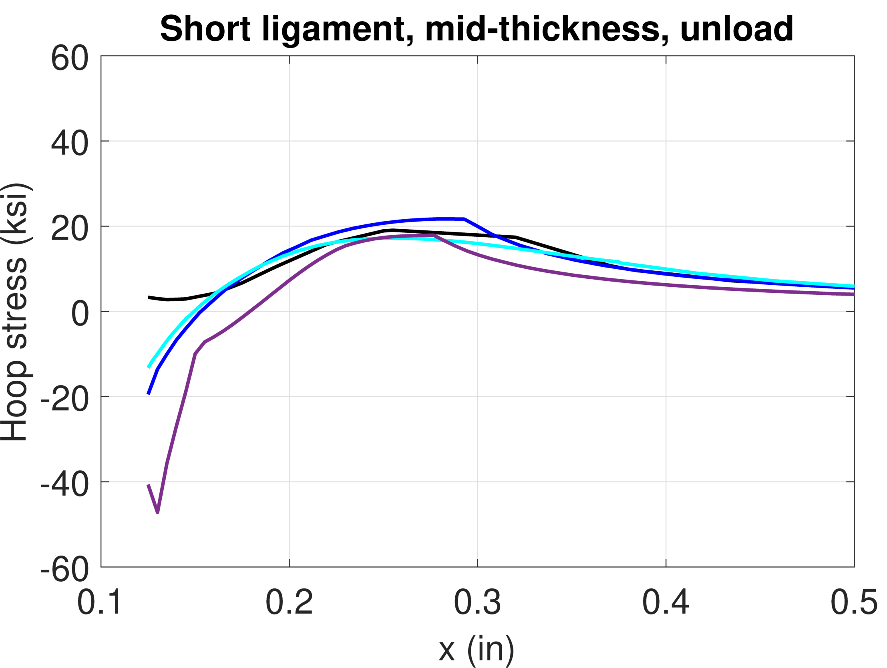
Comparisons
Stress after loading and unloading for all conditions below
  At mid-thickness
  Load to 30 ksi, then unload (fastener is still installed)
Neat fit
0.3% interf.
0.6% interf.
1.2% interf.

