Slide 1
Interference Fit Fastener – Working Group
Working Group on
Engineered Residual Stress Implementation
Robert Pilarczyk
rtpilarczyk@hill-engineering.com

Slide 2
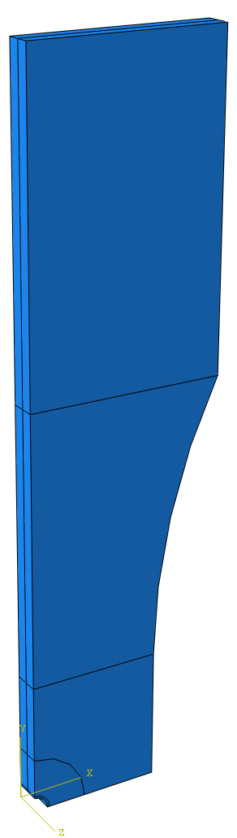
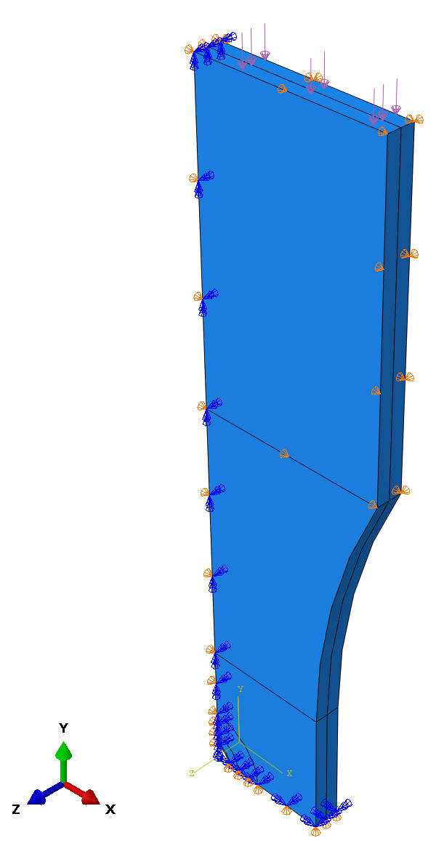
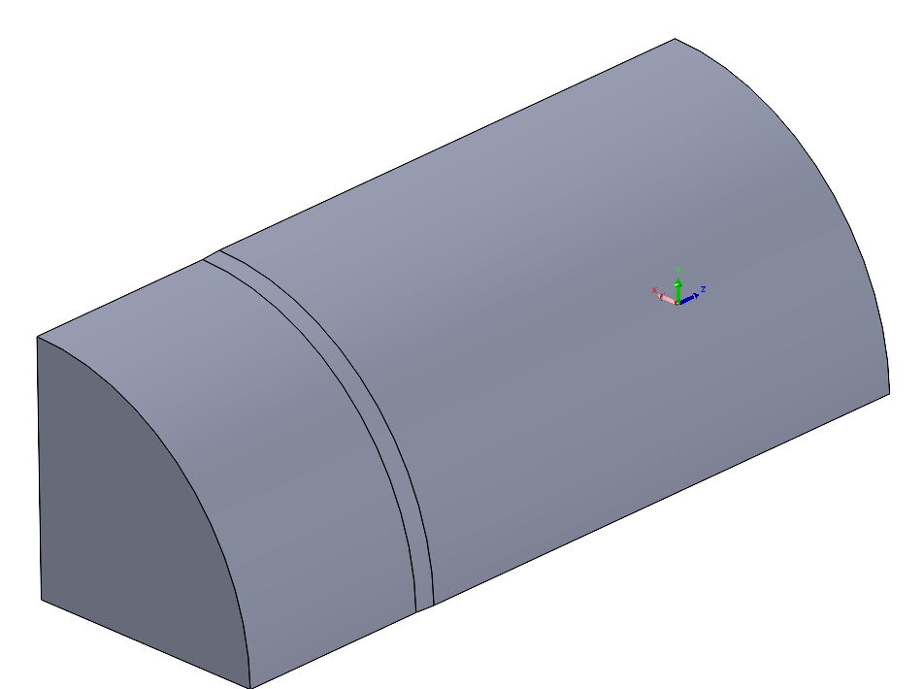
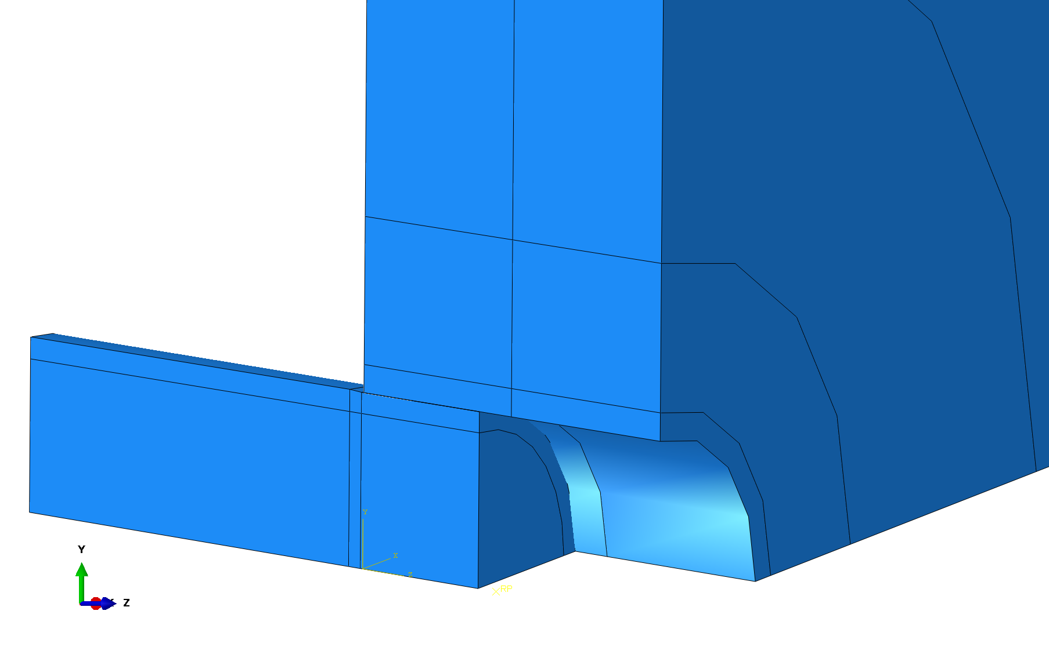
FE model – fastener installation
Abaqus 3D model, quarter-symmetric
Boundary conditions below
Frictionless contact between pin and bore
Incrementally push the oversized pin into the hole
Hole diameter = 0.25”
Min pin diameter = 0.25”
Max pin diameter set to give desired interference
Transition chamfer length constant at 0.025”
Results in different chamfer angles for different interference
Also ran the models with a more aggressive chamfer
12.7 deg constant angle at transition
x,z fixed on back surf.
Quarter-symmetric pin
x fixed on this surf.
Chamfer 0.025” length
x symmetry
Bore surface
Push pin in along this direction
y symmetry

Slide 3
0.3% interference
Step 1 – push pin in
Step 2 – remove pin

Slide 4
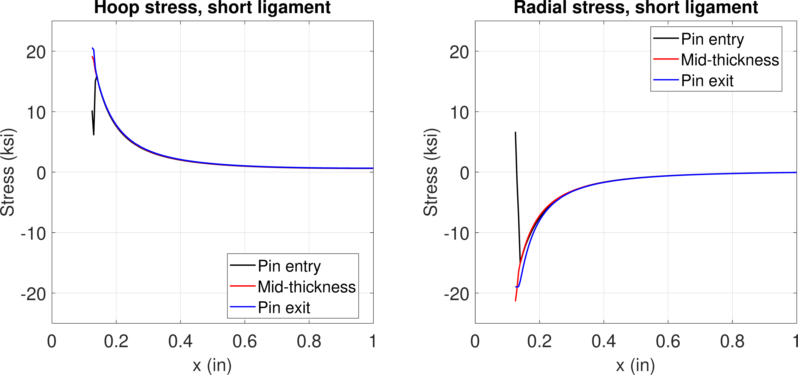
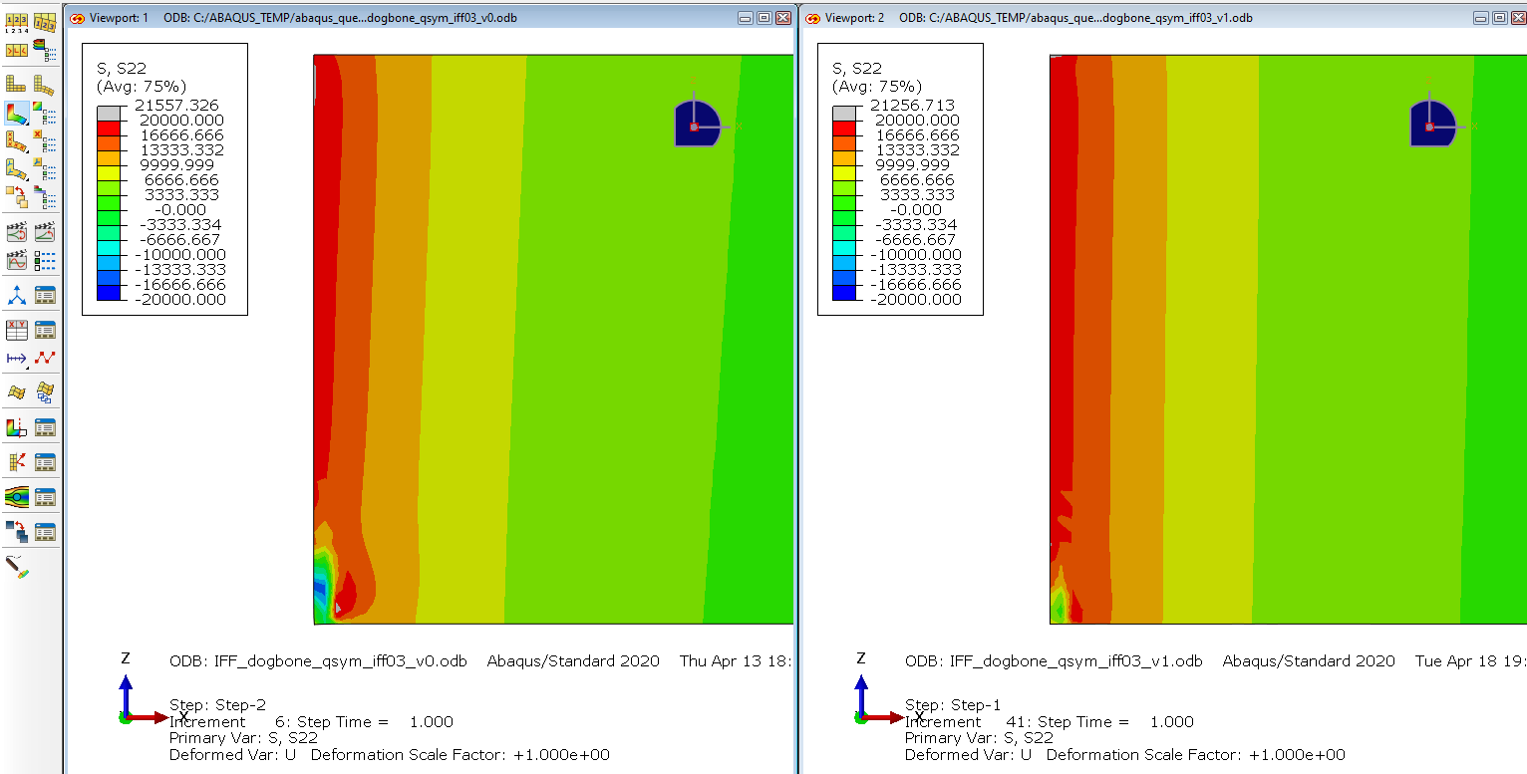
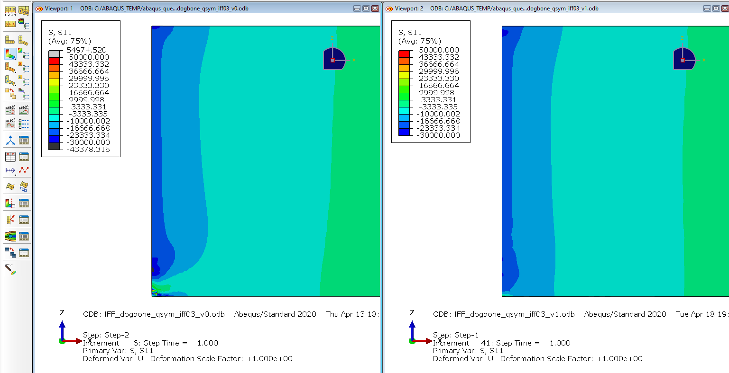
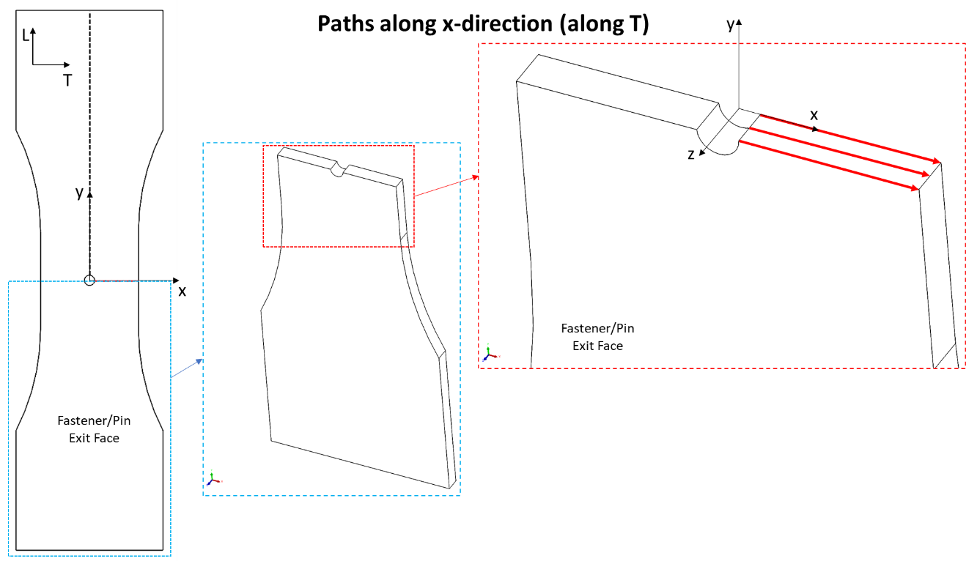
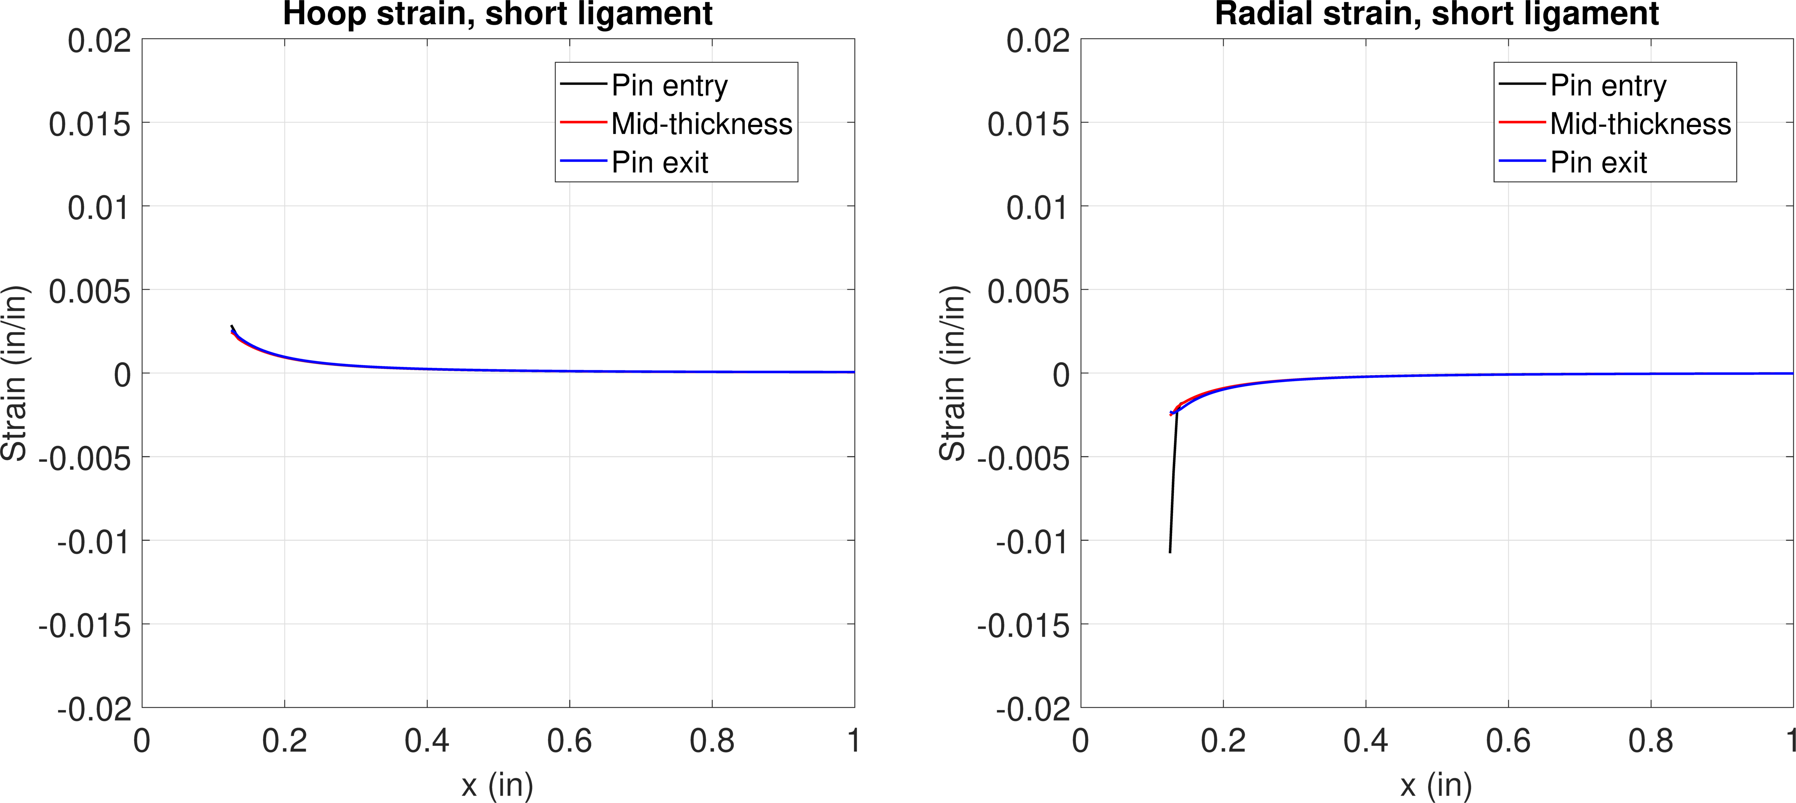
FE model results – 0.3% interf.
Hoop
Radial
Step 1
Pin installed
Stress
Hoop stress
Radial stress
Strain

Slide 5
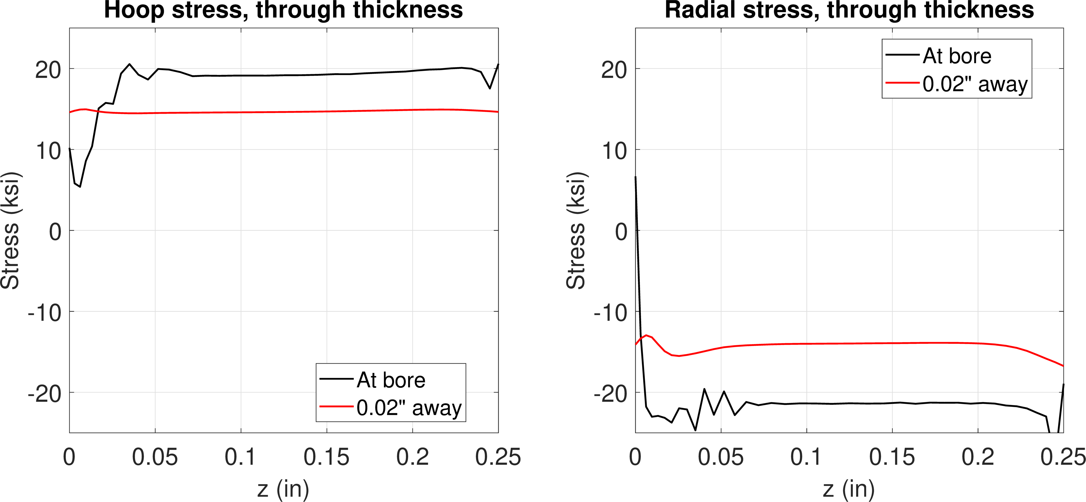
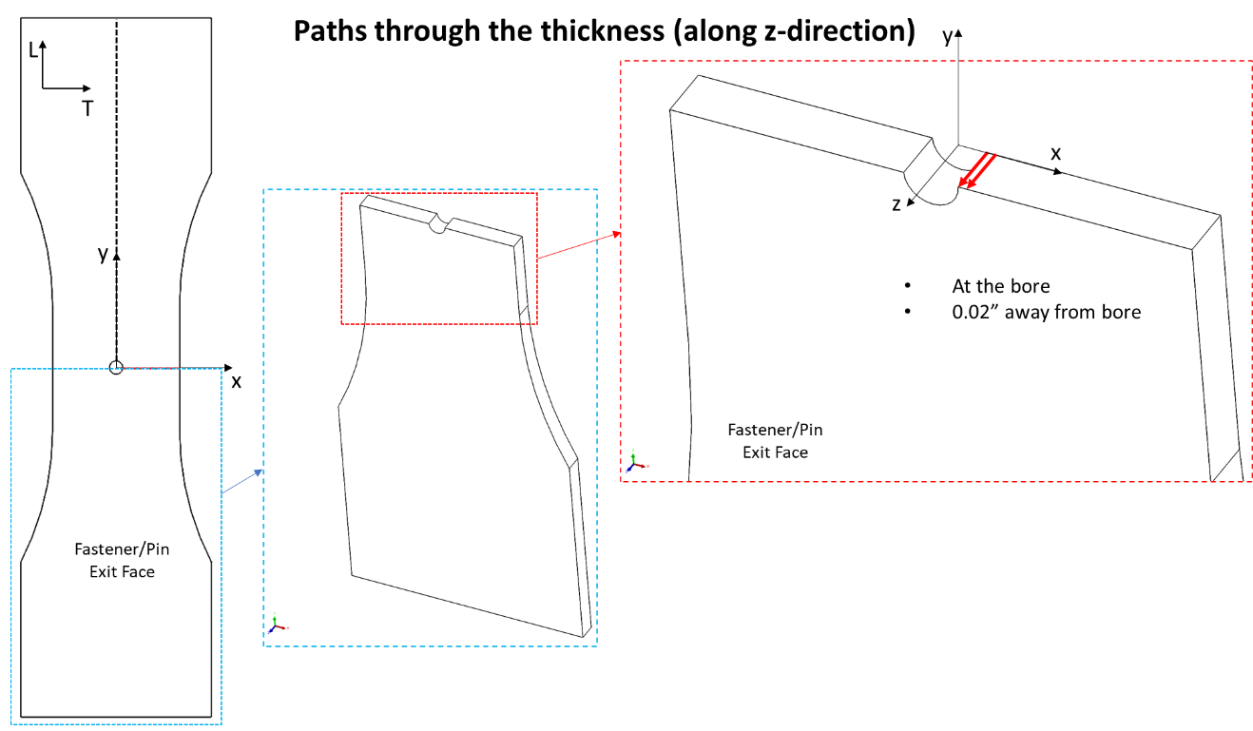
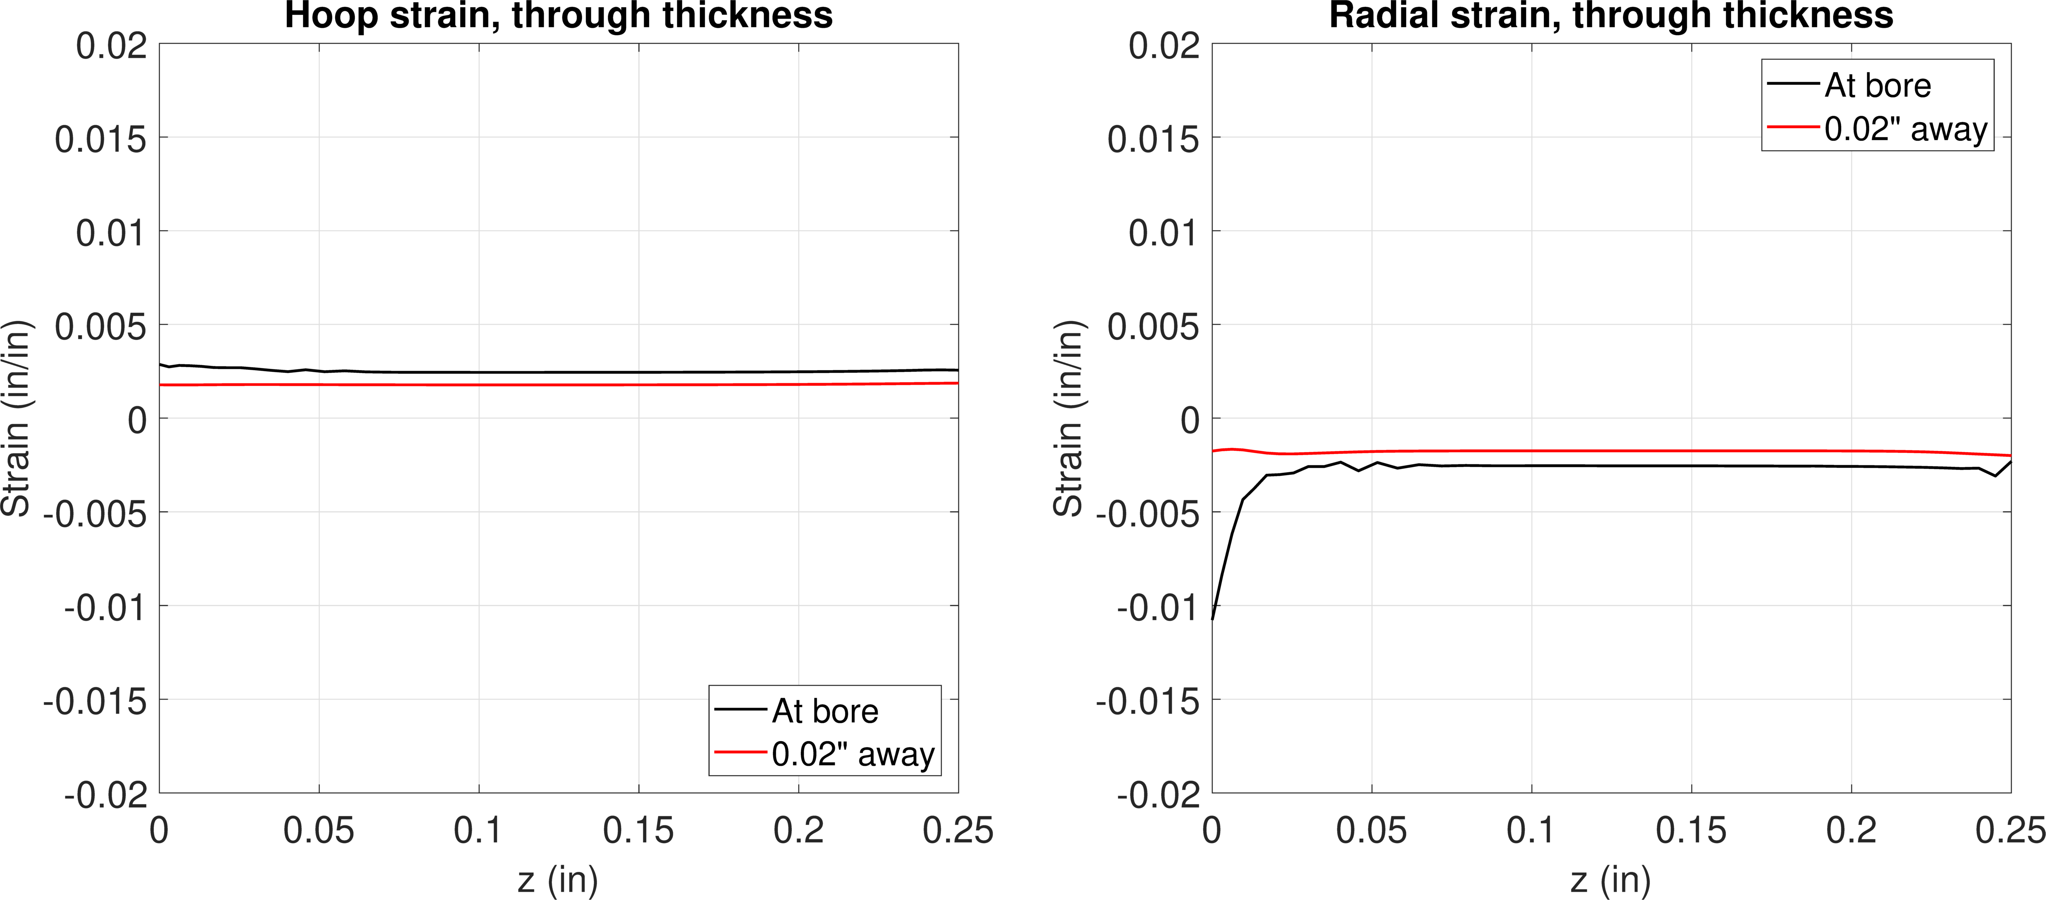
FE model results – 0.3% interf.
Hoop
Radial
Step 1
Pin installed
Stress
Hoop stress
Radial stress
Strain

Slide 6
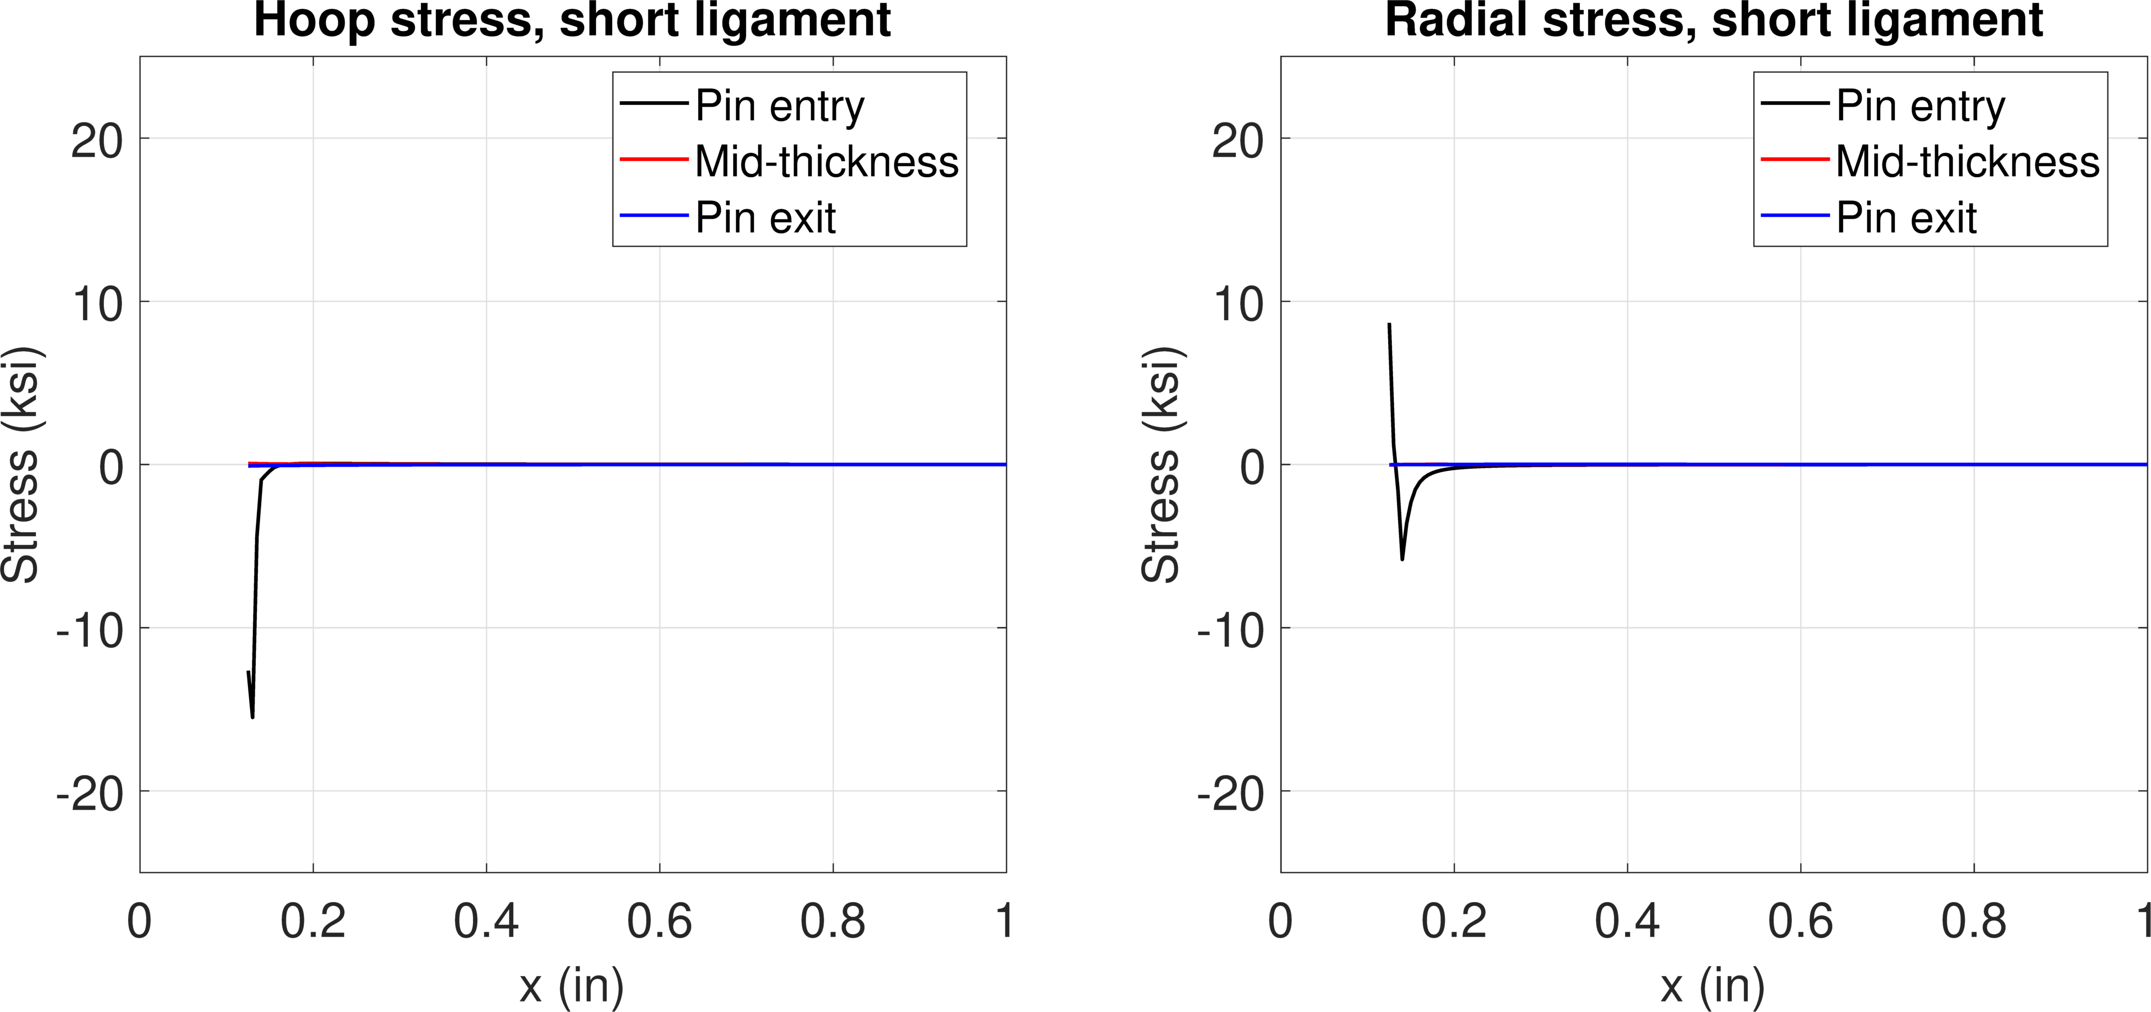
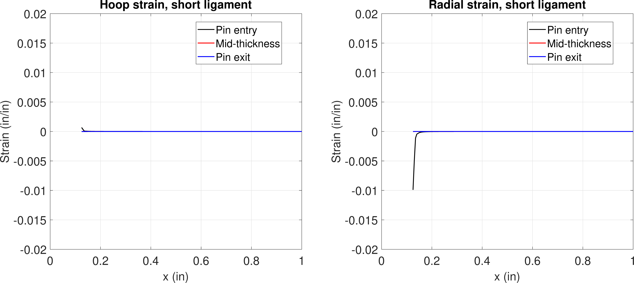
FE model results – 0.3% interf.
Hoop
Radial
Step 2
Pin removed
Stress
Strain

Slide 7
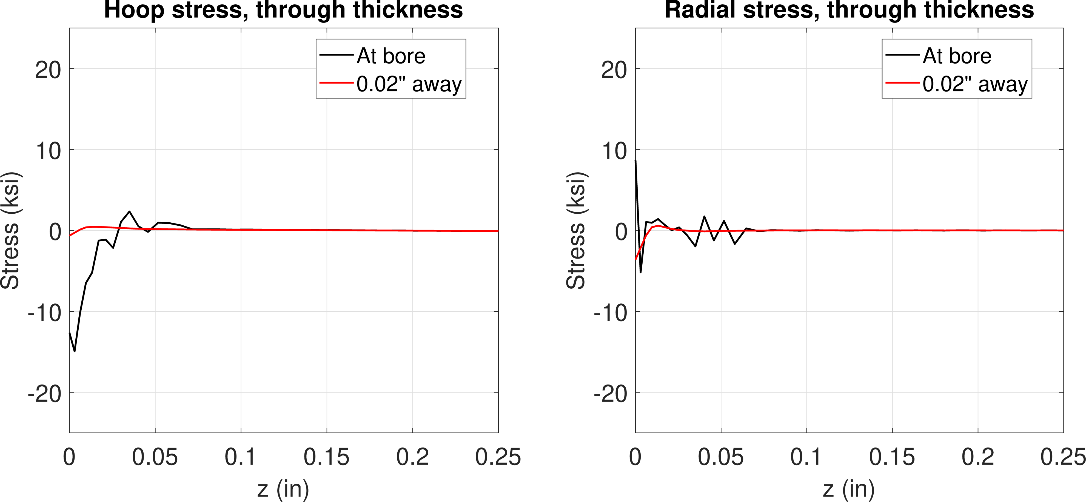
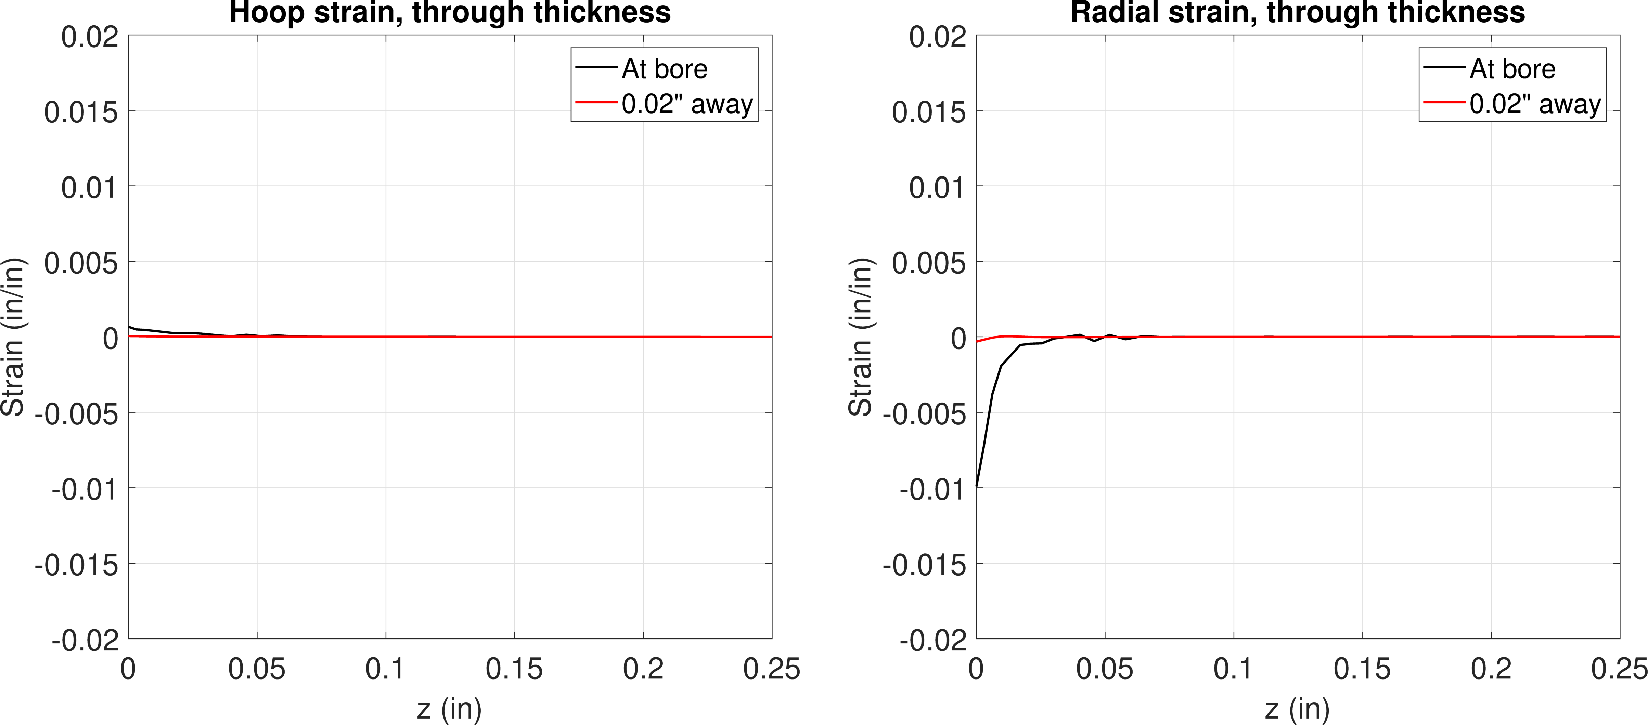
FE model results – 0.3% interf.
Hoop
Radial
Step 2
Pin removed
Stress
Strain

Slide 8
0.6% interference
Step 1 – push pin in
Step 2 – remove pin

Slide 9
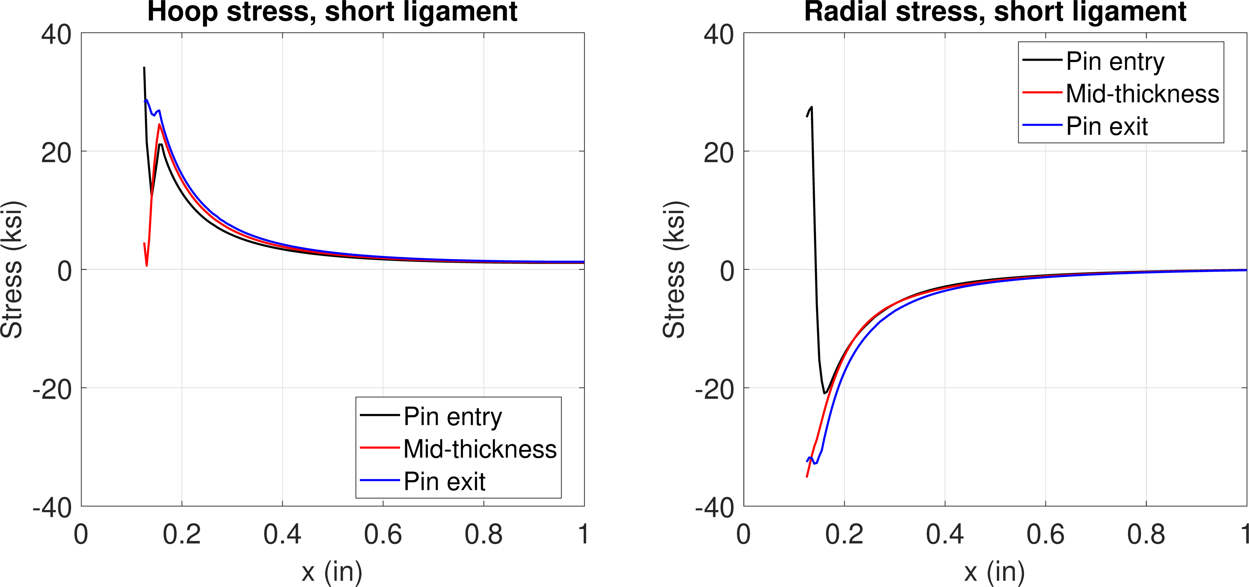
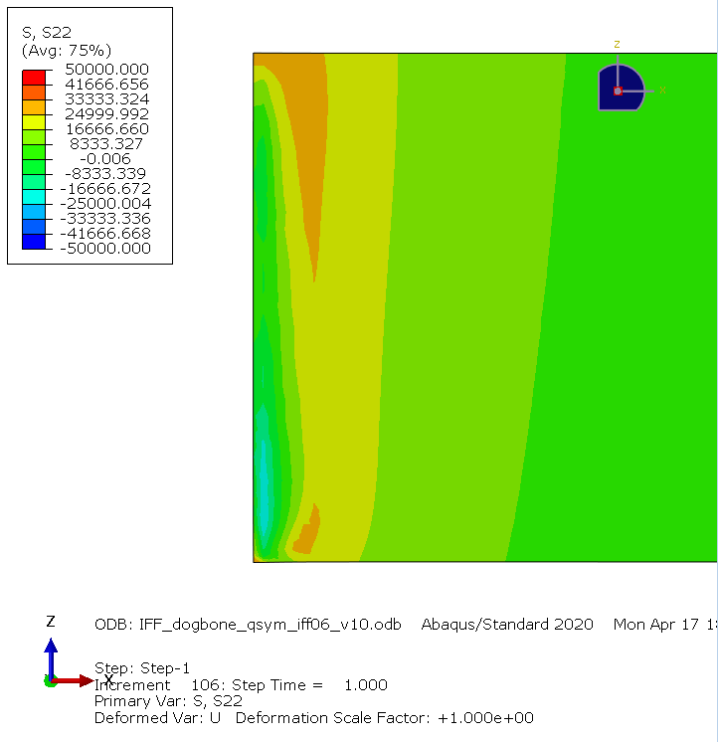
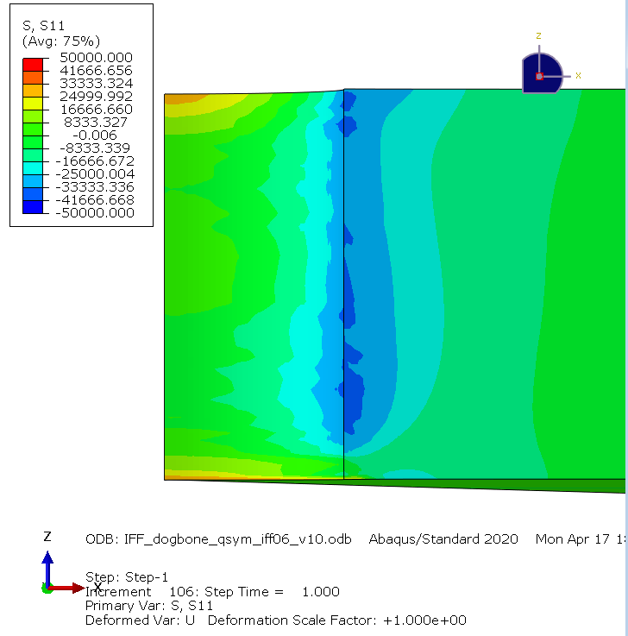
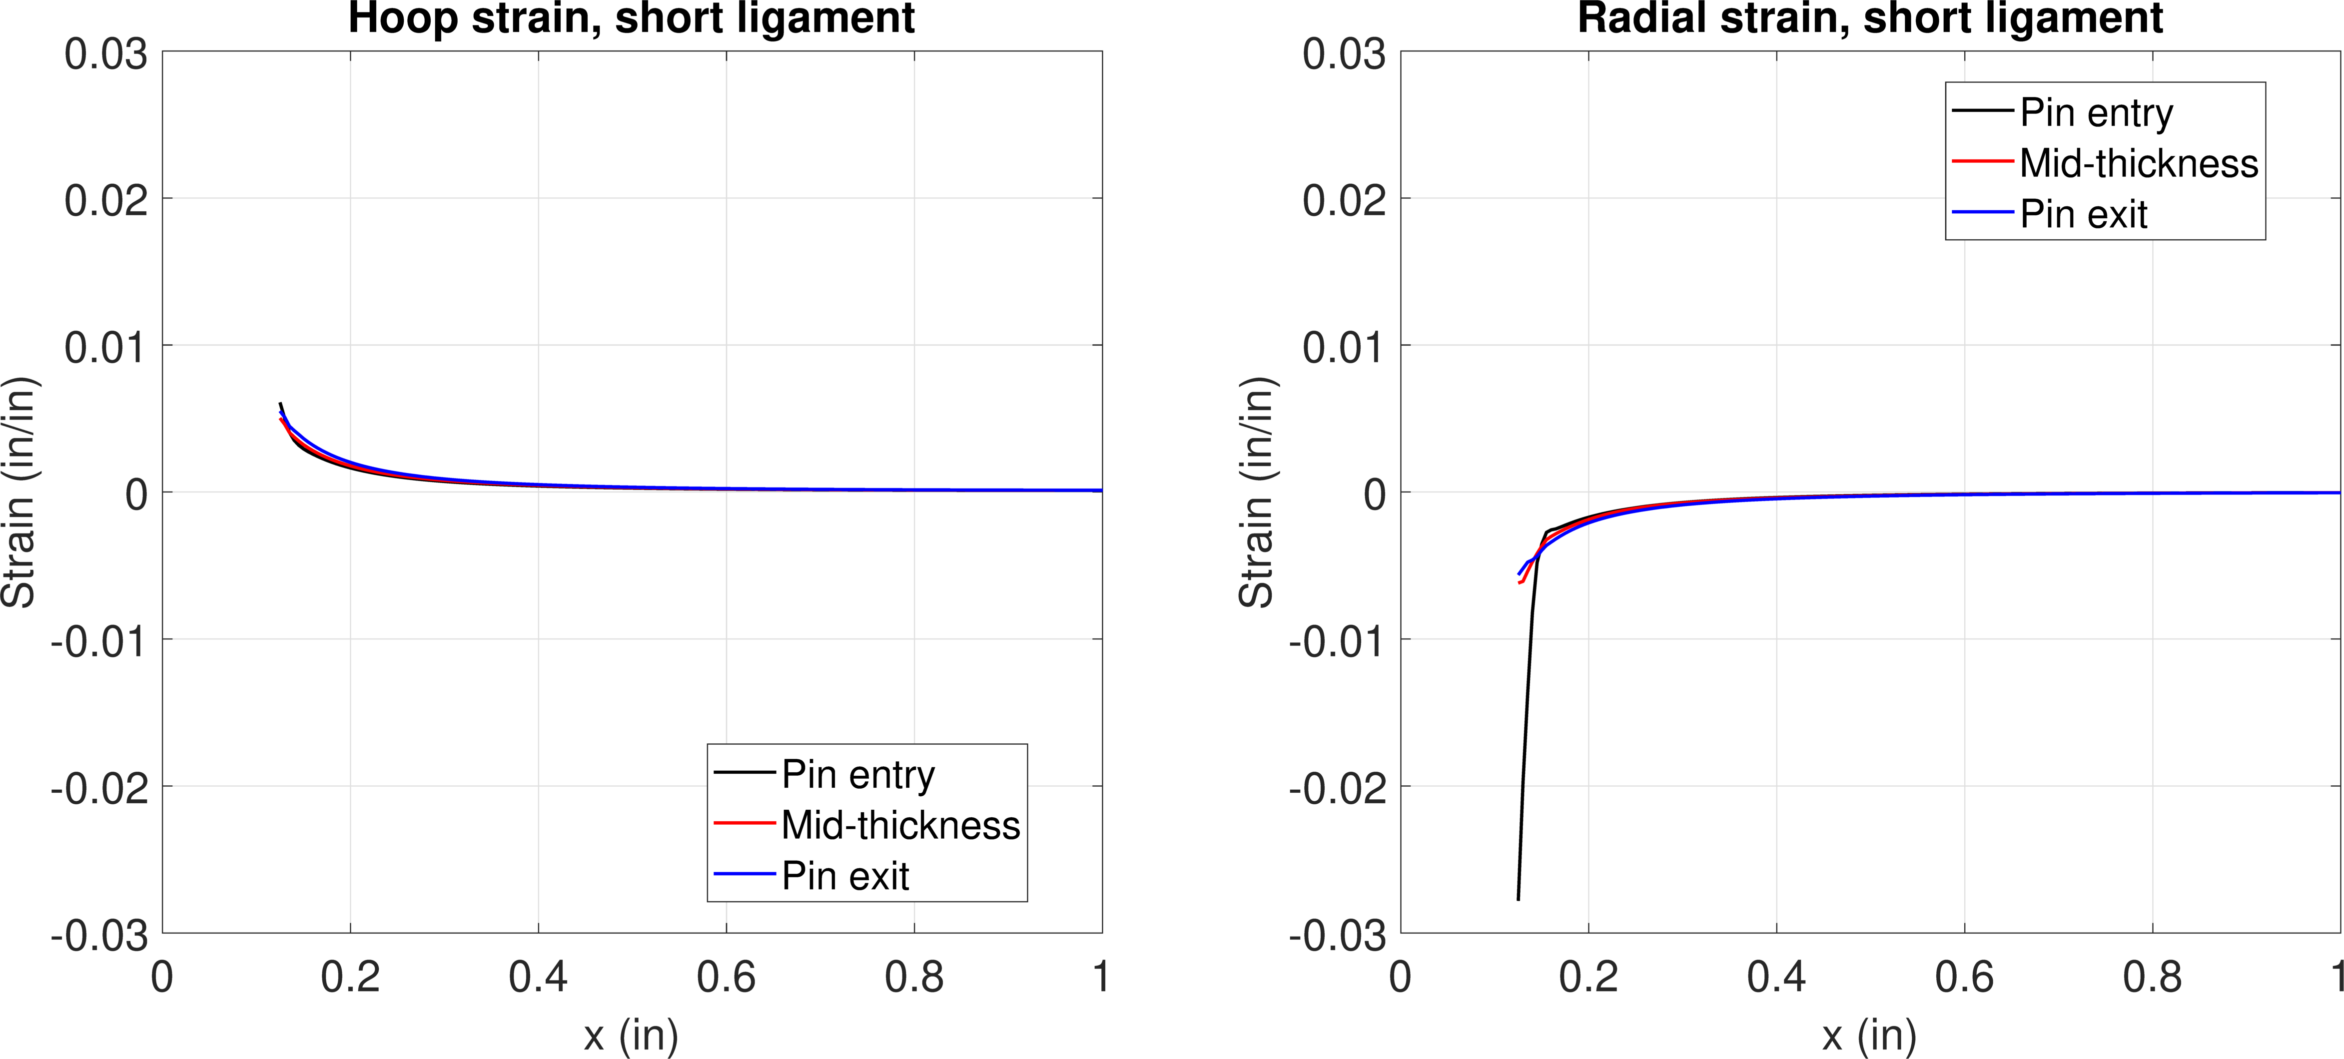
FE model results – 0.6% interf.
Hoop
Radial
Step 1
Pin installed
Stress
Hoop stress
Radial stress
Strain

Slide 10
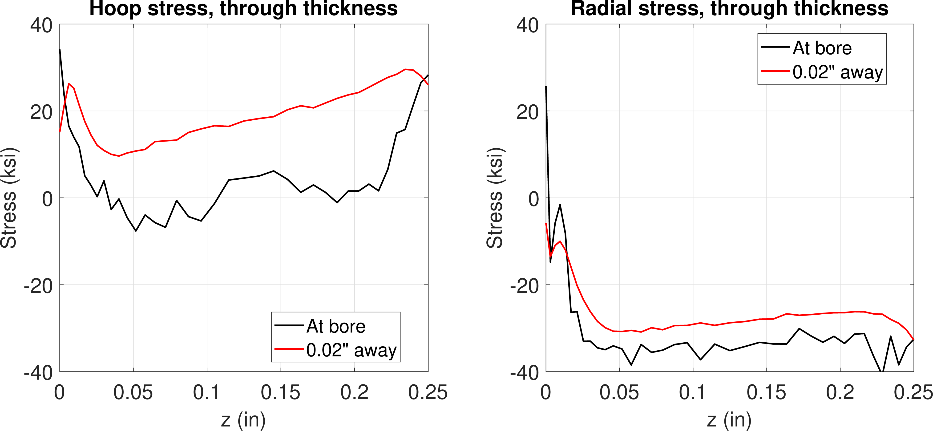
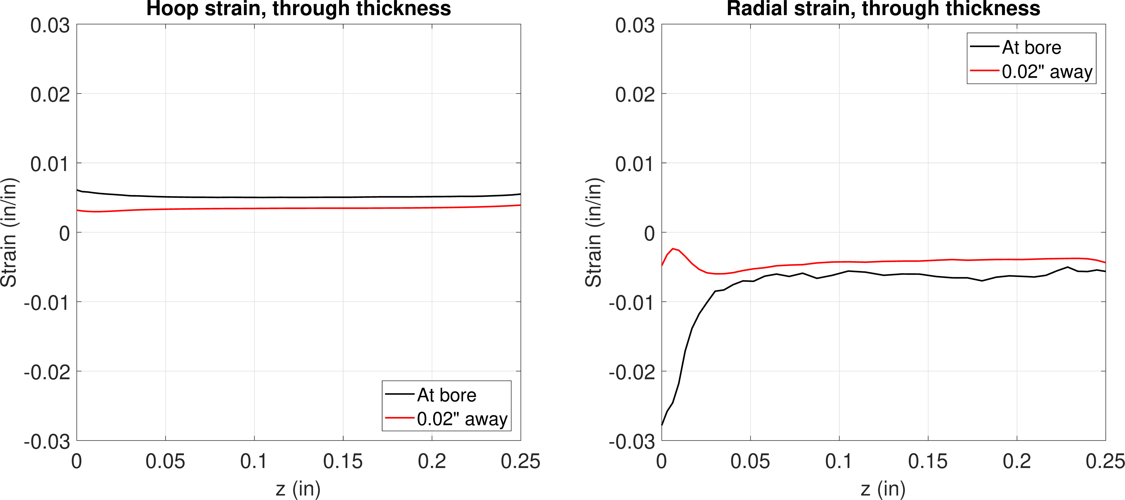
FE model results – 0.6% interf.
Hoop
Radial
Step 1
Pin installed
Stress
Hoop stress
Radial stress
Strain

Slide 11
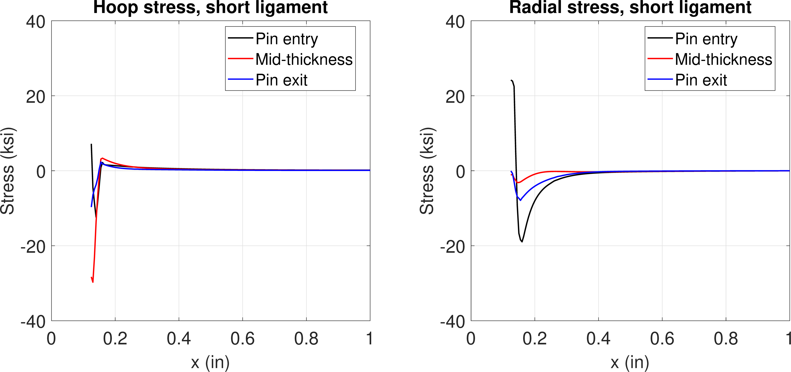
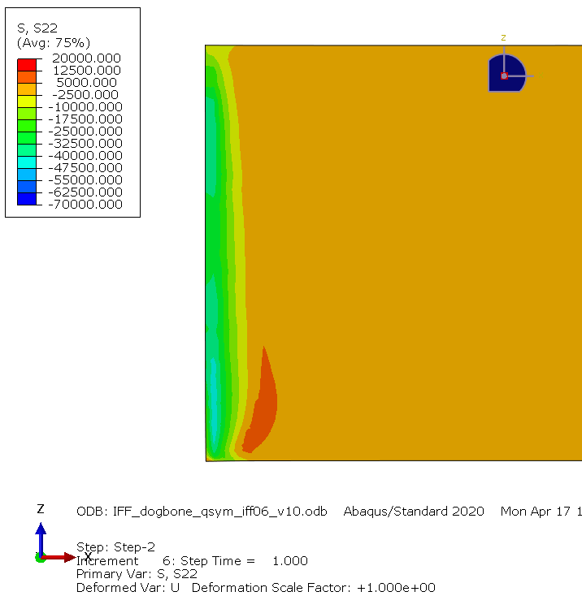
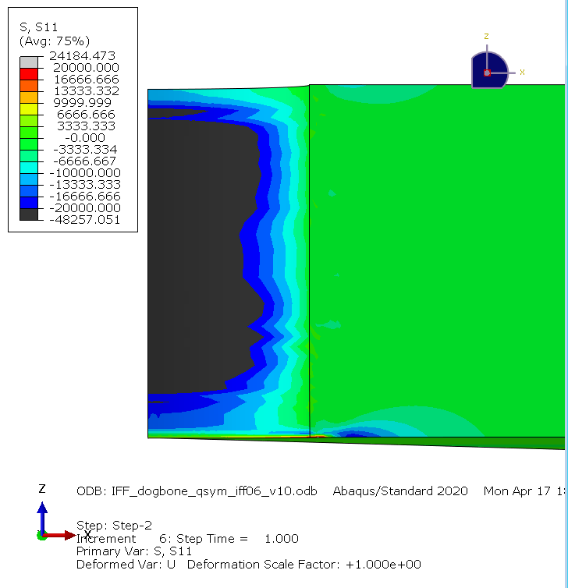
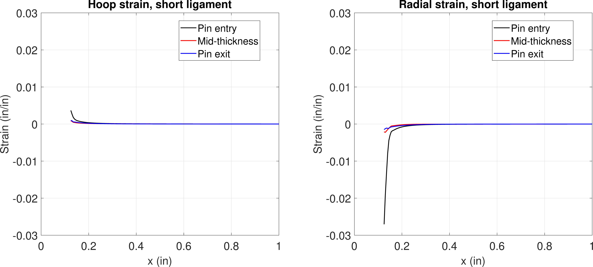
FE model results – 0.6% interf.
Hoop
Radial
Step 2
Pin removed
Bore
Stress
Hoop stress
Radial stress
Strain

Slide 12
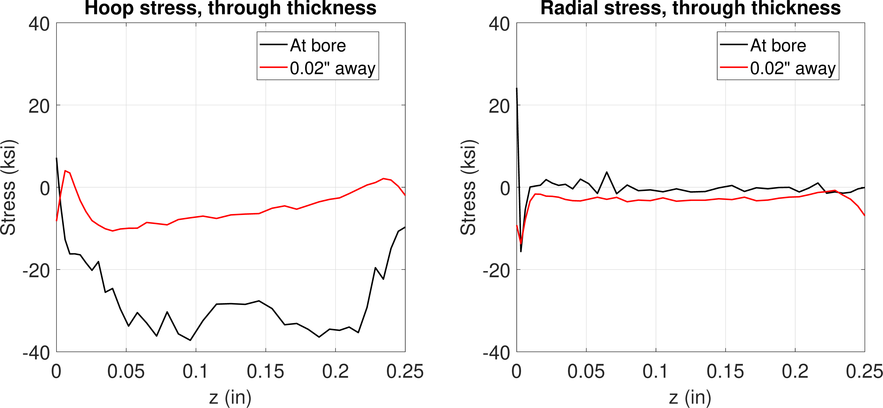
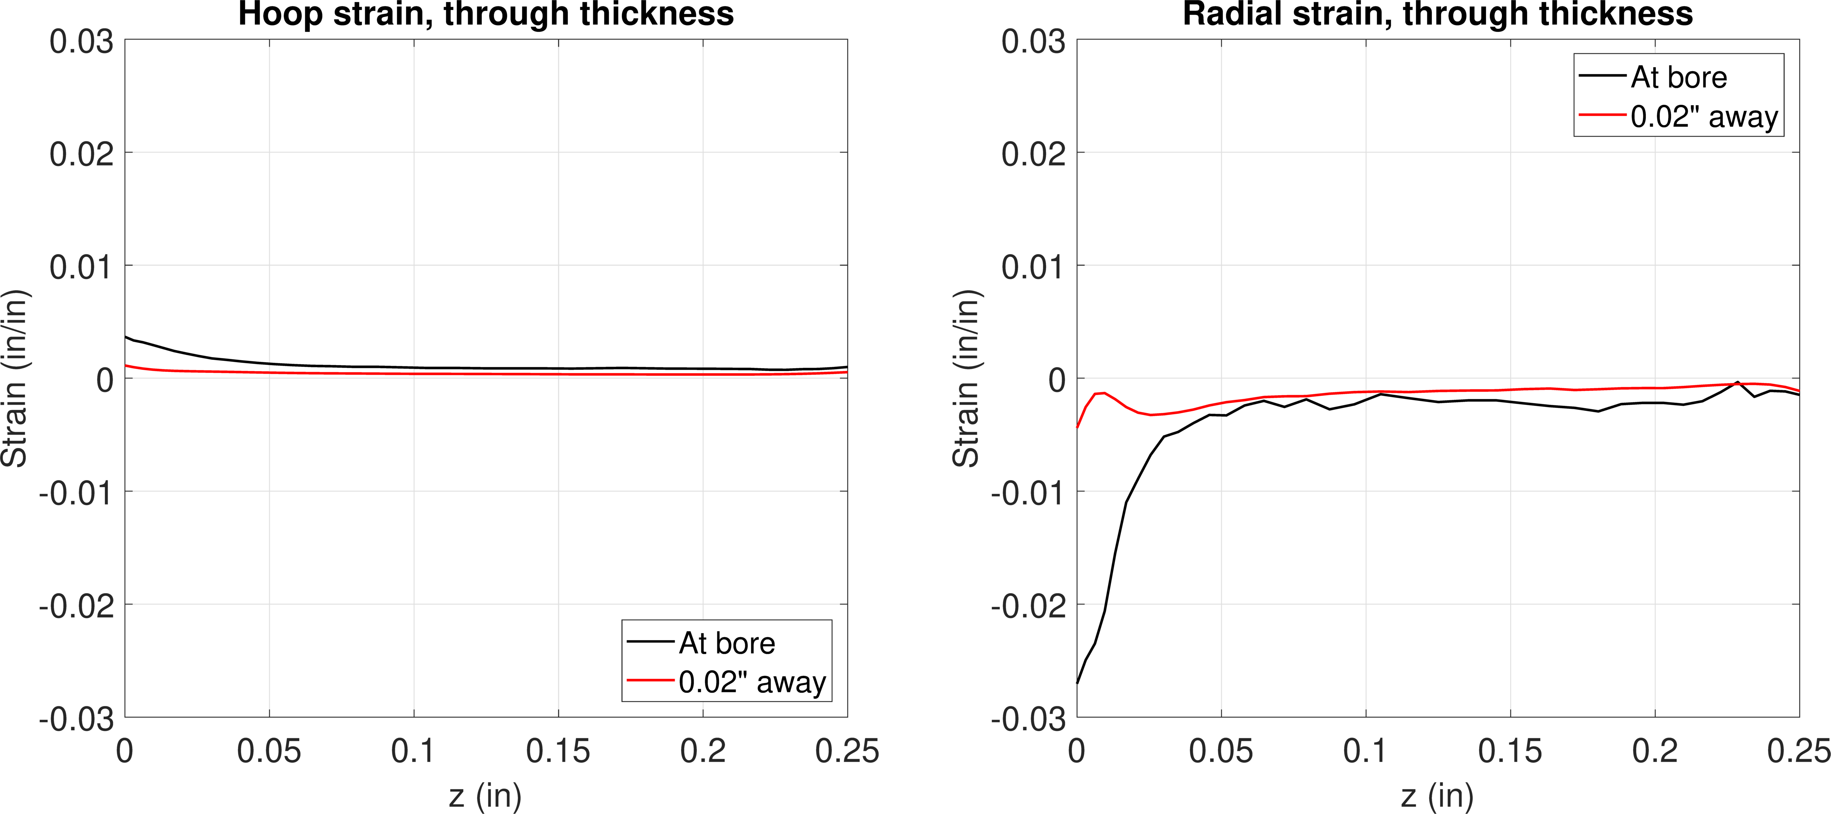
FE model results – 0.6% interf.
Hoop
Radial
Step 2
Pin removed
Bore
Stress
Hoop stress
Radial stress
Strain

Slide 13
1.2% interference
Step 1 – push pin in
Step 2 – remove pin

Slide 14
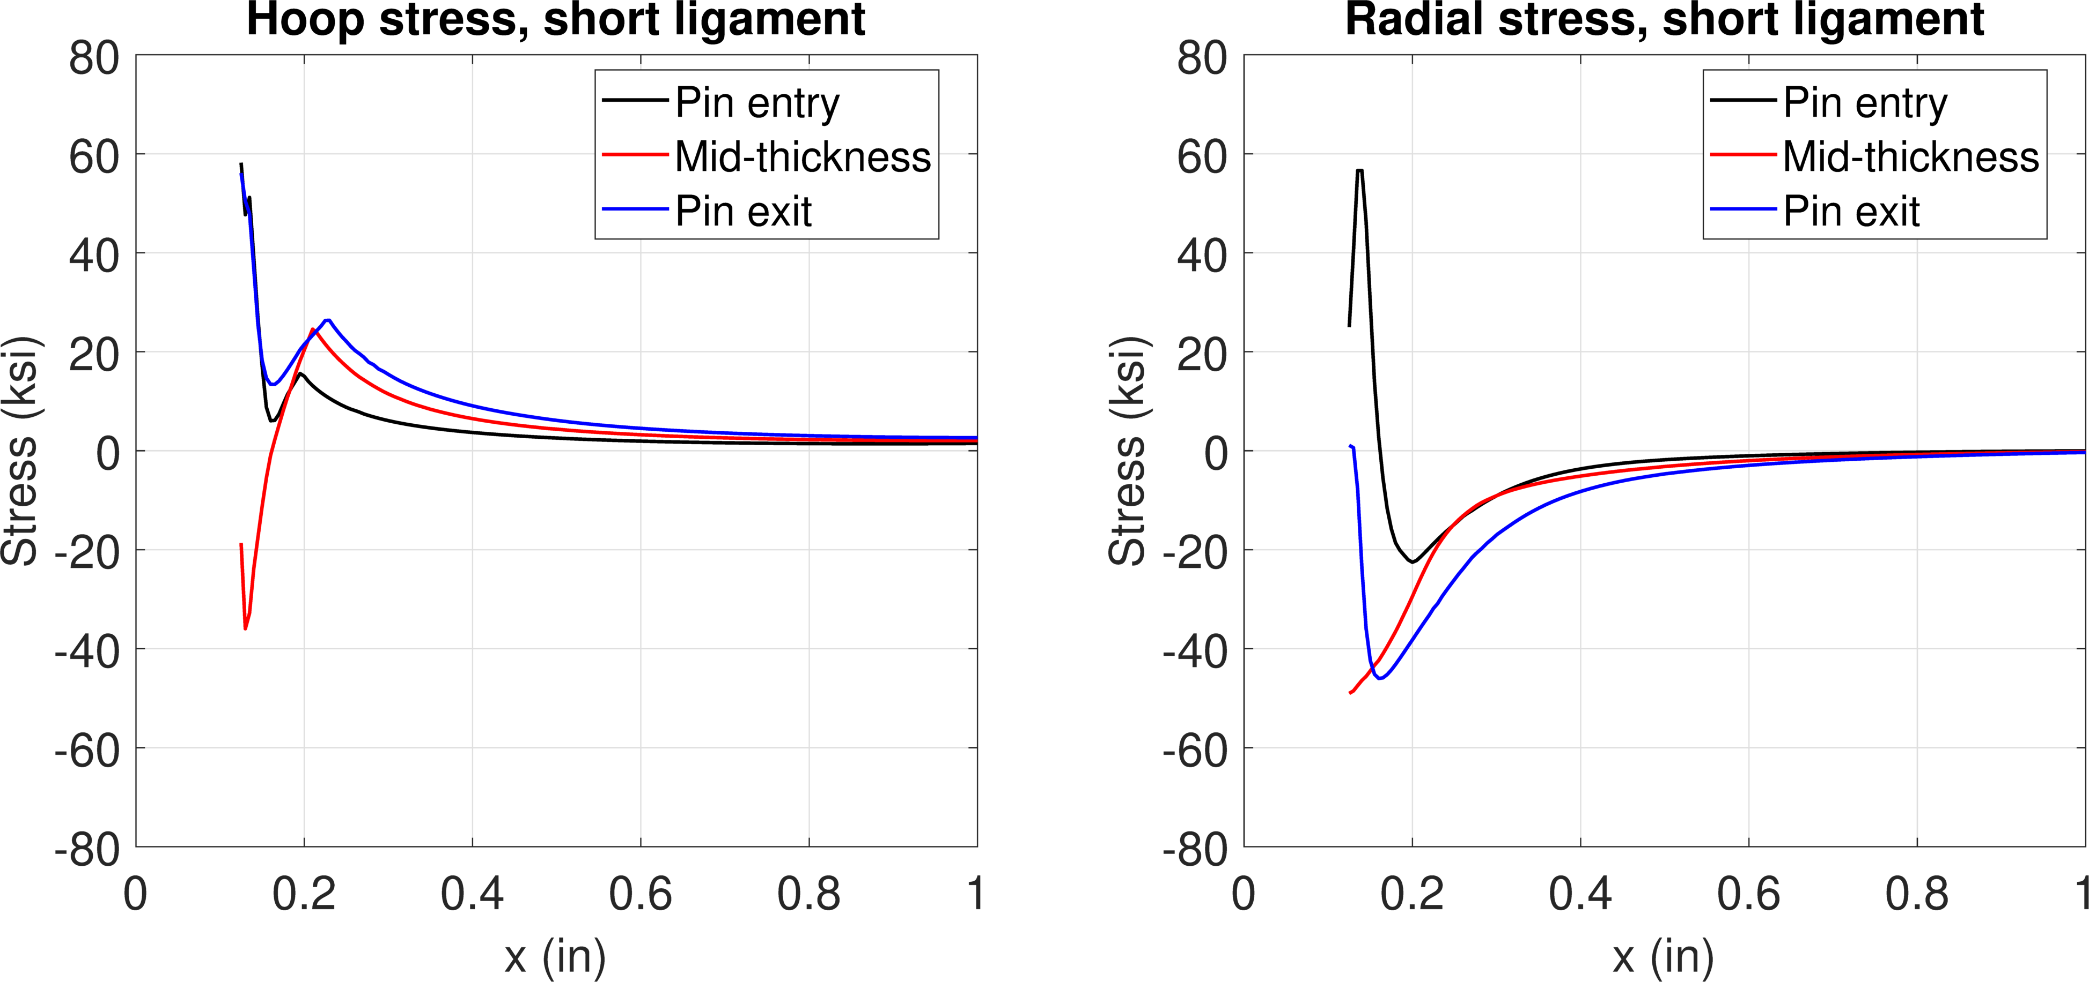
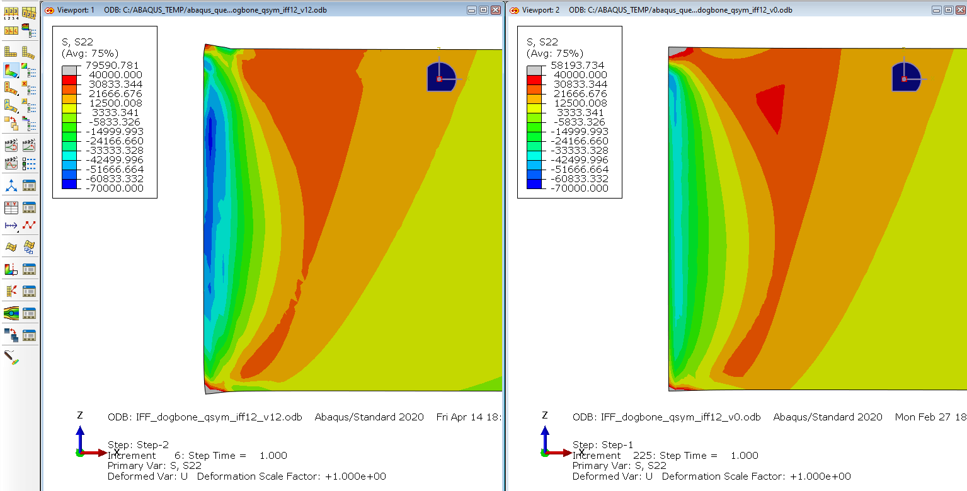
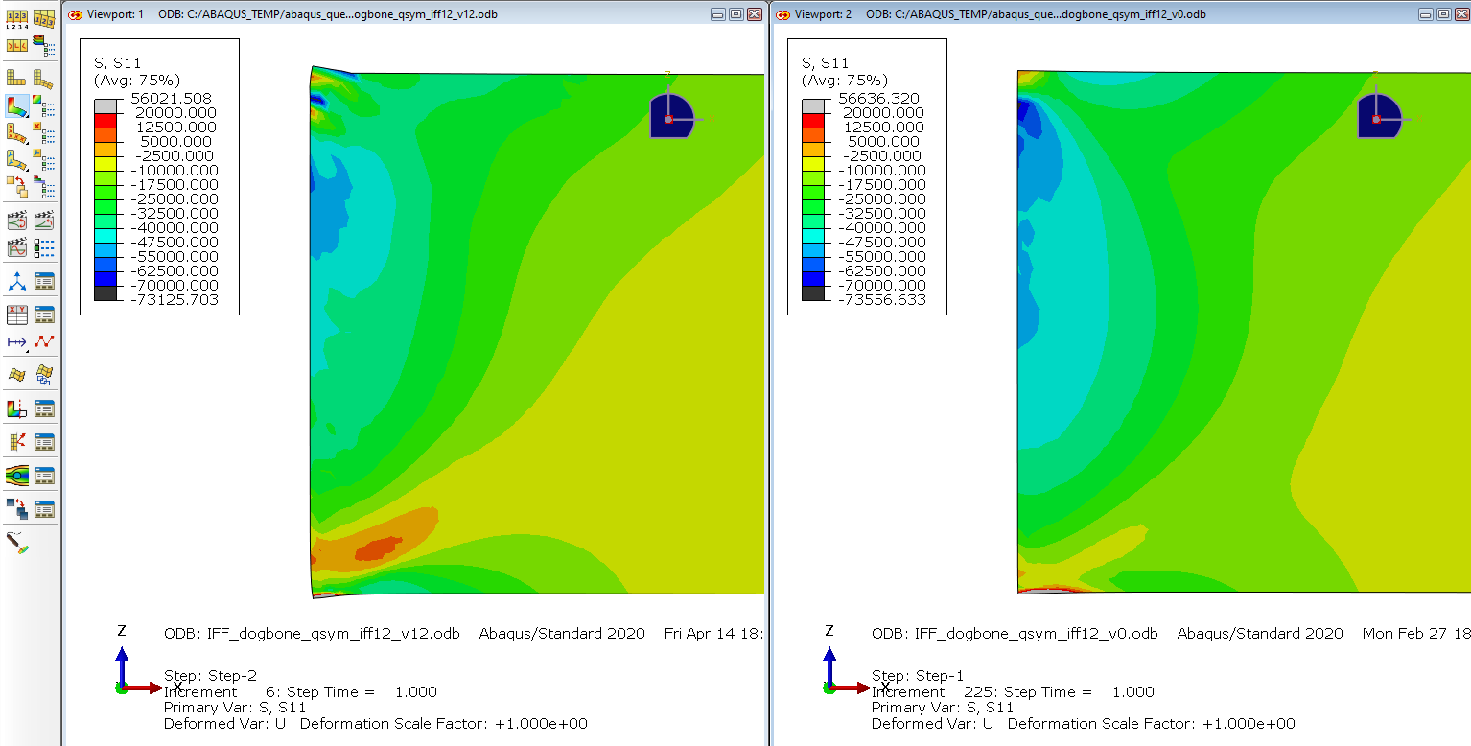
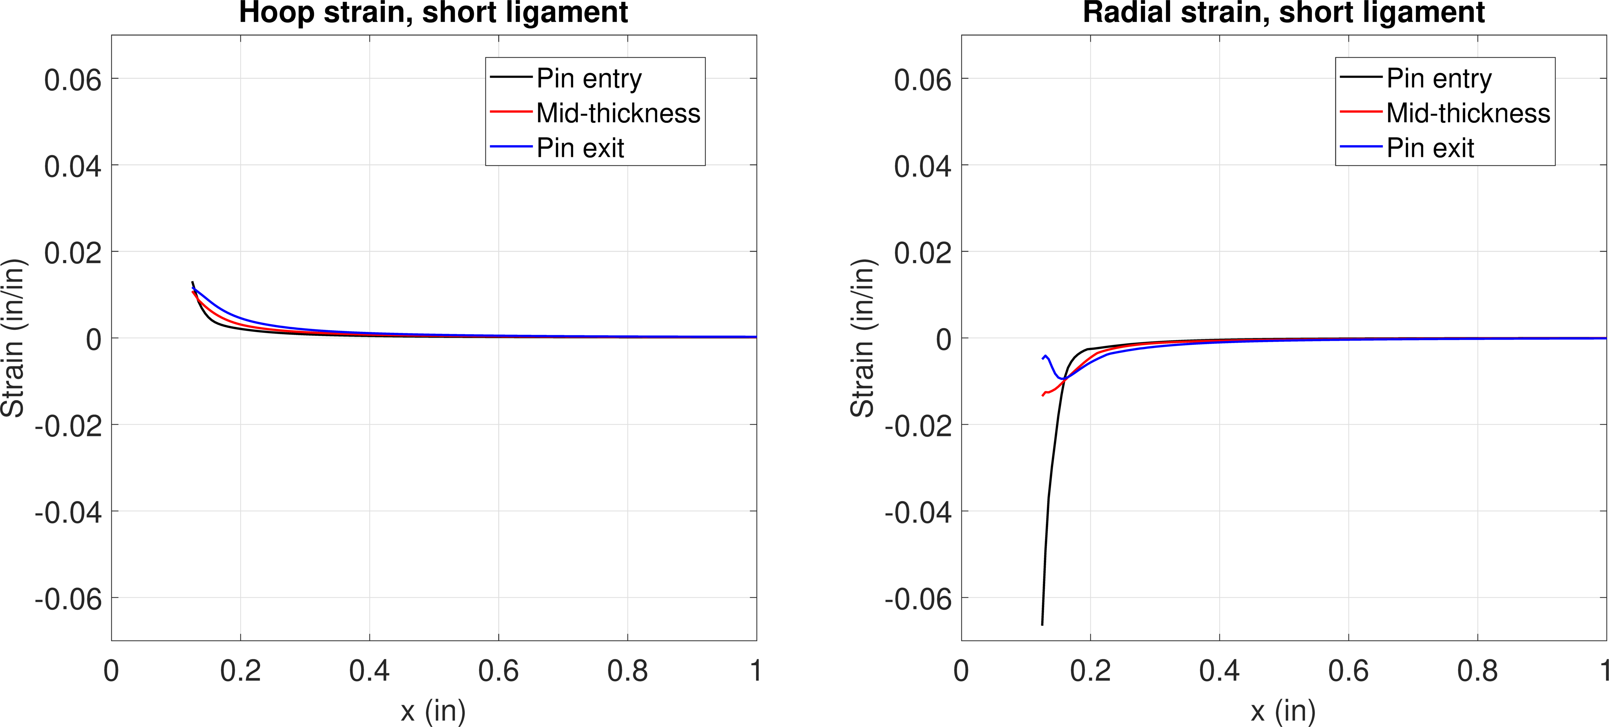
FE model results – 1.2% interf.
Hoop
Radial
Step 1
Pin installed
Stress
Hoop stress
Radial stress
Strain

Slide 15
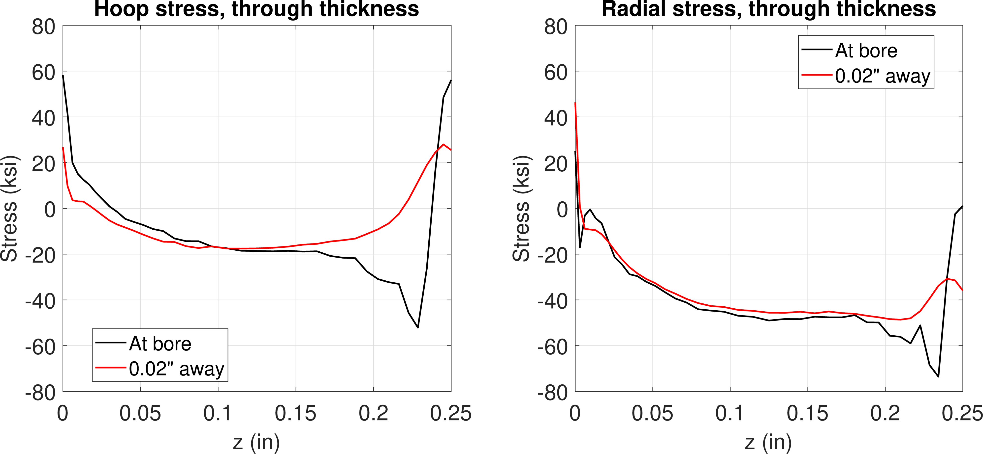
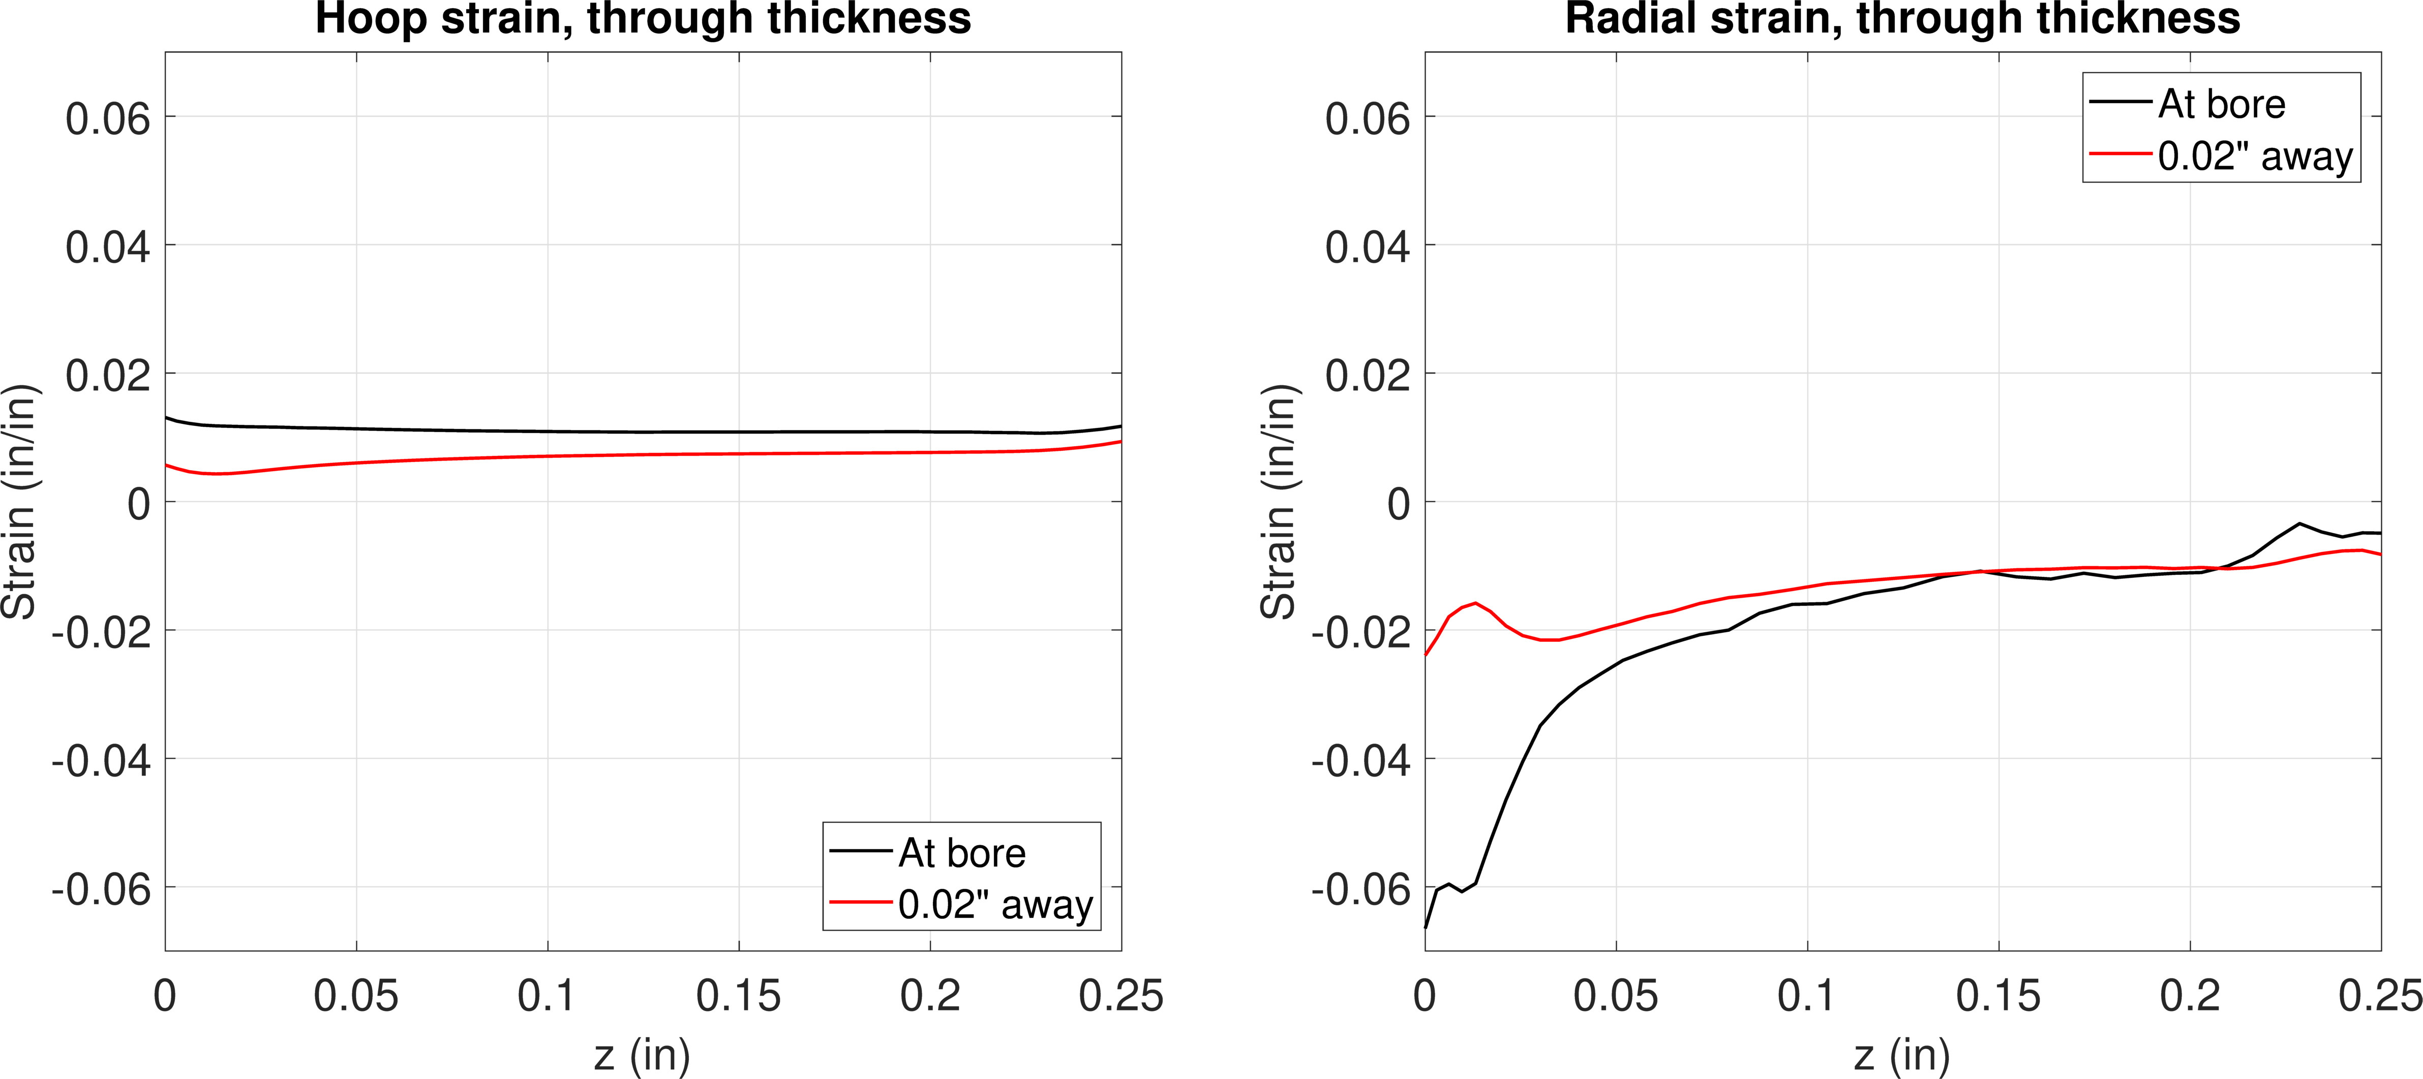
FE model results – 1.2% interf.
Hoop
Radial
Step 1
Pin installed
Stress
Hoop stress
Radial stress
Strain

Slide 16
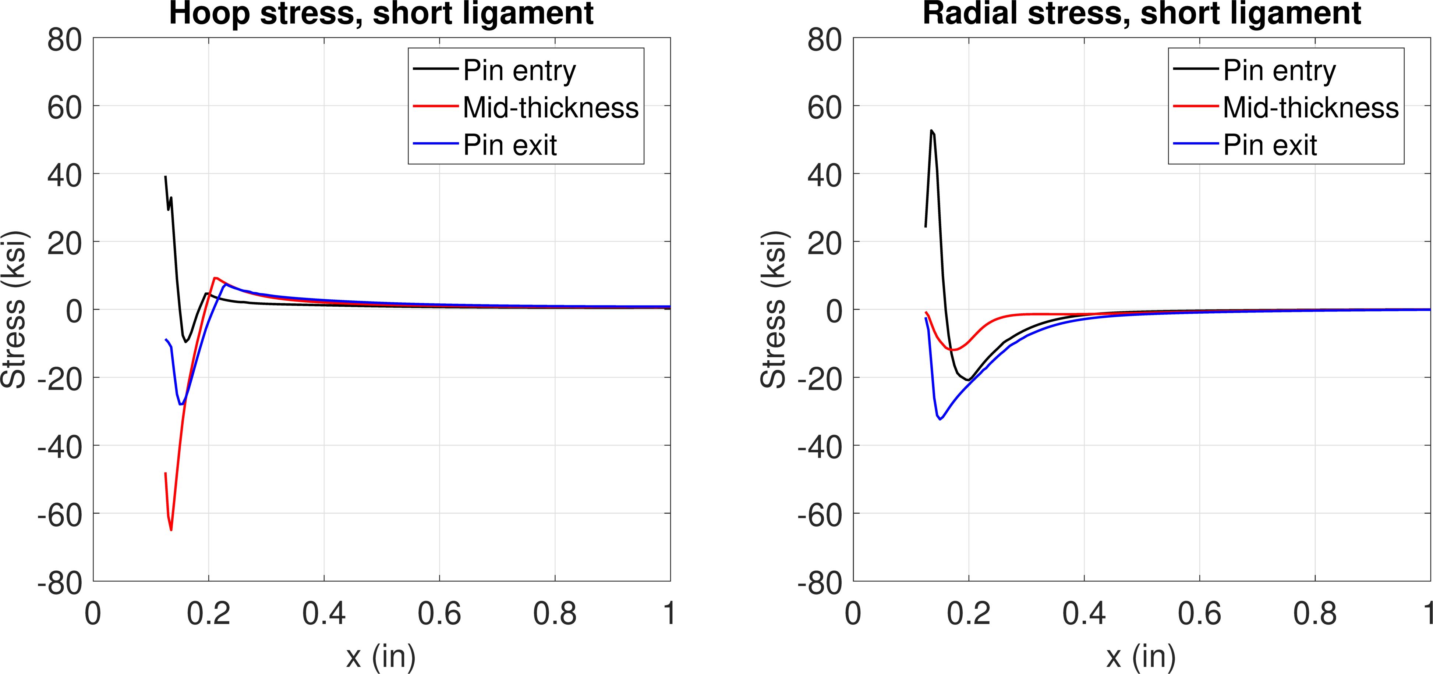
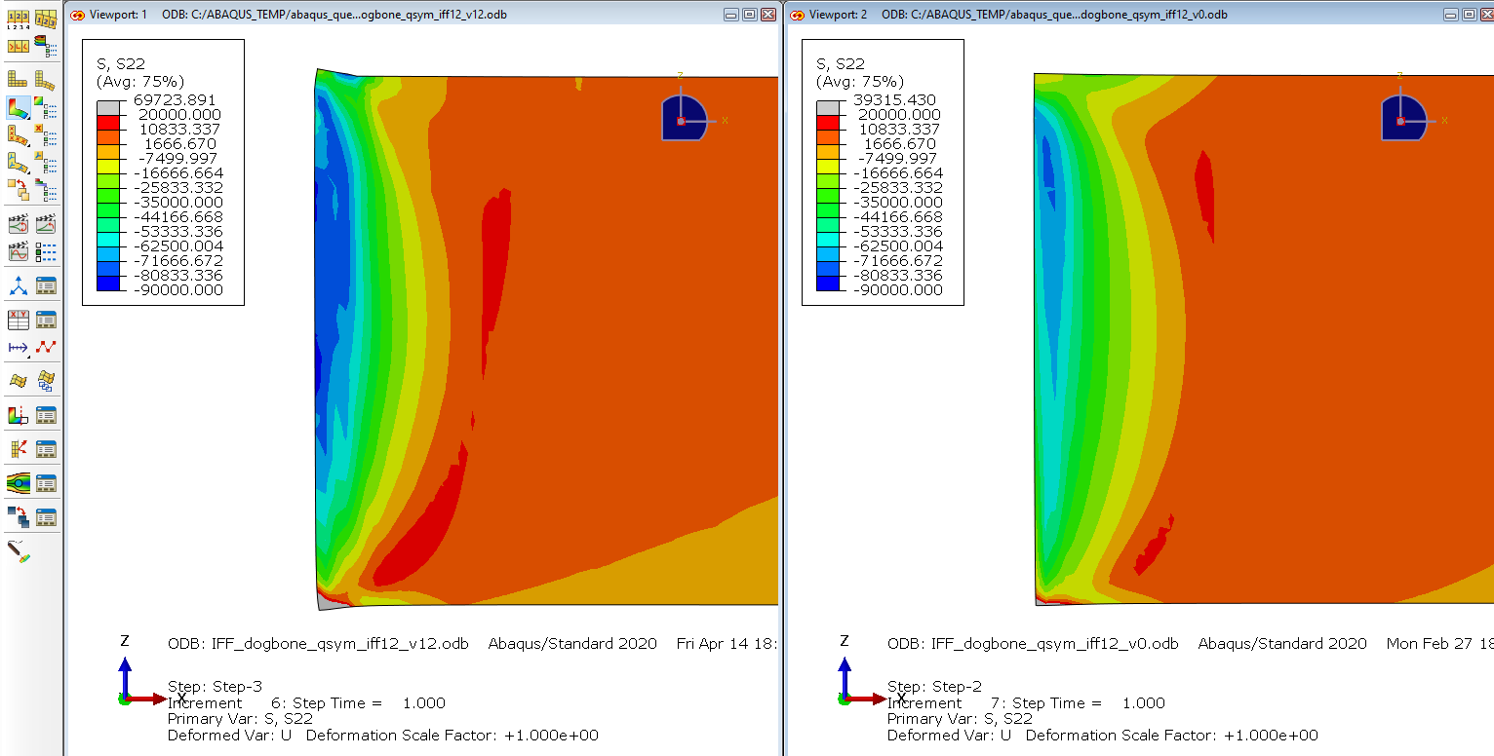
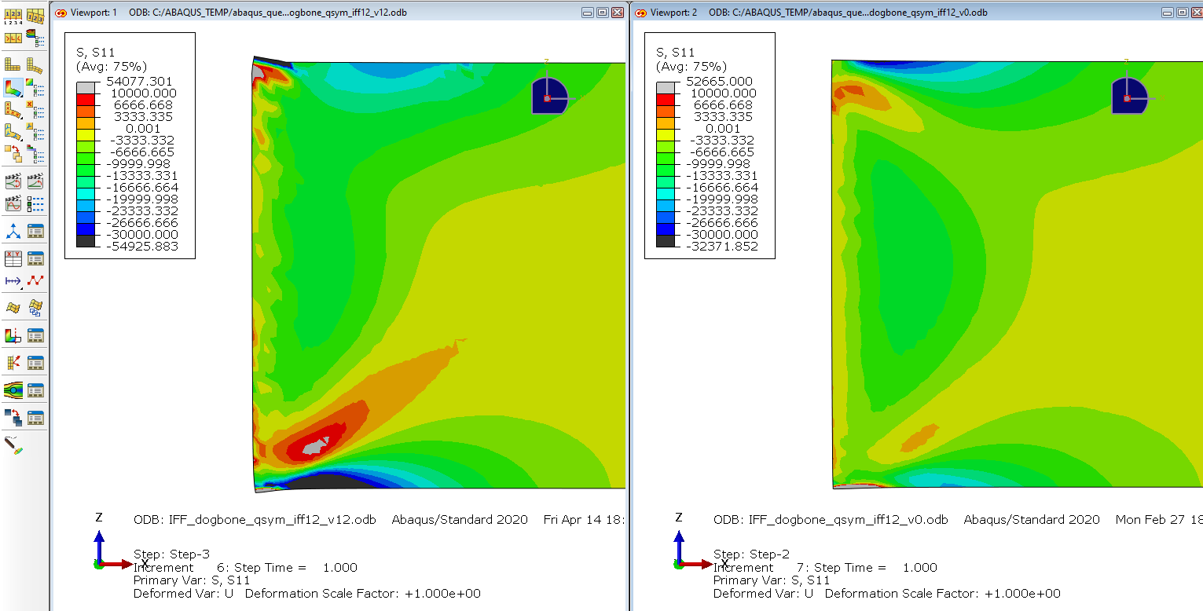
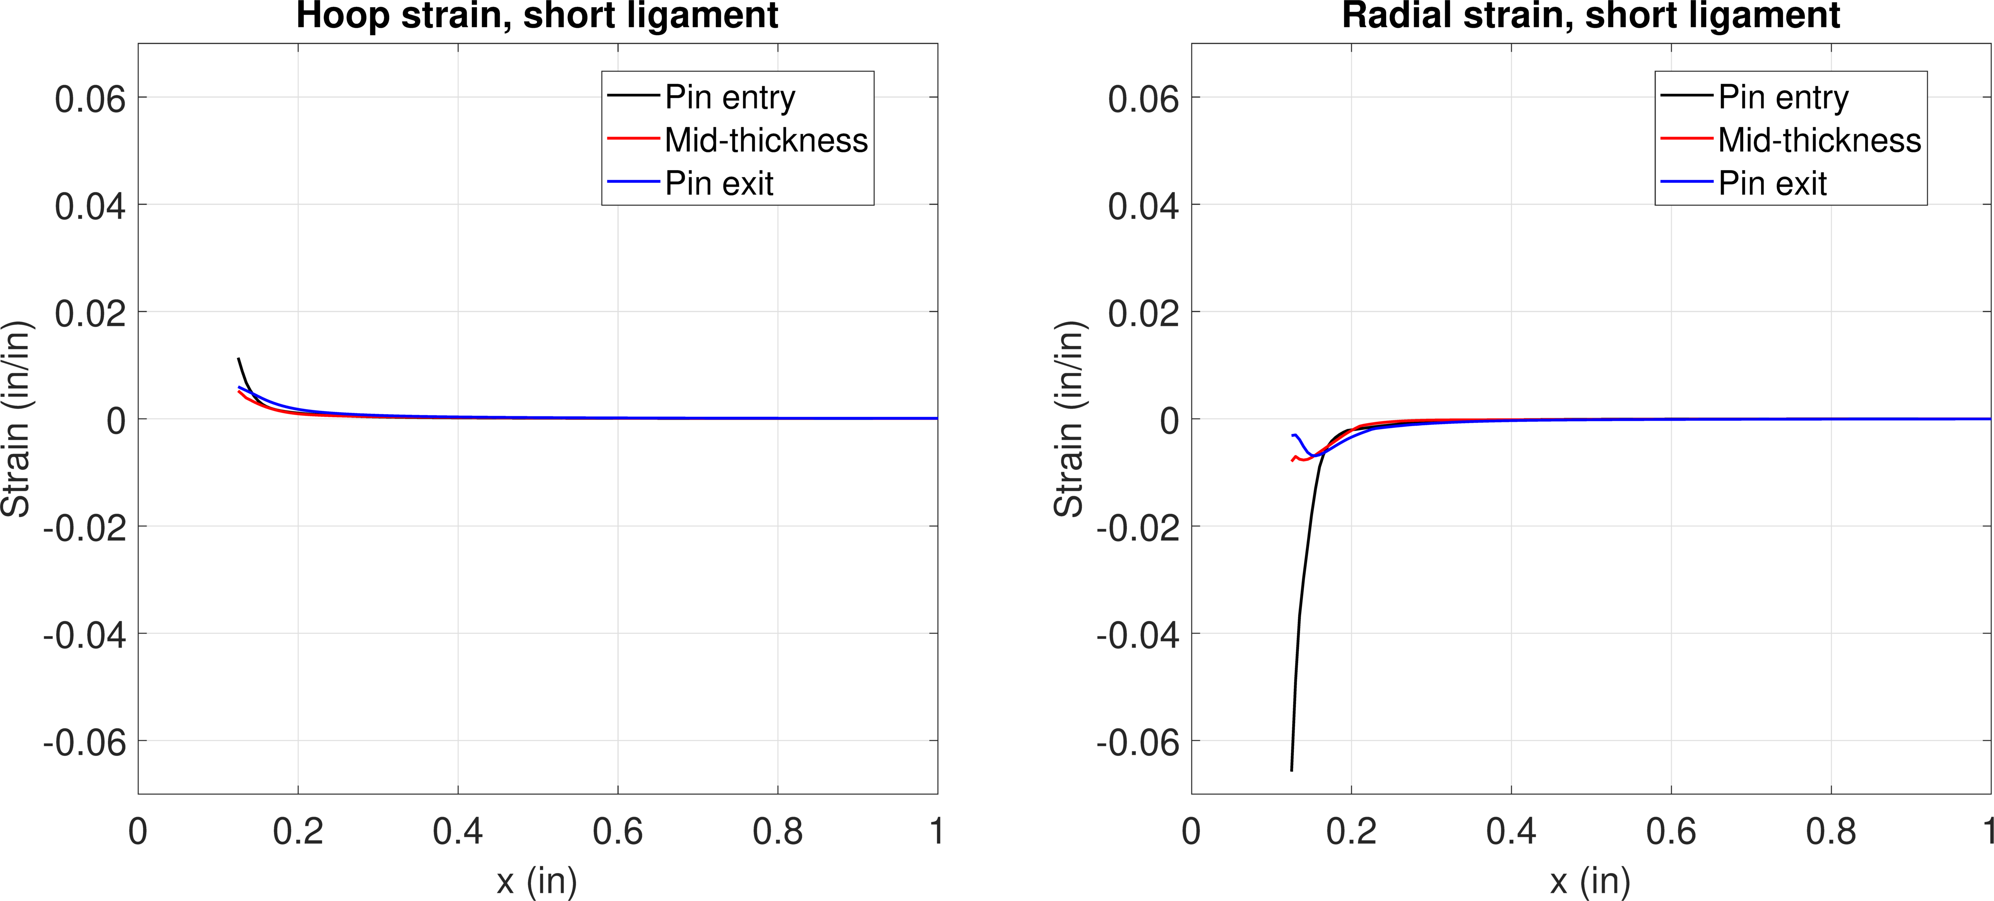
FE model results – 1.2% interf.
Hoop
Radial
Step 2
Pin removed
Stress
Hoop stress
Radial stress
Strain

Slide 17
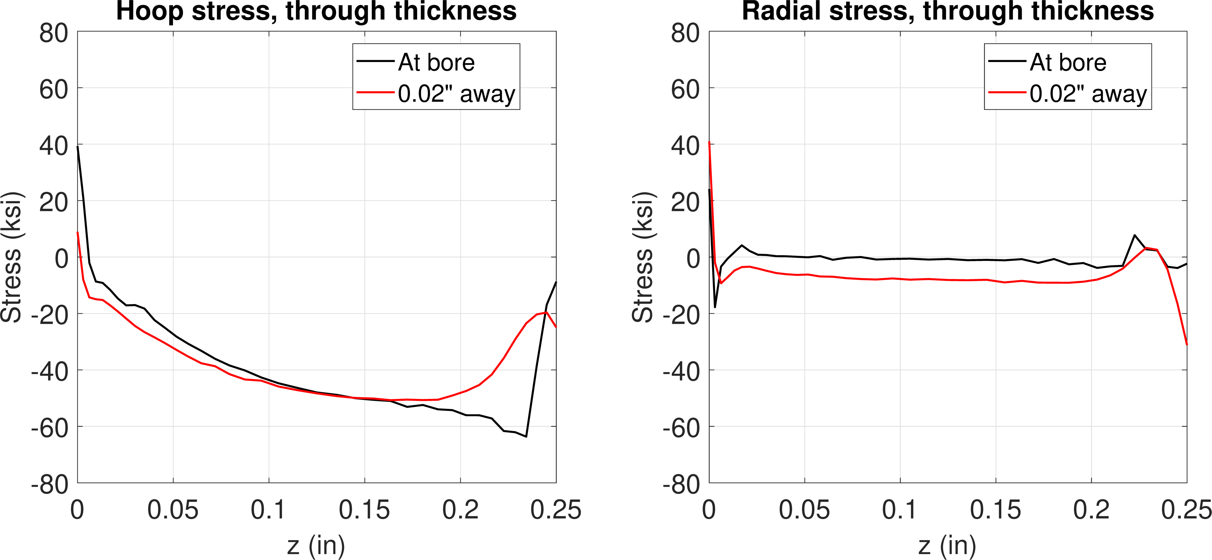
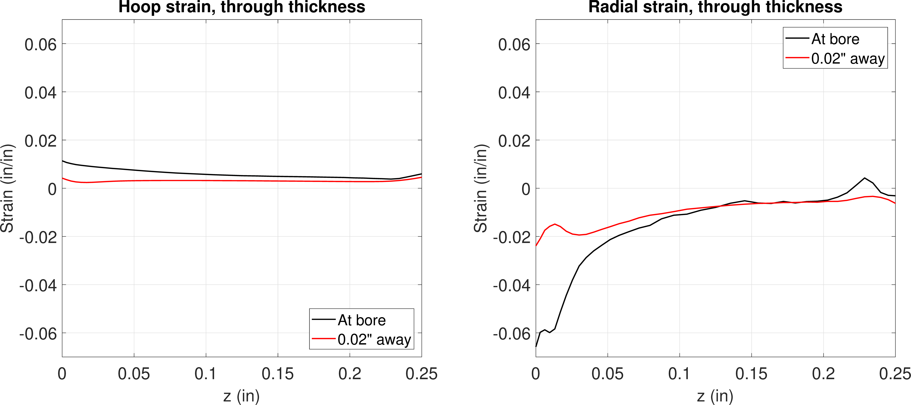
FE model results – 1.2% interf.
Hoop
Radial
Step 2
Pin removed
Stress
Hoop stress
Radial stress
Strain

Slide 18
Contour plot comparisons

Slide 19
0.3% interference – hoop stress
Pin installed
Pin installed
More aggressive
12.7 deg chamfer
Less aggressive
< 3 deg chamfer over 0.025”
More aggressive
12.7 deg chamfer
Less aggressive
< 3 deg chamfer over 0.025”
-20 to 20 ksi scale
-30 to 50 ksi scale

Slide 20
1.2% interference – hoop stress
Pin installed
Pin removed
More aggressive
12.7 deg chamfer
Less aggressive
< 3 deg chamfer over 0.025”
More aggressive
12.7 deg chamfer
Less aggressive
< 3 deg chamfer over 0.025”
-70 to 40 ksi scale
-90 to 20 ksi scale

Slide 21
1.2% interference – radial stress
Pin installed
Pin removed
More aggressive
12.7 deg chamfer
Less aggressive
< 3 deg chamfer over 0.025”
More aggressive
12.7 deg chamfer
Less aggressive
< 3 deg chamfer over 0.025”
-70 to 20 ksi scale
-30 to 10 ksi scale

Slide 22
Comparisons

Slide 23
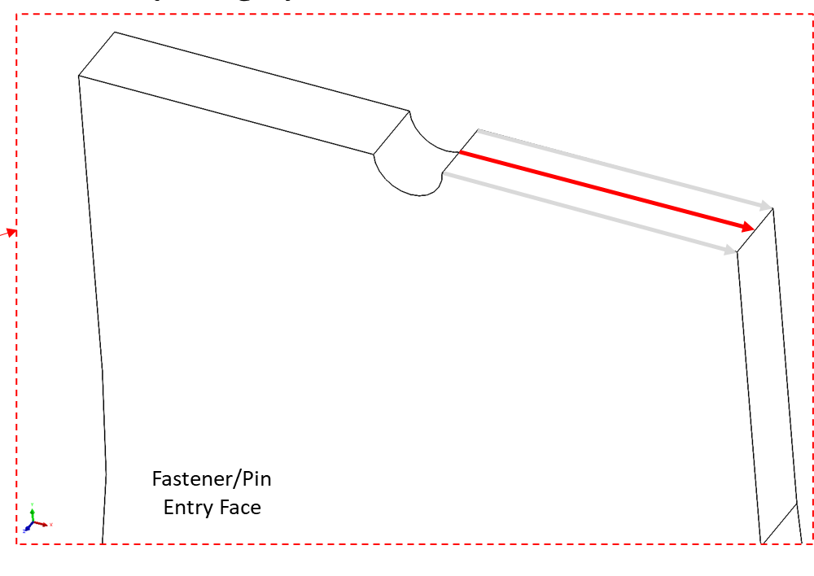
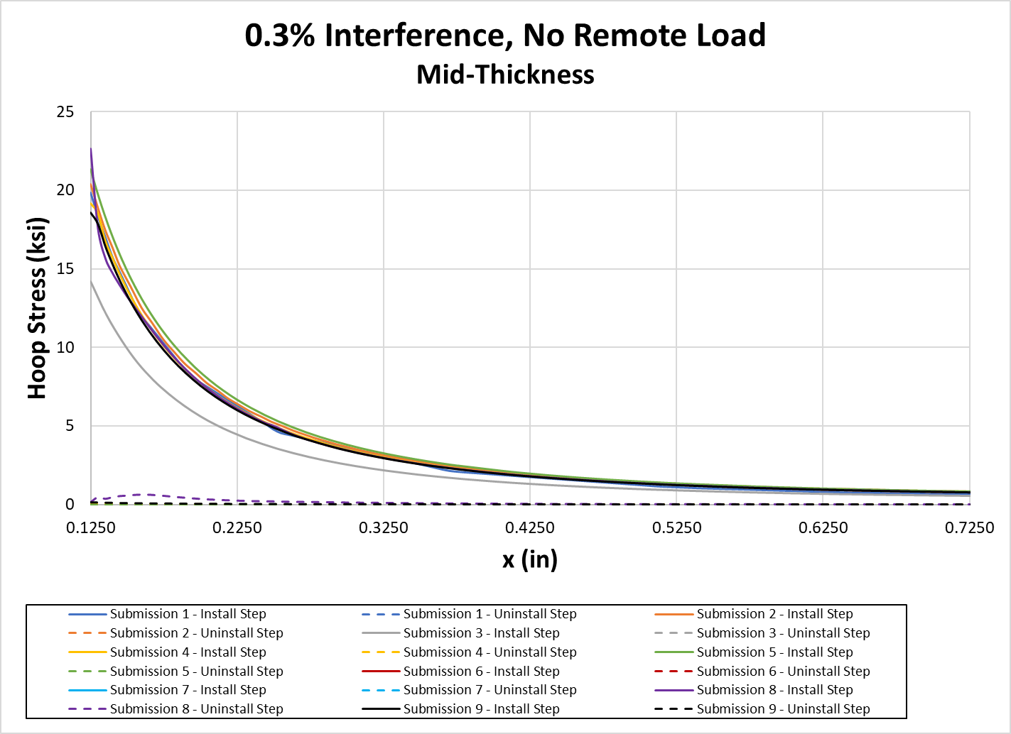
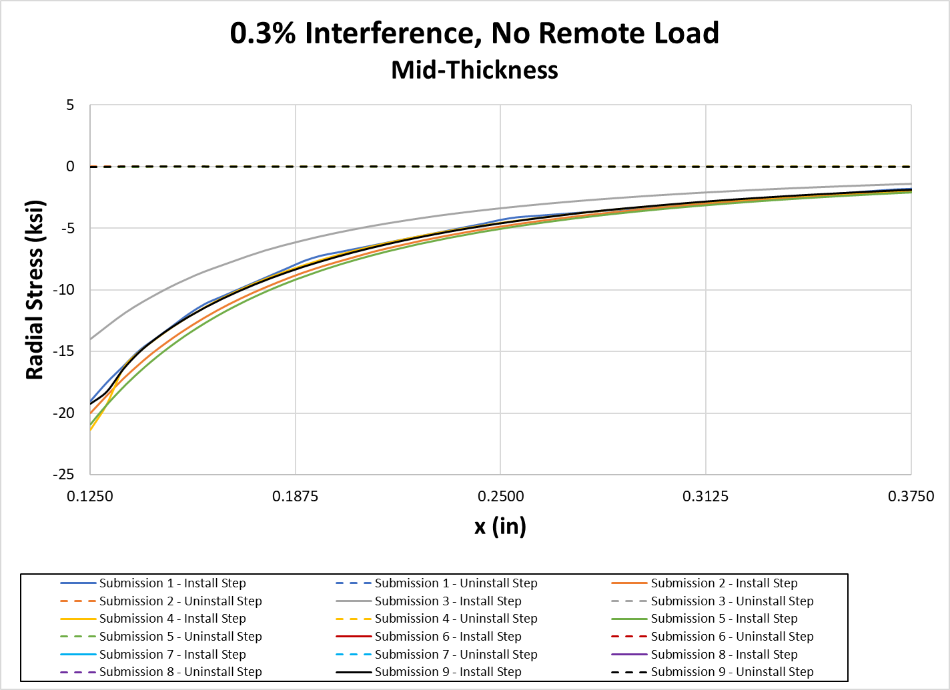
Comparison – 0.3% interference

Slide 24
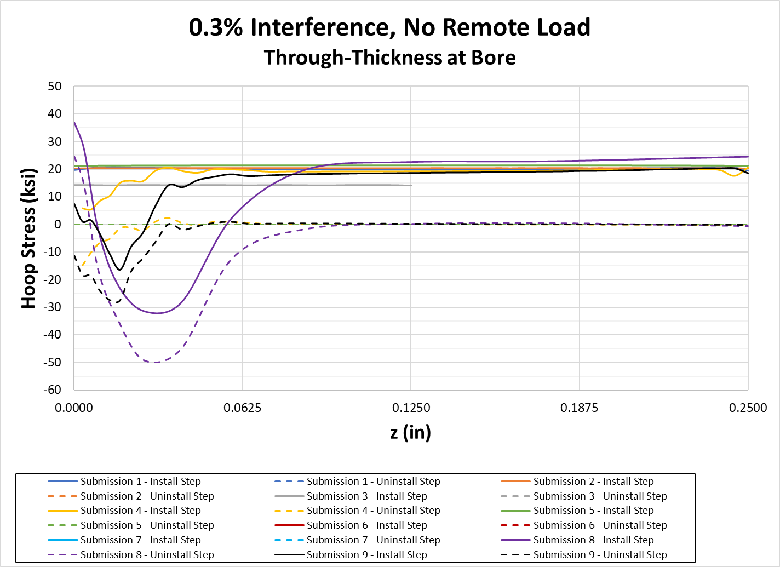
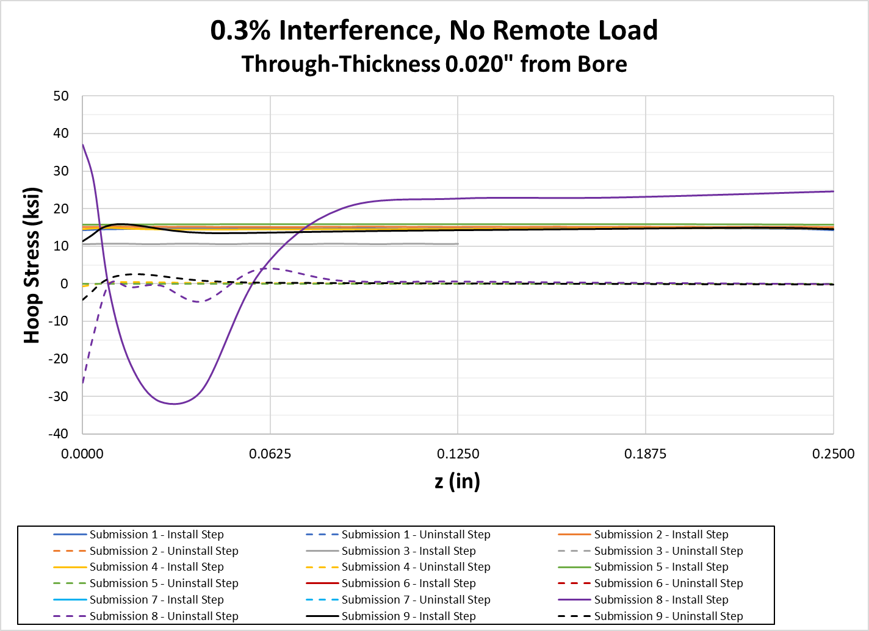
Comparison – 0.3% interference

Slide 25
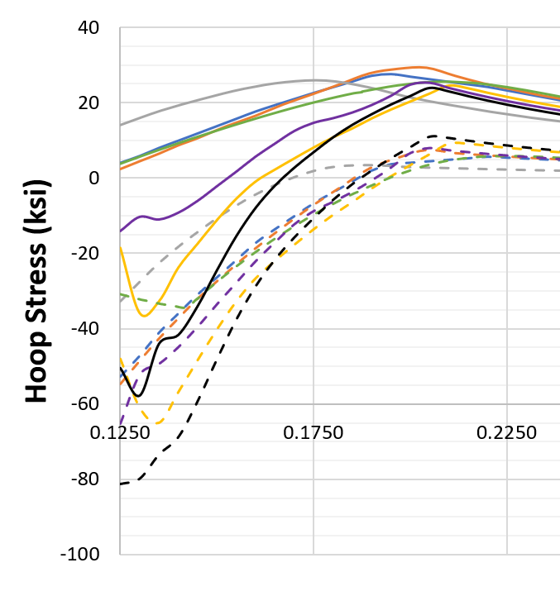
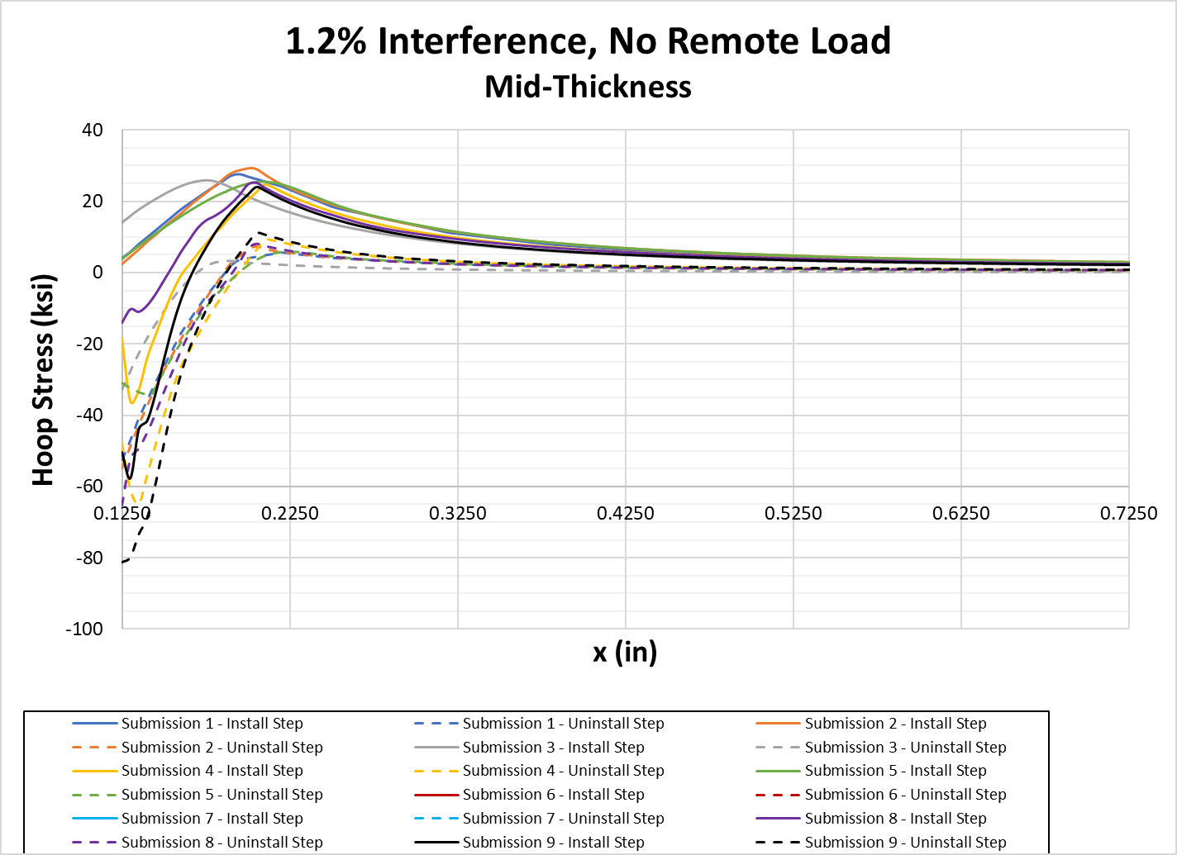
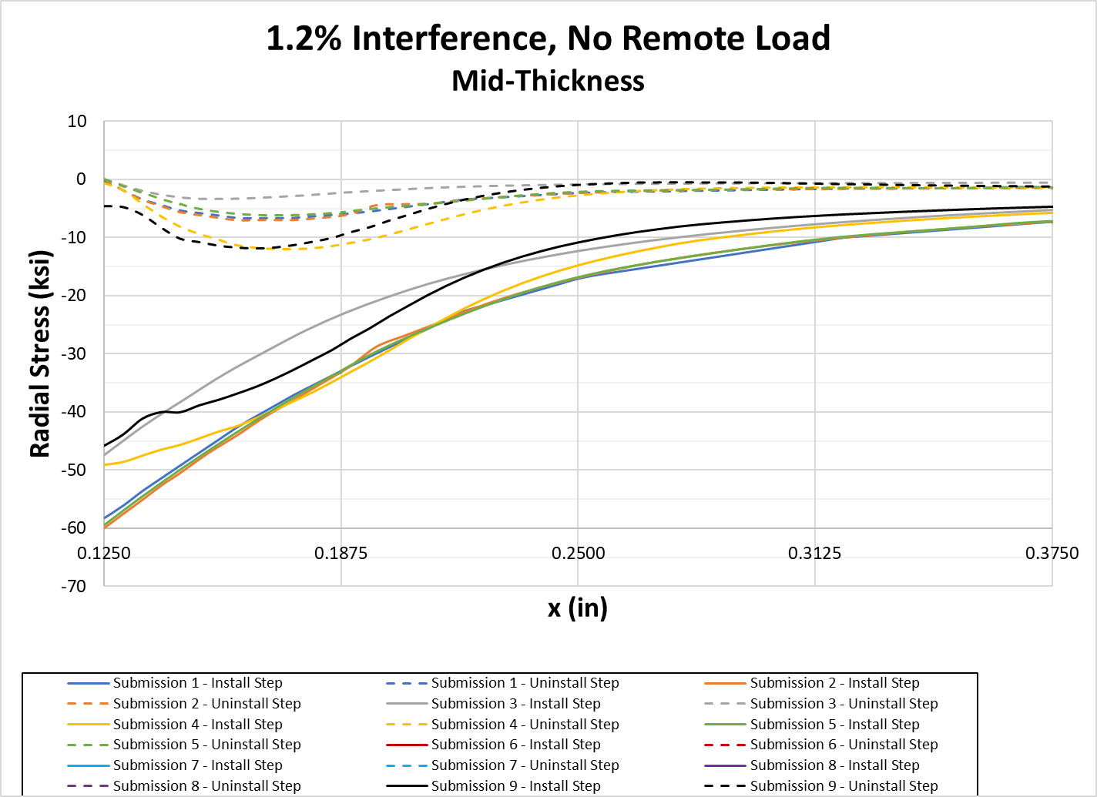
Comparison – 1.2% interference

Slide 26
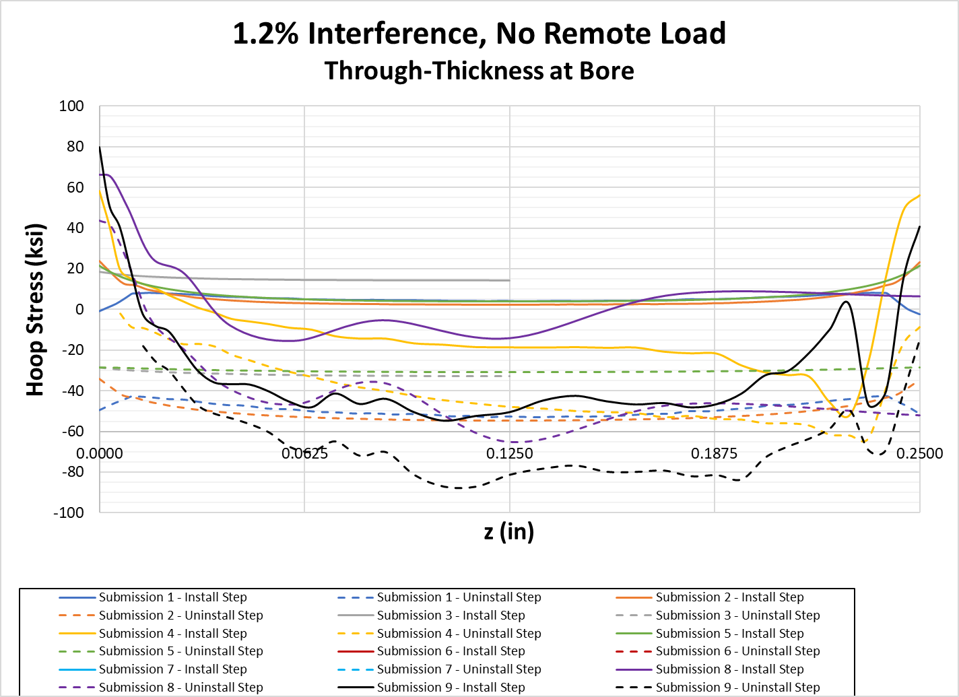
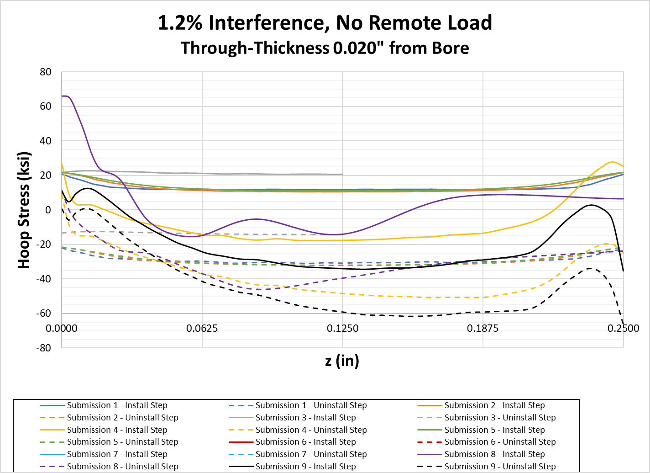
Comparison – 1.2% interference

Slide 27




Comparison – 1.2% interference, no remote load
Models that push the pin into the hole show compressive hoop stress near the bore
Similar results found previously (HOLSIP reference by FTI)
Another model with pin pushed in
Less aggressive pin transition
More aggressive pin transition
~ 1.8% interference

