Slide 1
Interference Fit Fastener – Working Group
Working Group on
Engineered Residual Stress Implementation
Robert Pilarczyk
rtpilarczyk@hill-engineering.com

Slide 2
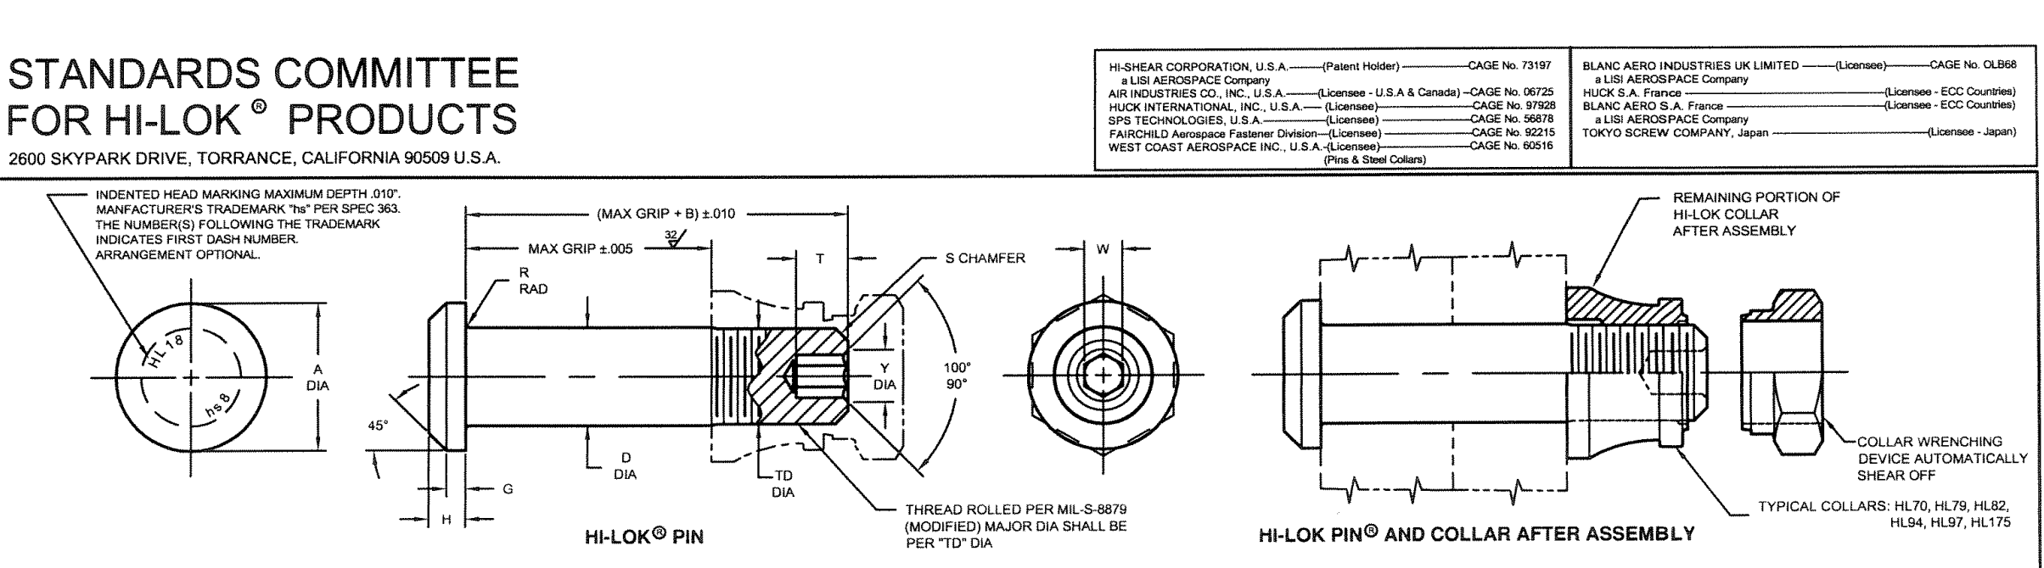
Fastener geometry and installation
Hi-Lok fasteners have a transition region
  From threaded portion to straight shank
    Chamfer/fillet
  Depending on modeling approach, this geometric feature could be important
Notice a small step in diameter here
http://www.jet-tek.com/hi-lok-pins/hl18.pdf

Slide 3
Fastener geometry and installation
Fastener installation
  Typically pushed into the hole with screw-driven process
  Several other ways
    Tapped into the hole
    Frozen to shrink diameter and slide into the hole
    Etc

Slide 4
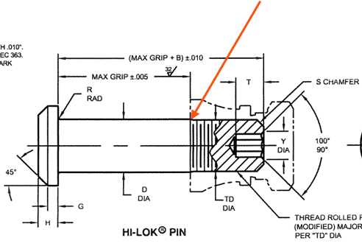
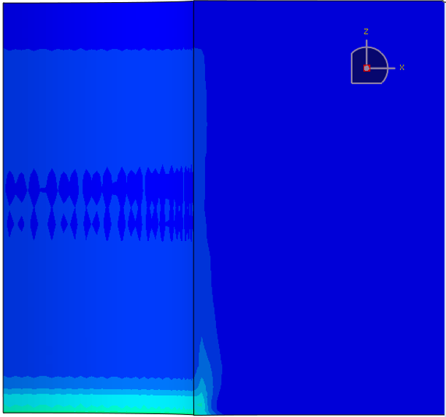
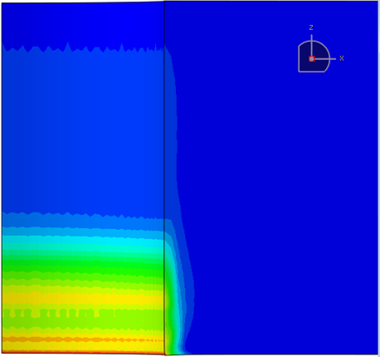
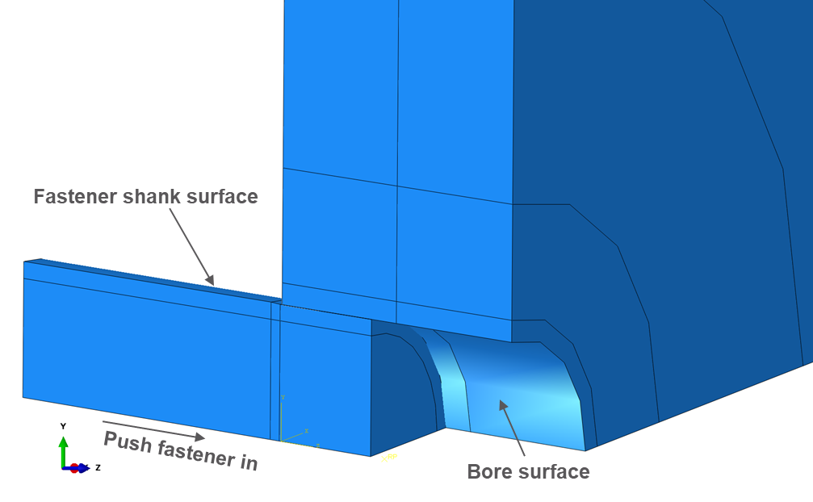
Fastener geometry and installation
FE modeling shows a significant influence of the chamfer geometry
  3D model, nonlinear elastic-plastic
  Fastener is incrementally pushed into the hole
    Solution for equilibrium for each incremental step
  More aggressive chamfer leads to higher levels of plasticity near the fastener entry side
  Longer, more gentle chamfer leads to lower levels of plasticity and more uniform results through the thickness
  Equivalent plastic strain comparison below
Equivalent plastic strain (PEEQ)
0.025” chamfer (more gradual transition)
0.010” chamfer (more abrupt transition)
Fastener exit
Bore
Installation direction
Hole edge
Fastener entrance

Slide 5
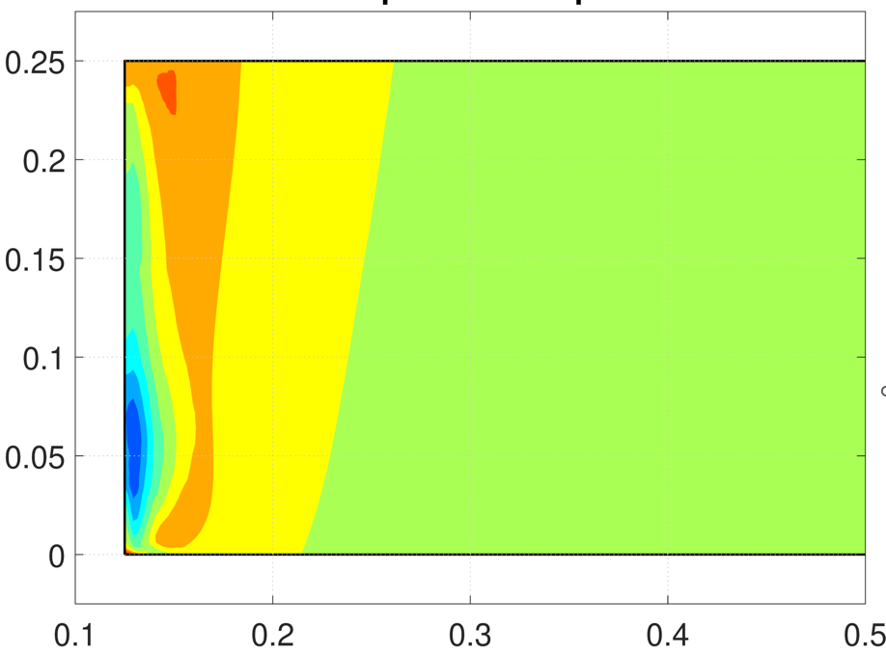
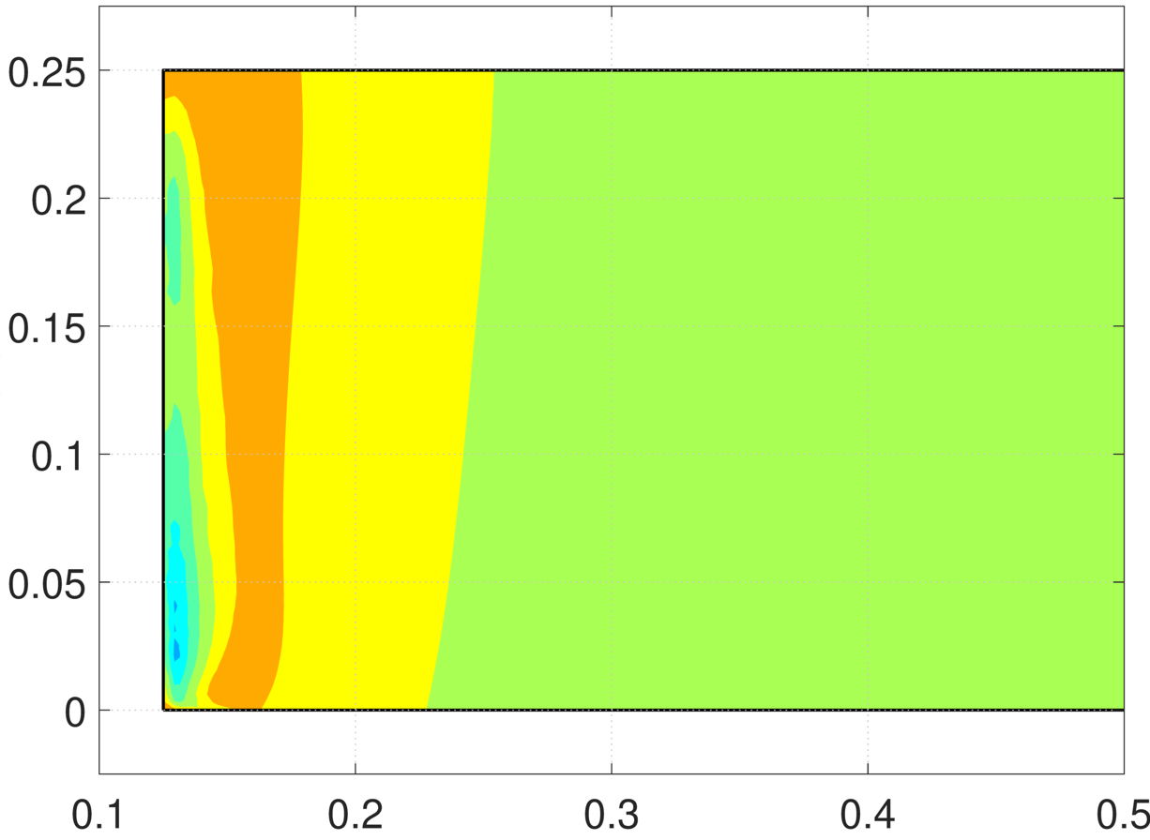
Fastener geometry and installation
FE modeling shows a significant influence of the chamfer geometry
  Influence of chamfer geometry on hoop stress field below
  More abrupt transition leads to more variation through the thickness near the bore
  More gradual transition leads to a stress field more uniform through the thickness
    Similar to what would be obtained with a simplified model expanding the entire bore surface at once
Hoop stress (fastener installed)
0.010” chamfer (more abrupt transition)
0.025” chamfer (more gradual transition)

