Slide 1
ERSI 2022 Boeing CSM Verification Test Data Round Robin Results
Moises Y. Ocasio

Slide 2
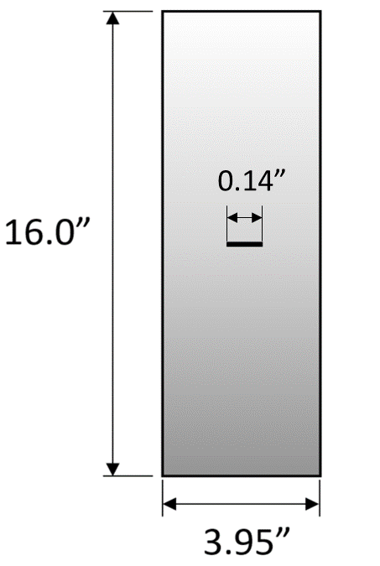
Summary
Aluminum 7075-T651,
Growth rate data provided from two sources : Boeing testing, MSU testing (Dr. Jim Newman)
2 tasks used for round robin exercise
  Task A: Constant Amplitude with Spike Overloads
  Task B: Fighter Lower Wing Spectrum

Slide 3
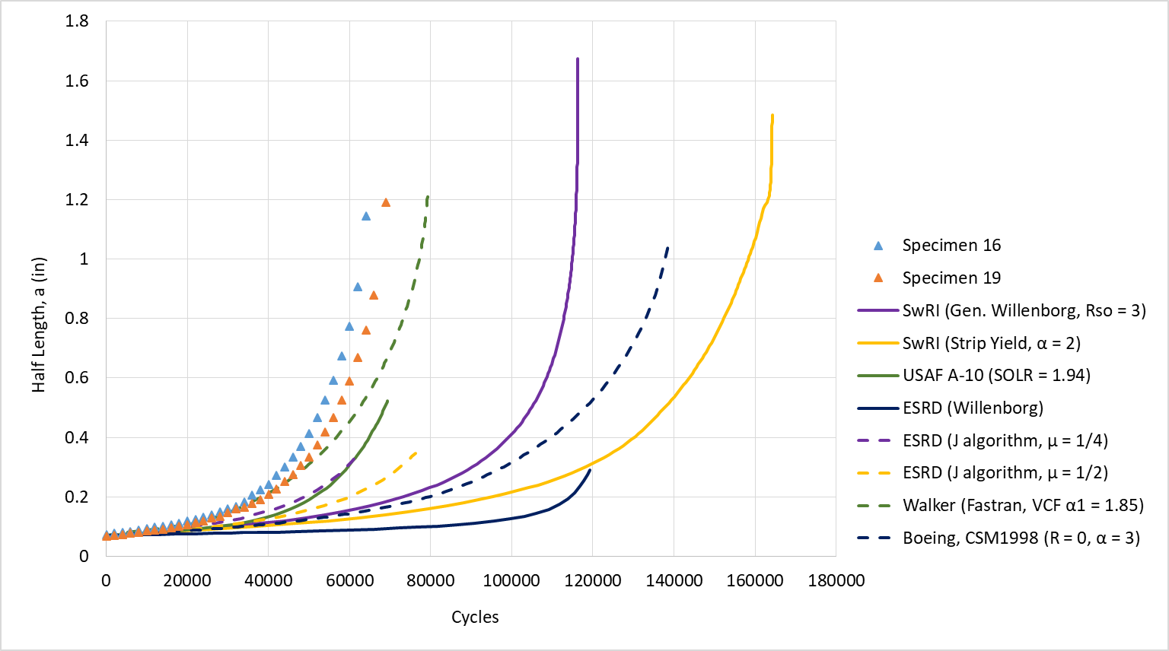
Configuration | Specimen Thickness (in) | Specimen Width (in) | Stress Level (ksi) | Stress Ratio | Test Type
A | 0.245 | 3.950 | 15.0 | 0.0 | Overload
Task A: Constant Amplitude with Spike Overloads Prediction
Submission | Errors (v. Specimen 16)
 | CG Life %error | acrit %error
SwRI (Gen. Willenborg, Rso = 3) | 82% | 46%
SwRI (Strip Yield, α = 2) | 157% | 30%
USAF A-10 (SOLR = 1.94) | 8% | -54%
ESRD (Willenborg) | 86% | -75%
ESRD (J algorithm, μ = 1/4) | -2% | -69%
ESRD (J algorithm, μ = 1/2) | 19% | -70%
Walker (Fastran, VCF α1 = 1.85) | 24% | 8%
Boeing, CSM1998 (R = 0, α = 3) | 117% | -8%

Slide 4
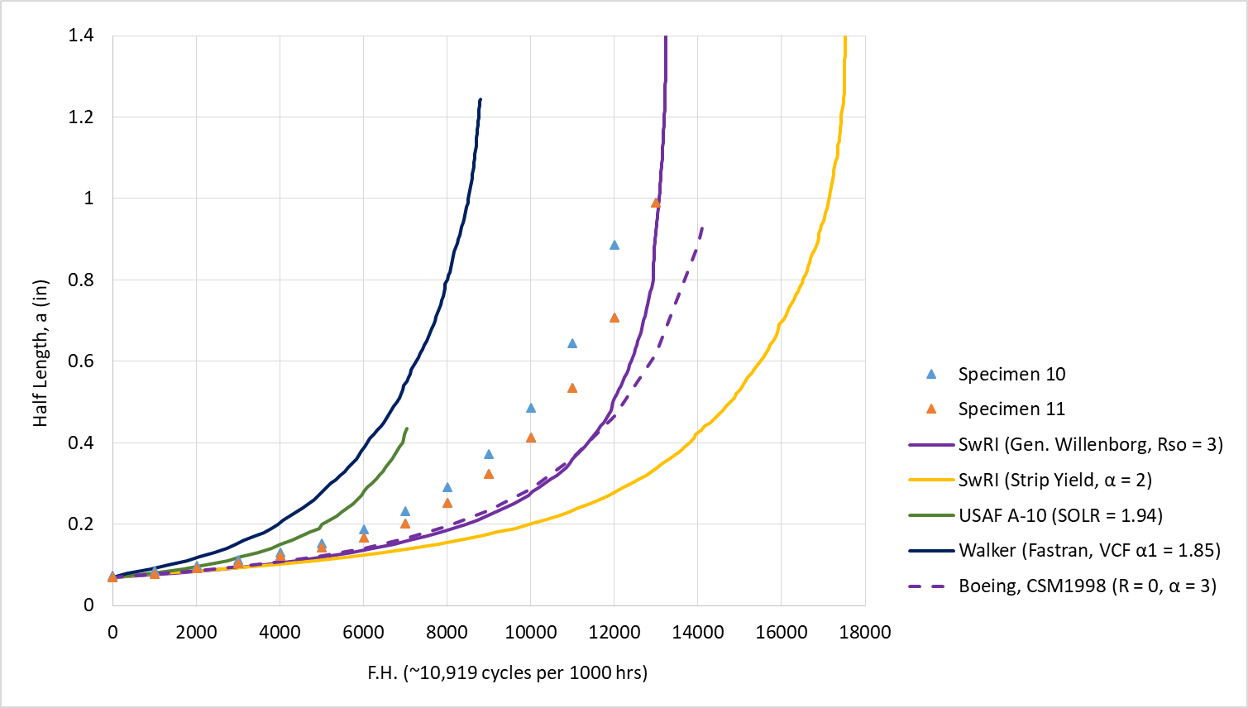
Configuration | Specimen Thickness (in) | Specimen Width (in) | Stress Level (ksi) | Test Type
B | 0.246 | 3.960 | 25.0 | Lower Wing
Task B: Fighter Lower Wing Spectrum
Submission | Errors (v. Specimen 10)
 | CG Life %error | acrit %error
SwRI (Gen. Willenborg, Rso = 3) | 10% | 74%
SwRI (Strip Yield, α = 2) | 46% | 68%
USAF A-10 (SOLR = 1.94) | -41% | -51%
Walker (Fastran, VCF α1 = 1.85) | -27% | 40%
Boeing, CSM1998 (R = 0, α = 3) | 18% | 6%

