Slide 1
Cross-Comparisons of Stress Intensity Factors from Various Sources
The Pathway to Improved SIF Solutions
ERSI FCG Analysis + Test Committee Meeting
Robert Pilarczyk
Hill Engineering LLC
AFGROW Workshop
13 September 2021

Slide 2
Acknowledgements
Special thanks to all the participants!!!!
  Dr. Börje Andersson
    BARE Research
  Joseph W. Cardinal
    Staff Engineer, Structural Engineering Department, Southwest Research Institute
  Jim Harter
    Senior Consultant, LexTech Inc.
  Dr. Adrian Loghin
    Senior Application Engineer, Simmetrix Inc.
  Dr. Sebastian Nervi
    Product Manager, Engineering Software Research and Development (ESRD) Inc
  Dr. Jim Newman
    Emeritus Professor, Department of Aerospace, Mississippi State University
  Dr. Per Nordlund
    MSC Software Corporation
  Dr. Kevin Walker
    QinetiQ Australia

Slide 3
Background
An initial FCG Analysis Methods round robin was completed to quantify the epistemic uncertainties in the prediction of crack growth life, given a fixed set of input data, for baseline and cold expanded (Cx) fastener holes [1,2]
  Specific input data developed to minimize the effect of random uncertainties but analysts were free to use any means to incorporate the residual stresses into their FCG life prediction
  The effort was an opportunity to exercise various analytical methods, comparing them to experimental results and uncovering strengths and weaknesses of the various approaches
During this initial round robin, the prediction sensitivity to the analysis inputs was highlighted with one specific case identifying the influence of error in the Mode I Stress Intensity Factor (K_{I}) for applied remote loading
  For several cases, error resulted in no crack growth (∆K_{I} lower than ∆K_{I,threshold})
As a result of these findings and subsequent discussions amongst the fatigue crack growth community, a follow-on collaborative round robin was established to investigate differences in stress intensity factors readily available in commercially available software like AFGROW and NASGRO

Slide 4
Objectives
Primary objective of the Stress Intensity Factor (SIF) round robin:
Evaluations included the root SIF solution and any corrections used to account for any additional corrections applied to the solution
  Single vs multiple cracks, finite width, and hole offset
Solutions compared to explicit Finite Element Analysis (FEA) results of each case
Findings intended to drive improvements to solutions available to the fracture mechanics community
  Evaluate differences between available SIF solutions for a single corner crack at a fastener hole with remote uniform tension loading

Slide 5
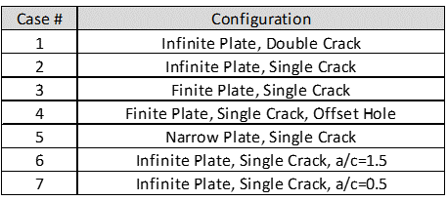
Overview
Seven different cases of corner cracks at a hole were developed and SIF solutions along the crack front were requested from participants
A building block approach was utilized, with Case 1 representing the root SIF solution available
  Without any corrections for single cracks, finite width, or hole offset, with a crack geometry aspect ratio (a/c) of 1.0
Each case added an additional level of complexity with corrections to the root solution as well as variations in the crack aspect ratio

Slide 6
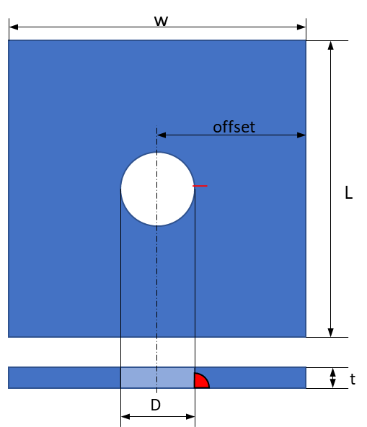
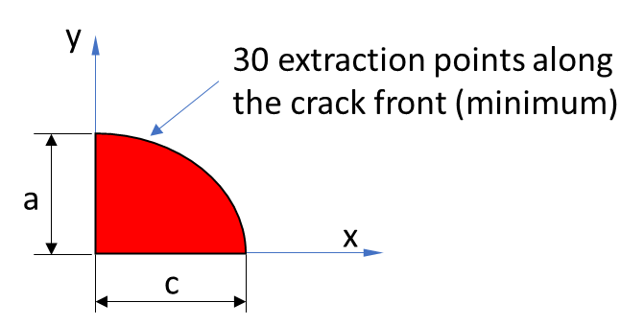
Overview: Analysis Inputs
Geometry
  Rectangular plate, width W, length L, and thickness t, diameter D
  Center hole (except Case 4)
Crack configuration
  Single corner crack at the hole
  Except Case 1 which uses double symmetric corner cracks
Loading conditions
  Uniform tension stress of 10 ksi applied at the ends of the coupon
Material properties:
  Young’s modulus E of 10,400 ksi
  Poisson’s ratio ν of 0.3
Uniform traction on ends
T = 10 ksi

Slide 7
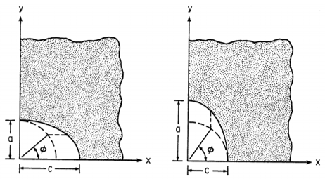
Overview: Analysis Inputs
Participants reported Mode I SIF versus the parametric angle
  Minimum of 30 SIF extraction points along the crack front
For finite plate configurations (Cases 3-5), L = 3W
All cases considered a/c = 1 except:
  Case 6, which considered a/c = 1.5
  Case 7, which considered a/c = 0.5

Slide 8
Submissions
Nine submissions were received from eight participants, with solutions utilized by
  AFGROW
  NASGRO
  Newman/Raju
  Fawaz/Andersson
  Explicit FEA
FEA approaches utilized various tools and methods which provides an additional opportunity to evaluate the different FEA approaches and their impact on the accuracy of the SIF
Seven reference solutions which have relative errors in K_{I} on the order of 0.03% or less were provided by Andersson (Submission 6), and were utilized as the reference solutions for each case evaluated

Slide 9
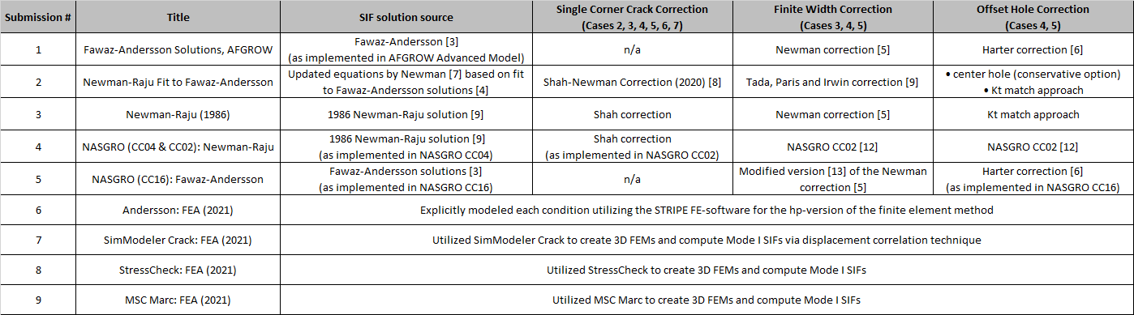
Submissions
Summary

Slide 10
Summary of Results
The following slides summarize comparisons for the seven cases evaluated
  For these comparisons, the Mode I SIF is plotted along the crack front as a function of normalized parametric angle
  Percent difference relative to Submission 6 from Andersson is also presented

Slide 11
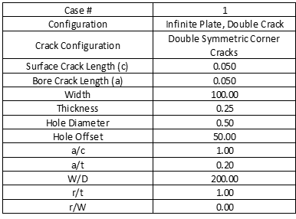
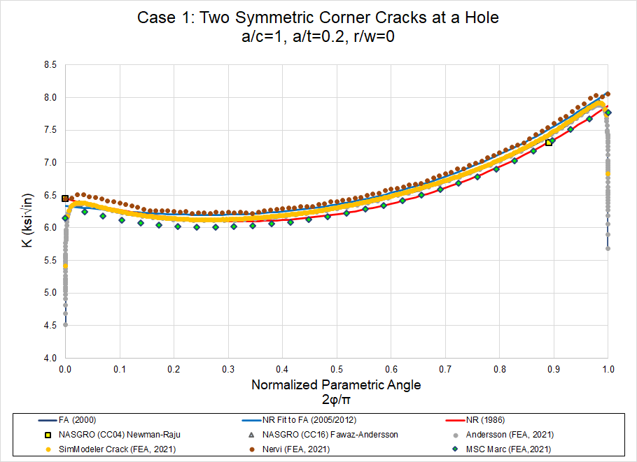
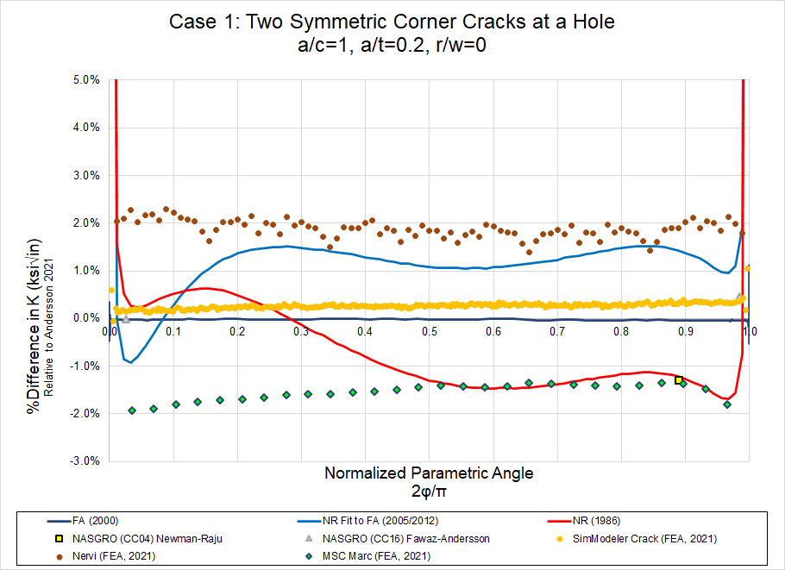
Summary: Case #1
Case #1: Two Symmetric Corner Cracks at a Hole, Infinite Plate
  Initial starting point to evaluate the root SIF solutions
    For this case, single crack, finite width, and hole offset corrections are not utilized
  Results within ±2% of Andersson submission, except near surface points

Slide 12
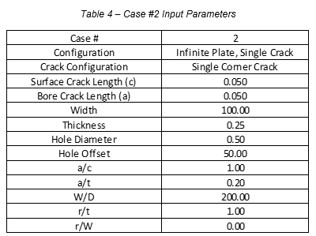
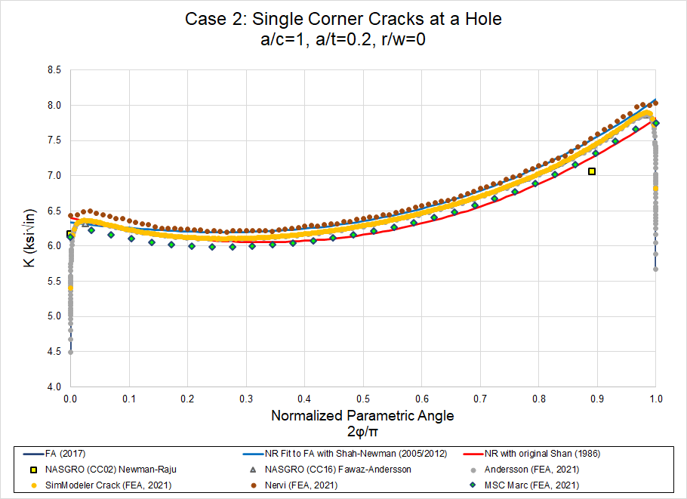
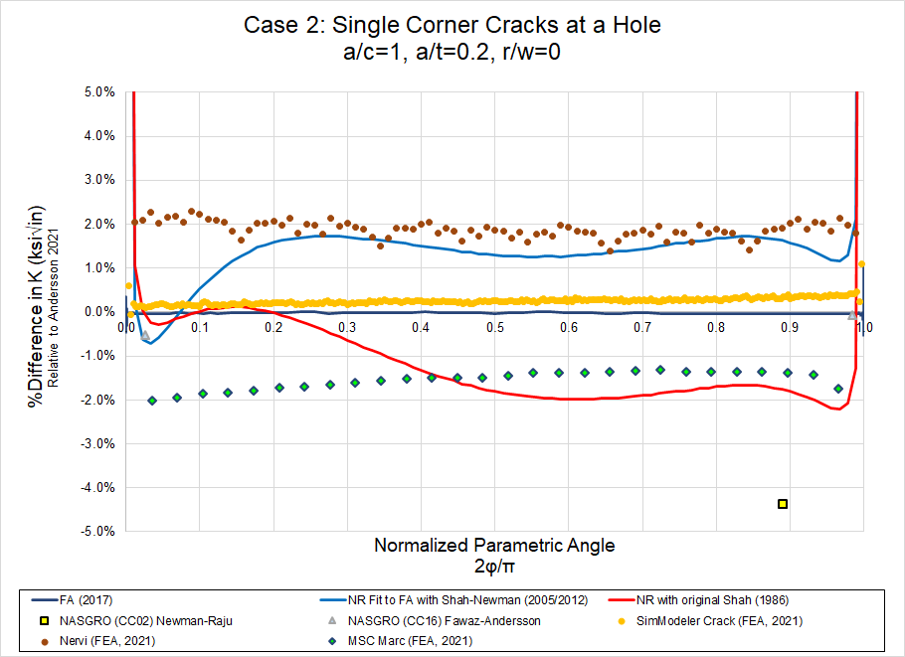
Summary: Case #2
Case #2: Single Corner Crack at a Hole, Infinite Plate
  Continuation from Case #1, incorporating effects of a single corner crack
    Submissions 2-4 utilize Shah or Shah/Newman corrections to adjust from double corner crack to single crack
    Submissions 1 & 5 utilized single crack modeling in development of root SIF solution
  Results generally within ±2% of Andersson submission, except near surface points
    Submission 4 (NASGRO CC02) differences exceeded 4% for point representative of hole bore

Slide 13
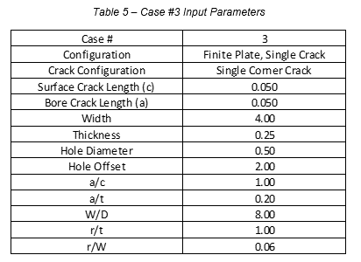
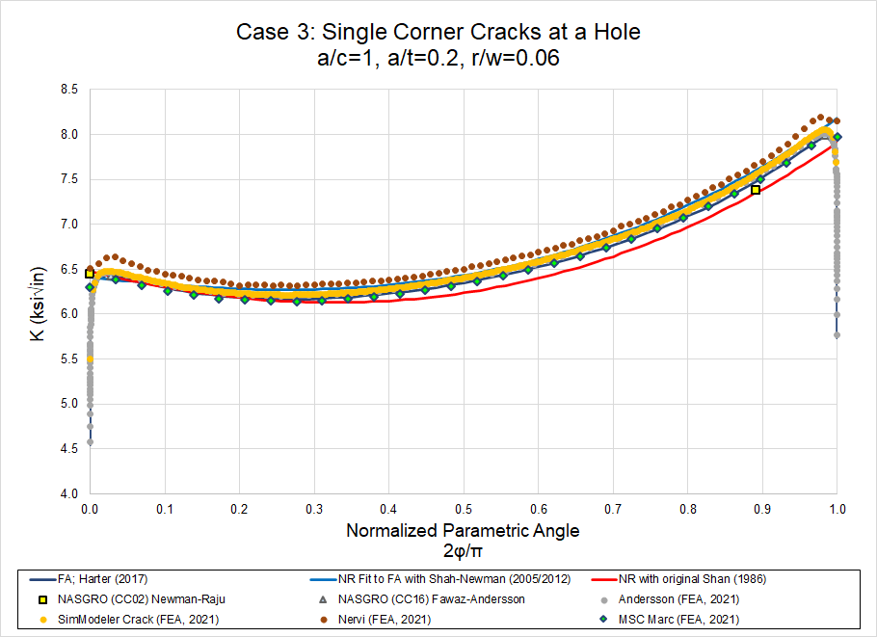
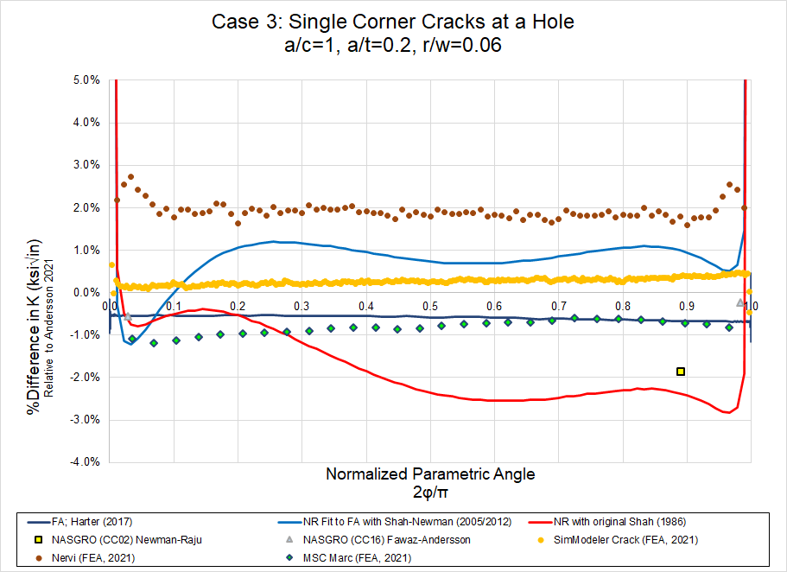
Summary: Case #3
Case #3: Single Corner Crack at a Hole, Finite Plate
  Continuation from Cases 1-2, incorporating finite width effects
    Submissions 1-3 utilized the Newman finite width correction. Submission 4 used the correction from [12] and Submission 5 used the correction from [13]
  Results generally within ±2% of Andersson submission, except near surface points
    Submission 3 (Newman-Raju 1986) differences exceeded 2% over a range of 0.4-1.0 normalized parametric angle, representative of crack front near the hole bore

Slide 14
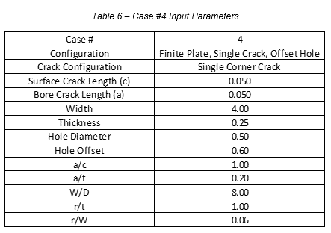
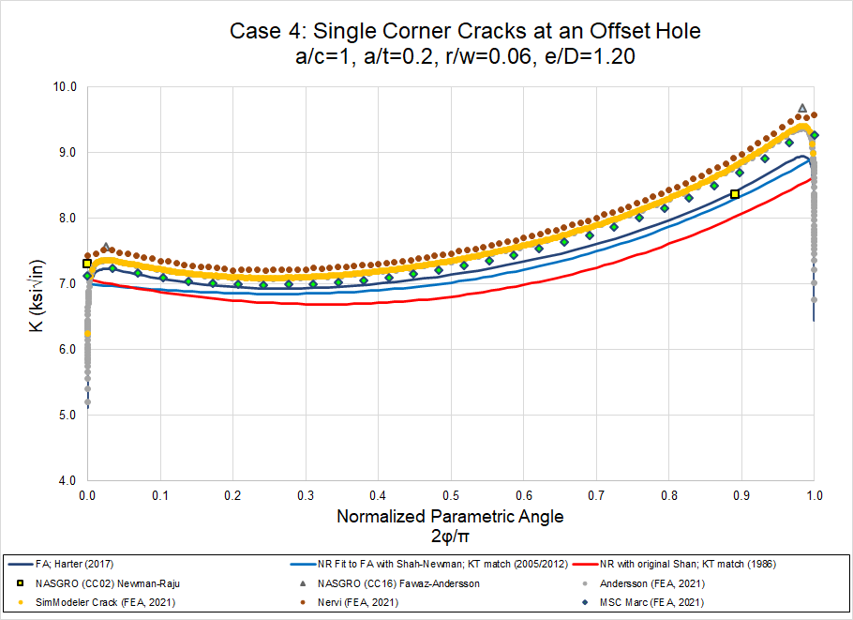
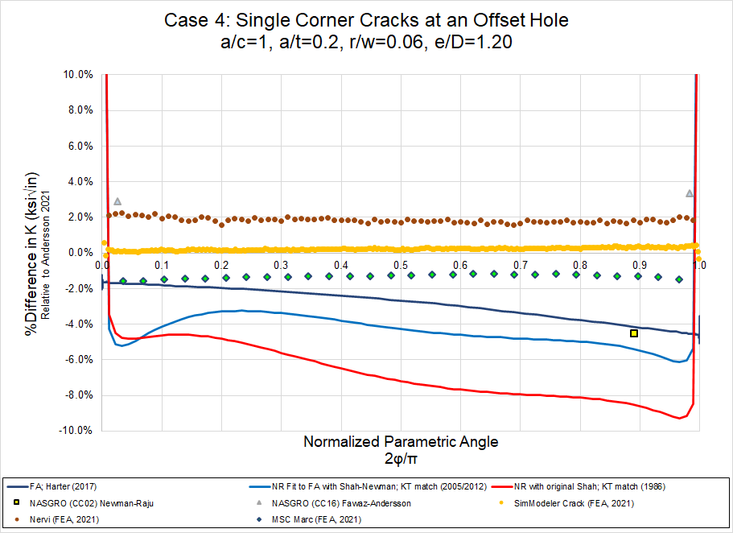
Summary: Case #4
Case #4: Single Corner Cracks at a Hole, Finite Plate, Offset Hole
  Continuation from Cases 1-3, incorporating hole offset effects
    Submission 1 utilized the Harter offset correction
    Submission 2-3 investigated two approaches to characterize the short offset, however, the Kt match approach was utilized for comparison
    Submission 4 used the correction from [12] and Submission 5 used the correction from [13]
  Significant differences (nearly 10% relative to Andersson submission) observed for Submissions 1-4

Slide 15
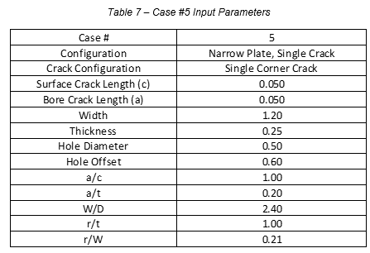
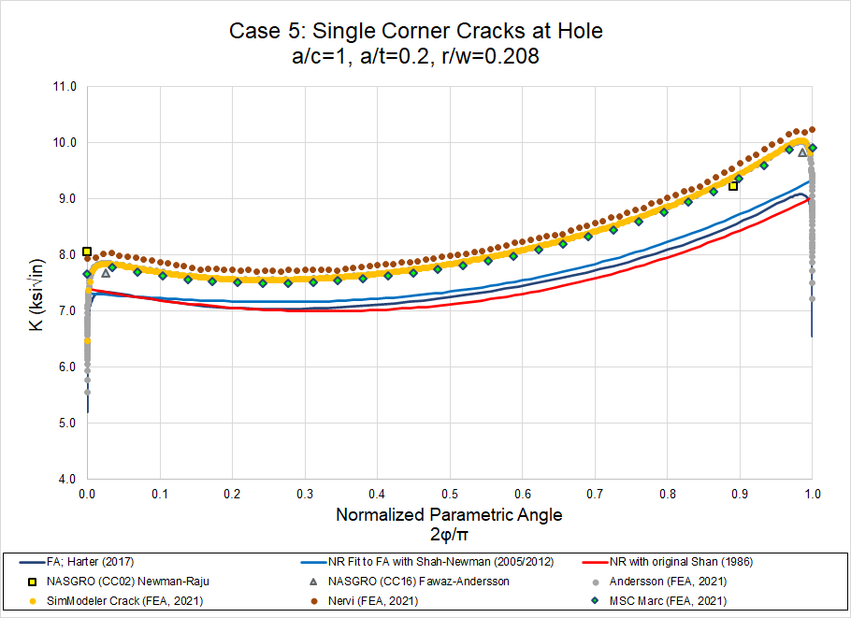
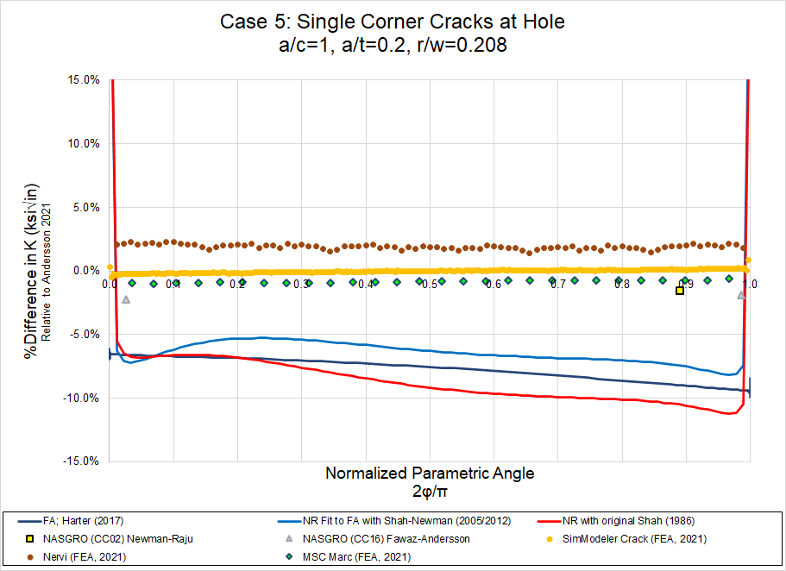
Summary: Case #5
Case #5: Single Corner Crack at a Hole, Narrow Plate
  Continuation from previous cases, but for relatively “narrow” width
    Submissions 1-3 utilized the Newman finite width correction
    Submission 4 used the correction from [12] and Submission 5 used the correction from [13]
  Significant differences (5-12% relative to Andersson submission) observed for Submissions 1-3, which utilized Newman finite width correction

Slide 16
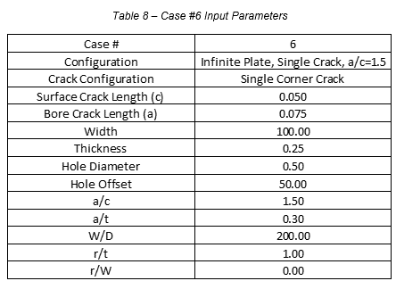
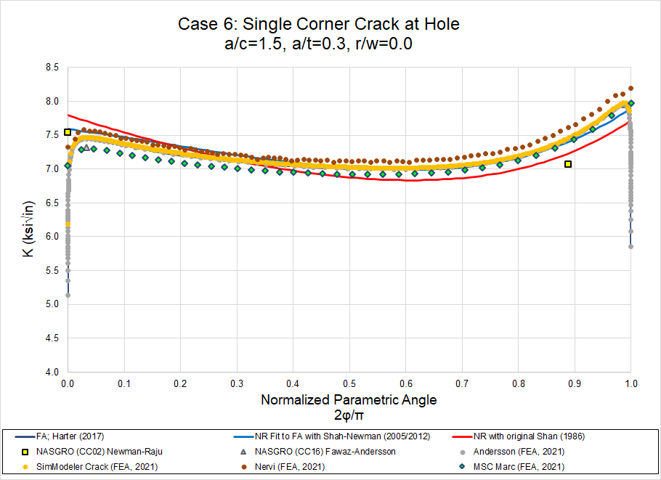
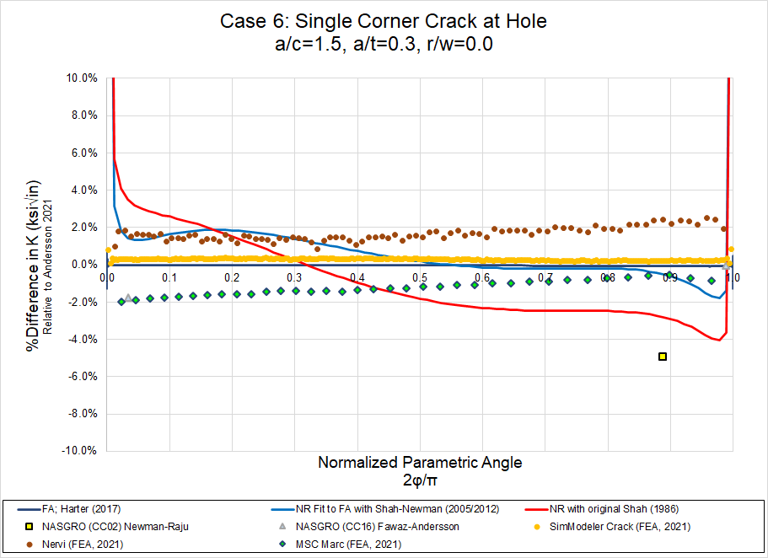
Summary: Case #6
Case #6: Single Corner Crack at a Hole, Infinite Plate, a/c=1.5
  Replicate of Case #2 but with a crack aspect ratio of a/c=1.5
  Results generally within ±2% of Andersson submission, except near surface points
    Submission 3 (Newman-Raju 1986) showed differences of ±4% across crack front
    Submission 4 (NASGRO CC02) showed differences over 4% for point representative of hole bore

Slide 17

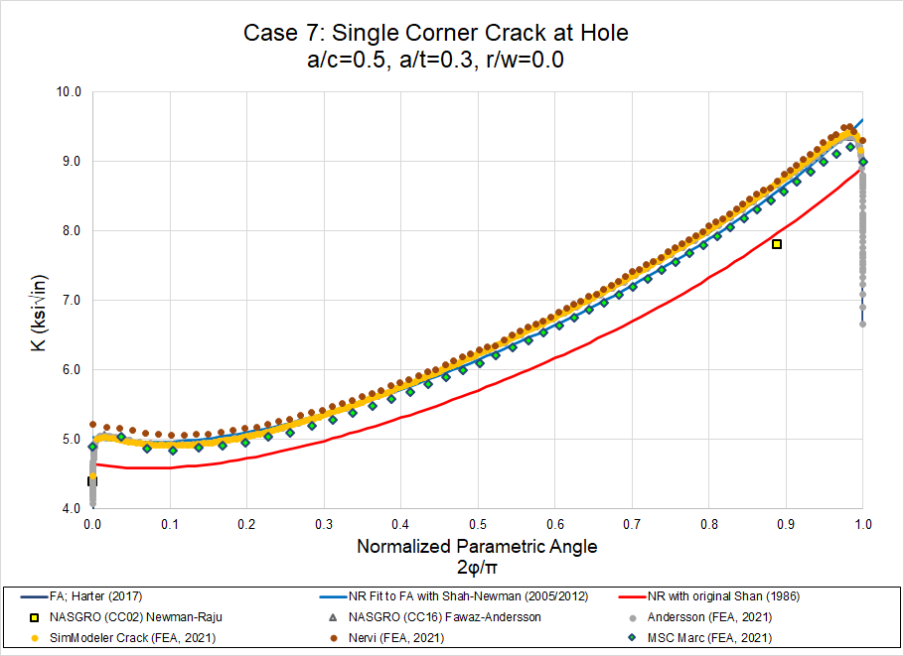
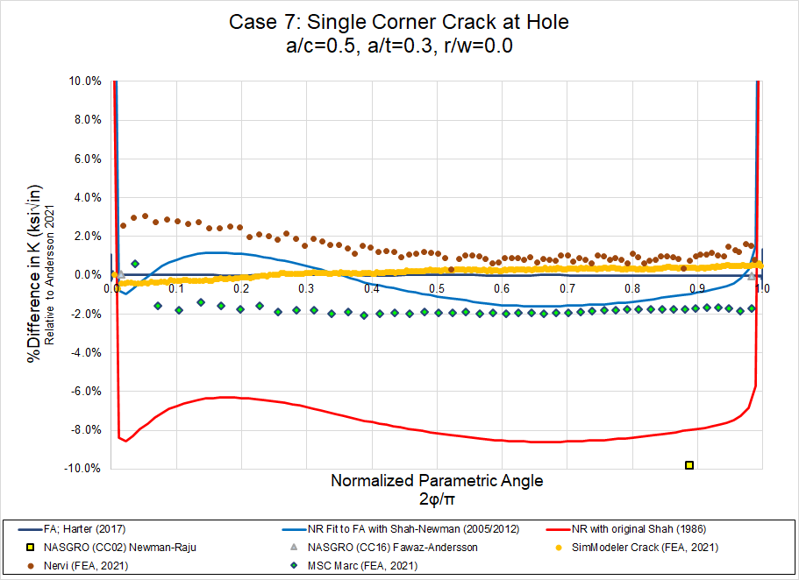
Summary: Case #7
Case #7: Single Corner Crack at a Hole, Infinite Plate, a/c=0.5
  Replicate of Case #2 but with a crack aspect ratio of a/c=0.5
  Results generally within ±2% of Andersson submission, except near surface points
    Submission 3 (Newman-Raju 1986) showed differences averaging ~8% across the crack front
    Submission 4 (NASGRO CC02) showed differences of 10% for point representative of hole bore

Slide 18
Individual Summary and Conclusions
Submission 2: Newman-Raju Fit to Fawaz-Andersson
  Results are within 2% for all cases except case 4 (about 6% maximum error) and case 5 (about 8% maximum error)
  Solutions accurate to within 2% are considered acceptable for most analyses, but errors of 6-8% are larger than desired for a reliable analysis.
  The errors for cases 4 and 5 are likely the result of limitations in the finite width correction. Improved finite width corrections are discussed in this report and are expected to improve the accuracy for the Submission 2 results.
Submission 4: NASGRO (CC04 & CC02): Newman-Raju
  For comparison purposes, the NASGRO (CC02) and (CC04) solutions were included in the round robin exercise, however, this solution has been superseded by CC16 and is not recommended for use anymore
  The comparisons shown for the a-tip provide evidence to no longer use CC02 and CC04

Slide 19
Individual Summary and Conclusions
Submission 5: NASGRO (CC16): Fawaz-Andersson
  Parametric angles for the a-tip and c-tip CC16 SIF values were provided that correspond approximately with the maximum SIF values from the “exact” Andersson (2021) solutions
    This is the best way to make an apple-to-apples comparison with the Andersson (2021) solutions and is consistent with the CC16 development based on the earlier Fawaz-Andersson solutions
  These parametric angles were generally from 1 to 3 degrees from the surface depending on the case considered
  In NASGRO, for engineering purposes, the single (local maximum) values computed at the offset angles are assigned to 0 and 90 degrees

Slide 20
Individual Summary and Conclusions
Submission 6: Andersson: FEA (2021)
  BARE has delivered several 100 million accurate K-solutions to USAF Academy since 2003 which now are available in AFGROW and NASGRO, the method used for K-calculation developed 30 years ago
  A strongly graded mesh towards and along the crack fronts are used (hp-version FEM)
    All these meshes are designed to give relative errors of order ~0.03% along the entire crack front
  These K-solutions are so accurate they follow the functional behavior K=const*s^{0.04782}
    s being the distance to the vertex, very accurately in a large region near the vertex
    'const' can easily be determined in each of these millions of solutions leading to analytic formulas for K(s) near vertices
    Note that for countersunk hole geometries K often goes to infinity near vertices
      In such cases it is practical to express the solution near the vertex as a constant
      For example constant=10 in K=constant*s^{(-0.10)}

Slide 21
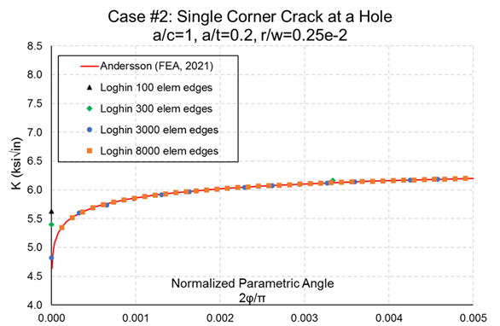
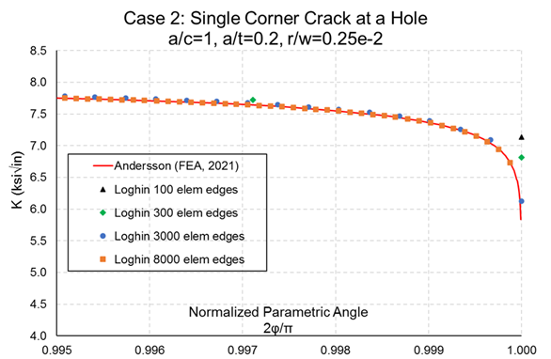
Individual Summary and Conclusions
Submission 6: Andersson: FEA (2021)
  For the seven benchmark cases we used our standard procedures for K-calculation
    The relative error in K_{I} in all seven solutions are then 0.03% of less
    Made detailed convergence studies for Case #2 and compared these solutions with Loghin high accuracy solutions obtained with highly refined meshes

Slide 22
Individual Summary and Conclusions
Submission 7: SimModeler Crack: FEA (2021)
  SimModeler Crack was employed to create 3D finite element models and compute Mode I SIF values for the benchmark problems considered in this study
  Any SimModeler Crack user can duplicate the results provided in this submission
  SimModeler Crack follows an integrated CAD to FEA modeling process which allows users to easily adopt it in their design and life assessment process
  CAD representation of each benchmark model was used to define the crack, create the associated mesh, apply boundary conditions and loading using geometric entities
  For all cases, ANSYS was used as a solver
  SIF values (all three modes) along each crack front are computed by SimModeler

Slide 23
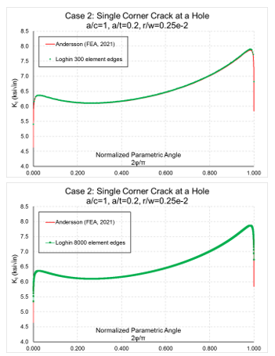
Individual Summary and Conclusions
Submission 7: SimModeler Crack: FEA (2021)
  For each 3D model utilized, stress and displacement contours along with Mode I SIF for each case are provided for a detailed release of the results and a potential reference data for other studies
  In Case 2, six models containing different mesh refinement along crack front were considered for a convergence study
    The densest crack front mesh contains 8000 element edges
  It was shown:
    With increased crack front mesh density mode I SIF solution is convergent
    The converged solution is within 0.2% average relative difference from Andersson’s semi-analytical solution
    Even though different techniques and formulations were used to compute stress intensity factors, Andersson and Loghin solutions match within 0.2%, comparison provided at right

Slide 24
Individual Summary and Conclusions
Submission 8: StressCheck: FEA (2021)
  ESRD interpreted the objective of this round robin (evaluate differences between available SIF solutions for a single corner crack at a fastener hole with remote uniform tension loading…compared to explicit finite element modeling of each case), as establishing a reference and a framework for DaDT engineers when using these tools for computing SIFs in an industrial setting
  Since the desired accuracy depends on the goal of the analysis, having the feedback information in the form of a reliable estimate of the relative error in the quantity of interest (QoI) is an essential technical requirement
  In addition, users must be provided means to reduce the relative error at the expense of a reasonable amount of additional computational effort, when necessary
  The error of approximation was evaluated from a converging sequence of solutions obtained by p-extension on a fixed mesh
  No prior knowledge of an exact solution or the reference results provided herein were used for error estimation, such information is not available in industrial applications

Slide 25
Individual Summary and Conclusions
Submission 9: MSC Marc: FEA (2021)
  As MSC Marc is a general purpose commercial non-linear solver, focus is on ease-of-use
    Model setup using solid geometry, both for plate and crack location
    Model is set up in minutes
  The crack and refined mesh is automatically created inside the Marc solver.
    A special focused mesh with very regular mesh is used around the crack
  VCCT was used for the SIF evaluation
    Alternatively, the more accurate J-integral can be used
    The mesh used is perfect for J-integral evaluation
    No assumption is made about an exact solution
    Standard lower order tetrahedral elements used
    Runs in a minute on a laptop
  Assumed that the recommended resolution of 30 elements along the crack should be used
    Yes, it said minimum
  Despite the relatively coarse mesh, results are within 2%
    Thanks to the regular mesh
    Definitely need finer mesh to resolve the solution near the ends
    One can easily bias the edge lengths towards the ends
  If needed, the crack can also grow, and the refined region will follow the crack

Slide 26
Overall Summary and Conclusions
Successful SIF comparisons completed utilizing a wide array of available solutions and toolsets, with submissions provided by (8) different participants
Overall, results were within 2% of the reference case, however, deviations were observed for narrow width and varying aspect ratio cases exceeded 10% in some cases
Issues with commonly utilized finite width corrections were discovered
A robust dataset was developed that can be utilized as a reference set for follow-on studies
Comparisons between varying FEM approaches have highlighted the opportunity to identify modeling best practices and provide guidance to the community

Slide 27
Next Steps
Finalizing summary report documenting round robin approach, results, conclusions, and follow-on investigations
New finite width corrections in work to support the community
Collaboration to identify FEA best practices and lessons learned
Consider publication of papers/presentations to share results with community

Slide 28
Thank you!!
Questions?

Slide 29
References
R. Pilarczyk, et al, “Successful Round Robin Analyses Resulting from the Engineered Residual Stress Implementation Working Group”, Materials Performance and Characterization, ASTM, DOI: 10.1520/MPC20190210
R. Pilarczyk, “Lifing Methods and Experimental Validation of Engineered Residual Stress, in Proceedings of the 2019 Aircraft Structural Integrity Program (ASIP) Conference (San Antonio, TX: Universal Technology Company, 2019).
https://ntrs.nasa.gov/api/citations/19840015857/downloads/19840015857.pdf
S.A. Fawaz, B. Andersson, “Accurate Stress Intensity Factor Solutions for Corner Cracks at a Hole”, Engineering Fracture Mechanics 71(9) (2004) 1235-1254.
Newman, J. C., Jr. and Raju, I. S., “Stress-intensity Factor Equations for Cracks in Three-Dimensional Finite Bodies,” Fracture Mechanics, Fourteenth Symposium --Volume 1, Theory and Analysis, ASTM STP 791, 1983, pp. 238-265.
Harter, James, A. “AFGROW User’s Guide and Technical Manual, Version 5.3”, Section3.2.3.1.1.5, https://afgrow.net/DocumentHandler.ashx?name=AFGROW_Technical_Manual_and_Users_Guide_5-3-5-24.pdf
Newman, J.C., Jr., Evaluation of Structural Integrity Analysis Methodologies for Corrosion Prediction Models, Final Report S&K Technologies, Inc., July 2005 (Revision June 2012).
Private communication: Improved Shah/Newman single corner crack correction
H. Tada, Paris, P.C., and Irwin, G.R., The stress analysis of cracks, Del Research Corporation 1973.
Newman, J. C., Jr. and Raju, I. S., “Stress-intensity Factor Equations for Cracks in Three-Dimensional Finite Bodies Subjected to Tension and Bending Loads,” Computational Methods in the Mechanics of Fracture, Vol. 2, S. N. Atluri (ed.), 1986, pp. 311-334.

Slide 30
References
R.C. Shah, Stress Intensity Factors for Through and Part-Through Cracks Originating at Fastener Holes, in: J.R. Rice, P.C. Paris (Eds.), ASTM International, West Conshohocken, PA, 1976, pp. 429-459.
Yeh, F., Mettu, S.R., and Forman, R.G., “Stress intensity factors for a through crack from an offset hole in a finite plate by boundary element method,” Johnson Space Center, Tech. Rep. JSC-29835, 2000.
Y. J. Guo, “Finite width correction and hole offset correction for one corner crack at an offset hole in a finite plate,” NASGRO, Houston, TX, USA, Tech. Rep. Internal, 2013.
https://www.esrd.com/product/computation-of-sifs-in-stresscheck/
Finite Element Analysis: Method, Verification and Validation, 2nd Edition. Barna Szabó and Ivo Babuška, John Wiley & Sons, Inc., United Kingdom, 2021. ISBN: 978-1-119-42642-4.
B. Andersson, U. Falk and I. Babuska, “Accurate and Reliable Calculation of Edge and Vertex Intensity Factors in Three-Dimensional Elastomechanics”, The 17th Congress of the International Council of the Aeronautical Sciences, Sept 9-14, 1990, Stockholm Sweden, Paper ICAS-90-4.9.2, pp 1730-1746
B. Andersson and J. Greer, “Creation and Verification of World’s Largest K_I-Databases for Multiple Cracks at Countersunk and Straight-Shank Hole in a plate subject to Tension, Bending and Pin-Loading”, International Committee for Aeronautical Fatigue ICAF, 29’th Symposium Nagoya, 7-9 June 2017, 10 pp
A. Loghin, Life Prediction Modeling Capabilities for FE Applications, CAASE18, Cleveland, OH, USA, 2018, https://www.researchgate.net/publication/325695699_LIFE_PREDICTION_MODELING_CAPABILITIES_FOR_FE_APPLICATIONS
A. Loghin, S. Ismonov, V&V 3D Fatigue Crack Growth Modeling: From Deterministic to Uncertainty Quantification (UQ) assessment, CAASE20, https://www.researchgate.net/publication/342282698_VV_3D_Fatigue_Crack_Growth_Modeling_From_Deterministic_to_Uncertainty_Quantification_UQ_assessment

Slide 31
References
A. Loghin, S. Ismonov, Application of Gaussian Process and Three-Dimensional FEA in Component Level Crack Propagation Life Assessment, NWC2019. https://www.researchgate.net/publication/334044793_Application_of_Gaussian_Process_and_Three Dimensional_FEA_in_Component_Level_Crack_Propagation_Life_Assessment
www.ansys.com
https://www.3ds.com/products-services/simulia/
http://www.dhondt.de/

Slide 32
Backup Slides

Slide 33
Follow-on Investigations
Case #2 Convergence Study: Two convergence studies were carried out in parallel
  Andersson (Submission 6)
    Made use of an hp-formulation and showed that the original solution (Andersson FEA 2021) had a relative in K of order 0.03% or less at arbitrary points along the crack front
    Then derived a solution with relative error ~0.01% along the entire crack front including the vertex regions
    This was possible by utilizing the known mathematical behavior of the solution near a vertex
    By using a least-square approximation to the calculated p=8 solution (obtained with a fine mesh) got two analytic expressions for K near and at the two vertices which are ~0.01% in error
    By using these two analytic expressions and the p=8 solution away from vertices, have a very accurate semi-analytic expression for K, which was used for comparison with Loghin high-accuracy solutions
  Loghin (Submission 7)
    Made use of a built-in element formulation in ANSYS and (7) uniform meshes (100, 200, 300, 1000, 2000, 3070, 8200 element edges) along the crack front via SimModeler
    Stress intensity factor values are computed in SimModeler using displacement correlation technique
    The semi-analytical solution derived by Andersson was used as a reference in the convergence study to calculate relative difference for each solution
  It is shown that, with increased mesh refinement, SimModeler solution is within 0.2% relative difference from Andersson’ semi-analytical formulation

Slide 34
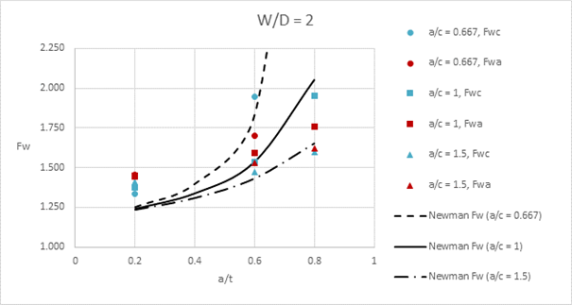
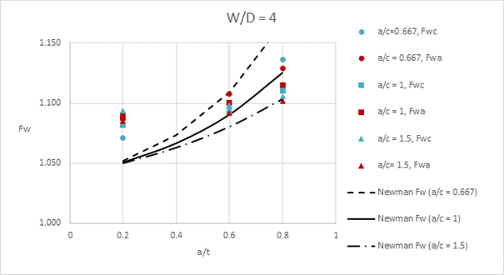
Follow-on Investigations
Finite Width Correction
  The Newman finite width correction [5] appears incorrect for Case #5
    A comparison with FEA results (SimModeler) for a few sample cases indicate that this finite width correction is too low for cracks when a/t ~< 0.6
    When a/t > 0.6 and W/D < 4, the correction becomes too large
    In addition, this correction is assumed to apply equally to both crack growth directions
    FEA results for W/D ≤ 4 (r/t = 1) indicate differences in width correction for each growth direction > 5%
    For W/D ≤ 2, the difference becomes exceptionally large (10% – 15+%)
    The required finite width corrections are shown with the Newman correction for these cases

Slide 35
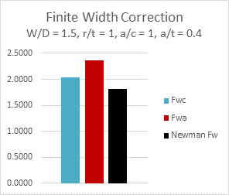
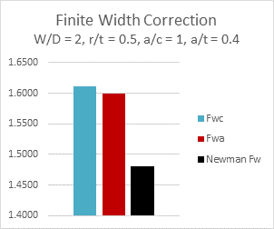
Follow-on Investigations
Finite Width Correction (cont’d)
  The Newman finite width correction [5] appears incorrect for Case #5
    A few additional cases were analyzed using SimModeler for a different r/t and higher aspect ratio cracks to assess sensitivity of the finite width correction to other geometric parameters
    Appears the width correction for narrow plates is a function of several parameters (i.e., a/c, a/t, and r/t)
    The additional cases included an extremely narrow plate (W/D = 1.5), an example for a narrow plate with r/t = 0.5, and two higher aspect ratio cracks (a/c = 4 and a/c = 6)
    Narrow plate with W/D =1.5, a/c = 1, a/t = 0.4, and r/t = 1
      Difference in width corrections is ~17%
      The Newman width correction is 10 – 25% too low
    Narrow plate with W/D = 2.0, a/c = 1, a/t = 0.4, and r/t = 0.5
      Difference in width corrections is < 1%
      The Newman width correction is approximately 7.5% too low
    Results indicate hole radius to thickness ratio (r/t) has significant effect on required finite width correction

Slide 36
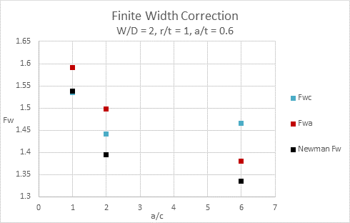
Follow-on Investigations
Finite Width Correction (cont’d)
  The Newman finite width correction [5] appears incorrect for Case #5
    The effect of crack aspect ratio is also very interesting
      Differences between the finite width correction in
      each growth direction is relatively minor (~3-5%)
      The Newman correction tends to be low in all cases,
      but the magnitude of the width correction switches
      from being higher in the a-direction for a/c = 1 and 2,
      to becoming lower in the a-direction for a/c = 6
    This issue should be investigated thoroughly since
    major modifications are required to correct the
    closed-form finite width correction
    In 2013, Guo [13] developed revised finite width
    corrections for the a-tip and c-tip values
    Andersson has completed analyses to support an updated finite width correction
    Solutions being utilized by Harter and Newman to generate new finite width corrections

Slide 37
Follow-on Investigations
Submission 8 (StressCheck FEA) Updated Meshing Strategy & Associated Results
  All use cases were cast on a single parametric file with guided mesh (creation of a ‘parent’ coarse mesh followed by automatic h-discretization)
  The advantage of this approach is that high accuracy (for this study we targeted < 0.5%) can be achieved with minimal computational effort (< 1 min to produce a sequence of solutions of increasing number of degrees of freedom by p-extension and to extract the SIFs along the crack front for each case)
  The computation of the SIFs performed using the Contour Integral Method described in [15]
  Convergence in the estimated error in energy norm (global) and local convergence on SIF was obtained from the solutions computed using uniform p-extension from p-level 6 to 8
  For more details on recommended approach for computing SIF in StressCheck refer to [14]

Slide 38
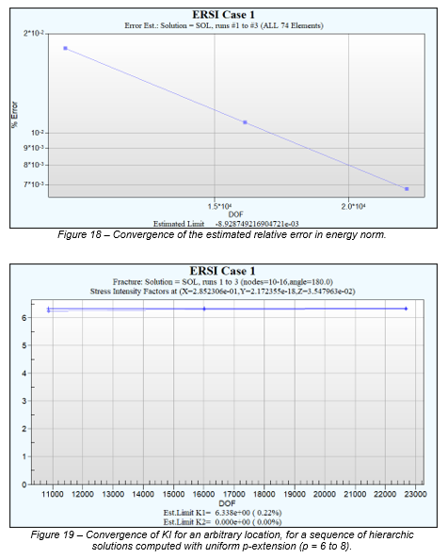
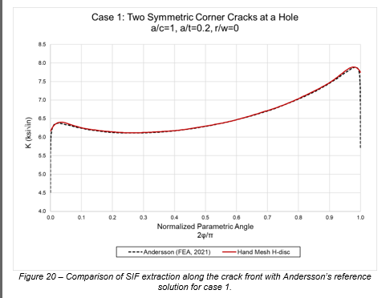
Follow-on Investigations
Submission 8 (StressCheck FEA) Updated Meshing Strategy & Associated Results
  Case 1: Double Symmetric Corner Cracks (Infinite Plate)

Slide 39
Submissions
Submission 1: Fawaz-Andersson Solutions, AFGROW
  Utilized SIF solutions from Fawaz-Andersson [3] for a single corner crack at a fastener hole which are currently utilized in the Advanced Model solutions in AFGROW
  To correct for a finite width, the Newman correction [5] is utilized (Cases 3-5)
  To account for an offset hole, the Harter correction [6] is utilized (Cases 4-5)

Slide 40
Submissions
Submission 2: Newman-Raju Fit to Fawaz-Andersson
  Utilized updated equations by Newman [7] based on fit to corner crack at hole Fawaz-Andersson solutions [4]
  To correct for a single corner crack, Shah-Newman Correction (2020) [8] was utilized (Cases 2-7)
  To correct for a finite width, the Tada, Paris and Irwin correction [9] is utilized (Cases 3-5)
  To account for an offset hole, two methods were investigated (Cases 4-5)
    First option was to assume the total width was 1.2 inches with a center hole (conservative option)
    Second option was to also assume a central hole but modify width such that K_{t} at the edge of the hole (short ligament side) matches the correct K_{t} for the offset hole geometry
      Expected to produce more accurate solution (referred to as the K_{t} match approach)

Slide 41
Submissions
Submission 3: Newman-Raju (1986)
  Utilized the 1986 Newman-Raju solution [9]
  To correct for a single corner crack, the Shah correction was utilized (Cases 2-7)
  To correct for a finite width, the Newman correction [5] is utilized (Cases 3-5)
  To account for an offset hole, two methods were investigated (Cases 4-5)
    See details from Submission 2
    The K_{t} match approach was utilized for comparisons

Slide 42
Submissions
Submission 4: NASGRO (CC04 & CC02): Newman-Raju
  Utilized the NASGRO CC04 solution, which incorporates 1986 Newman-Raju solution [9]
  To correct for a single corner crack, the Shah correction in the NASGRO CC02 model was utilized (Cases 2-7)
  To correct for finite width effects and an offset hole, the NASGRO CC02 model utilizes a solution for a through crack from an offset hole in a plate [12] (Cases 3-5)
  These legacy NASGRO solutions (CC02 and CC04) were included in the round robin exercise for comparison purposes & have been superseded by CC16 and are not recommended for use anymore

Slide 43
Submissions
Submission 5: NASGRO (CC16): Fawaz-Andersson
  Utilized the NASGRO CC16 solution, which incorporates Fawaz-Andersson solutions [3]
    Fundamentally based on the original Fawaz-Andersson solutions, CC16 represents the a-tip and c-tip SIFs with single values based on the local maximum (peak value) observed near the surface, which is usually around 2 to 3 degrees, but varies from case to case
  To correct for a finite width, a modified version of the Newman finite width correction factor [5] was used [13] (Cases 3-5)
  To account for an offset hole, the Harter correction from AFGROW [6] is utilized in NASGRO CC16 solution (Cases 4-5)
  For the comparisons in this study, the CC16 results are compared to the Andersson (2021) local maximum results at the angles reported for the Andersson (2021) solutions

Slide 44
Submissions
Submission 6: Andersson: FEA (2021)
  Explicitly modeled each condition utilizing the STRIPE FE-software for the hp-version of the finite element method
  Convergence tests and comparisons to the exact solution were completed for case
  Shown that point wise relative error in K at arbitrary points along the seven crack fronts was less than 0.03%
  This submission was utilized as the reference solution for comparisons as a result of the convergence studies

Slide 45
Submissions
Submission 7: SimModeler Crack: FEA (2021)
  Utilized SimModeler Crack to create 3D finite element models and compute Mode I SIFs via displacement correlation technique based on model solution performed in ANSYS, ABAQUS or CalculiX
    SimModeler Crack is a pre- and post-processor designed for component level finite element-based 3D FCG simulations
  For all models, a similar overall mesh refinement and a uniform mesh size that provides about 300 element edges along the crack front were used
    For Case 2, an average relative difference of 0.23% from Andersson semi-analytic solution was computed, with similar differences expected for the other cases

Slide 46
Submissions
Submission 8: StressCheck: FEA (2021)
  Utilized StressCheck to create 3D finite element models and compute Mode I SIFs
    Initial modeling approach utilized recommended modeling practices for cracked bodies, with automated graded meshing towards the crack front, targeting an estimated error in the computation of SIF within 2%
    Additionally, the same cases were computed utilizing a completely parametric model with guided mesh targeting an estimated error in the computation of SIF ≤ 0.5%
    The computation of the SIFs was performed using the Contour Integral Method
    Solution verification included the estimated relative error in energy norm (global error measure) and the local convergence of SIFs at points along the crack front from a sequence of solutions obtained by uniform p-extension from p-level
    No prior knowledge of an exact solution or the reference results provided herein were used for error estimation, such information is not available in industrial applications

Slide 47
Submissions
Submission 9: MSC Marc: FEA (2021)
  Utilized MSC Marc to create 3D finite element models and compute Mode I SIFs
    Marc is a general-purpose non-linear solver with special capabilities for crack initiation and crack growth using automatic remeshing
    The mesh for the crack evaluation was generated automatically, using the recommended minimum number of evaluation point of 30 as the number of nodes along the crack front

