Slide 1
Interference Fit Fastener – Working Group
Working Group on
Engineered Residual Stress Implementation
Robert Pilarczyk
rtpilarczyk@hill-engineering.com

Slide 2
Agenda
Review Physics of Interference Fit Fastener
Characterize Existing Methods & Data
Identify Key Factors and Gaps in Current Methods/Data
Sources of numerical and experimental UQ
Define Working Group Goals/Objectives
Develop Plan to Achieve Goals/Objectives
Identify Roles for Working Group Members
Discuss Available Resources

Slide 3
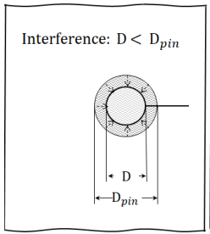
Physics of IFF Behavior
Interference fit consists of a pin inserted in a hole with smaller diameter
  Contact pressure and friction
  Interference introduces stress in the plate
    Tensile hoop stress: maximum at the hole edge, decays with distance from the hole
      Directly affects fatigue crack growth
    Radial compressive stress
Interference fit has been shown to slow crack growth and lead to longer life [need some references]
Haikal, et al. 2021 ASIP, Austin, TX.
http://meetingdata.utcdayton.com/agenda/asip/2021/proceedings/presentations/P21565.pdf
Need plot that details change in K as a function of load for different interference levels

Slide 4
Physics of IFF Behavior
XXX
  Capture additional stiffness due to IFF as the crack propagates
  R ratio changes along the crack front for each increment
From Adrian Loghin

Slide 5
Existing Methods
From Adrian Loghin
AFGROW
  Filled hole correction
NASGRO
  Pin-loaded holes with neat fit pin (several solutions, TC03, TC13, etc)
  TC38 – through crack at (offset) hole with interference fit
LifeWorks (Boeing
  No current IFF benefit (yet)
  Neat fit correction factor based on contact FEM
  FEMDriver solution for driven StressCheck model with a crack in a filled hole
Other
  Interference stress modeled as residual stress
  Explicit FEA modeling with contact
  BAMpF K-Array
Before talking about existing IFF fatigue crack growth numerical implementations, we need to show that the stress analysis that was used to generate the solutions is correct by verifying it against NASA solution (from Kevin Walker)
The far field-local loading cycle needs to be identified and documented
The IFF KI solutions are dependent on accuracy of the stress analysis where no crack is present in the model
There is a direct relationship between IFF variability along the bore and the fatigue crack growth. This relationship needs to be identified by FEA where no crack is present in the model.

Slide 6
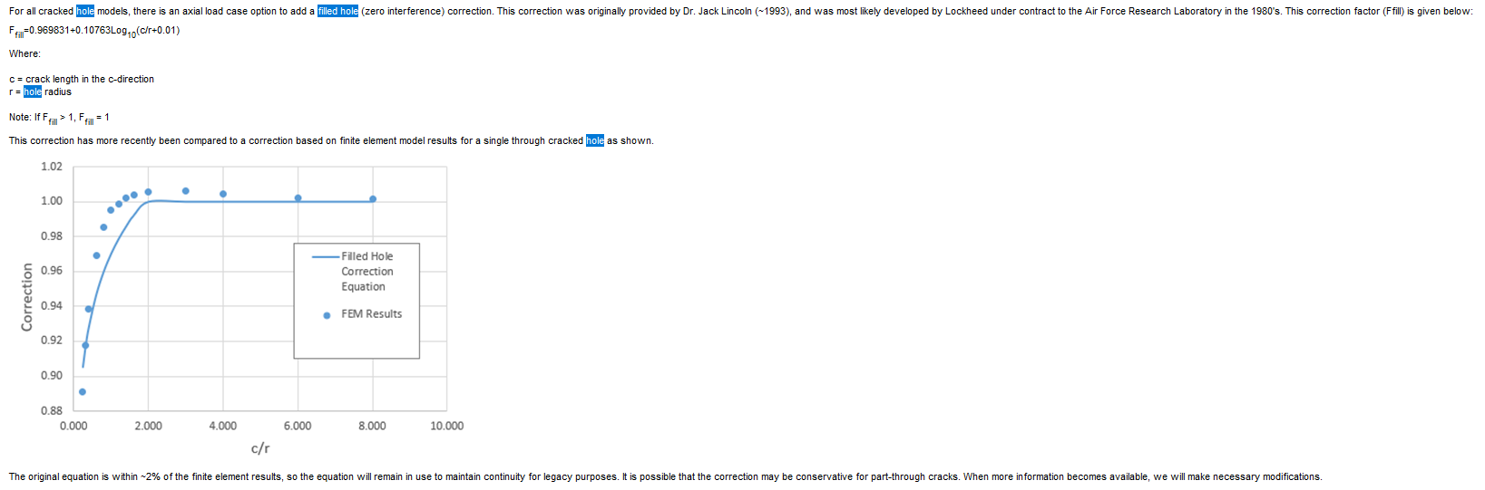
Existing Methods
AFGROW
  Filled hole correction (zero interference)
  Description from Help menu below
    Correction factor from approximately 0.9 to 1
    Beta correction factor on K
AFGROW version 5.4.1.25, 2020.

Slide 7

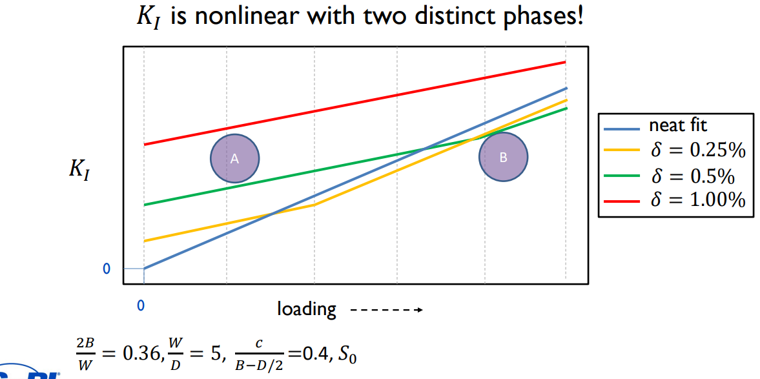
Existing Methods
NASGRO TC38 – through crack at (offset) hole with interference fit
Developed with 2D finite element models
  Stress intensity factor solutions obtained for wide variety of parameters
  Results show bilinear trend in SIF vs loading
  Used Latin Hypercube Sampling to produce a set of FE solutions to interpolate from
    300 Abaqus models for each load
    Find fit parameters and incorporate in data tables for TC38 solution
  Verification of TC38 done with sets of 2500 random samples using LHS points in the range of acceptable inputs
Haikal, et al. 2021 ASIP, Austin, TX.
http://meetingdata.utcdayton.com/agenda/asip/2021/proceedings/presentations/P21565.pdf
https://member-nasgro.swri.org/system/tdf/nasgro_v10.0f_release_notes_0.pdf?file=1&type=node&id=42026&force=0

Slide 8



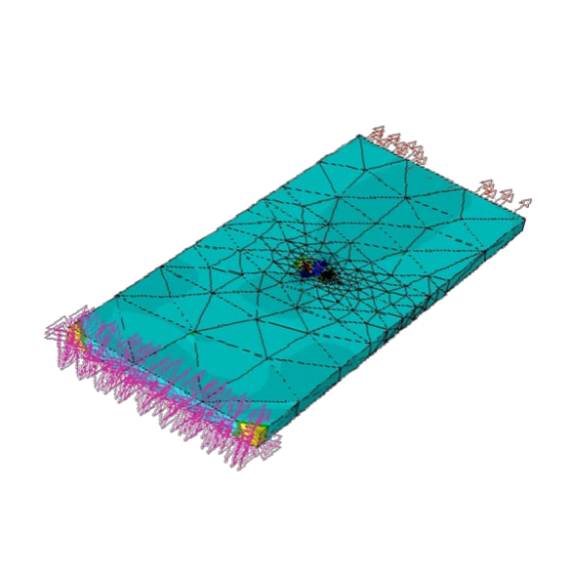
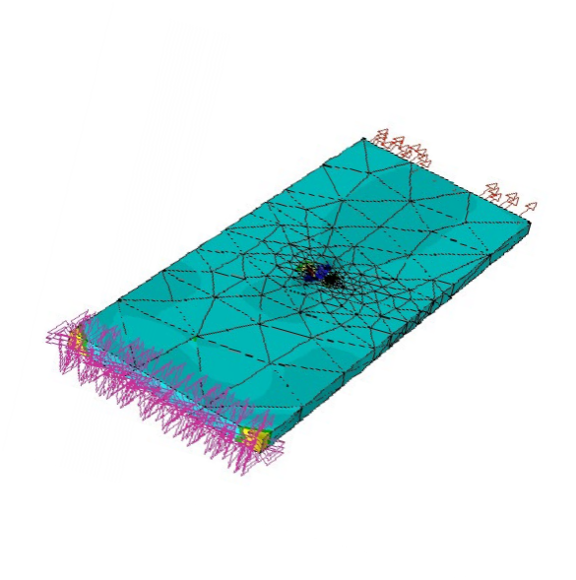

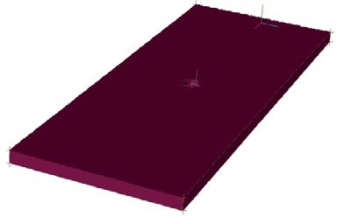
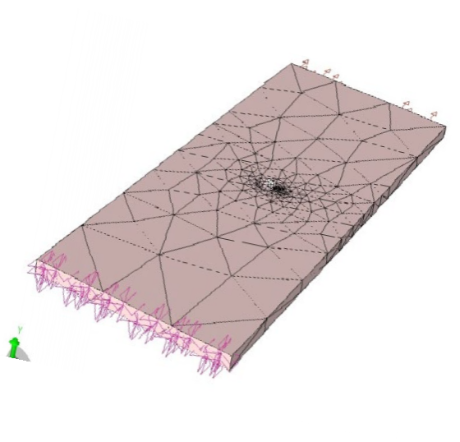
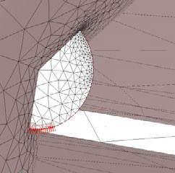

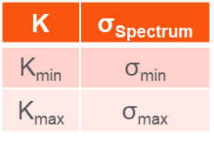

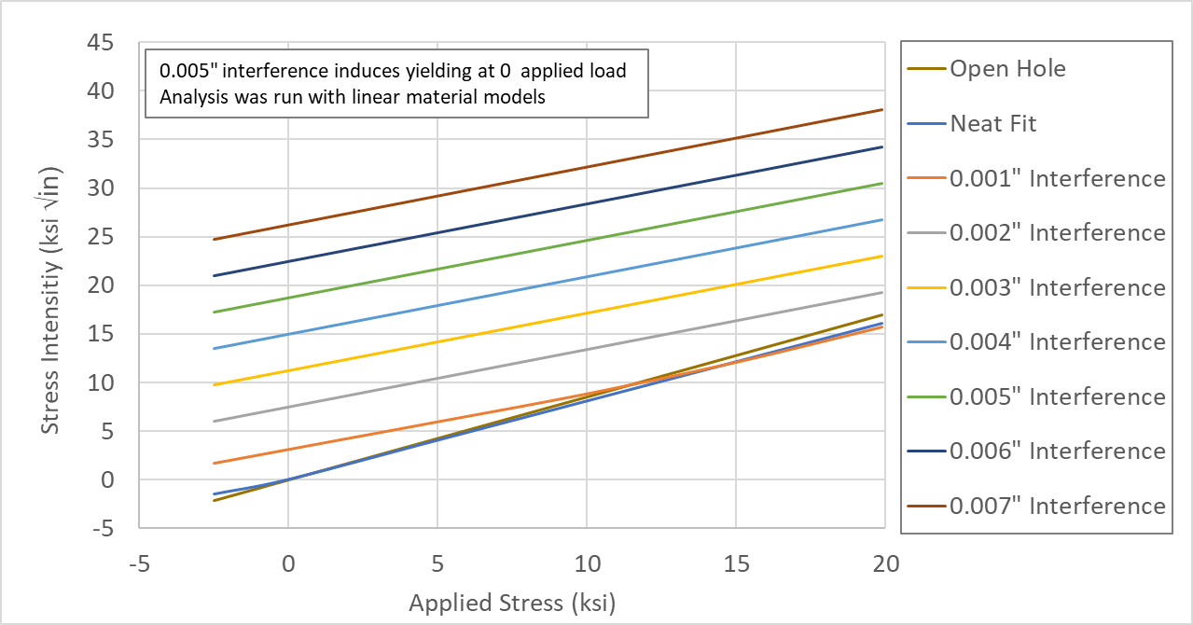








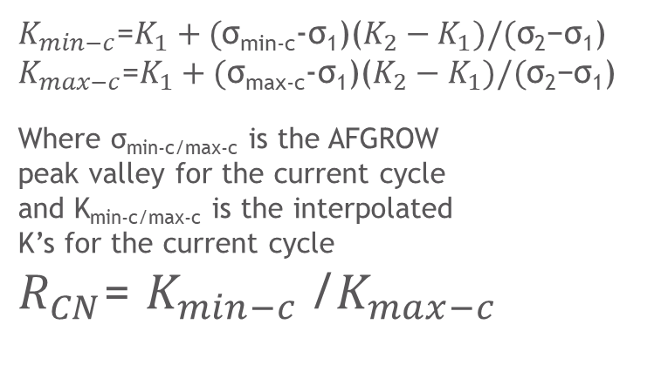
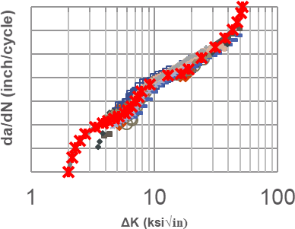



Existing Methods
BAMpF K-array
  AFGROW traditionally uses a K/σ for Plug-In
    Assumes K is linear with σ
    Assumes K=0 at no applied loads
  Stress intensities for IFF do not satisfy these assumptions
  Capability added to AFGROW Plug-In and BAMpF to account for these differences
https://www.afgrow.net/workshop/documents/2021/Josh_Hodges_BAMpF-Workshop-2021.pdf

Slide 9
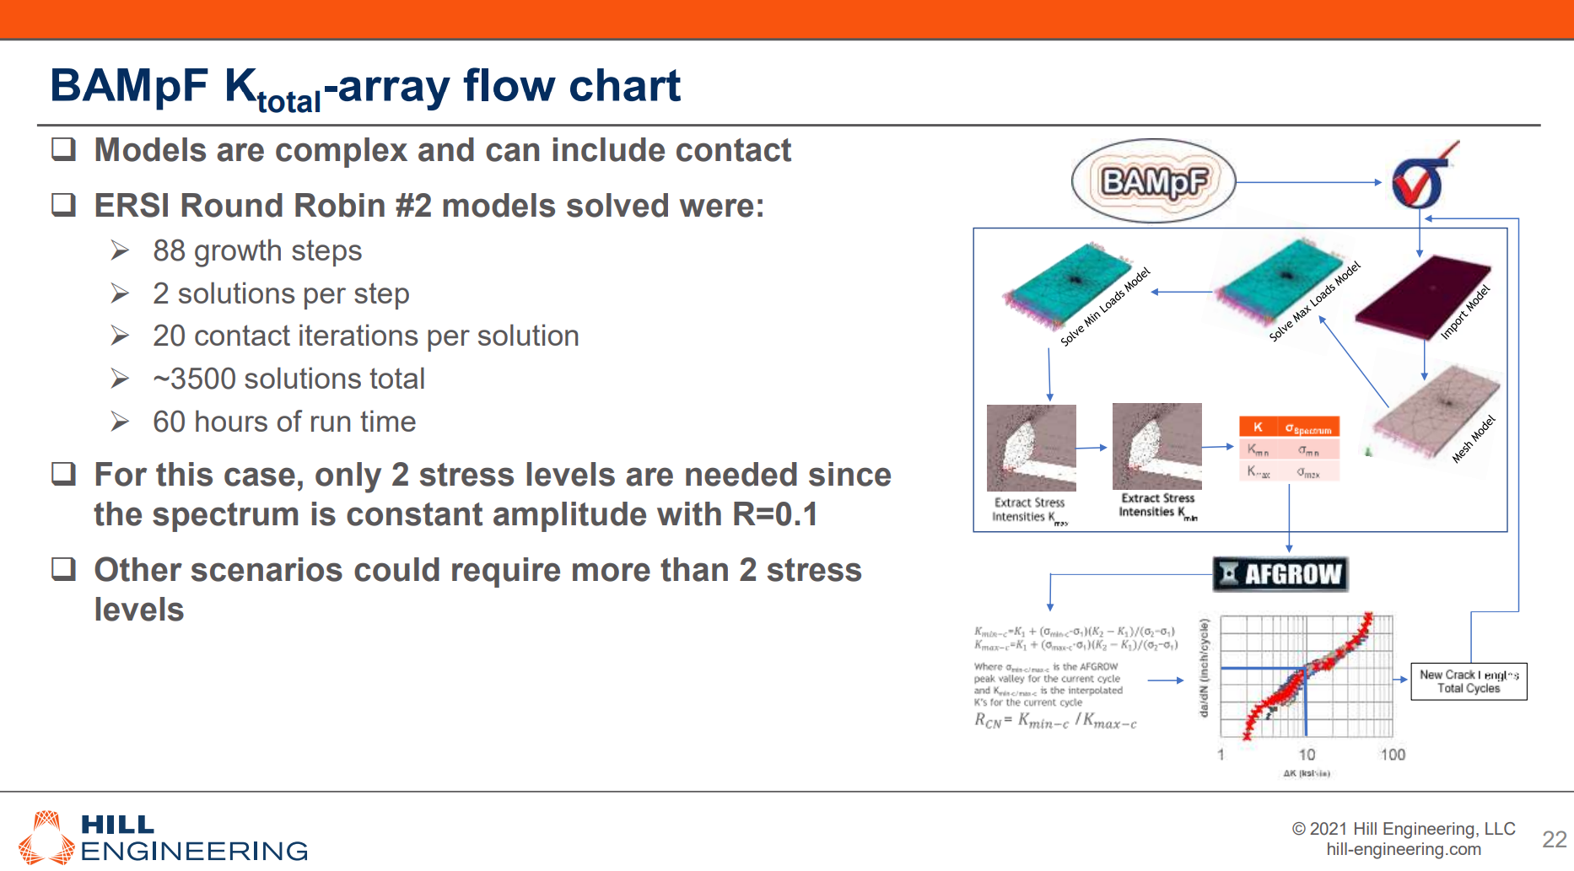
Existing Methods
BAMpF K-array
https://www.afgrow.net/workshop/documents/2021/Josh_Hodges_BAMpF-Workshop-2021.pdf

Slide 10
Existing Methods
NRC – In progress
  Completed:
    Radial crack with neat fit and interference fit fasteners
    Various levels of interference fit (limited by elastic material assumption)
    Fastener and plate materials: Aluminium, Titanium, Steel
    Obtained by fitting FEA results (StressCheck; contact; elastic materials only)
    Closed-form solutions for:
      K-residual due to installation (not exactly residual…) vs. crack size
      K-mechanical due to bypass load vs. crack size
    Crack growth simulations performed for generic cases. Got surprising results!
      Interference fit is not always beneficial
      Results suggest that there would be an optimal level of interference fit for given application (geometry, material, LOADING!)
  Current work:
    Currently validating StressCheck results with MSC/MARC for small crack sizes
    Diametrical cracking scenario:
      Parametric study completed
      Closed-form equation fitting is underway
  Next:
    Experimental validation (using existing data)
    Bearing loads, unequal cracks, interference fit fasteners with plastic deformations,…

Slide 11
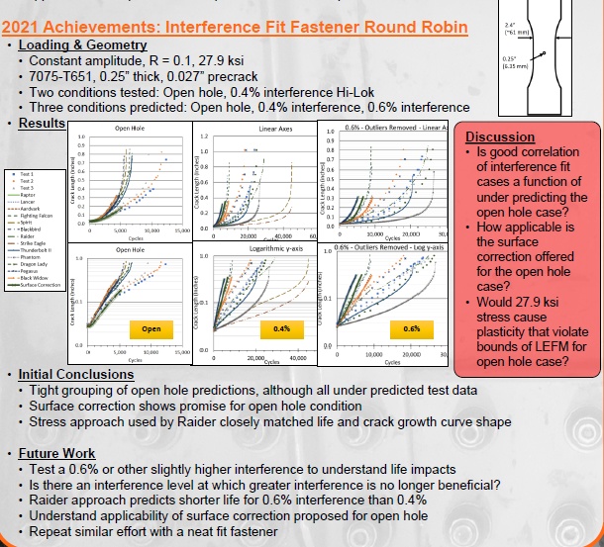
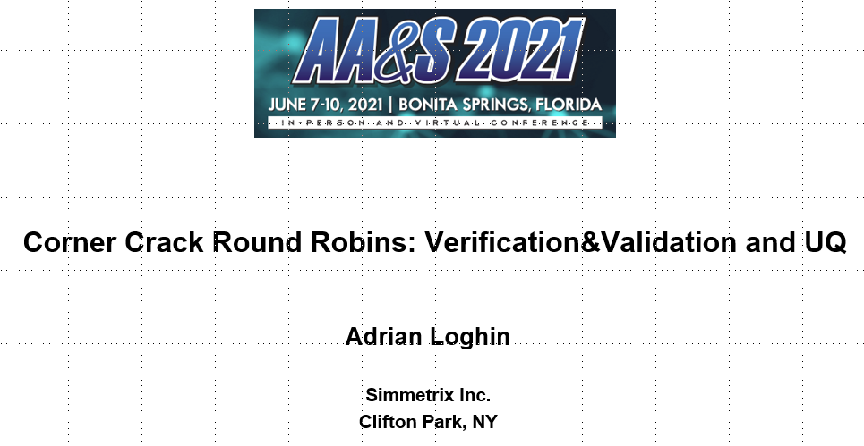
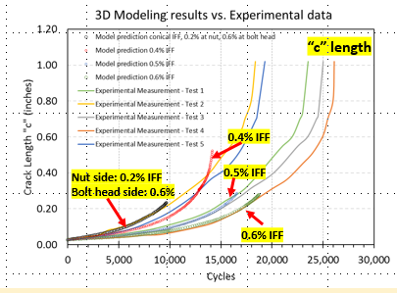
Existing Data
ERSI IFF Round Robin

Slide 12
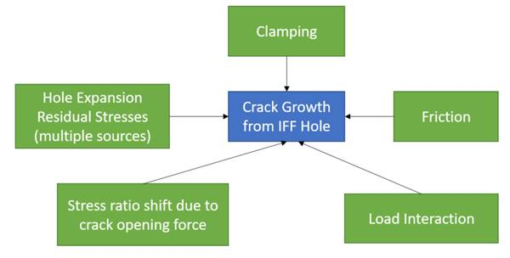
Key Factors and Gaps in Current Methods/Data
Key Factors
  Hole expansion residual stress
    Plastic deformation near the hole may
    occur, leading to residual stress
  Stress ratio shift due to crack opening force
  Load interaction
  Clamping
  Friction
Gaps in Current Methods and Data
  From Moises
    In regards to identifying gaps in our methodology and drawing up a plan to understand this problem better ... In the diagram below I show some of the known factors that contribute to IFF crack growth. Clamping and Friction should be avoided at least in the initial stage of this effort due to complexity in both modeling and testing.

Slide 13
Key Factors and Gaps in Current Methods/Data
Gaps in Current Methods and Data
  There is no numerical study related to KI variability across all tools for a given set of IFF values, crack sizes and shapes.
  There is no RUL numerical study related to accuracy of reduced order models against a 3D model that captures explicitly the IFF and implicitly R variation along the crack front.
  There is no DIC measurement for a specimen-fastener assembly (no crack present in the specimen) that would provide stress distribution due to IFF and a relationship between far field loading and local strain cycle
    Neutron diffraction and/or EDXRD measurements could be an option, and would provide the stress state due to the interference
  No 3D measurement of the bore and fastener prior to assembly
  No 3D measurement of the crack shape and size during propagation. Only the visible side is tracked.
  Insufficient verification of the models
  Insufficient UQ assessment related to IFF scatter, FCGR data used in numerical solutions
From Adrian Loghin

Slide 14
Working Group Goals/Objectives
XXX
  From Moises
    The relationship between residual stresses (from interference), hole expansion and the stress intensities, I think, has been captured well with the approach Nasgro used for TC38; it would be great if we could put together testing to validate TC38 and similar methods. It would be also great if some of our tools could employ a similar method to develop SIF solutions for corner cracks from an IFF hole. This could be a starting point in this effort. I know in 2020 the ERSI IFF Round Robin was a constant amplitude testing; I am not acquainted with all the details but that could be revisited if necessary and even expanded with more testing from OEMs to be sure we understand the basic principles of this problem. I am revisiting the IFF round Robin with what I‘ve learned recently hoping to get better predictions of the constant amplitude testing (one thing I think the original testing didn't capture was thickness effects).
    I think the second stage could go in two directions depending on your priorities. We could add geometrical complexity (real fastener, clamped fastener or even a real joint) or we could add spectrum effects (same configurations as IFF round robin) with either real spectra or CA with overload (there's the question of what happens to your residuals when you have combined sources of residuals like CW + IFF expansion + Overload/Hole Yielding). I'm personally inclined to the latter (building on spectrum effects) since we could collaborate with the effort we are doing on the Spectrum Loading Effects committee to maximize effort and testing.

Slide 15
Implementation Plan
  Using a nominal configuration:
  Start with a 3D FE model that represents the IFF test specimen from RR. Identify the reference stress analysis that anyone would agree with.
    Use different tools, Ansys, Nastran, Stress Check etc
  Use a IFF reduced order model (plate like) and compare the stress analysis against the specimen level results
  Verification against known published solution (tollgate)
  Add a corner crack to the IFF 3D model and perform the same comparison: specimen vs. reduced order model, different tools
  Add an edge crack to the IFF 3D model and perform the same comparison: specimen vs. reduced order model, different tools
  Complete a verification tollgate
  Perform crack growth for a IFF corner crack using different tools and compare results
  Perform crack growth for a IFF edge crack using different tools and compare results
  Complete a verification tollgate
  At this point continue with validation (comparison with RR test data)
  Document all above
From Adrian Loghin

Slide 16
Working Group Members – Responsibilities
  Bob: I can be the focal. (Adrian)

Slide 17
Available Resources
A-10 ASIP Funded Task
  Evaluating the Fatigue Life Benefit of Common Fastener Installations on the A-10
    Open literature is replete with papers documenting the fatigue life benefits of both neat and interference fit fasteners
    Currently no A-10 Damage Tolerance Analyses (DTAs) include any such benefit
    The contractor shall develop and execute a test program that will quantify the benefit of applicable A-10 fastener installations. The test program shall include a baseline, open hole, set of tests for all fastener installation methods evaluated. All fastener installs shall follow all relevant A-10 fastener installation specifications to ensure the benefit observed in test is representative of the benefit to be expected on the aircraft. The test program shall include bypass only and load transfer test cases at multiple stress levels (at least 2). Markerbands and fractography shall be used to determine the crack growth of load transfer tests to avoid fastener removal and permit the fastener to remain torqued throughout testing. Markerbands and quantitative fractography should be considered for the bypass tests as well.
    The contractor shall use the BAMpF software plugin to predict all results prior to testing and deliver those predictions the A-10 program office prior to the start of testing. The contractor shall also perform correlated predictions after the test results are received using the BAMpF plugin. Both analysis sets, as well as all test details and results, shall be included in a final report documenting the effort.

Slide 18
References
Andersson 2020: The main conclusion from this study is that the pin load model used in 2019 provided conservative 𝐾𝐼 values and we recommend its use in future K database generation.
AFGROW: Andersson 2019, Warner 2019, Ekenstam 2020, Hodges 2019, Renaud 2014, Bombardier 2018
Haikal 2021 ASIP (http://meetingdata.utcdayton.com/agenda/asip/2021/proceedings/presentations/P21565.pdf)
Loghin 2021 AA&S (http://meetingdata.utcdayton.com/agenda/airworthiness/2021/proceedings/presentations/P21320.pdf)

